Slide 1
Relative Guardianships: Increased options for sustained Permanency
Society for Social Work
& Research
New Orleans, LA
1/17/2015
Joseph Magruder, PhD
University of California, Berkeley
Daniel Webster, PhD
University of California, Berkeley
Aron Shlonsky, PhD
University of Melbourne

Slide 2
Background
1979 Miller v. Youakim decision - relative caregivers serving as foster parents eligible for Title IV-E funding
Foster care by relatives increased, peaking
Nationally in 1998 at 29%
California in 2000 at 43%
Foster placements with kin are different
More stable
Reunification slower
Reentry less likely for those who reunify
Achieving permanency is more difficult - kin (and social workers) have resisted adoption by kin
California extended guardian assistance payments (KinGAP) to relatives who were foster parents in 2000.
A decade and a half later take stock of impact of relative guardian exits on numbers achieving permanency and stability of this type of discharge.

Slide 3
Data & Method
California Children’s Services Archive Data System
Exits from Jan. 1, 2001 to Dec. 31, 2010 were included.
Bivariate frequencies
Event history analysis of reentry to care
Children were followed from discharge to reentry to care (or study end date—October 1, 2014).

Slide 4
First Entries (Age 0-17)
Exit Status at 4 Years
*Children in care 8+ days, six month Apr-Sep entry cohorts.

Slide 5
Exit Proportions
by Year of Discharge (Age 0-17)

Slide 6
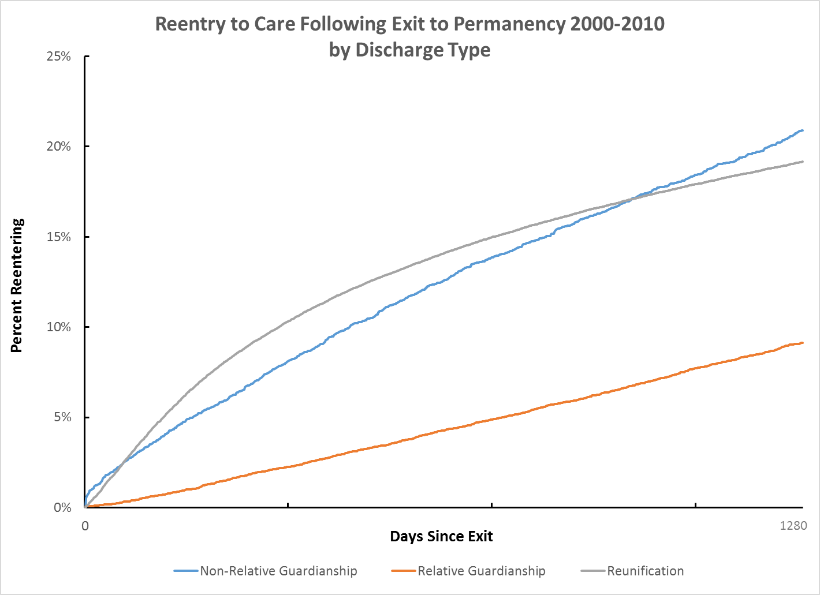
Survival Curves for Reentry
by Permanency Discharge
Children exiting to relative guardianships were less likely to return to care over time than those exiting to reunification or non-relative guardianship.

Slide 7
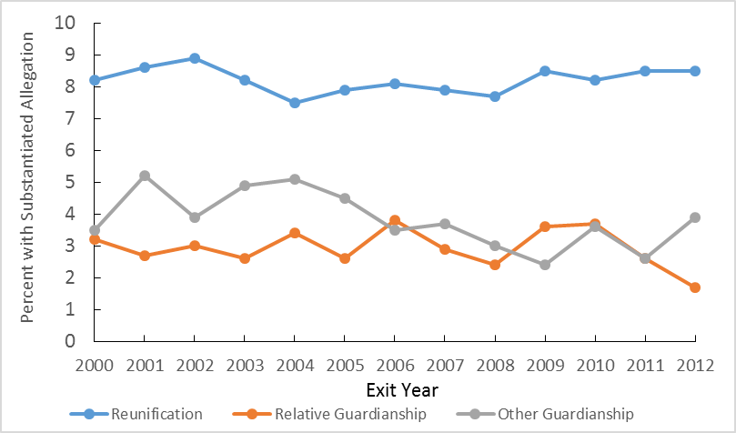
Recurrence of Maltreament within 12 Months of Exit
by Discharge Type

Slide 8
Frequencies for Reentry vs Not Following Exit to Relative Guardianship (Table 1)
Between 2001 and 2010 there were 26,244 discharges from foster care to relative guardianship:
Median Age: 9 years
Median Time In Care: 2 years
Gender: 51% Female
Race:
Hispanic 41.8%
Black 32.8%
White 21.5%
Other 3.9%

Slide 9
EXITS TO RELATIVE GUARDIANSHIP BETWEEN 2001 AND 2010 – CHILDREN TURNING 18 BEFORE 10/1/14
Exits to Relative Guardianship |  | Reentries to Care Following Exit to Relative Guardianship
Exit Age | N | N | Percent of Exits in Age Group | Median Reentry Age
4 | 57 | 11 | 19.3 | 12
5 | 224 | 59 | 26.3 | 11
6 | 524 | 118 | 22.5 | 13
7 | 760 | 186 | 24.5 | 12
8 | 936 | 213 | 22.8 | 13
9 | 1,166 | 261 | 22.4 | 14
10 | 1,328 | 297 | 22.4 | 14
11 | 1,497 | 333 | 22.2 | 14
12 | 1,641 | 334 | 20.4 | 15
13 | 1,710 | 303 | 17.7 | 15
14 | 1,736 | 245 | 14.1 | 16
15 | 1,539 | 136 | 8.8 | 16
16 | 1,464 | 77 | 5.3 | 17
17 | 968 | 12 | 1.2 | 17
Total | 15,550 | 2,585 | 16.6 | 15
Data Source: CWS/CMS Q3 2014 Extract

Slide 10
EXITS TO reunification BETWEEN 2001 AND 2010 – CHILDREN TURNING 18 BEFORE 10/1/14
Exits to Reunification |  | Reentries to Care Following Exit to Reunification
Exit Age | N | Number | Percent of Exits in Age Group | Median Reentry Age
4 | 389 | 121 | 31.1 | 8
5 | 1,754 | 520 | 29.6 | 8
6 | 3,196 | 907 | 28.4 | 8
7 | 4,482 | 1,222 | 27.3 | 9
8 | 5,617 | 1,432 | 25.5 | 10
9 | 6,695 | 1,692 | 25.3 | 11
10 | 7,593 | 1,882 | 24.8 | 12
11 | 8,377 | 2,219 | 26.5 | 13
12 | 9,467 | 2,420 | 25.6 | 13
13 | 10,326 | 2,590 | 25.1 | 14
14 | 10,918 | 2,527 | 23.1 | 15
15 | 10,283 | 1,984 | 19.3 | 16
16 | 9,317 | 1,309 | 14.0 | 16
17 | 6,935 | 430 | 6.2 | 17
Total | 95,349 | 21,255 | 22.3 | 14
Data Source: CWS/CMS Q3 2014 Extract

Slide 11
Cox Model on Time to Reentry Following Exit to Relative Guardianship (Table 2)
Discharges to relative guardianships in 2001-2010.
Children age 0 to 17 at exit.
Study cut-off October 1, 2014.

Slide 12
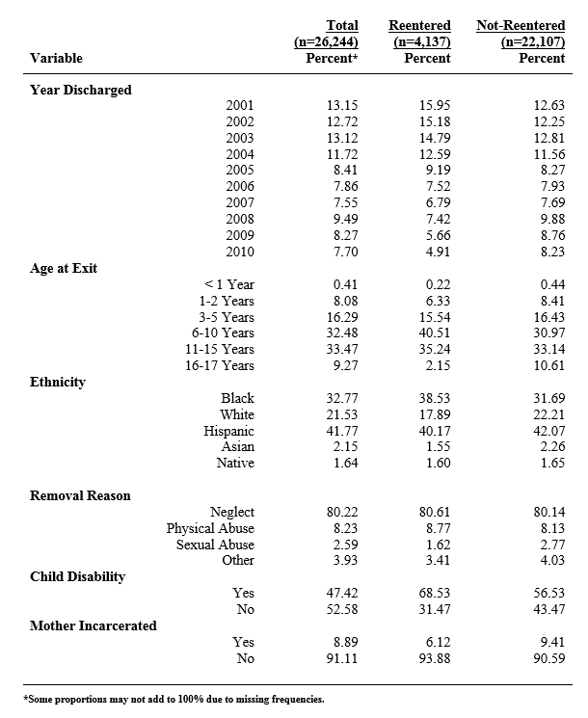
Table 1
Frequencies and Proportions (N = 26,244)
Children Exiting to Relative Guardianship 2000-2010

Slide 13
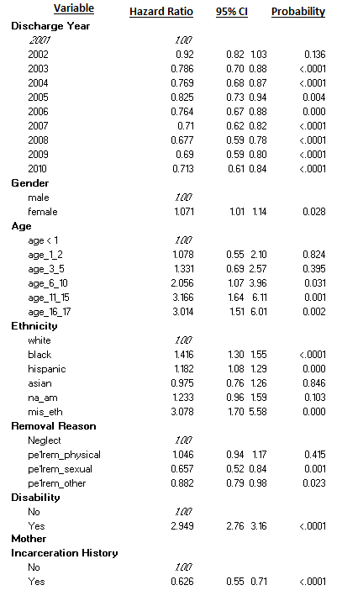
Table 2
Cox Model on Time to Reentry Following Exit to Relative Guardianship
n=26,244 (reentered: 4,137; censored: 22,107)
-2 Log L with covariates: 78462.21, without covariates: 80141.14; df=25; p <.0001

Slide 14
Results
Children exiting to relative guardianships experience lower rates of recurrence at 12 months than those exiting to reunification or non-relative guardianships.
Children exiting to relative guardianships experience lower rates of reentry than those exiting to reunification or non-relative guardianships.
For those children discharged to relative guardianship:
Black children were much more likely and Hispanic children somewhat more likely to reenter than Whites.
For children exiting before adolescence, the likelihood of reentry does not appear to be linked to age at exit. Rather, it is linked to adolescence.
Disabled children are more likely to reenter.
These reentry patterns are quite different from children who exit to reunification.

Slide 15
Discussion
Age difference between child and caregiver appeared to have a large impact on reentry, but too much missing data to include in our models. Children whose guardians were between ages 43 and 51 when the child was born are least likely to reenter.
Overall rates of permanency have not changed dramatically since advent of relative guardian assistance program in California (KinGAP).
Evaluation of IV-E Waiver impact must take into account usage of this discharge option.
Guardians caring for children reaching adolescence may have unmet service needs.

Slide 16
Next steps
Further examination of incarceration influence (e.g., offense type, number of prior offenses, duration of incarceration).
Explore different models for those exiting as younger children versus those exiting in early to later adolescence.
Model subsequent substantiated maltreatment allegations following discharge to different permanency types.
Explore issues of potential bias introduced by autocorrelation and stages of incidental selectivity.
Similar analysis of long-term reentry patterns for children exiting to reunification may allow identification of risk groups and the development of effective services.

Slide 17
Questions? joemagruder@berkeley.edu dwebster@berkeley.edu aron.shlonsky@unimelb.edu.au
The California Child Welfare Indicators Project is supported by
the California Department of Social Services
and the Stuart Foundation

