Slide 1
California Child Welfare Indicators Project YOUTH IN EXTENDED FOSTER CARE
Center for Social Services Research
School of Social Welfare
University of California, Berkeley
The California Child Welfare Indicators Project (CCWIP) is a collaboration of the California Department of Social Services and the School of Social Welfare, University of California at Berkeley, and is supported by the California Department of Social Services and the Stuart Foundation
Notes:
Q2_19 Updates

Slide 2
Research Questions?
How many youth age 18-21 are in extended foster care (EFC)?
How has the number of youth age 18-21 in foster care changed since the implementation of AB12?
What are the demographic and case characteristics of youth in EFC?
Are there county differences in the percentage of foster youth in EFC?
1

Slide 3
How many youth age 18-21 are in EFC?
2

Slide 4
How many youth age 18-21 are in EFC?
As of July 1, 2019, 8,411 youth age 18-21 were in foster care in California.
Of these, 88 percent were child welfare supervised and 12 percent were probation supervised.
3

Slide 5
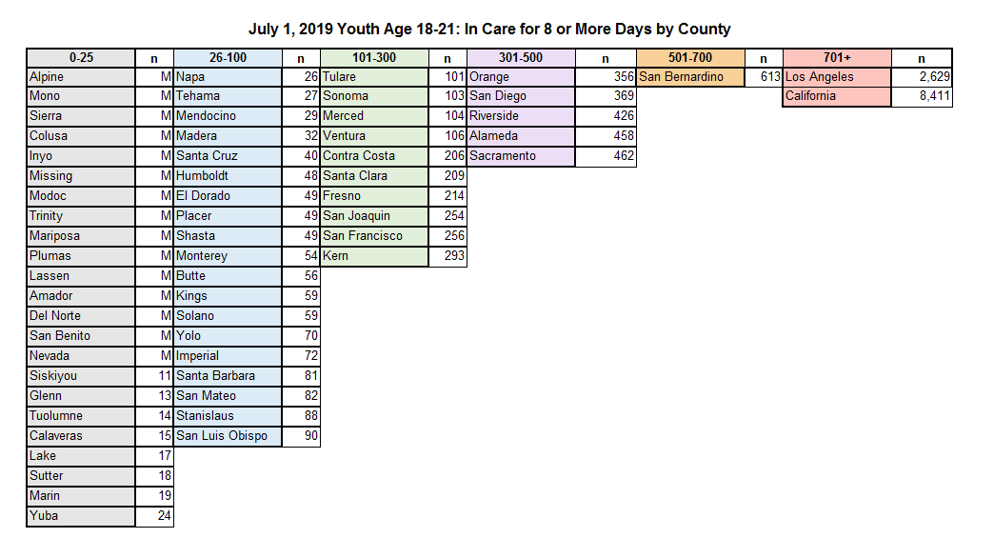
How many youth age 18-21 are in EFC?
4
Notes:
Alpine, Mono, and Sierra actually have counts of 0.

Slide 6
How has the number of youth age 18-21 in foster care changed since the implementation of AB12?
The number of youth age 18-21 in foster care in California increased 188 percent between July 1, 2010 (2,921) and July 1, 2019 (8,411).
The number of youth age 18-21 in foster care increased 182 percent among child welfare supervised youth and 246 percent among probation supervised youth.
5

Slide 7
Caseload Trends
6

Slide 8
Caseload Trends
The growth in the foster care caseload age 18-21 is attributable to: a decline in exits, and an increase in reentries to foster care, immediately following implementation of AB12.
7

Slide 9
Exit Trends
8

Slide 10
Exit Trends
Exits from foster care among youth age 18-21 declined 19 percent between 2010 (5,572) and 2019 (4,499).
Exits declined primarily among youth in child welfare supervised foster care.
9

Slide 11
Reentry Trends
10

Slide 12
Reentry Trends
Reentries to foster care among youth age 18-20 rose for three years following implementation of AB12 in 2012, and then started to decline, before stabilizing in 2017. In 2010, 35 youth age 18-20 reentered care; in 2013, 574 youth reentered care; and by 2018, 575 youth reentered care.
Reentries following implementation of AB12 were most common among youth in child welfare supervised foster care.
11

Slide 13
Youth Age 18-21 In Foster Care on July 1, 2019
12

Slide 14
Youth Age 18-21 In Foster Care on July 1, 2019
12

Slide 15
Youth Age 18-21 In Foster Care on July 1, 2019
12

Slide 16
What are the demographic and case characteristics of youth in EFC?
Black and Latino youth account for the majority of 18-21 year olds in EFC.
Forty-one percent of 18-21 year olds in EFC on July 1, 2019 were living in supervised independent living placements (SILP). Twenty-four percent were living in transitional housing.
Forty-seven percent of 18-21 year olds in EFC on July 1, 2019 had been in care for 4 or more years.
Seventy-two percent of youth age 18-21 receiving services on July 1, 2019 were in supportive transition.
16

Slide 17
Are there county differences in the percentage of foster youth in EFC?
17

Slide 18
Are there county differences in the percentage of foster youth in EFC?
17

Slide 19
Are there county differences in the percentage of foster youth in EFC?
17

Slide 20
Are there county differences in the percentage of foster youth in EFC?
The proportion of the foster care caseload age 18-21 increased between 2010 and 2019 for all except four counties with small foster care populations.
The proportion of California’s foster care caseload age 18-21 increased from 5 percent in 2010 to 14 percent in 2019.
20

Slide 21
Questions?
For more information please contact:
Stephanie Cuccaro-Alamin
stephca@berkeley.edu
Wendy Wiegmann
wendy.wiegmann@berkeley.edu
22

Slide 22
http://cssr.berkeley.edu/ucb_childwelfare
Webster, D., Lee, S., Dawson, W., Magruder, J., Exel, M., Cuccaro-Alamin, S., Putnam-Hornstein, E., Wiegmann, W., Saika, G., Chambers, J., Hammond, I., Sandoval, A., Benton, C., Hoerl, C., Yee, H., Flamson, T., Hunt, J., Carpenter, W., Casillas, E., & Gonzalez, A. (2019). CCWIP reports. Retrieved 11/20/2019, from University of California at Berkeley California Child Welfare Indicators Project website. URL: http://cssr.berkeley.edu/ucb_childwelfare
23
Notes:
22
Q2_2019

