Slide 1
Reporter Type as a Predictor of Case Disposition
January 13, 2012
Society for Social Work Research
Washington, DC
Bryn King, MSW
Jennifer Lawson, MSW
Emily Putnam-Hornstein, PhD

Slide 2
Acknowledgements
Thank you to our colleagues at the Center for Social Services Research and the California Department of Social Services
Funding for this and other research arising from the California Performance Indicators Project generously provided by the California Department of Social Services, the Stuart Foundation, & Casey Family Programs

Slide 3
Overview
Historically, mandated reports have constituted a smaller proportion of child abuse hotline calls than non-mandated reports, although more recently, the proportion of mandated reporters has increased
Prior studies have found that maltreatment substantiation rates vary based on the source and status (mandated vs. non-mandated) of the reporter and that there is an association between reporter type and allegation type as different reporters are likely to observe different types of maltreatment based on the vantage points from which they have access to children and families
Demographic characteristics of children and families (i.e. race, income, family structure, etc.) have been associated with likelihood of a maltreatment allegation

Slide 4
What we know
Young children with a prior allegation of maltreatment are more likely to die of injuries than unreported children
Of the over 530,000 children born in California in 2002, 14% were reported for maltreatment before the age of five
Individual and family characteristics identified in birth records, such as Medi-Cal eligibility, mother’s age and level of education, and paternity status at birth, were found to be significant risk factors for a maltreatment allegation
Of those children reported, approximately 22% were substantiated as victims of maltreatment, while 63% received an investigation that was inconclusive or unfounded, and another 15% were evaluated out over the phone

Slide 5
Objectives
Build on previous research regarding the relationships between reporter type/reporter status and substantiation
Determine whether the status and type of maltreatment reporter were independent predictors of case substantiation, across maltreatment types and after adjusting for characteristics of the child and family
Specifically, this study answers these questions:
Does reporter status (mandated vs. non-mandated) predict substantiation? Does it vary by allegation type?
Does the likelihood of substantiation vary by mandated reporter type? Is there variation across allegation types?

Slide 6
Data/Methods
Population of children born in 2002 and reported for maltreatment before age five (N=71,940)
Key outcome variable: substantiation vs. all other dispositions (evaluated out and unfounded)
Key independent variable: reporter status and reporter type
First reporters coded into nine major types
Each of these types coded as mandated vs. non-mandated
Control variables include maltreatment allegation type and child age (CPS data), as well as maternal and family characteristics extracted from birth record data
Generalized linear models used to assess the impact of reporter status and reporter type on substantiation

Slide 7
Variable coding: reporter type
law enforcement,
probation and
parole officers
medical and
dental
professionals
cws and other
govt agency
staff
clergy and
“other
professionals"
counselors,
therapists, and
advocates
LEGAL
MEDICAL
PUBLIC
AGENCY
OTHER
PROFESSIONALS
HELPING
PROFESSIONALS
school personnel,
teachers, day care,
substitute care
relatives (e.g.
grandparents,
siblings, etc.)
neighbors, friends, and “no relation”
“other” reporters and missing
SCHOOL/CHILDCARE
FAMILY
COMMUNITY
UNIDENTIFIED

Slide 8
VARIABLE CODING: REPORTER STATUS

Slide 9
VARIABLE CODING: ALLEGATION TYPE

Slide 10
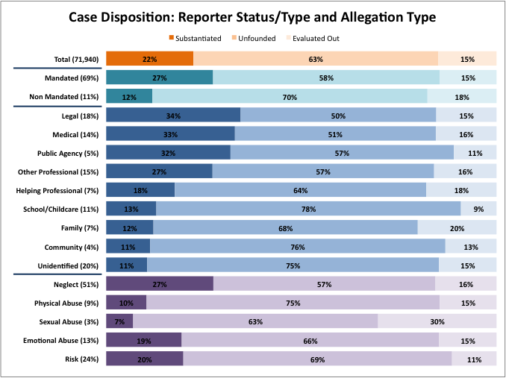

Slide 11
Results: reporter status and substantiation
 | Model 1 |  |  | Model 2ª
 | Substantiated Reports, unadjusted |  |  | Substantiated Reports, adjusted
 | RR | 95% CI |  | RR | 95% CI
Reporter Status
Mandated Reporter | 2.31*** | (2.18, 2,46) |  | 2.40*** | (2.26, 2.56)
Allegation Type
Sexual Abuse vs. Physical Abuse | -- | -- |  | 0.66*** | (0.56, 0.78)
Neglect vs. Physical Abuse | -- | -- |  | 2.41*** | (2.23, 2.60)
Emotional Abuse vs. Physical Abuse | -- | -- |  | 1.73*** | (1.59, 1.88)
Substantial Risk vs. Physical Abuse | -- | -- |  | 1.63*** | (1.50, 1.76)
ªAdjusts for child’s age; mother's race, birthplace, age, and education level; birth payment method; and paternity status.

Slide 12
Results: reporter status and substantiation
Models Stratified by Allegation Type
Reporter Status (Mandated) and Substantiated Reports, Adjustedª
Allegation Type | RR | 95% CI
Physical Abuse (n=5,070) | 3.16*** | (2.16, 4.67)
Neglect (n=27,662) | 2.62*** | (2.43, 2.82)
Emotional Abuse (n=7,608) | 2.01*** | (1.64, 2.46)
Substantial Risk (n=15,175) | 1.70*** | (1.47, 1.97)
Sexual Abuse (n=2,101) | 1.31 | ns
ªAdjusts for child's age; mother's race, birthplace, age, and education level; birth payment method; and paternity status.

Slide 13
Results: reporter type and substantiation
 | Model 4 |  |  | Model 5ª
 | Substantiated Reports, unadjusted |  |  | Substantiated Reports, adjusted
 | RR | 95% CI |  | RR | 95% CI
Mandated Reporter Type
Legal | 2.91*** | (2.73, 3.11) |  | 3.19*** | (2.99, 3.40)
Medical | 2.79*** | (2.61, 2.98) |  | 2.48*** | (2.32, 2.65)
Public Agency | 2.69*** | (2.49, 2.90) |  | 2.56*** | (2.37, 2.76)
Other Professionals | 2.30*** | (1,36, 1.62) |  | 2.19*** | (2.05, 2.35)
Helping Professionals | 1.49*** | (1.36, 1.62) |  | 1.68*** | (1.54, 1.83)
Child Care/School | 1.09* | (1.01, 1.18) |  | 1.31*** | (1.20, 1.43)
Allegation Type
Sexual Abuse vs. Physical Abuse | -- | -- |  | 0.62*** | (0.52, 0.73)
Neglect vs. Physical Abuse | -- | -- |  | 2.18*** | (2.02, 2.35)
Emotional Abuse vs. Physical Abuse | -- | -- |  | 1.46*** | (1.34, 1.60)
Substantial Risk vs. Physical Abuse | -- | -- |  | 1.66*** | (1.53, 1.79)
ªAdjusts for child’s age; mother's race, birthplace, age, and education level; birth payment method; and paternity status.

Slide 14
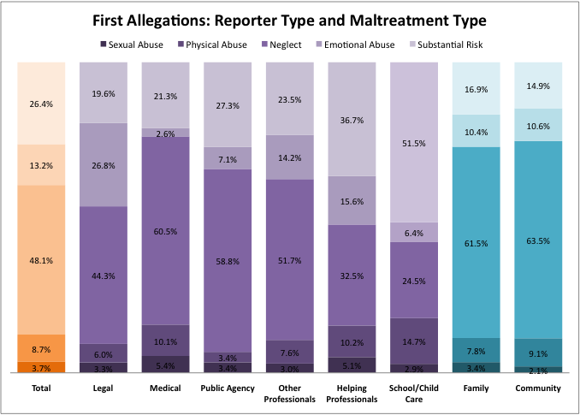

Slide 15
summary
Mandated reporter status does predict substantiation among first allegations of maltreatment, even when adjusting for maltreatment type, child age, and family characteristics.
Mandated reports of physical abuse, neglect, emotional abuse, and substantial risk are more likely to be substantiated than non-mandated reports of the same allegations. Mandated reports of neglect and physical abuse are more likely to be substantiated than mandated reports of substantial risk.
Compared to non-mandated reports, legal, medical, public agency, and other professional reports are more than twice as likely to be substantiated

Slide 16
conclusions
Over time, mandated reporting laws have shifted the ways in which child maltreatment is reported and investigated. In this study, mandated reporters constituted a significant majority of maltreatment allegations
Maltreatment allegations from mandated sources, particularly law enforcement, medical professionals, and other professionals are more likely to be substantiated
Substantiation does vary by allegation type, even when adjusting for reporter status/type and child and family characteristics

Slide 17
Questions? brynking@berkeley.edu jennlawson@berkeley.edu ehornste@usc.edu

