Slide 1
Foster Care in California:
What the Data Tells Us
Barbara Needell, MSW, PhD
Emily Putnam-Hornstein, MSW, PhD
Center for Social Services Research
University of California at Berkeley
The Performance Indicators Project is a collaboration of the
California Department of Social Services and
the University of California at Berkeley,
and is supported by the
California Department of Social Services and the Stuart Foundation
Notes:
Q3_10 Updates

Slide 2
big picture trends
large/consistent caseload declines over time
  1999 (peak)= 109,396
  2004 = 83,085
  2009 = 61,004 (with further declines, 2010 = 57,877)
why?
  flow of children exiting from foster care has consistently outpaced flow of children entering into care

Slide 3
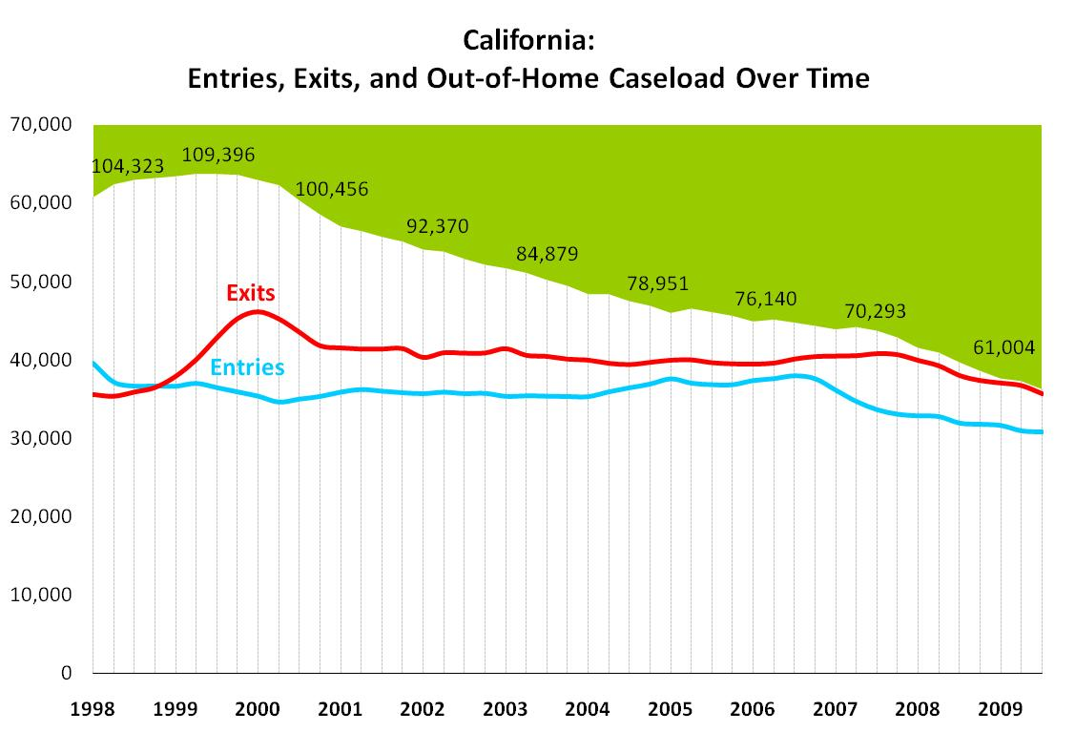
Notes:
Q3_10

Slide 4
big picture trends (part 2)
time children spend in foster care has been declining
evidence?
  a greater percentage of children exit to permanency within 48 months of first entering care
  point-in-time counts of children in foster care at a given age highlight that young children who enter care, are not (typically) staying for very long

Slide 5
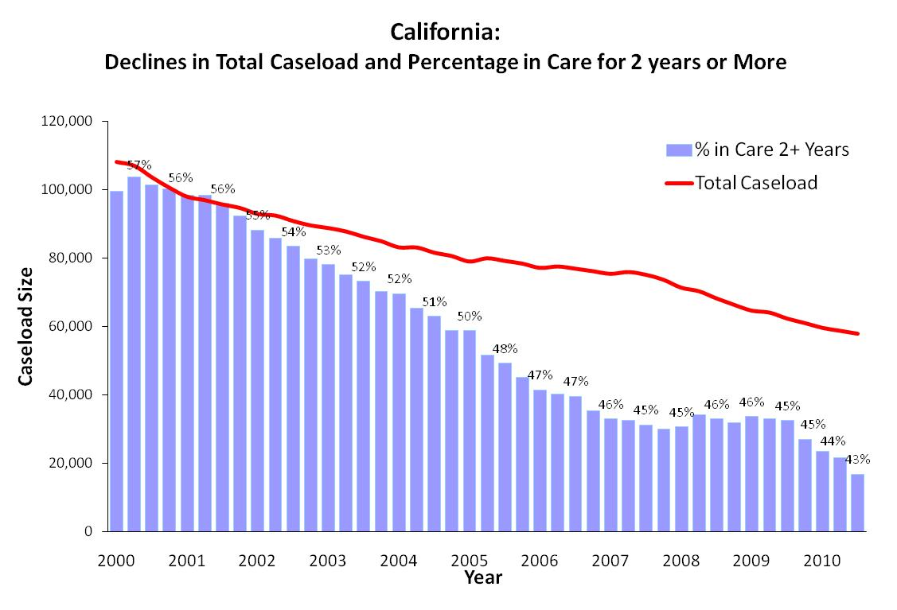
Notes:
Q3_10

Slide 6
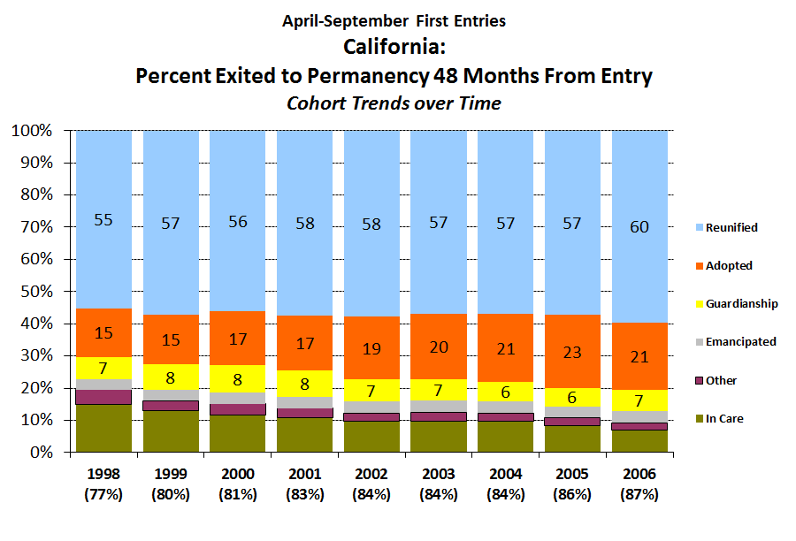

Slide 7
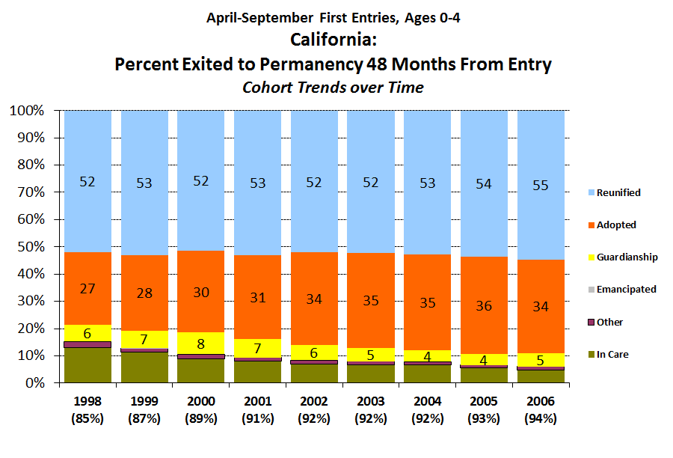

Slide 8
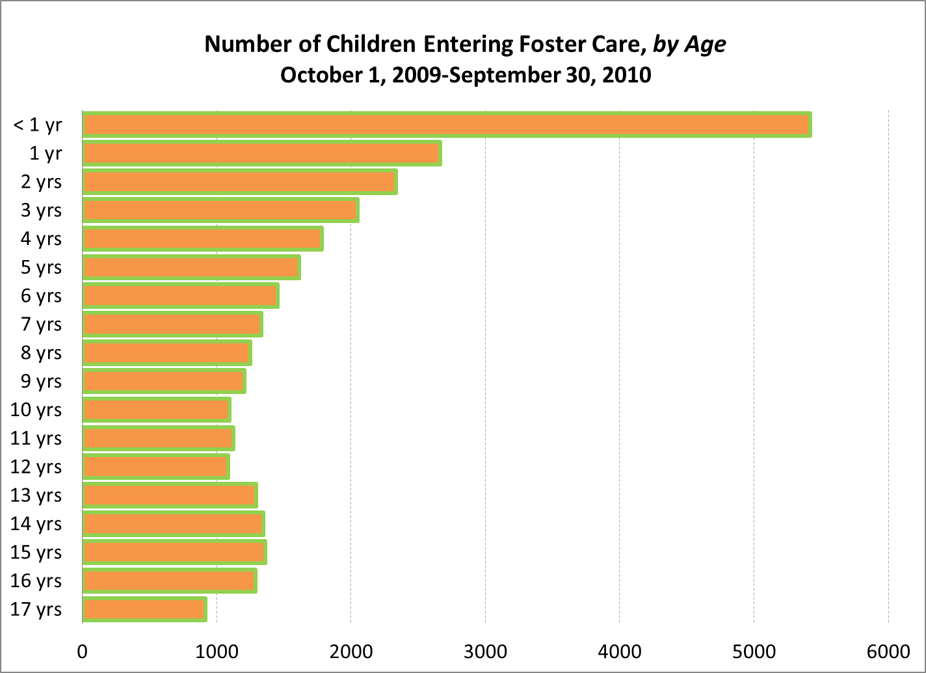

Slide 9
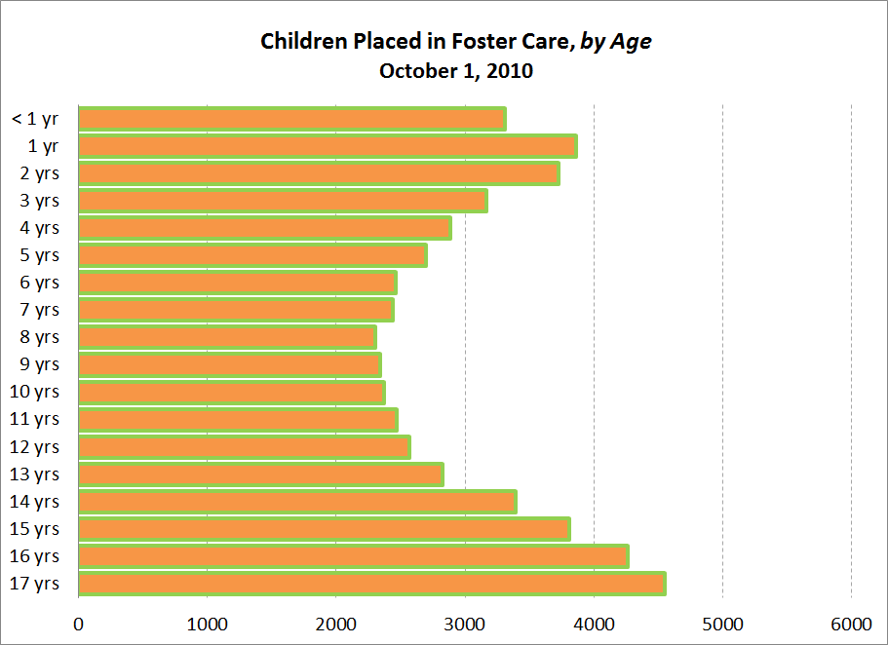

Slide 10
Children Entering Foster Care in California
1998-2008
all children
Notes:
These are unique children entering in a given calendar year, regardless of length of stay, by age at entry
That is, this is a count of the number of children who entered care once or more in the year.

Slide 11
Children Entering Foster Care in California (by age)
1998-2008
infants

Slide 12
Children Entering Foster Care in California (by age)
1998-2008
1 yr olds

Slide 13
Children Entering Foster Care in California (by age)
1998-2008
2 yr olds

Slide 14
Children Entering Foster Care in California (by age)
1998-2008
3 yr olds

Slide 15
Children Entering Foster Care in California (by age)
1998-2008
4 yr olds

Slide 16
Children Entering Foster Care in California (by age)
1998-2008
5 yr olds

Slide 17
Children Entering Foster Care in California (by age)
1998-2008
6 yr olds

Slide 18
Children Entering Foster Care in California (by age)
1998-2008
7 yr olds

Slide 19
Children Entering Foster Care in California (by age)
1998-2008
8 yr olds

Slide 20
Children Entering Foster Care in California (by age)
1998-2008
9 yr olds

Slide 21
Children Entering Foster Care in California (by age)
1998-2008
10 yr olds

Slide 22
Children Entering Foster Care in California (by age)
1998-2008
11 yr olds

Slide 23
Children Entering Foster Care in California (by age)
1998-2008
12 yr olds

Slide 24
Children Entering Foster Care in California (by age)
1998-2008
13 yr olds

Slide 25
Children Entering Foster Care in California (by age)
1998-2008
14 yr olds

Slide 26
Children Entering Foster Care in California (by age)
1998-2008
15 yr olds

Slide 27
Children Entering Foster Care in California (by age)
1998-2008
16 yr olds

Slide 28
Children Entering Foster Care in California (by age)
1998-2008
17 yr olds

Slide 29
Children Entering Foster Care in California (by age)
1998-2008

Slide 30
Children in Foster Care
1998-2009

Slide 31
Children in Foster Care (by age)
1998-2009
infants

Slide 32
Children in Foster Care (by age)
1998-2009
1 yr olds

Slide 33
Children in Foster Care (by age)
1998-2009
2 yr olds

Slide 34
Children in Foster Care (by age)
1998-2009
3 yr olds

Slide 35
Children in Foster Care (by age)
1998-2009
4 yr olds

Slide 36
Children in Foster Care (by age)
1998-2009
5 yr olds

Slide 37
Children in Foster Care (by age)
1998-2009
6 yr olds

Slide 38
Children in Foster Care (by age)
1998-2009
7 yr olds

Slide 39
Children in Foster Care (by age)
1998-2009
8 yr olds

Slide 40
Children in Foster Care (by age)
1998-2009
9 yr olds

Slide 41
Children in Foster Care (by age)
1998-2009
10 yr olds

Slide 42
Children in Foster Care (by age)
1998-2009
11 yr olds

Slide 43
Children in Foster Care (by age)
1998-2009
12 yr olds

Slide 44
Children in Foster Care (by age)
1998-2009
13 yr olds

Slide 45
Children in Foster Care (by age)
1998-2009
14 yr olds

Slide 46
Children in Foster Care (by age)
1998-2009
15 yr olds

Slide 47
Children in Foster Care (by age)
1998-2009
16 yr olds

Slide 48
Children in Foster Care (by age)
1998-2009
17 yr olds

Slide 49
Children in Foster Care (by age)
1998-2009

Slide 50
where is work still needed?
Rates of Black children in care have declined even more than rates for other children, but racial disparities remain pronounced
Black children are overrepresented among children who are in foster care, and their disproportionality is greatest for children who have been in care for longer timeframes

Slide 51
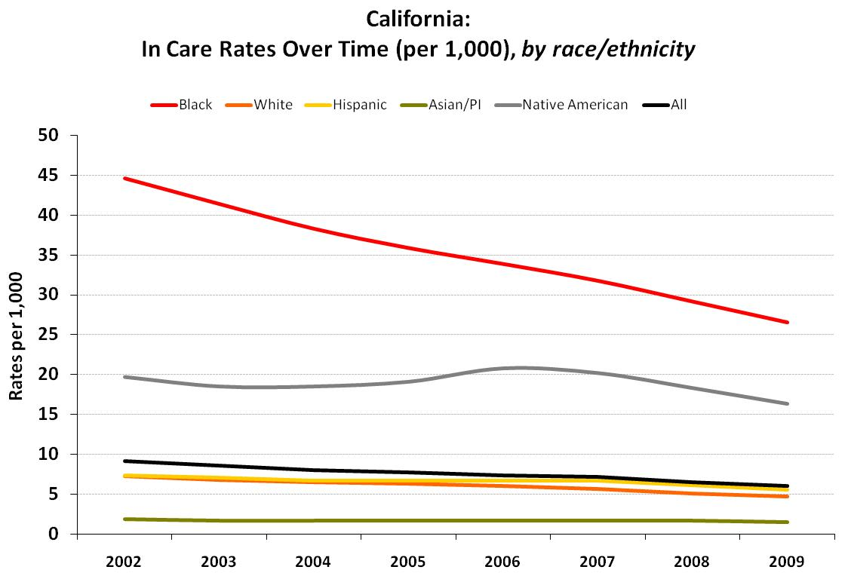
Notes:
Q3_10

Slide 52
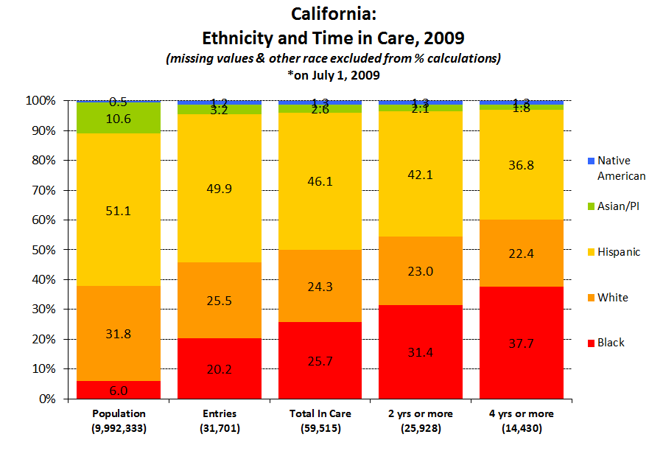

Slide 53

http://cssr.berkeley.edu/ucb_childwelfare
Needell, B., Webster, D., Armijo, M., Lee, S., Dawson, W., Magruder, J., Exel, M., Cuccaro-Alamin, S., Putnam-Hornstein, E., Williams, D., Simon, V., Hamilton, D., Lou, C., Peng, C., Moore, M., Jacobs, L., & King, B. (2011). Child Welfare Services Reports for California. Retrieved 5/4/2011, from University of California at Berkeley Center for Social Services Research website. URL: <http://cssr.berkeley.edu/ucb_childwelfare>
Notes:
53
Q3_10

