Slide 1
Los Angeles County
Department of Children and Family Services
Data-Driven Decision Making Leadership Organizational Group
Safe Children. Healthy Communities. Strong Families.

Slide 2
Welcome

Slide 3
Director’s Message Bobby D. Cagle
Data-Driven Decision Making Leadership Organizational Group

Slide 4
Chief Deputy Director Ginger Pryor
Data-Driven Decision Making Leadership Organizational Group

Slide 5
Deputy Director Kym Renner
Data-Driven Decision Making Leadership Organizational Group

Slide 6
Division Chief Roxanna Flores-Aguilar
Data-Driven Decision Making Leadership Organizational Group

Slide 7
Wendy Wiegmann California Child Welfare Indicators Project
Data-Driven Decision Making Leadership Organizational Group

Slide 8
California Child And Family Services Review (C-CFSR) Process
County Self-Assessment
Peer Review
System Improvement Plan
Annual Progress Reports
technical assistance
technical assistance
technical assistance
technical assistance
Notes:
COUNTY SELF-ASSESSMENT (CSA) The CSA is a comprehensive review of the child welfare and probation placement programs, from prevention and protection through permanency and aftercare. The CSA is completed every five years by the county in coordination with their local community partners as outlined earlier. The CSA is the analytic vehicle by which counties determine effectiveness of current practice, programs and resources across the continuum of child welfare and probation placement services and identifies areas for targeted system improvement. Counties are encouraged to conduct focus groups, hold stakeholder forums, and administer satisfaction surveys as a means to fully engage stakeholders in the analysis of the system.
PEER REVIEW The Peer Review provides counties with qualitative information about their programs by examining child welfare practices and policies that impact outcomes for children and families. The Peer Review also offers the opportunity for sharing successful efforts across counties. Peers from counties assisting with the review share information on best or promising practices used in their own county.
SYSTEM IMPROVEMENT PLAN (SIP) The System Improvement Plan is the operational agreement between the CDSS and the county. The SIP is developed every five years by the lead agencies in collaboration with their local community, prevention and early intervention partners and is approved by the county Board of Supervisors (BOS). It provides an outline for how the county will improve their system of care for children and families. The SIP identifies how programs and services funded with CAPIT/CBCAP/PSSF funds will address priority needs within the CWS continuum.
ANNUAL SIP PROGRESS REPORT Following the development of the five-year SIP, County Child Welfare Departments and Probation Placement Agencies, in collaboration with their community partners, will develop and submit to the CDSS an Annual SIP Progress Report. The progress report reevaluates and provides a written analysis of current performance to determine whether the SIP strategies are achieving the desired results. This provides counties an opportunity to amend or modify the SIP as necessary. The CDSS will collaborate with counties to determine if these changes warrant BOS’ approval. If the SIP Progress Report impacts CAPIT/CBCAP/PSSF funded strategies, this information will be shared with the OCAP consultant. Submission of the Annual SIP Progress Report does not relieve counties of the requirement to file an annual report for the CAPIT/CBCAP/PSSF Programs.
QUARTERLY DATA REPORTS The data utilized in the C-CFSR represent the children and families receiving child welfare services in California. The CDSS issues Quarterly Data Reports that include outcome-based data focused on core safety, permanency and well-being measures for each county’s child welfare and probation placement youth populations. Analyzing data in relation to the outcome measures provides valuable information to counties about the successes and/or challenges present in the system that impact the lives of children and families served. The primary data utilized throughout the C-CFSR is derived from the Child Welfare Services/Case management System (CWS/CMS) and is extracted approximately one month after a quarter ends. Reports are released during the months of January, April, July and October. The Quarterly Data Report provides summary data for program measures as the basis for the C-CFSR and is used to track state and county performance over time. Data is used to inform and guide both the assessment and planning processes, and to analyze policies and procedures. This level of evaluation allows for a systematic assessment of program strengths and limitations in order to improve service delivery. Linking program processes and performance with outcome measures helps evaluate progress and modify the program and/or practice as appropriate. The information obtained from the Quarterly Data Reports is used by the county to make decisions about future program goals and strategies. Analysis of this type is best viewed as a continuous process of quality improvement as opposed to a one-time activity.
TECHNICAL ASSISTANCE (TA) The CDSS partners with the county throughout the C-CFSR process. The CDSS staff provides technical assistance (TA) in the development, review and approval of the CSA, SIP and Annual Progress Report. State staff assists with the identification and sharing of best and promising practices between counties. The state assists counties in accessing resources and information within the CDSS, including connecting counties to other bureaus and divisions within the department. Consultants provide training to counties needing assistance in data analysis, identification of best practices, access to current literature and research on child welfare practice and support the county in the development of methods and facilitation of stakeholder engagement.
→ QUARTERLY CONTACT These meetings offer counties and the state the opportunity to discuss the effectiveness of the strategies contained within the SIP, trends in other outcome measures. Counties are encouraged to share changes to county programs, staffing and/or funding issues, and the progress or challenges experienced by the county in implementing action steps and reaching the target improvement goals outlined in their SIP.

Slide 9
Los Angeles county’s system improvement plan (SIP) goals
Priority One - Recurrence of Maltreatment
Target Improvement Goal: By 2020, Los Angeles County will meet or surpass the 9.1% National Standard for four consecutive quarters for children 0-5 years of age and African American children and youth.
Notes:
Reminder:
The SIP is an agreement between LA County and CDSS. It is approved by the County Board of Supervisors.
It is developed every 5 years by Child Welfare and Probation, in collaboration with local stakeholders.
Meet or surpass the 9.1% National Standard for 4 consecutive quarters. Focus children disparity for 0-5 and African American.
Improve by 10%. Companion indication (3-P4) will continue movement towards 8.3% National Standard
Increase percentage of CFSR case reviews receiving “Strength” rating on Child Well-Being Outcomes Items 12 & 13.
Joined quarterly data-driven decision making meetings in place for DCFS, Probation child welfare and contractors

Slide 10
Los Angeles county’s system improvement plan (SIP) goals
Priority Two- Permanency in 12 Months for Children Entering Foster Care
Target Improvement Goal: By 2020, Los Angeles County will improve by 10%. This represents a goal of 40.1% for Child Welfare and 35.3% for Probation.
Notes:
Reminder:
The SIP is an agreement between LA County and CDSS. It is approved by the County Board of Supervisors.
It is developed every 5 years by Child Welfare and Probation, in collaboration with local stakeholders.
Meet or surpass the 9.1% National Standard for 4 consecutive quarters. Focus children disparity for 0-5 and African American.
Improve by 10%. Companion indication (3-P4) will continue movement towards 8.3% National Standard
Increase percentage of CFSR case reviews receiving “Strength” rating on Child Well-Being Outcomes Items 12 & 13.
Joined quarterly data-driven decision making meetings in place for DCFS, Probation child welfare and contractors

Slide 11
Los Angeles county’s system improvement plan (SIP) goals
Priority Three- Enhance County Case Review System
Target Improvement Goal: By 2020, Los Angeles County will increase the percentage of CFSR case reviews receiving a “Strength” rating for Child Well-Being Items 12 (Needs Assessment & Provision of Services) and 13 (Family Engagement in Case Planning).
Notes:
Reminder:
The SIP is an agreement between LA County and CDSS. It is approved by the County Board of Supervisors.
It is developed every 5 years by Child Welfare and Probation, in collaboration with local stakeholders.
Meet or surpass the 9.1% National Standard for 4 consecutive quarters. Focus children disparity for 0-5 and African American.
Improve by 10%. Companion indication (3-P4) will continue movement towards 8.3% National Standard
Increase percentage of CFSR case reviews receiving “Strength” rating on Child Well-Being Outcomes Items 12 & 13.
Joined quarterly data-driven decision making meetings in place for DCFS, Probation child welfare and contractors

Slide 12
System improvement efforts
Invest LA Strategic Planning
Office of Equity and Inclusion
Parents in Partnership
P3 Family Finding
Up-Front Family Finding
All Staff Implicit Bias Training
Effective Black Parenting Training
Project Fatherhood
Father Engagement Workgroup
Father Engagement Training
Cultural Brokers
Fatherhood Prison Outreach
Family Preservation Assessment
Training for all staff and community partners working with the 0-5 population
0-5 Champion Groups in regional offices
Increased use of Child & Family Team (CFT) meetings, with better quality
Resource Family Approval (RFA)
Relative Support Services (RSS)/Relative Home Assessment Services (RHAS)
Resource Family training contract with the Community College Foundation
Ongoing DCFS Stat Meetings
LGBTQ workgroups
RISE LGBTQ+ trainings
LGBTQ Resource Guide
LGBTQ Champions
Many others….

Slide 13
Phone survey

Slide 14
S2: RECURRENCE OF MALTREATMENT
7/1/17
6/30/18
6/30/19
Children with a substantiated allegation during the 12-month period
Children with another substantiated allegation within 12 months
National Standard: <=9.1%
Notes:
*In the SIP, focus on disparity for 0-5 and Black children.
S2: “Of all children with a substantiated allegation during the 12-month period, what percent had another substantiated allegation within 12 months?”
Child 1: 7 months, first substantiated allegation prior to 12-month period
Child 2: 20 months, first substantiated allegation during 12-month period, second substantiated allegation after 12 months
Child 3: 17 months, first substantiated allegation prior to 12-month period
Child 4: 9 months, first substantiated allegation during 12-month period, second substantiated allegation within 12 months
Child 5: 4 months, first substantiated allegation prior to 12-month period
Child 6: 20 months, first substantiated allegation during 12-month period, no second allegation
Child 7: 5 months, first substantiated allegation during 12-month period, second substantiated allegation within 12 months
Child 8: 22 months, first substantiated allegation during 12-month period, second substantiated allegation after 12 months
Child 9: 2 months, first substantiated allegation prior to 12-month period
Child 10: 7 months, first substantiated allegation during 12-month period, second substantiated allegation within 12 months

Slide 16
National Standard: ≤ 9.1%

Slide 17
Phone survey

Slide 18
National Standard: ≤ 9.1%

Slide 19
Phone survey

Slide 23
Game! WE OBSERVE THAT
Make friends with the table next to you. Introduce yourselves. Set an intention to have fun.
Using the provided bouncy ball, go through the “We Observe That” sequence for Measure S2, tossing the ball to your neighbors while filling in the blanks:
We observe that _____________________________________.
We think it is because _____________________________________.
So, we intend to _____________________________________.
Which will result in _____________________________________.
After finishing a sequence, talk it through. Was the sequence consistent? Did you end with a clear, testable hypothesis?
Notes:
Special thanks to The Center for State Child Welfare Data at Chapin Hall for inspiration for this game. Please see the following manuscript for more information:
https://www.chapinhall.org/research/toward-a-common-understanding-of-cqi-in-child-welfare/

Slide 24
Color Blind or Color Brave?

Slide 25
Deputy Director Angela Parks-Pyles
Data-Driven Decision Making Leadership Organizational Group

Slide 26
Eliminating Racial Disproportionality & Disparity (ERDD)

Slide 27
Office of Equity
Eq∙ui∙ty
Unbiased. Individual. Intentional. Support.
▪ERDD ▪LGBTQ+ ▪Women & Girls

Slide 28
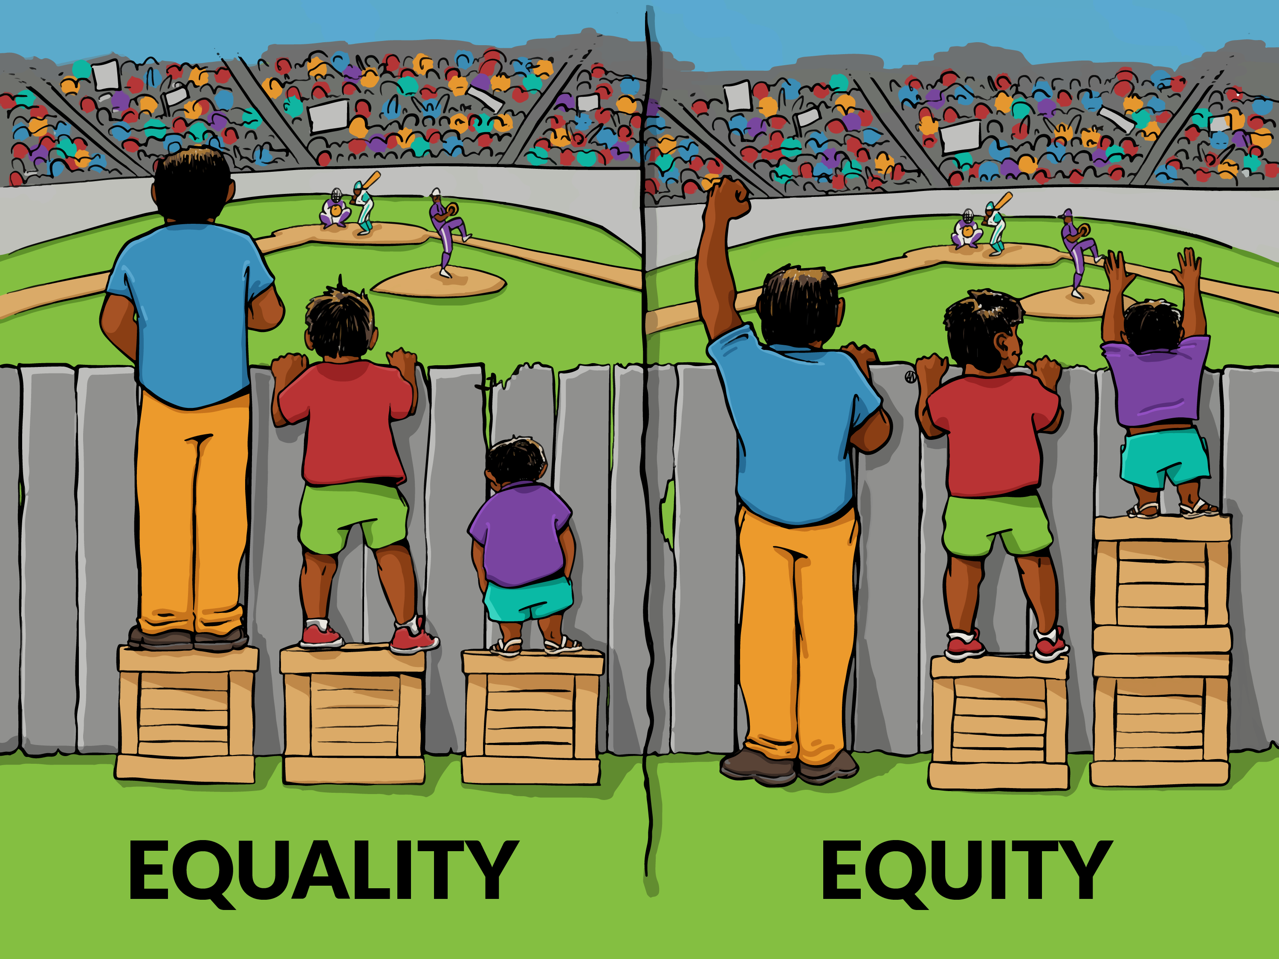
Los Angeles County
Department of Children and Family Services

Slide 29
Celebrate Diversity, Ensure Inclusion & Demand Equity

Slide 30
ERDD EFFORTS
Eliminating Racial Disproportionality and Disparity for African American children and families (ERDD)
Father Engagement
Cultural Trainings
Effective Black Parenting

Slide 31
FATHER ENGAGEMENT

Slide 32
Desired outcomes of Father Engagement:
Increase access to and utilization of fatherhood services
Increase community capacity to provide fatherhood services
Reduce involvement in the child protective system
Increase father-to-child contact
Greater awareness of fatherhood issues

Slide 33
LGBTQ + Youth In Foster Care

Slide 34
ESTIMATE OF LGBTQ YOUTH POPULATION
In a 2014 research study on foster youth in Los Angeles County, it was estimated that 19.1% of the Los Angeles foster care youth population ages 12-21 years self-identify as LGBTQ.
Data Source: Wilson, B., Cooper, K., Kastanis, A., & Nezhad, H. (2014). Sexual and gender minority youth in foster care: Assessing disproportionality and disparities in Los Angeles. Retrieved on August 8, 2018 from https://williamsinstitute.law.ucla.edu/wp-content/uploads/LAFYS_report_final-aug-2014.pdf

Slide 35
The LGBTQ Youth Permanency Barriers:
More placement
Higher rates of overnight hospitalizations
Higher rates of hospitalizations due to emotional reasons
Higher rates of homelessness
More likely to live in a group home
Note: 81% represents the foster youth general population.

Slide 36
CURRENT EFFORTS
The Data
DCFS Steering Committee
Subcommittees
Working with our Community Partners
Safe Spaces

Slide 37
DCFS Faith-Based Initiative

Slide 38
Planned Faith-Based Structure
Faith-based Organizations
DCFS Regional Offices
Specialized Units/Offices
Data & Tracking
Training
Office of
Faith-Based Engagement (DCFS)
Technical Assistance
Resource Materials & Toolkits
Stakeholder
Engagement
Policies & Procedures

Slide 39
Women & girls initiative (WGI)

Slide 40
History of The WGI
Centennial Celebration
Empowering young women and girls will help move the needle in the right direction

Slide 41
Public Calendar of events at:
https://www.lacounty.gov/wgi-19-amendment-centennial/
The WGI is on the web:
Facebook, Instagram, Twitter as @LACWGI
https://www.lacounty.gov/wgi/

Slide 43
P1: PERMANENCY IN 12 MONTHS FOR CHILDREN ENTERING FOSTER CARE
7/1/17
6/30/18
6/30/19
Children entering care during the year
Children achieving permanency within 12 months
National Standard: >=40.5%

Slide 44
National Standard: ≤8.3%

Slide 45
Phone survey

Slide 46
Phone survey

Slide 47
Case Review Items 12 (A, B, C) Needs & Services of Child, Parents, & Foster Parents
Questions:
Did the agency conduct formal or informal comprehensive assessments that identified the needs of the child(ren), parent(s), and foster parent(s)?
Did the agency provide appropriate services to meet the needs of the child(ren), parent(s), and foster parent(s)?
Notes:
12A Behaviors
Engage with youth, even if initially rejected
Not just SDM
Spend adequate time
Collect information and follow up
Provide culturally appropriate services, not referrals
Break through barriers
12B Behaviors
Find parents whose whereabouts are unknown
Engage with parents, even if initially rejected or parents are incarcerated
Not just SDM
Spend adequate time
Collect information and follow up
Provide culturally appropriate services, not referrals
Break through barriers
12C Behaviors
Conduct timely home approvals
Visit caregivers (at least monthly)
Consider caregivers’ skills and needs
Talk about:
Placement stability
Permanency options
Court process
Progress of case
Visitation
Include caregivers in children’s services (Regional Center, Wraparound, etc.)

Slide 48
Case Review Items 12 Strength Rating

Slide 49
Case Review Item 13 Child & Family Involvement in Case Planning
Question:
Did the agency make concerted efforts to actively involve the child, mother, and father in the case planning process?
Notes:
12A Behaviors
Engage with youth, even if initially rejected
Not just SDM
Spend adequate time
Collect information and follow up
Provide culturally appropriate services, not referrals
Break through barriers
12B Behaviors
Find parents whose whereabouts are unknown
Engage with parents, even if initially rejected or parents are incarcerated
Not just SDM
Spend adequate time
Collect information and follow up
Provide culturally appropriate services, not referrals
Break through barriers
12C Behaviors
Conduct timely home approvals
Visit caregivers (at least monthly)
Consider caregivers’ skills and needs
Talk about:
Placement stability
Permanency options
Court process
Progress of case
Visitation
Include caregivers in children’s services (Regional Center, Wraparound, etc.)

Slide 50
Case Review Item 13 Strength Rating

Slide 51
Regional Data Trainings Staff Survey Question
What motivates you about your work? What do you want to accomplish for the children and families you serve?

Slide 52
Regional Data Trainings Staff Survey RESPONSE
Most Common:
Making a Positive Change
Strengthening Families
Child Safety
Advocacy for Others
Permanency
Improving a Child’s Life

Slide 53
Regional Data Trainings Staff Survey Question
If you could change one thing to help you improve permanency for children on your caseload, what would it be?

Slide 54
Regional Data Trainings Staff Survey RESPONSE
Most Common:
Community-based services 51% (28% Quality, 23% Availability)
More timely court process 18%;
Improving Trust and Communication with Parents 9%.

Slide 55
Regional Data Trainings Staff Survey Question
What available resources help you achieve permanency for the children and families you serve?

Slide 56
Regional Data Trainings Staff Survey RESPONSE
Most Common:
Teaming/CFT Meetings
Parent Partners
Family Preservation
Wraparound
Informal Supports
Visits/Visitation Support

Slide 57
Game! PERMANENCY JENGA
Make friends with folks at your table. If you don’t know each other, introduce yourselves. Set an intention to have fun.
On your turn, take one block from any level of the tower.
If present, read the resource/barrier written on the block. How might this impact permanency?
Place the block on the topmost level of the tower.
The game ends when the tower falls. Reset, and play again.

Slide 58
A Story of adoption

Slide 59
Data Walk

Slide 60
Thank You!
The California Child Welfare Indicators Project (CCWIP) is a collaboration of the California Department of Social Services and the School of Social Welfare, University of California at Berkeley, and is supported by the California Department of Social Services, Casey Family Programs, and the Conrad N. Hilton Foundation.

Slide 61
Chief Deputy Director Ginger Pryor
Data-Driven Decision Making Leadership Organizational Group

