Slide 1
Data vs. Outcomes: CCWIP Primer for Child Welfare Professionals
Wendy Wiegmann
CA Child Welfare Indicators Project
July 22, 2020

Slide 2
Data/Process Measures/Outcomes

Slide 3
Why does it matter?
Data are only the building blocks of understanding. They alone do not tell us anything. Questions need to be asked of them, and they need to be organized and analyzed using appropriate methods to answer questions.
Process measures tell us what we do. They may tell us how many MDTs were held, how many trainings were conducted, or how many clients were served/identified. They do not tell us the value or impact of those processes.
Outcome measures can tell us whether we made an impact. They are an indicator of effectiveness, helping us to understand whether our processes achieved intended results. They require identification of the intended results of the policy or practice.

Slide 4
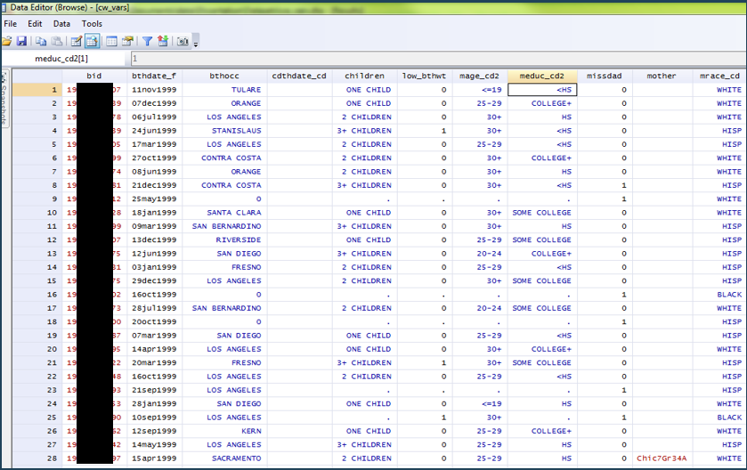
Data
Notes:
This is specially an example of “micro-data” = individuals as units of analysis

Slide 5
Uses of Data
Descriptive
Demographic characteristics of a population, place, office, etc.
Trends over time (one period compared to another)
Differences/similarities between groups, counties, placement settings, interventions, etc.
Exploratory
Often conducted as pilot studies, they attempt to examine feasibility issues for a new policy or practice, they also provide preliminary data to develop fuller hypotheses and research proposals
Explanatory
Analysis of the relationship between two events (or two variables)
Looking at the contributions of various factors to some outcomes
Evaluation
To evaluate social policies, programs, and interventions
The evaluation process encompasses all three uses of data listed above

Slide 6
Data Terminology
Qualitative vs. Quantitative
why, how vs. who, what, where, when
“All quantitative data is based upon qualitative judgments; and all qualitative data can be described and manipulated numerically.” (Research Methods Knowledge Base)
Longitudinal vs. Cross-Sectional
repeated observations over time vs. a slice
Primary vs. Secondary
you collect it vs. someone else collected it
Aggregate vs. Micro-level
group tabulations vs. individual units
De-identified vs. Identified
987334 vs. Joe Smith
Sample vs. Census/Population
partial vs. full coverage

Slide 7
Administrative Data (e.g., CWS/CMS)
Collected during the normal course of agency operations
When tabulated/aggregated, it may be publicly available
Full coverage of populations served
Analysis of trends over time
Can lead to performance indicators
Particularly salient to social work…
Notes:
Key to emphasize the fact that administrative/aggregate data can measure what’s occurring at a systemic level – allows us to better understand the institutional and environmental conditions affecting the individuals and populations we work with and makes us more effective advocates for macro-level change (social justice).

Slide 8
Realities of Administrative Data
Measures are often crude
Sometimes limited documentation
Missing data
Garbage In → Garbage Out: Do you trust what has been entered?
Often much more difficult to analyze than expected…requires careful thinking
May be dated
Definitions may change over time

Slide 9
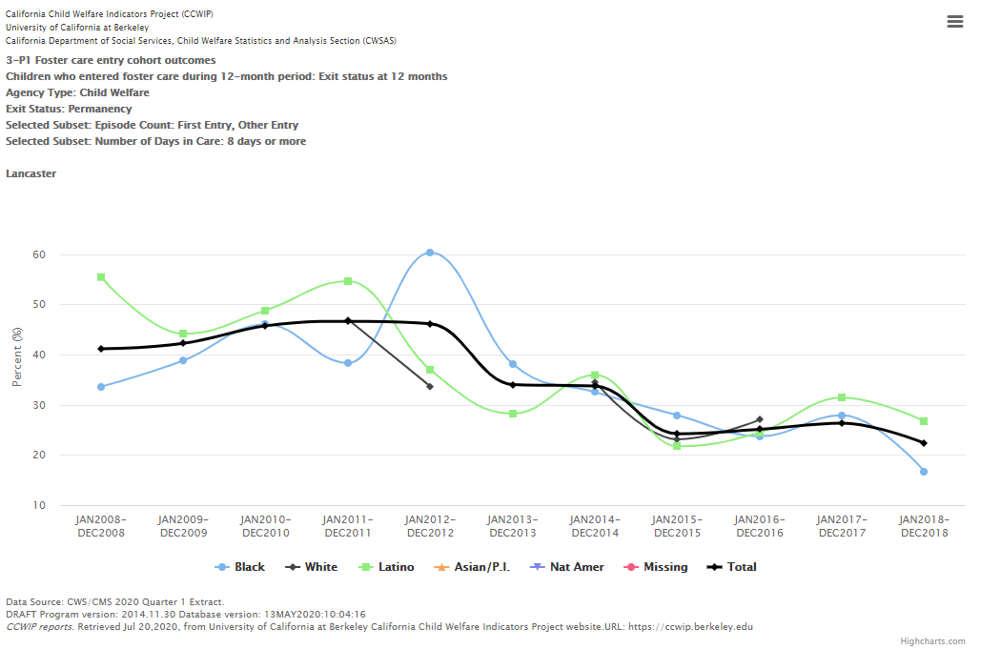
Data vs. Outcomes
What data are needed to determine this outcome?

Slide 10
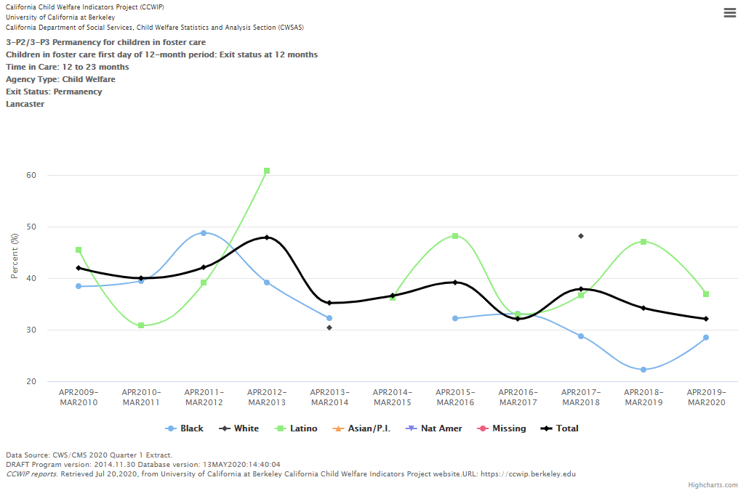
Process Measures vs. Outcomes
What process measures support this outcome?

Slide 11
Outcomes vs. Process Measures
What outcomes should this process measure promote?

Slide 12
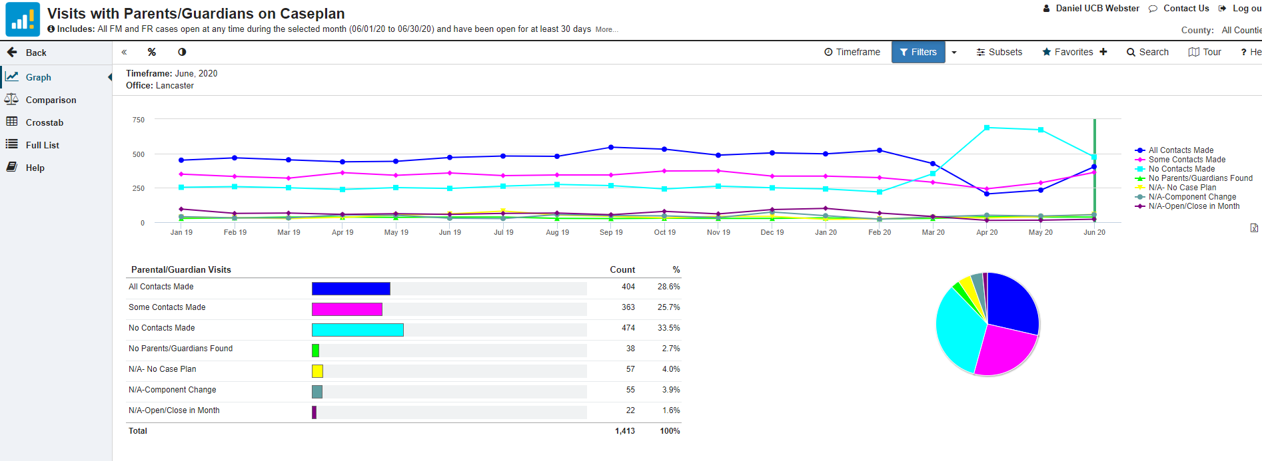
Outcomes vs. Process Measures
What outcomes should this process measure promote?

Slide 13
Questions?
Wendy Wiegmann
wendy.wiegmann@berkeley.edu

Slide 14
Thank You!
The California Child Welfare Indicators Project (CCWIP) is a collaboration of the California Department of Social Services and the School of Social Welfare, University of California at Berkeley, and is supported by the California Department of Social Services, Casey Family Programs, and the Conrad N. Hilton Foundation.

