Slide 1



CCWIP Data Analysis Training
Using the CCWIP Website to Understand County Performance on CFSR 3 Measures
Wendy Wiegmann
CCWIP
May 1, 2017

Slide 2
Outline
The CFSR: History, Goals, and Process
Child Welfare Data Measurement: A Primer
Federal CFSR3 Measures & Statewide Outcomes
CCWIP website

Slide 3
The cfsr:
History, goals, & Process

Slide 4
Federal Legislation:
Child and Family Service Reviews
1994 Amendments to the Social Security Act
  Mandated that a process be created to ensure conformity with the Social Security Act
The Adoption and Safe Families Act of 1997
  Mandated creation of outcome measures
2000 Final Rule published in the Federal Register
  Established a review system, called the Child and Family Services Reviews (CFSRs)
Notes:
1994 AMENDMENTS TO THE SOCIAL SECURITY ACT
Amendments to the Social Security Act in 1994 mandated the U.S. Department of Health and Human Services (USDHHS) to determine a process for ensuring conformity with titles IV-B and IV-E of the Social Security Act
ADOPTION AND SAFE FAMILIES ACT
The Adoption and Safe Families Act of 1997 directed USDHHS to develop a set of outcome measures that could be used to assess state performance in achieving the goals of safety; permanency; and child and family well-being
THE FINAL RULE
In 2000, a final rule was published in the Federal Register that established a review system for monitoring state child welfare programs
This system, called the Child and Family Services Reviews (CFSRs), is administered by the Children’s Bureau (a division of of USDHHS)

Slide 5
CFSR History
CFSR Round 1: 2001 – 2004
  Data indicators consisted of 6 items (2 safety/4 permanency)
CFSR Round 2: 2007 – 2010
  Data indicators also consisted of 6 items, expanded to 15 different measures that were distilled into four composites
CFSR Round 3: 2015 – Present
  Data indicators consist of 7 items (2 safety/5 permanency)

Slide 6
CFSR: Overall Goals
To ensure conformity with title IV-B and IV-E child welfare requirements in the Social Security Act
Determine what is happening to children and families who have contact with the child welfare system
Support states to enhance their capacity to improve outcomes and systems for children and families

Slide 7
CFSR Process (Simplified)
States submit data on maltreatment reports (annually) and children in foster care (semi-annually)
The Children’s Bureau (CB) compiles and sends a State Data Profile to each state
Each state conducts a Statewide Assessment and submits it to CB
Based on the results, an Onsite Review is conducted (either by or in collaboration with CB)
Each state is held responsible for meeting “substantial conformity” on safety, permanency, and well-being outcomes and systemic factors
Program Improvement Plan (PIP) required for any indicator
that does not meet national standard

Slide 8
Child Welfare System Improvement and Accountability Act (AB 636)
Passed in 2001; went into effect January 1, 2004
Includes additional performance indicators, above those required by the CB
All 58 counties receive quarterly data reports (from CWS/CMS) on their outcomes
Data inform their System Improvement Plans (SIPs), which are sent to CDSS and become part of the state’s overall accountability process

Slide 9
child welfare data measurement

Slide 10
The Current Placement System*
(highly simplified)
the foster care system
CHILD IN
a bunch of stuff happens
CHILD OUT
*Adapted from Lyle, G. L., & Barker, M.A. (1998). Patterns & Spells: New Approaches to Conceptualizing Children’s Out of Home Placement Experiences. Chicago, IL: American Evaluation Association Annual Conference.
Notes:
10
This is what people outside the system thinks happen.

Slide 11
Counterbalanced Indicators of
System Performance
rate of referrals/
substantiated referrals
home-based services vs.
out of home care
reentry to care
permanency
through reunification,
adoption, or
guardianship
use of least
restrictive
form of care
length
of stay
positive attachments to family, friends, and neighbors
stability of care
Source: Usher, C.L., Wildfire, J.B., Gogan, H.C. & Brown, E.L. (2002). Measuring Outcomes in Child Welfare. Chapel Hill, NC: Jordan Institute for Families,
Notes:
We really know that child welfare data measurement includes many different outcomes, some which may work against others. Child welfare agencies are striving for a balance between these multiple indicators.

Slide 12
3 Key Data Views in Child Welfare
Data
Entry
Cohorts
Exit
Cohorts
Point
in Time
Notes:
In addition to the issue of different (and sometimes competing) measures, it is also important to understand that the data can be examined multiple way, some of which give an accurate picture of what happened/happens to a child in the child welfare system, and others which may skew the picture.
The first question that has to be answered is, “Whose outcomes do I want to measure?”
There basic are 3 choices:
Children in foster care - the active caseload (other terms: point-in-time, cross-section, or census)
Children leaving foster care - children who left placement in the last year (other terms: an exit cohort)
Children entering foster care - children placed during some period of time, usually one year (other terms: an admission cohort)
Each of these approaches represents a different way to sample the children who have ever been in foster care

Slide 13
What is the difference?
Cross-Sectional/Point-in-time - Only children in care
Exit cohort - Only children who left care
Entry cohort - All children who entered

Slide 14
What are the implications?
It is much harder to measure outcomes over time using either a point-in-time or an exit cohort sample because the samples are missing some children:
  A point-in-time analysis is missing the kids who left placement
  An exit cohort only includes kids who leave
  You can’t assess change if you leave out either of these children because their experiences aren’t factored into the outcomes. All children have to be included in the system for monitoring outcomes.

Slide 15
PIT Snapshots vs Entry Cohorts
Jan. 1, 2016
Jan. 1, 2015
Jan. 1, 2017
Notes:
Another problem with point-in-time data: the over-capture of long-stayers.

Slide 16
Tracking an Entry Cohort for 1 Year
2015
2016
Dec. 31
Dec. 31
Jul. 7
Jul. 7
Mar. 1
Mar. 1
Jan. 1
Dec. 31
Jan. 1
Dec. 31
Notes:
How Entry Cohorts work

Slide 17
federal CFSR3 measures

Slide 18
Outcomes: Safety
Children are, first and foremost, protected from abuse and neglect.
Children are safely maintained in their homes whenever possible and appropriate.

Slide 19
CFSR3 Data Indicators: Safety
  S1: Maltreatment in foster care
  “Of all children in care during the 12-month period, what is the rate of victimization per day?”
  S2: Recurrence of maltreatment
  “Of all children with a substantiated allegation during the 12-month period, what percent had another substantiated allegation within 12 months?”
Notes:
S1: Of all children in foster care during a 12-month period, what is the rate of victimization per day of foster care?
What’s changed from CFSR 2?
Rate of maltreatment per child days in foster care vs. percentage of children not maltreated in foster care
Includes all maltreatment types by any perpetrator vs. just maltreatment by foster parents/facility staff
Includes:
All days in foster care during the year (across episodes)
Multiple incidents of substantiated maltreatment for the same child are included in the numerator
Excludes:
Children in care for less than 8 days
Incidents occurring before or within 7 days of the date of removal
Children age 18+
Days in care after 18th birthday
S2: Of all children who were victims of a substantiated report of maltreatment during a 12-month reporting period, what percent were victims of another substantiated maltreatment allegation within 12 months of their initial report?
What’s changed from CFSR 2?
Window is 12 months vs. 6 months
Recurrence vs. no recurrence
Excludes:
Children age 18+ at initial report
Substantiated allegations occurring within 14 days of initial report

Slide 20
  S1: Maltreatment in foster care
Cohort: Children in Care Between Apr 2015 – Mar 2016
Child A
Days in care: 275
Instances of maltreatment: 0
1
Denominator: total days in care
275 + 45 + 310 + 95 + 188 = 913
2
Numerator: instances of maltreatment
0 + 1 + 2 + 0 + 0 = 3
Child B
Days in care: 45
Instances of maltreatment: 1
3
Calculate rate of maltreatment per day in care
3 / 913 = 0.003286
Child C
Days in care: 310
Instances of maltreatment: 2
4
Multiply by 100,000
0.003286 * 100,000 = 328.6 victimizations
per 100,000 days in foster care
Child D
Days in care (episode 1): 95
Instances of maltreatment: 0
Days in care (episode 2): 188
Instances of maltreatment: 0
National Standard:
<= 8.50 per 100,000
Notes:
S1: “Of all children in care during the 12-month period, what is the rate of victimization per day?”
Days in care – across episodes
Maltreatment – includes multiple instances/child

Slide 21
  S2: Recurrence of maltreatment
04/1/14
4/1/15
4/1/16
Children with a substantiated allegation during the 12-month period: 6
Children with another substantiated allegation within 12 months: 3
Performance (P1): 50%
National Standard: <=9.1%
Notes:
S2: “Of all children with a substantiated allegation during the 12-month period, what percent had another substantiated allegation within 12 months?”
Child 1: 7 months, first substantiated allegation prior to 12-month period
Child 2: 20 months, first substantiated allegation during 12-month period, second substantiated allegation after 12 months
Child 3: 17 months, first substantiated allegation prior to 12-month period
Child 4: 9 months, first substantiated allegation during 12-month period, second substantiated allegation within 12 months
Child 5: 4 months, first substantiated allegation prior to 12-month period
Child 6: 20 months, first substantiated allegation during 12-month period, no second allegation
Child 7: 5 months, first substantiated allegation during 12-month period, second substantiated allegation within 12 months
Child 8: 22 months, first substantiated allegation during 12-month period, second substantiated allegation after 12 months
Child 9: 2 months, first substantiated allegation prior to 12-month period
Child 10: 7 months, first substantiated allegation during 12-month period, second substantiated allegation within 12 months

Slide 22
Case Review Outcomes:
Safety
  Case Review Item 1: Timeliness of Initiating Investigations of Reports of Child Maltreatment
  Item 2: Services to Family to Protect Child(ren) in the Home and Prevent Removal or Re-Entry Into Foster Care
  Item 3: Risk and Safety Assessment and Management

Slide 23
Outcomes: Permanency
Children have permanency and stability in their living arrangements.
The continuity of family relationships and connections is preserved for children.

Slide 24
CFSR3 Data Indicators
Permanency
  P1: Permanency in 12 months for children entering foster care
  “Of all children who entered care in the 12-month period, what percent discharged to permanency within 12 months?”
  Trial Home Visit (THV) Adjustment: Children who have a discharge to reunification that was preceded by a trial home visit will have their length of stay adjusted to be at the time of the entry to the THV plus 30 days…and THV +30 will be considered the date they exited to permanency, even if the actual episode ends later.
Notes:
P1: Of all children who enter foster care in a 12-month period, what percent discharged to permanency within 12 months of entering foster care?
What’s changed from CFSR 2?
Expanded definition of permanence includes reunification, adoption, or guardianship vs. reunification only
Includes all children entering foster care during the year vs. just those who were removed for the first time
Entry cohort window is 12 months vs. 6 months
Excluded:
Children in care for less than 8 days
Children entering care at age 18+

Slide 25
  P1: Permanency in 12 months for children entering foster care
04/1/14
4/1/15
4/1/16
Children entering care during the year: 6
Children achieving permanency within 12 months: 4
Performance (P1): 67%
National Standard: >=40.5%
Notes:
P1: “Of all children who enter foster care in a 12-month period, what percent discharged to permanency within 12 months of entering foster care?”
Child 1: 7 months, entered care prior to 12-month period, exit to reunification
Child 2: 2 months, entered care during 12-month period, exit to reunification
Child 3: 17 months, entered care prior to 12-month period, exit to reunification, but not within 12 months
Child 4: 9 months, entered care during 12-month period, exit to guardianship
Child 5: 4 months, entered care prior to 12-month period, exit to reunification
Child 6: 20 months, entered care during 12-month period, no exit
Child 7: 5 months, entered care during 12-month period, exit to reunification
Child 8: 17 months, entered care during 12-month period, exit to reunification, but not within 12 months
Child 9: 2 months, entered care prior to 12-month period, exit to reunification
Child 10: 7 months, entered care during 12-month period, exit to reunification

Slide 26
CFSR3 Data Indicators
Permanency (con’t)
  P2/P3: Permanency in 12 months for children in foster care for 12-23 months (P2) or for 24 months or more (P3)
  “Of all children in care on the first day of the 12-month period who had been in care between 12 and 23 months (P2) or for 24 months or more (P3), what percent discharged to permanency within 12 months?”
Notes:
P2/P3: Of all children in foster care on the first day of the 12-month period, who had been in foster care (in that episode) for 12-23 months (P2) or for 24 months or more (P3), what percent discharged to permanency within 12 months of the first day?
What’s changed from CFSR 2?
P2 is a new measure with an intermediate time period (between 12 and 23 months)
Excludes:
Children who were age 18+ on the first day of the year
No Trial Home Visit adjustment

Slide 27
  P2/P3: Entry & Length of Stay for months
4/1/12
4/1/13
4/1/14
4/1/15
4/1/16
Children in care less than 12 months prior to censor date: 4
Children in care for 12-23 months prior to censor date: 6
Children in care for more than 24 months prior to censor date: 5
Notes:
Child 1: No time prior to first day, exit to reunification (7 months total)
Child 2: 23 months prior to first day, no exit (more than 48 months total)
Child 3: 1 month prior to first day, exit to reunification (2 months total)
Child 4: 36 months prior to first day, exit to adoption (46 months total)
Child 5: 24 months prior to first day, exit to reunification (30 months total)
Child 6: 12 months prior to first day, exit to guardianship (14 months total)
Child 7: 10 months prior to first day, no exit (37 months total)
Child 8: 14 months prior to the first day, exit to reunification (22 months total)
Child 9: 22 months prior to the first day, exit to guardianship (46 months total)
Child 10: 18 months prior to the first day, exit to adoption (20 months total)
Child 11: 25 months prior to the first day, exit to adoption (38 months total)
Child 12: No time prior to first day, exit to reunification (6 months total)
Child 13: 27 months prior to the first day, exit to adoption (34 months total)
Child 14: 14 months prior to the first day, exit to reunification (18 months total)
Child 15: No time prior to the first day, exit to reunification (2 months total)
Child 16: 30 months prior to the first day, exit to guardianship (48 months total)
Child 17: 1 month prior to first day, exit to reunification (13 months total)
Child 18: 6 months prior to the first day, exit to adoption (11 months total)

Slide 28
  P2: Permanency in 12 months for children in care for 12-23 months
4/1/12
4/1/13
4/1/14
4/1/15
4/1/16
Children in care on the first day of the censor year who had been in care for 12-23 months: 6
Children achieving permanency within 12 months of censor date: 4
Performance (P2): 67%
National Standard: >=43.6%
Notes:
P2: “Of all children in care on the first day of the 12-month period who had been in care between 12 and 23 months, what percent discharged to permanency within 12 months?”
Child 1: No time prior to first day, exit to reunification (7 months total)
Child 2: 23 months prior to first day, no exit (more than 48 months total)
Child 3: 1 month prior to first day, exit to reunification (2 months total)
Child 4: 36 months prior to first day, exit to adoption (46 months total)
Child 5: 24 months prior to first day, exit to reunification (30 months total)
Child 6: 12 months prior to first day, exit to guardianship (14 months total)
Child 7: 10 months prior to first day, no exit (37 months total)
Child 8: 14 months prior to the first day, exit to reunification (22 months total)
Child 9: 22 months prior to the first day, exit to guardianship (46 months total)
Child 10: 18 months prior to the first day, exit to adoption (20 months total)
Child 11: 25 months prior to the first day, exit to adoption (38 months total)
Child 12: No time prior to first day, exit to reunification (6 months total)
Child 13: 27 months prior to the first day, exit to adoption (34 months total)
Child 14: 14 months prior to the first day, exit to reunification (18 months total)
Child 15: No time prior to the first day, exit to reunification (2 months total)
Child 16: 30 months prior to the first day, exit to guardianship (48 months total)
Child 17: 1 month prior to first day, exit to reunification (13 months total)
Child 18: 6 months prior to the first day, exit to adoption (11 months total)

Slide 29
  P3: Permanency in 12 months for children in care for 24+ months
4/1/12
4/1/13
4/1/14
4/1/15
4/1/16
Children in care on the first day of the censor year who had been in care for more than 24 months: 5
Children achieving permanency within 12 months of censor date: 3
Performance (P3): 60%
National Standard: >=30.3%
Notes:
P3: “Of all children in care on the first day of the 12-month period who had been in care for 24 months or more, what percent discharged to permanency within 12 months?”
Child 1: No time prior to first day, exit to reunification (7 months total)
Child 2: 23 months prior to first day, no exit (more than 48 months total)
Child 3: 1 month prior to first day, exit to reunification (2 months total)
Child 4: 36 months prior to first day, exit to adoption (46 months total)
Child 5: 24 months prior to first day, exit to reunification (30 months total)
Child 6: 12 months prior to first day, exit to guardianship (14 months total)
Child 7: 10 months prior to first day, no exit (37 months total)
Child 8: 14 months prior to the first day, exit to reunification (22 months total)
Child 9: 22 months prior to the first day, exit to guardianship (46 months total)
Child 10: 18 months prior to the first day, exit to adoption (20 months total)
Child 11: 25 months prior to the first day, exit to adoption (38 months total)
Child 12: No time prior to first day, exit to reunification (6 months total)
Child 13: 27 months prior to the first day, exit to adoption (34 months total)
Child 14: 14 months prior to the first day, exit to reunification (18 months total)
Child 15: No time prior to the first day, exit to reunification (2 months total)
Child 16: 30 months prior to the first day, exit to guardianship (48 months total)
Child 17: 1 month prior to first day, exit to reunification (13 months total)
Child 18: 6 months prior to the first day, exit to adoption (11 months total)

Slide 30
CFSR3: Data Indicators
Permanency (con’t)
  P4: Re-entry to foster care
  “Of all children who enter care in the 12-month period who discharged within 12 months to reunification or guardianship, what percent re-enter foster care within 12 months.”
  P5: Placement stability
  “Of all children who enter care in the 12-month period, what is the rate of placement moves per day?”
Notes:
P4: Of all children who enter foster care in a 12- month period and are discharged within 12 months to reunification or guardianship, what percent re-entered foster care within 12 months of their date of discharge?
What’s changed from CFSR 2?
Entry cohort (denominator includes all children who enter care during the year and exit within 12 months) vs. all children who exit during the year
Includes exits to reunification and guardianship vs. reunification only
Excluded:
Children in care for less than 8 days
Children entering or exiting care at age 18+
Note:
If a child has multiple re-entries to foster care within 12 months of their discharge, only the first re-entry is selected.
P5: Of all children who enter foster care in a 12- month period, what is the rate of placement moves per day of foster care?
What’s changed?
Entry cohort vs. all children in care for less than 12 months
Controls for time in care by constructing a moves/placement day vs. the number of moves per child
Accurately accounts for actual number of moves vs. the prior “2 or more” indicator
Excluded:
Children in care for less than 8 days
Children entering or exiting care at age 18+
Note:
The initial removal from home (and into foster care) is not counted as a placement move.

Slide 31
  P4: Re-Entry to Foster Care
04/1/14
4/1/15
4/1/16
Children entering care during the year: 6
Children achieving permanency within 12 months: 4
Children reentering foster care within 12 months of date of discharge: 2
Performance (P4): 50%
National Standard: <=8.3%
8 months
4 months
Notes:
P4: “Of all children who enter foster care in a 12- month period and are discharged within 12 months to reunification or guardianship, what percent re-entered foster care within 12 months of their date of discharge?”
Child 1: 7 months, entered care prior to 12-month period, exit to reunification
Child 2: 2 months, entered care during 12-month period, exit to reunification
Child 3: 17 months, entered care prior to 12-month period, exit to reunification, but not within 12 months
Child 4: 9 months, entered care during 12-month period, exit to guardianship
Child 5: 4 months, entered care prior to 12-month period, exit to reunification
Child 6: 20 months, entered care during 12-month period, no exit
Child 7: 5 months, entered care during 12-month period, exit to reunification
Child 8: 17 months, entered care during 12-month period, exit to reunification, but not within 12 months
Child 9: 2 months, entered care prior to 12-month period, exit to reunification
Child 10: 7 months, entered care during 12-month period, exit to reunification

Slide 32
P5: Placement Stability
Cohort: Children Entering Care Between Apr 2013 – Mar 2014
Child A
Days in care: 342
Placement moves: 2
1
Denominator: total days in care
342 + 196 + 35 + 167 + 154 = 894
2
Numerator: placement moves
2 + 0 + 1 + 1 + 0 = 4
Child B
Days in care: 196
Placement moves: 0
3
Calculate rate of moves per day in care
4 / 894 = 0.00447
Child C
Days in care (episode 1): 35
Placement moves: 1
Days in care (episode 2): 167
Placement moves: 1
4
Multiply by 1,000
0.00447 * 1,000 = 4.5 placement moves per
1,000 days in foster care
Child D
Days in care: 154
Placement moves: 0
National Standard:
<= 4.12 per 1,000
Notes:
P5: “Of all children who enter care in the 12-month period, what is the rate of placement moves per day?”
Days in care/placement moves – across episodes

Slide 33
Case Review Outcomes: Permanency
  Case Review Item 4: Stability of Foster Care Placement
  Item 5: Permanency Goal for Child
  Item 6: Achieving Reunification, Guardianship, Adoption, or Other Planned Permanent Living Arrangement

Slide 34
Case Review Outcomes: Permanency (con’t)
  Case Review Item 7: Placement with Siblings
  Item 8: Visiting with Parents and Siblings in Foster Care
  Item 9: Preserving Connections
  Item 10: Relative Placement
  Item 11: Relationship of Child in Care with Parents

Slide 35
Outcomes: Well-Being
Families have enhanced capacity to provide for their children's needs.
Children receive appropriate services to meet their educational needs.
Children receive adequate services to meet their physical and mental health needs.

Slide 36
Case Review Outcomes:
Well-Being
  Case Review Item 12: Needs and Services of Child (12A), Parents (12B), and Foster Parents (12C)
  CR Item 13: Child and Family Involvement in Case Planning
  CR Item 14: Caseworker Visits with Child
  CR Item 15: Caseworker Visits with Parents

Slide 37
Case Review Outcomes:
Well-Being
  Case Review Item 16: Educational Needs of the Child
  CR Item 17: Physical Health of the Child
  CR Item 18: Mental/Behavioral Health of the Child

Slide 38
Statewide Outcomes

Slide 39
Additional Statewide Indicators
Participation Rates
Timely Response (Investigation & Visitation)
Sibling Placement
Least Restrictive Placement
ICWA/Native American Placement Status
Timely Health/Dental Exams
Authorizations for Psychotropic Medications
Individualized Education Plans
Exit Outcomes for Youth Aging out of Foster Care

Slide 40
… Break …

Slide 41
examining child welfare data using the ccwip website

Slide 42
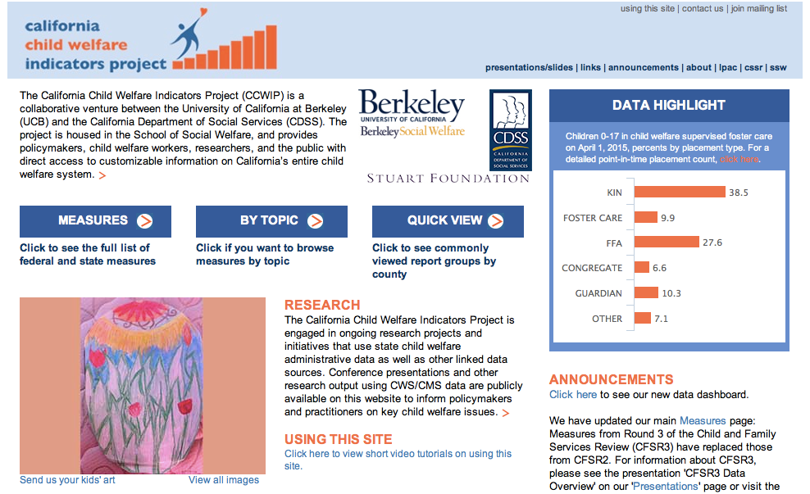
Website
Notes:
Demo using actual page navigation on website

Slide 43
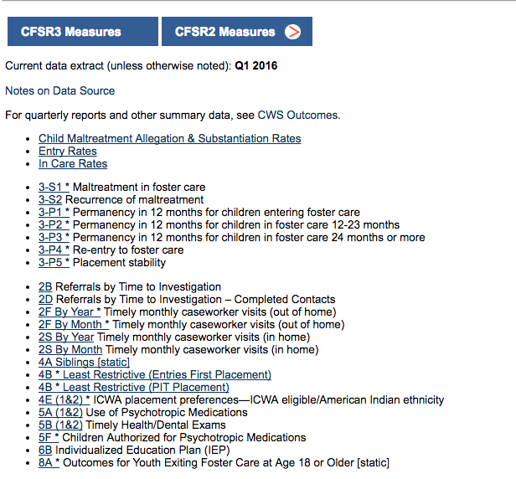
Report Index:
Federal (CFSR) Measures
Notes:
Demo using actual page navigation on website

Slide 44
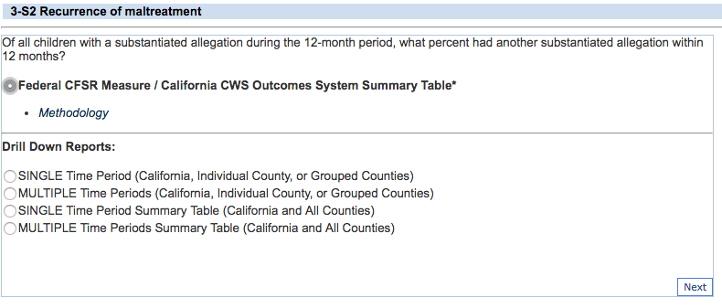
Federal CFSR Summaries
Notes:
Demo using actual page navigation on website

Slide 45
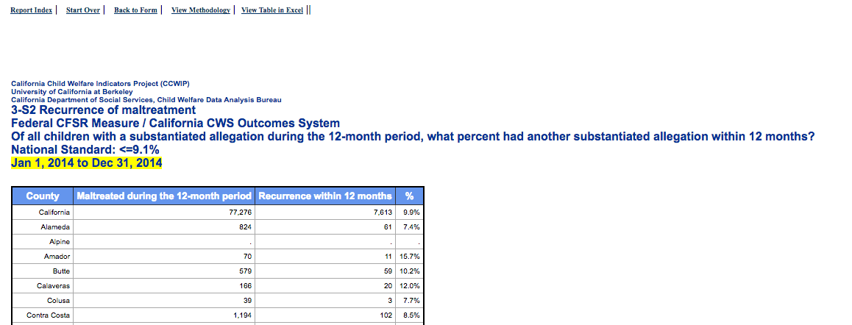
Methodology Links
Notes:
Demo using actual page navigation on website

Slide 46
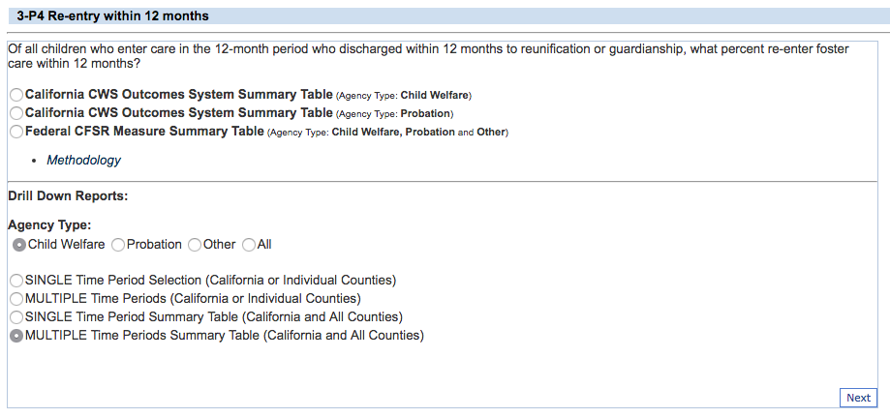
Multiple Time Periods

Slide 47
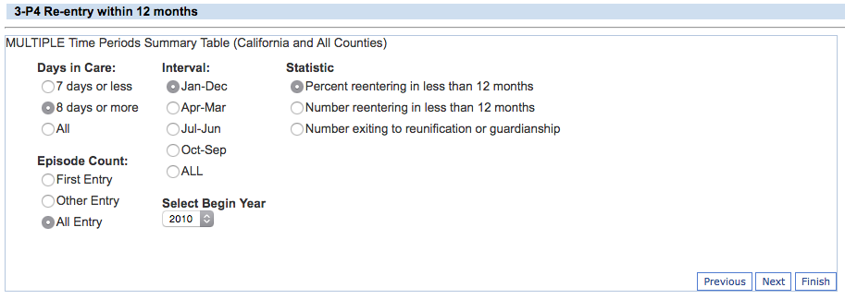
Additional Subgroup Filters

Slide 48
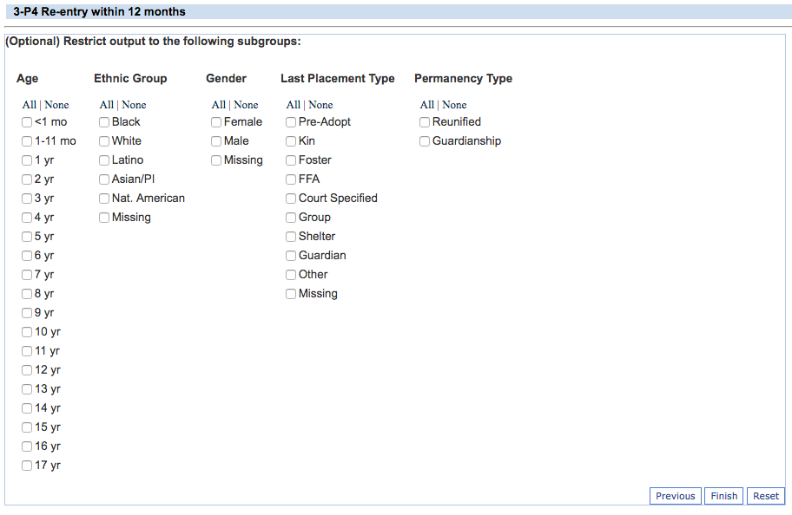
Additional Subgroup Filters

Slide 49
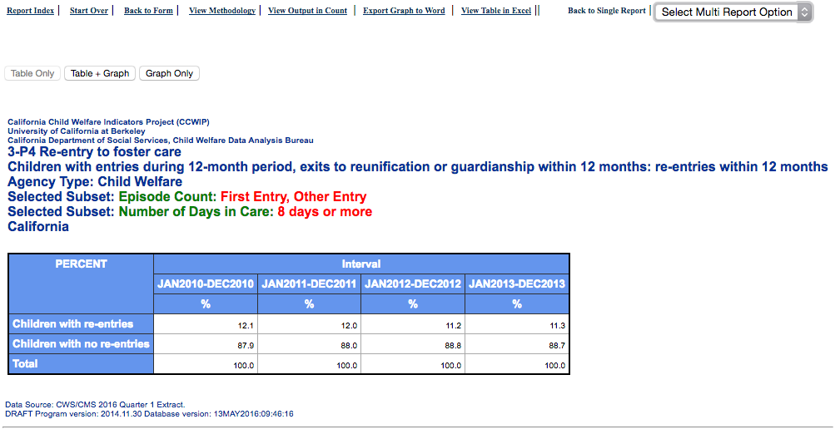
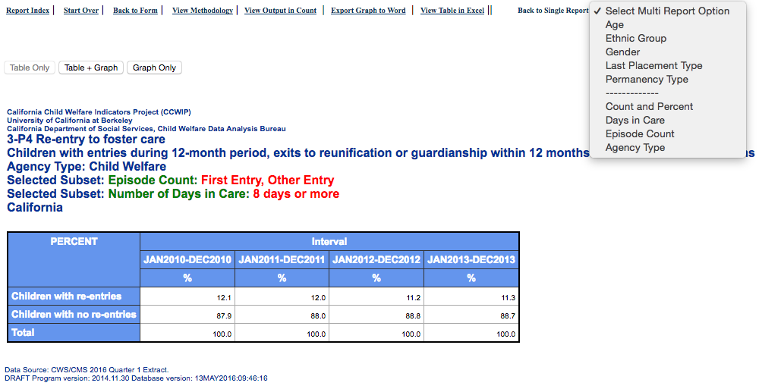
Multi-Report Option

Slide 50



Thank You!
  The California Child Welfare Indicators Project (CCWIP) is a collaboration of the California Department of Social Services and the School of Social Welfare, University of California at Berkeley, and is supported by the California Department of Social Services, Casey Family Programs, the Stuart Foundation, and the Conrad N. Hilton Foundation.
Notes:
CCWIP is a collaboration of the California Department of Social Services and the School of Social Welfare, University of California at Berkeley, and is supported by the California Department of Social Services and the Stuart Foundation.

Slide 51
Questions?
  Wendy Wiegmann
  wendy.wiegmann@berkeley.edu
  510-643-0839

