Slide 1

Trends in Child Welfare Outcomes
CA Blue Ribbon Commission
May1, 2013
The Performance Indicators Project is a collaboration of the
California Department of Social Services and UC Berkeley,
and is supported by CDSS , and the Stuart Foundation.

Slide 2
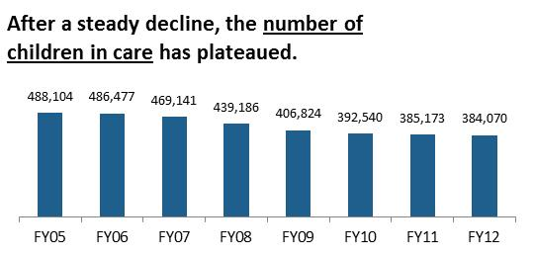
National Trends
National data are from AFCARS
Notes:
FY12 is an estimate based on state submitted AFCARS files and CA data from CWS/CMS
Ages 0-17 Point In Time on 9/30/xx

Slide 3
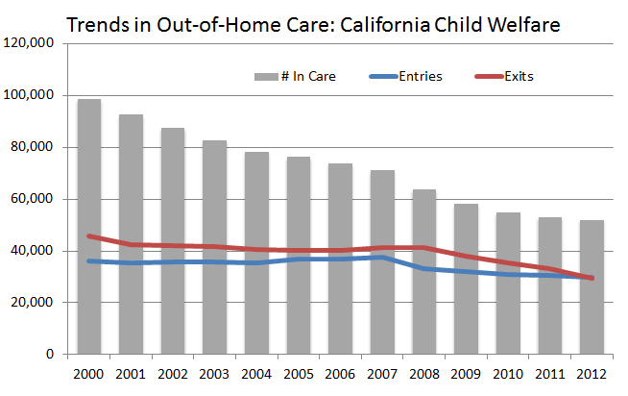
In CA, the number of children in care (ages 0-17) has been declining as exits have continually exceeded entries. The decline is now leveling off.
Throughout these slides, CA data are from the CWS/CMS Dynamic Report System at http://cssr.berkeley.edu/ucb_childwelfare/default.aspx National data are from AFCARS
Notes:
(Point in time on 10/1, Child Welfare only, ages 0-17)
During this time period, reduction occurred in almost every county. In the most recent year or two, however, the number of children in care has flattened out and started in increase in several counties.
Notice that entries have been relatively stable except for a drop in 2008 – entries are starting to creep up in many counties and if exits don’t keep up, we will start to see an increase in the number in care. (Already are in a few counties.)
I think this is counter to what many people believe is the reason for the decline in the number in care – many people think it has been a significant reduction in entries. (And it has been in some counties… but at the state level this is not the case.)

Slide 4
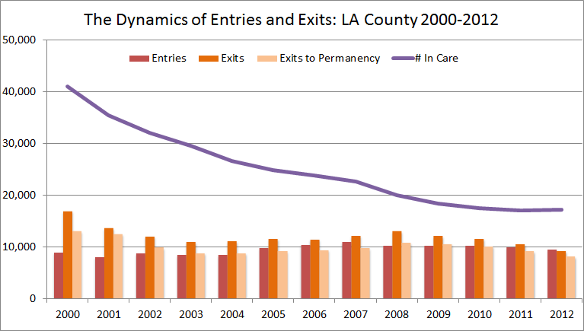
Different Patterns for Overall Reduction: LA
Notes:
bench

Slide 5
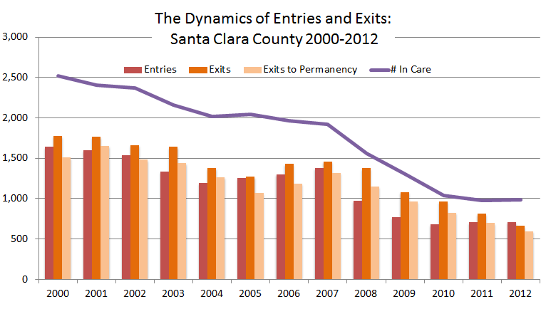
Different Patterns for Overall Reduction: Santa Clara
Notes:
bench

Slide 6
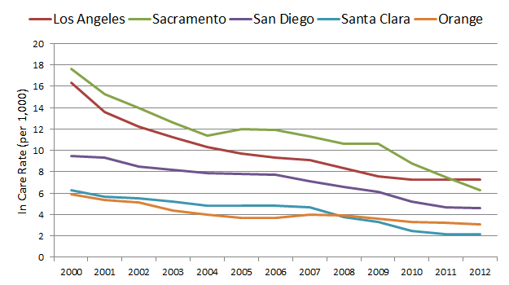
Using a rate controls for population size. This tells us the likelihood of a child being in out of home care. The in care rate (per 1,000) varies across counties and has been declining..
Notes:
(Point in time on 10/1, Child Welfare only, ages 0-17) ADD STATE RATE
During this time period, reduction occurred in almost every county. In the most recent year or two, however, the number of children in care has flattened out and started in increase in several counties.
The in-care rate in CA is similar to the national rate (slightly higher). For every 1,000 children, about 5 are in out of home care. Rate is per 1,000 in the child population (estimates)
Much higher for African American and Native American children
Notice that entries have been relatively stable except for a drop in 2008 – entries are starting to creep up in many counties and if exits don’t keep up, we will start to see an increase in the number in care. (Already are in a few counties.)
I think this is counter to what many people believe is the reason for the decline in the number in care – many people think it has been a significant reduction in entries. (And it has been in some counties… but at the state level this is not the case.)

Slide 7
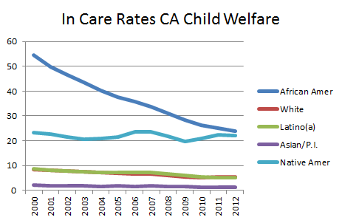
Statewide, the number of children in care has declined for all children but most dramatically for African Americans. Rates remain highest for African American and Native American Children
Notes:
While entry rates are highest for infants, in care rates are highest for teens.
Incidence rates per 1,000 child population - uses # in care on July 1, 2012 (ages 0-17)

Slide 8
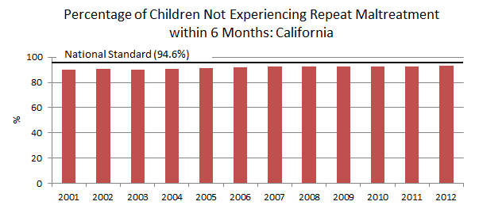
Balancing safety and permanency: The absence of repeat maltreatment (a measure of child safety) has increased slightly in CA. For this measure, higher is better.
Notes:
Time period is October-March (Oct2000-Mar2001, Oct 2001-march 2002, etc…)
CA most recent performance=93.1

Slide 9
Children entering care
State and Counties
Notes:
This speaks to “front end” services – primary prevention, in home services etc…

Slide 10
Key Questions: Entries
What is the entry rate – by age/race?
Are entries increasing/decreasing? for all groups?
How many children enter and exit within just a few days?
What are the reasons for removal?
What strategies/service are in place/planned to reduce entries (and re-entries) into care?
Notes:
Front end strategies
Safely decrease the number of children entering foster care - Strengthen families to prevent maltreatment (prevention svcs)
Engaging families (including fathers and paternal extended family, “kin”)
Provision of in-home services

Slide 11
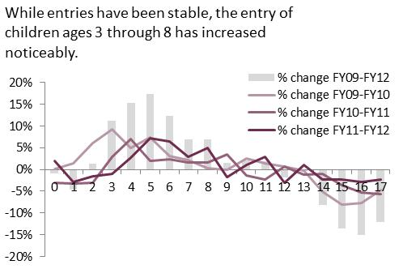
National Trends
National data are from AFCARS
Notes:
FY12 is an estimate based on state submitted AFCARS files and CA data from CWS/CMS

Slide 12
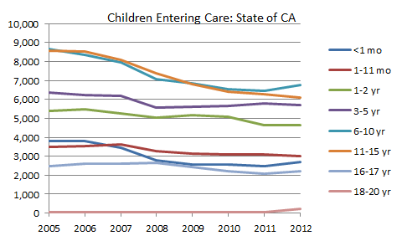
California Trends: After a period of decline, we are starting to see an increase in the number of newborns and children ages 6-10 entering care

Slide 13
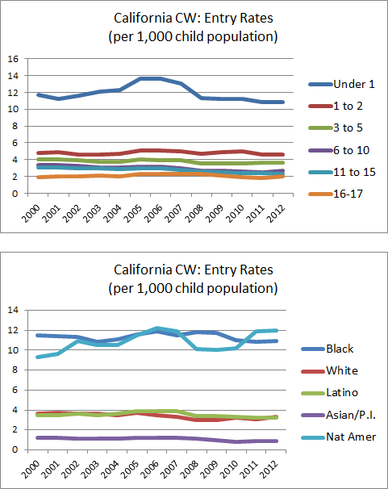
At the state level, there has been little change in the rate of entry. Like other jurisdictions, rates are highest for infants, and African American and Native children
Notes:
Patterns are really different from county to county
Some have had considerable declines
Starting to see some statewide uptick in some age groups (newborns and 6-10)

Slide 14
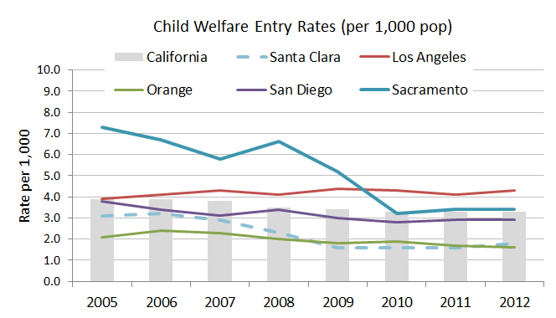
At the county level, there are very different trends in entry rates

Slide 15
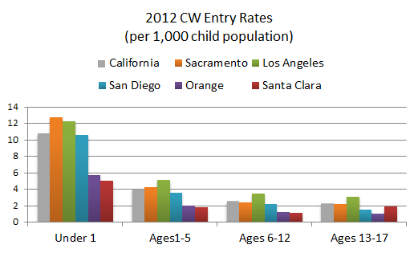
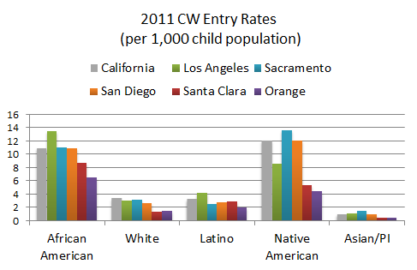
The likelihood of a child entering care varies by age and race, and across counties

Slide 16
Permanency
State and Counties
Notes:
Likelihood, timeliness, and “permanence”

Slide 17
Key Questions: Permanency Outcomes
What proportion of children entering care will eventually reunify? Within 12 months?
For children who do not return home within a year, what proportion exit to permanency (reunification, adoption, or guardianship) within 2 years, 3 years etc…
Are there differences by age/race?
Is the trends changing over time?
Notes:
Strategies:
Safely decrease the length of stay for children in foster care, thereby increasing the number of exits from care
Reunite children with birth parents when safe and appropriate to do so – (safety vs. risk)
Increase adoptions and legal guardianships (finding family/kin)
Reduce use of congregate care, family settings with in-home services

Slide 18
Timely reunification
Achieving Permanency
Notes:
Likelihood, timeliness, and “permanence”

Slide 19
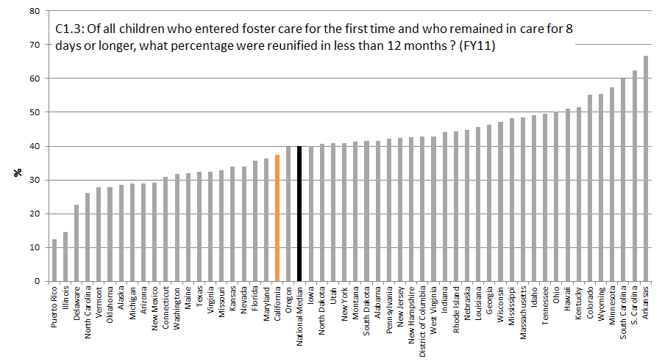
The likelihood of timely reunification in California is similar to the national median – this measure varies considerably across states.
Notes:
Q4 July-Dec

Slide 20
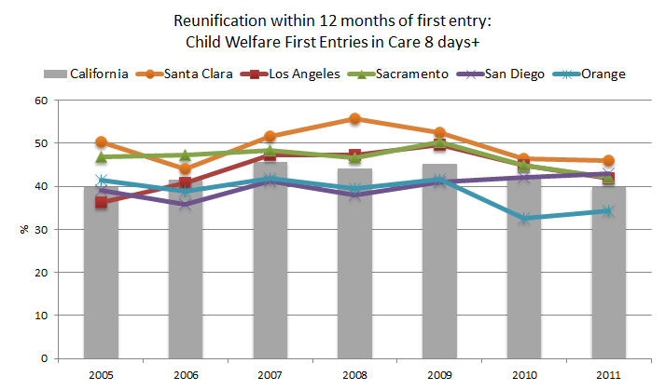
The likelihood of timely reunification in California is similar to the national median and there has been little change in recent years.
Notes:
Q4 July-Dec
Remind about entry rates

Slide 21
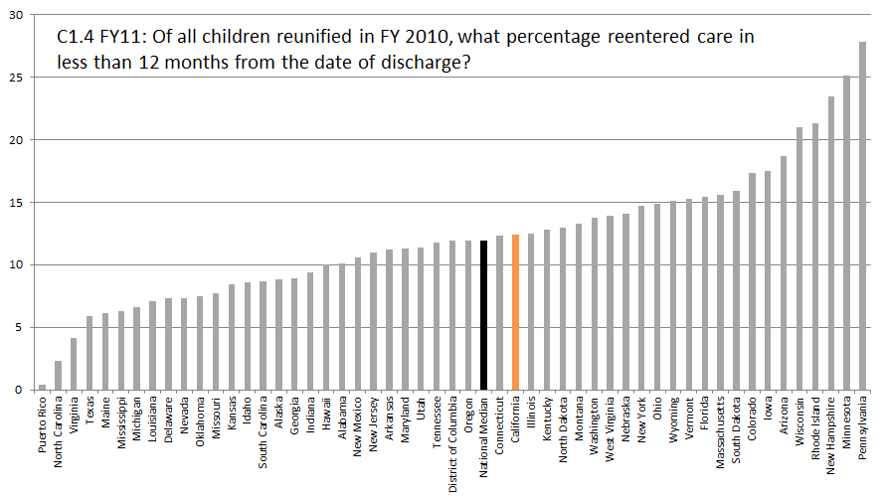
Timely reunification must be considered in context with re-entries into care

Slide 22
Children and youth in care for longer periods of time
Achieving Permanency
Notes:
Likelihood, timeliness, and “permanence”

Slide 23
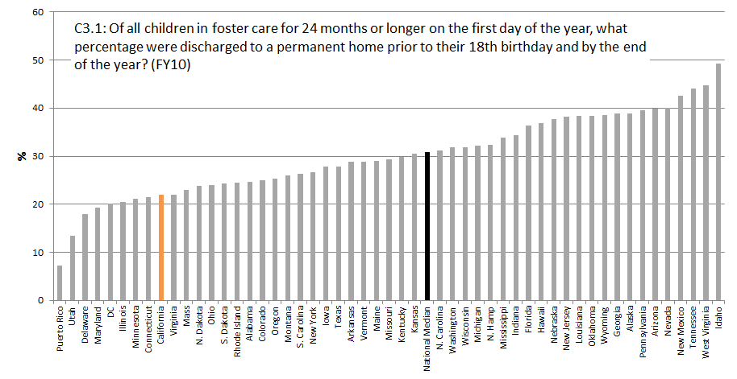
California’s performance on this measure is below the national median – this measure varies considerably across states.
Notes:
Q4 July-Dec

Slide 24
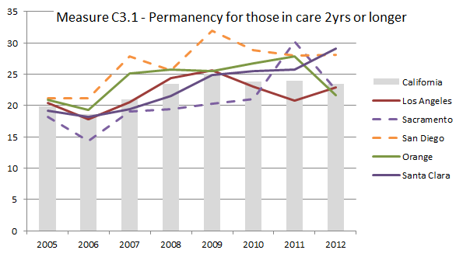
Children who have already been in care two years or more – What proportion will exit to permanency during the year that follows?
Notes:
This measures efforts/success at the “back end”
Improvement in most areas
Important to consider AGE (which is associated with exit type)
Q4 extract – time periods is Jan-Dec

Slide 25
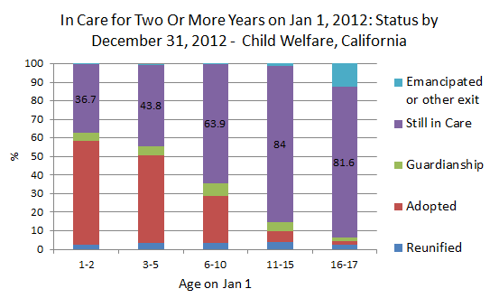
Performance on this measure varies dramatically by age

Slide 26
AB 12: Non Minor Dependents
Achieving Permanency
Notes:
Likelihood, timeliness, and “permanence”

Slide 27
Large increase in 18-20 year old FC population driven largely by SILP placements (AB12)
Notes:
CW PIT counts on Jan 1 each year, children 18-20 years old
FC population increased from 2,807 in 2012 to 4,645 in 2013 [n=1,838 more children, 65% increase]
The following placement types accounted for over 90% of the 1,838 children increase from ‘12-’13:
--SILP (47%)
--Court Specified (20%)—this category used by ctys before SILP added to cws/cms, thus expect counts in future to shift from this category to SILP
--Guard. Other (10%)
--Kin (7%)
--FFA (7%)
This increase reflected across all ethnic groups with Latino children accounting for largest proportion of 18-20yr olds in care:
Latino (42%), Black (33%), White (22%), Asian (3%)
Also see increase in 18-20yr olds returning to FC for subsequent placement episode (Other Entries):
Eightfold increase from 2011 (n=25) to 2012 (n=208)
Again most going into SILP and Court specified homes
These are children who had exited an earlier spell in FC, but elected to return to care as allowed by ab12

Slide 28
Wide variability across counties for percent increase in 18-20 year old FC population (AB12)
Notes:
Wide variability in growth in this population by county, with LA accounting for largest in sheer frequencies—(2012—1,383; 2013—1,716, n=+333); San Bernardino (2012—153; 2013—269, n=+116; Santa Clara (2012—72, 2013—136; n=+64); OC (2012—95, 2013—186, n=+91), San Diego (2012—134, 2012—263, n=+129), Sac (2012—126, 2013—274, n=+148); 10 ctys with most freqs (LA, al, sac, sbern, sd, riv, oc, sf, fres, sc) account for 80% of 18-20yr population.
but not in terms of percent change from 2012-2013
% growth ‘12-’13 for 10 ctys with largest number of 18-20 year olds in FC:
Los Angeles 24% San Bernardino 76% Santa Clara 89% Alameda 89% Orange 96% San Diego 96% San Francisco 98% Sacramento 117% Fresno 134% Riverside 135% ; (California 65%)
Not in graph:
missing dta=alpine, mono, sierra, modoc, mariposa, kings
ctys with 0% change=imperial, napa, del norte, san benito, glenn, inyo, plumas
ctys with 200%+ change=colusa, siskiyou, tulare, tuolumne, yolo

Slide 29
Large drop in 17-18 Year Olds formerly exiting to emancipation or other non-permanent exit (AB12)
Notes:
Drop in total exits for 17-18 year olds: 2008—5,389, 2012—2485 [a 54% decrease, n=-2,904]
Of the 17-18 year olds exiting, higher proportion are discharged to permanency
(Perm exits as proportion of all exits: 2008=20%, 2011=20%, 2012=30%)
Also for 15-16 year olds exiting seeing higher proportion discharged to permanency
(Perm exits as proportion of all exits: 2008=82%, 2011=87%, 2012=88%)

Slide 30
Dependency Court Data in CA
Excel Tool
Court-related variables
Developed User’s Guide
Includes voluntary & court-ordered placements
Convenient access to selected summary data
Making data relevant to non-researchers
Allows for statewide comparison
Allows courts & child welfare to align outcome measures
Notes:
Partnership between AOC and CDSS/UCB
AOC responds to requests for data on California’s dependency caseload
No statewide case management system for 58 ctys
Common statewide element: Case Filings

Slide 31
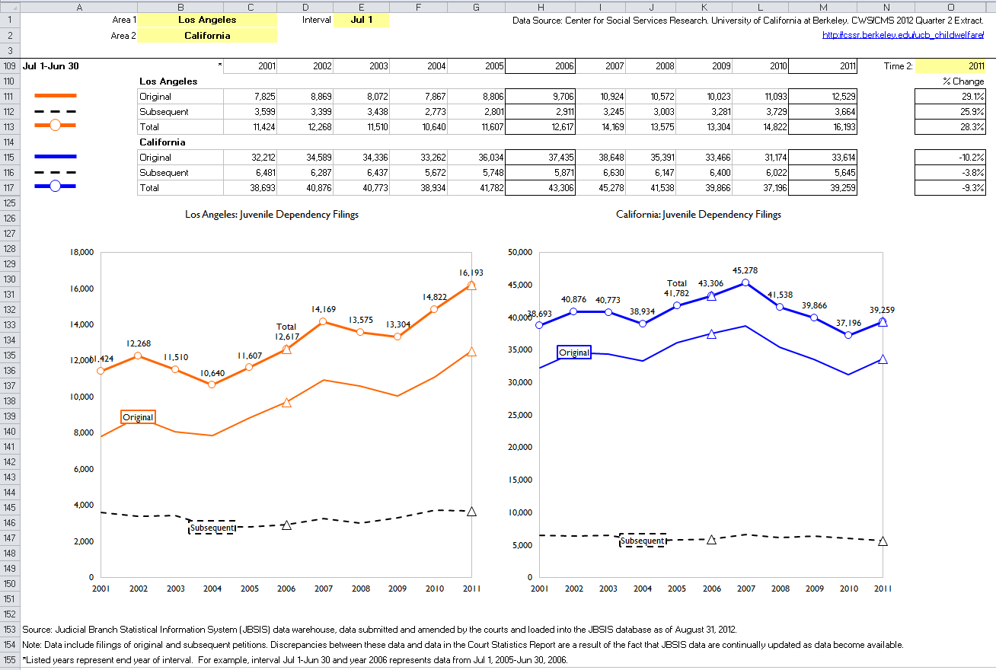
County Data Profiles for the Courts
California Judicial Branch website: http://www.courts.ca.gov/brc.htm#acc18886
Notes:
Live demonstration of tool features if time permits.

Slide 32
Thank you! Please contact us with any additional questions
Daniel Webster: dwebster@berkeley.edu
Melissa Correia: mcorreia@casey.org

