Slide 1
Record Linkage as a Policy Tool : A Child Welfare Case Study
5/7/13
Alameda County Interagency Children’s Policy Council (ICPC)
Oakland, CA
Emily Putnam-Hornstein, PhD
University of Southern California
School of Social Work

Slide 2
Acknowledgements
Thank you to my colleagues at the Center for Social Services Research and the California Department of Social Services
Ongoing support for research arising from the California Performance Indicators Project is generously provided by CDSS, the Stuart Foundation, and Casey Family Programs
Linkages funded by the Harry Frank Guggenheim Foundation
Forthcoming linkage work funded by the Conrad N. Hilton Foundation and First 5 LA

Slide 3
a “snapshot” of victims
before
CPS Data
after
Children not Reported for Maltreatment

Slide 4
expanded surveillance of child victims
child protective service records
birth data
death data
before
CPS Data
after
Children not Reported for Maltreatment
population-based information

Slide 5
record linkages 101
File A
File B
SSN
SSN
deterministic match
First Name
First Name
Middle Name
Middle Initial
Last Name
Last Name
probabilistic match
Date of Birth
Date of Birth
Address
Zip Code

Slide 6
linked dataset
cps records
514,000
LINKED DATA
birth no cps no death
birth records
birth cps no death
birth no cps death
birth cps death
4.3 million
25,000
all deaths
death records
1,900
injury
deaths

Slide 7
what have we done with these data?
Cumulative Risk and Targeting Services

Slide 8
identification of risk factors
family
pregnancy
child
?
Maltreatment
Referral
Substantiation
Entry to Care
?
Notes:
- as such, we choose to view a referral to CPS as a measure of “familial disorganization or dysfunction” that may place a child at risk of harm from maltreatment (either current, or future) and treat the referral itself, rather than any classification, as providing practical and valuable descriptive information

Slide 9
birth record variables
sex
female
birth weight
2500g+
prenatal care
1st trimester
<2500g
birth abnormality
3rd trimester
no care
present
none
maternal birth place
US born
non-US born
race
native american
black
Hispanic
white
asian/pacific islander
2nd trimester
male
maternal age
<=19
maternal education
<high school
pregnancy termination hx
prior termination
20-24
high school
named father
none reported
missing
named father
# of children in the family
one
two
birth payment method
public/med-cal
other
25-29
30+
some college
college+
three+

Slide 10
selected findings…
14% of children in birth cohort were reported to CPS by age 5
lower bound estimate…could not match 16% of CPS records
35% of all reported children were reported as infants
Not yet published data – 15%
11 of 12 variables were significantly associated with CPS contact
crude risk ratios >2 were observed for 7 variables
Contact with CPS is hardly a rare event for certain groups
25% of children born to teen mothers
Over 1/3 infants born without a second parent/father named

Slide 11
Cumulative Risk
Relative to many public health problems, yearly rates of child welfare involvement appear small…and given a narrow focus on substantiation and foster care placements (rather than the broader population of children reported for maltreatment), the number of children impacted feel even smaller.
Yet, even small yearly risks can add up to very high cumulative risks. For example, 6% of African American children have a parent imprisoned on any given day (Maruschak et al., 2010), but 25% have a parent imprisoned by age 14 (Wildeman, 2009).

Slide 12
The Cumulative Reality?
In California, what are the cumulative rates of maltreatment by age 5?
5.4% are reported for maltreatment each year
14% of all children are reported by age 5
lower bound estimate…could not match 16% of CPS records
children may have moved out of state and had contact
30% of black children
1.3% are substantiated as victims of abuse or neglect each year
5% of all children are substantiated as victims by age 5
12% of black children
12% of children born to teen mothers
0.5% enter a foster care placement
2.4% of all children have entered foster care by age 5
6% of black children
9% of children with missing paternity

Slide 15
an epidemiologic risk assessment tool?
we classified as “high risk” any child with three or more of the following (theoretically modifiable) risk factors at birth:
late prenatal care (after the first trimester)
missing paternity
<=high school degree
3+ children in the family
maternal age <=24 years
Medi-Cal birth for a US-born mother

Slide 16
administered at birth?
Full Birth Cohort
Children Reported to CPS

Slide 17
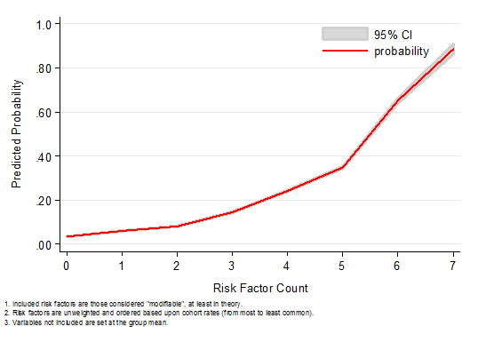
presence of multiple risk factors…
High Risk on Every Modifiable Risk Factor: 89% probability of CPS report
Low Risk on Every Modifiable Risk Factor: 3% probability of CPS report

Slide 18
discussion
compared with the demographics of the birth cohort as a whole, these young children are defined by the presence of multiple risk factors
a standardized assessment tool can never replace more comprehensive assessments of a family’s strengths and risks…but against an invariable backdrop of limited resources, the ability to prioritize services and adjust levels of case monitoring in order to meet the greater needs of a targeted swath of at-risk children and families holds real potential
Feasibility of using universally collected birth record data to target children and families for services?

Slide 19
what have we done with these data? (part 2)
Contextualizing Child Deaths

Slide 20
child death review teams (CDRTs)
first established in LA in 1978, now in place in almost every state and in most counties in California
“The primary mission of the State Child Death Review Council is to reduce child deaths associated with child abuse and neglect. The secondary mission is to reduce other preventable child deaths.” (CA Child Death Review Council, 2005)
most California CDRTs review all sudden, traumatic and/or unexpected child deaths (i.e., Coroner cases), including injury, natural and undetermined deaths (selection criteria vary by team, budgets)

Slide 21
missing epidemiological context
CDRTs compile data to identify child death patterns and clusters, examine possibly flawed decisions made by CPS and other systems, summarize the characteristics of fatally injured children, and make policy and practice recommendations
yet these recommendations are based on information concerning only those children who have already experienced the outcome of interest (death)
absent is information concerning the experiences and characteristics of children who were similarly reported to CPS, but did not die

Slide 22
Development of Prospective Policy and program questions…
risks
outcome
prospective
retrospective

Slide 23
Child Injury Death
A mortality-based standard for evaluating parental behavior may be the closest we can get to “culture-free” definitions of neglect and abuse (S.R. Johannson, 1987)
CPS report
Child A
Injury Death (?)
Child B
Injury Death (?)
Risk factors associated with both death, and being reported for maltreatment
Notes:
first prospective birth cohort analysis of injury mortality among children reported to child protective services
captures all children reported for maltreatment (including those screened out over the phone)
examines both unintentional and intentional injury fatalities
controls for sociodemographic risk factors present at birth

Slide 24
Key finding
after adjusting for other risk factors at birth, a previous referral to CPS emerged as the strongest predictor of injury death during a child’s first five years of life
a previous referral to CPS was significantly associated with a child’s risk of both unintentional and intentional injury death

Slide 25
adjusted rate of injury death for children with a prior allegation of maltreatment, by cause of death
HR: 2.59
HR: 2.00
HR: 5.86

Slide 26
Other findings
Children “evaluated out” die at rates that are twice as high as children with similar risk factors, but no prior allegation
No evidence that we are able to effectively screen maltreatment allegations over the phone, without an in-person investigation
in-person investigation of all referrals involving children < age 5?
possibly cost-effective, given that 40% of children are re-reported within 2-years, regardless of initial disposition?

Slide 27
Next steps?

Slide 28
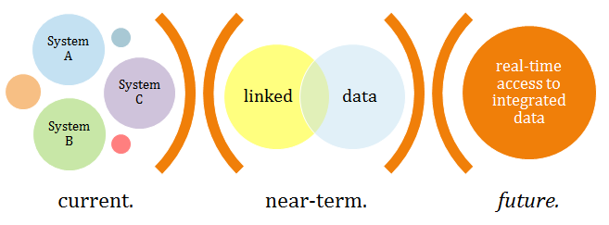
An Integrated Data repository
“Each person in the world creates a Book of Life. This Book starts with birth and ends with death. Its pages are made up of the records of the principal events in life. Record linkage is the name given to the process of assembling the pages of this Book…” (Dunn, 1946)

Slide 29
Current work…
County-specific cumulative contact estimates and examinations of risk factors
Intergenerational maltreatment linkages
Examination of medically encountered infant maltreatment (emergency departments and hospitals)
Substance abuse services received by mothers of children referred to CPS
Risk of SIDS and other SUIDS

Slide 30
Questions? ehornste@usc.edu

