Slide 1




CFSR3 Data Overview
California Child Welfare Indicators Project
Center for Social Services Research
School of Social Welfare
University of California, Berkeley
The California Child Welfare Indicators Project (CCWIP) is a collaboration of the California Department of Social Services and the School of Social Welfare, University of California at Berkeley, and is supported by the California Department of Social Services and the Stuart Foundation
Notes:
Contributors: Bryn King, Barbara Needell, William Dawson, Daniel Webster, and Joseph Magruder
Last update: August 2015

Slide 2
What are the CFSRs?
Amendments to the Social Security Act in 1994 mandated the U.S. Department of Health and Human Services (USDHHS) to determine a process for ensuring conformity with titles IV-B and IV-E of the Social Security Act
The Adoption and Safe Families Act of 1997 directed USDHHS to develop a set of outcome measures that could be used to assess state performance in achieving the goals of safety; permanency; and child and family well-being
In 2000, a final rule was published in the Federal Register that established a review system for monitoring state child welfare programs
This system, called the Child and Family Services Reviews (CFSRs), is administered by the Children’s Bureau (a division of of USDHHS)

Slide 3
CFSR History
CFSR Round 1
  Conducted between 2001 and 2004
  Data indicators to measure state performance consisted of 6 items (2 safety/4 permanency)
CFSR Round 2
  Conducted between 2007 and 2010
  Data indicators also consisted of 6 items, but the permanency standards were expanded to 15 different measures that were distilled into four composites
CFSR Round 3
  Begins in 2015
  Data indicators have been revised and will consist of 7 items (2 safety/5 permanency)

Slide 4
CFSR: Overall Goals
Ensure conformity with title IV-B and IV-E child welfare requirements
Determine what is happening to children and families who have contact with the child welfare system
Support states to enhance their capacity to improve outcomes and systems for children and families

Slide 5
CFSR3: What Has NOT Changed
The process:
  Data profile (3 years data trends and national standards)
  Statewide assessment
  Onsite review
Assessment based on the same 7 outcomes and 7 systemic factors using national standards and measures of expected performance
States found to be “not in compliance” will continue to have the opportunity to improve their programs before facing the possibility of financial penalties
Notes:
CB will send each state a data profile that includes:
aggregate data on the state’s foster care and in-home service populations
performance on national standards on safety and permanency data indicators
Also: there is still a regulated penalty structure

Slide 6
CFSR Process
States submit data to to two systems: the National Child Abuse and Neglect Data System (NCANDS) and the Adoption and Foster Care Analysis and Reporting System (AFCARS)
The Children’s Bureau (CB) of the Administration for Children and Families sends each state a State Data Profile of the state’s performance relative to national standards for three years prior to the review period
Using the most recent year of data from the State Data Profile, states develop a Statewide Assessment, a report on child and family outcomes and systemic factors, and submits it to CB
Onsite review is conducted based on the results of the statewide assessment and involves stakeholder interviews and case reviews. States meeting specific criteria can conduct their own case reviews using the federal review instrument
States held responsible for meeting “substantial conformity” on safety, permanency, and well-being outcomes and systemic factors

Slide 7
Seven Outcomes
Safety
  Children are, first and foremost, protected from abuse and neglect.
  Children are safely maintained in their homes whenever possible and appropriate.
Permanency
  Children have permanency and stability in their living arrangements.
  The continuity of family relationships and connections is preserved for children.
Child and Family Well-Being
  Families have enhanced capacity to provide for their children's needs.
  Children receive appropriate services to meet their educational needs.
  Children receive adequate services to meet their physical and mental health needs.

Slide 8
Seven Systemic Factors
Statewide Information System
Service Array
Case Review System
Staff Training
Quality Assurance System
Agency Responsiveness to the Community
Foster & Adoptive Parent Licensing, Recruitment, & Retention

Slide 9
CFSR3: What Has Changed
Statewide data indicators and national standards
The statewide assessment and integration with the Child and Family Services Plans (CFSPs) and Annual Progress and Services Reports (APSRs)
Onsite reviews
  Stakeholder interviews
  Case reviews

Slide 10
STATEWIDE DATA INDICATORS

Slide 11
Statewide Data Indicators:
CFSR2 vs. CFSR3
No composites!
Fewer and simpler measures
Greater reliance on entry cohorts
Increased utility for jurisdictions
More opportunity for CQI innovation

Slide 12
CFSR3 Indicators
Safety
  S1: Maltreatment in foster care
  S2: Recurrence of maltreatment
Permanency
  P1: Permanency in 12 months for children entering foster care
  P2: Permanency in 12 months for children in foster care for 12 to 23 months
  P3: Permanency in 12 months for children in foster care for 24 months or more
  P4: Re-entry to foster care
  P5: Placement stability

Slide 13
Methods
Cohorts
  In foster care during the 12-month period (S1)
  Children who were victims of a substantiated report of maltreatment during the 12-month period (S2)
  Children entering care during the 12-month period (P1, P4, P5)
  In foster care on the first day of the year (P2, P3)
Measures
  Percent (S2, P1, P2, P3, P4)
  Count/rate per day of foster care (S1, P5)
    Accounts for time at risk for the outcome (maltreatment in care or placement moves) using the total number of days eligible children were in care

Slide 14
S1: Maltreatment in Foster Care
Of all children in foster care during a 12-month period, what is the rate of victimization per day of foster care?
What’s changed?
  Rate of maltreatment per child days in foster care vs. percentage of children not maltreated in foster care
  Includes all maltreatment types by any perpetrator vs. just maltreatment by foster parents/facility staff
Includes all days in foster care during the year (across episodes)
Multiple incidents of substantiated maltreatment for the same child are included in the numerator
Notes:
Exclusions:
Children in care for less than 8 days
Incidents occurring before or within 7 days of the date of removal
Children age 18+
Days in care after 18th birthday

Slide 15
Calculating Rate Per Day of Foster Care:
Maltreatment in Foster Care
Cohort: Children in Care Between Oct 2012 – Sep 2013
Child A
Days in care: 275
Instances of maltreatment: 0
1
Denominator: total days in care
275 + 45 + 310 + 95 + 188 = 913
2
Numerator: instances of maltreatment
0 + 1 + 2 + 0 + 0 = 3
Child B
Days in care: 45
Instances of maltreatment: 1
3
Calculate rate of maltreatment per day in care
3 / 913 = 0.003286
Child C
Days in care: 310
Instances of maltreatment: 2
4
Multiply by 100,000
0.003286 * 100,000 = 328.6
Child D
Days in care (episode 1): 95
Instances of maltreatment: 0
Days in care (episode 2): 188
Instances of maltreatment: 0
328.6 victimizations per
100,000 days in foster care
Notes:
Days in care – across episodes
Maltreatment – includes multiple instances/child
If hiding the next slide: data on example children:
Child A entered care 12/17/12 and turned 18 on 9/19/13.
Child B entered care on 1/15/13, exited care on 2/19/13, and the substantiated report of maltreatment occurred on 1/18/13.
Child C entered care 11/24/12 and was still in care on the last day of the 12-month period. Substantiated reports of maltreatment occurred on 1/30/13 and 4/15/13.
Child D had two episodes in care. The first started on 5/9/12 and ended on 1/4/13. The second started on 3/21/13 and ended 9/25/13.

Slide 16
Maltreatment in Foster Care:
Example – Children in Care Oct 2012-Sep 2013
 | Child A | Child B | Child C | Child D (1) | Child D (2)
Entry date | 12/17/12 | 1/15/13 | 11/24/12 | 5/9/12** | 5/21/13
Exit date | in care | 2/19/13 | In care | 1/4/13 | 11/24/13
18th birthday | 9/19/13* | n/a | n/a | n/a | n/a
Age at entry/1st day of year | 17 | 3 | 8 | 12 | 13
Total days in care | 275 | 45 | 310 | 95 | 188
Substantiated reports | 0 | 1 | 2 | 0 | 1
Date of report | n/a | 1/18/13 | 1/30/13 6/15/13 | n/a | 5/24/13***
*Day count ends at 18th birthday
**Day count starts on the first day of the 12-month period
***Instance of maltreatment is excluded because it was reported within 7 days of foster care placement

Slide 17
S2: Recurrence of Maltreatment
Of all children who were victims of a substantiated report of maltreatment during a 12-month reporting period, what percent were victims of another substantiated maltreatment allegation within 12 months of their initial report?
What’s changed?
  Window is 12 months vs. 6 months
  Recurrence vs. no recurrence
Notes:
Excludes:
Children age 18+ at initial report
Substantiated allegations occurring within 14 days of initial report

Slide 18
Measuring Recurrence:
6-Month to 12-Month Window
State and County performance will appear to decline when comparing CFSR2 measure S1.1 to CFSR3 measure S1
The longer follow up exposure time in the revised measure (12 months vs. 6 months) increases the likelihood that children will experience recurrence of maltreatment

Slide 19
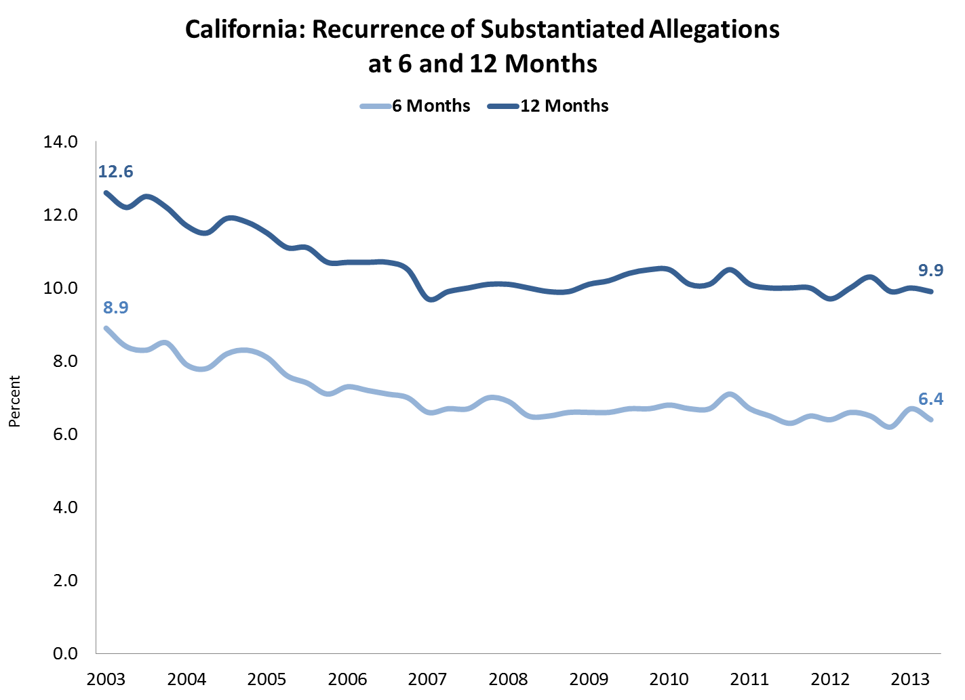
Notes:
http://cssr.berkeley.edu/ucb_childwelfare/RecurAlleg.aspx

Slide 20
P1: Permanency in 12 Months for Children Entering Care
Of all children who enter foster care in a 12-month period, what percent discharged to permanency within 12 months of entering foster care?
What’s changed?
  Expanded definition of permanence includes reunification, adoption, or guardianship vs. reunification only
  Includes all children entering foster care during the year vs. just those who were removed for the first time
  Entry cohort window is 12 months vs. 6 months
Notes:
Exclusions
Children in care for less than 8 days
Children entering care at age 18+

Slide 21
Trial Home Visit Adjustment
Children who have a discharge to reunification that was preceded by a trial home visit will have their length of stay adjusted to be at the time of the entry to the THV plus 30 days…and THV +30 will be considered the date they exited to permanency, even if the actual episode ends later.

Slide 22
Measuring Timely Reunification:
Entry Cohorts vs. Exit Cohorts
Counties that have relied more heavily on exit cohorts to assess and report timely reunification (CFSR2 measure C1.1) will look worse in the revised measure
For example, compare these statistics:
  Of children exiting to reunification in 2014 (Jan-Dec), 63.6% did so in less than 12 months (CFSR2 C1.1)
  Of children entering care between July and December 2013, 35.5% exited to reunification within 12 months (CFSR2 C3.1)

Slide 23
Example: Entry Cohorts vs. Exit Cohorts
CHILD | ENTRY & EXIT DATES | MONTHS IN CARE | EXIT REASON | EXIT COHORT | ENTRY COHORT
1 | 9/11-4/12 | 7 | Reunification | ✓
2 | 4/12-6/12 | 2 | Reunification | ✓ | ✓
3 | 4/11-9/12 | 17 | Reunification | ✓
4 | 12/11-9/12 | 9 | Guardianship |  | ✓
5 | 8/11-12/11 | 4 | Reunification | ✓
6 | 3/12- | 20 | N/A – no exit |  | ✓
7 | 9/12-2/13 | 5 | Reunification |  | ✓
8 | 12/11-5/13 | 17 | Reunification |  | ✓
9 | 9/11-11/11 | 2 | Reunification | ✓
10 | 4/12-11/13 | 7 | Reunification |  | ✓
Notes:
These data are in the notes for the following graphic slides – you can hide this slide for most audiences

Slide 24
Measuring Timely Reunification:
Entry Cohorts vs. Exit Cohorts
10/1/11
10/1/12
10/1/13
Notes:
Child 1: 7 months, included in exit cohort, exit to reunification
Child 2: 2 months, included in exit and entry cohorts, exit to reunification
Child 3: 17 months, in exit cohort, exit to reunification
Child 4: 9 months, included in entry cohort, exit to guardianship (excluded from exit cohort due to exit type)
Child 5: 4 months, included in exit cohort, exit to reunification
Child 6: 20 months, included in entry cohort, no exit
Child 7: 5 months, included in entry cohort, exit to reunification
Child 8: 17 months, included in entry cohort, exit to reunification
Child 9: 2 months, included in exit cohort, exit to reunification
Child 10: 7 months, included in entry cohort, exit to reunification

Slide 25
CFSR2/C1.1: Exit Cohort
10/1/11
10/1/12
10/1/13
Children discharged to reunification during the year: 5
Children reunified within 12 months: 4
Performance (C1.1): 80%
Median time to reunification (C1.2):
4 months
Notes:
Child 1: 7 months, included in exit cohort, exit to reunification
Child 2: 2 months, included in exit and entry cohorts, exit to reunification
Child 3: 17 months, in exit cohort, exit to reunification
Child 4: 9 months, included in entry cohort, exit to guardianship (excluded from exit cohort due to exit type)
Child 5: 4 months, included in exit cohort, exit to reunification
Child 6: 20 months, included in entry cohort, no exit
Child 7: 5 months, included in entry cohort, exit to reunification
Child 8: 17 months, included in entry cohort, exit to reunification
Child 9: 2 months, included in exit cohort, exit to reunification
Child 10: 7 months, included in entry cohort, exit to reunification

Slide 26
CFSR3/P1: Entry Cohort
10/1/11
10/1/12
10/1/13
Children entering care during the year: 6
Children achieving permanency within 12 months: 4
Performance (P1): 60%
Median time to permanency: 8 months
Notes:
Child 1: 7 months, included in exit cohort, exit to reunification
Child 2: 2 months, included in exit and entry cohorts, exit to reunification
Child 3: 17 months, in exit cohort, exit to reunification
Child 4: 9 months, included in entry cohort, exit to guardianship (excluded from exit cohort due to exit type)
Child 5: 4 months, included in exit cohort, exit to reunification
Child 6: 20 months, included in entry cohort, no exit
Child 7: 5 months, included in entry cohort, exit to reunification
Child 8: 17 months, included in entry cohort, exit to reunification
Child 9: 2 months, included in exit cohort, exit to reunification
Child 10: 7 months, included in entry cohort, exit to reunification

Slide 27
P2: Permanency in 12 Months for Children in Care for 12-23 Months
Of all children in foster care on the first day of the 12-month period, who had been in foster care (in that episode) for 12-23 months, what percent discharged to permanency within 12 months of the first day?
What’s changed?
  New measure with an intermediate time period (between 12 and 23 months)
Notes:
Excludes children who were age 18+ on the first day of the year
No THV adjustment

Slide 28
P3: Permanency in 12 Months for Children in Care for 24+ Months
Of all children in foster care on the first day of the 12-month period, who had been in foster care (in that episode) for 24 or more months, what percent discharged to permanency within 12 months of the first day?
What’s changed?
  nothing
Notes:
Excludes children who were age 18+ on the first day of the year
No THV adjustment

Slide 29
P4: Re-entry to Foster Care
Of all children who enter foster care in a 12- month period and are discharged within 12 months to reunification or guardianship, what percent re-entered foster care within 12 months of their date of discharge?
What’s changed?
  Entry cohort (denominator includes all children who enter care during the year and exit within 12 months) vs. all children who exit during the year
  Includes exits to reunification and guardianship vs. reunification only
Notes:
Exclusions:
Children in care for less than 8 days
Children entering or exiting care at age 18+
If a child has multiple re-entries to foster care within 12 months of their discharge, only the first re-entry is selected.

Slide 30
P5: Placement Stability
Of all children who enter foster care in a 12- month period, what is the rate of placement moves per day of foster care?
What’s changed?
  Entry cohort vs. all children in care for less than 12 months
  Controls for time in care by constructing a moves/placement day vs. the number of moves per child
  Accurately accounts for actual number of moves vs. the prior “2 or more” indicator
Notes:
Exclusions:
Children in care for less than 8 days
Children entering or exiting care at age 18+
The initial removal from home (and into foster care) is not counted as a placement move.

Slide 31
Calculating Rate Per Day of Foster Care:
Placement Stability
Cohort: Children Entering Care Between Apr 2013 – Mar 2014
Child A
Days in care: 342
Placement moves: 2
1
Denominator: total days in care
342 + 196 + 35 + 167 + 154 = 894
2
Numerator: placement moves
2 + 0 + 1 + 1 + 0 = 4
Child B
Days in care: 196
Placement moves: 0
3
Calculate rate of moves per day in care
4 / 894 = 0.00447
Child C
Days in care (episode 1): 35
Placement moves: 1
Days in care (episode 2): 167
Placement moves: 1
4
Multiply by 1,000
0.00447 * 1,000 = 4.5
4.5 placement moves per
1,000 days in foster care
Child D
Days in care: 154
Placement moves: 0
Notes:
Days in care/placement moves – across episodes
If hiding the next slide: data on example children:
Child A entered care 4/23/13 and had two placement moves on 5/1/13 and 9/30/13. Still in care at the end of the year
Child B entered care 6/22/13 and exited 1/14/14
Child C had two episodes: the first started on 5/4/13 and ended 6/8/13 with one placement move on 5/12/13; the second started on 10/15/13 with one placement move on 12/26/13. Still in care at the end of the year
Child D entered care on 8/30/13 and turned 18 on 2/1/14. One placement move after 18th birthday on 2/27/14

Slide 32
Placement Stability:
Example – Children Entering Care Apr 2013-Mar 2014
 | Child A | Child B | Child C (1) | Child C (2) | Child D
Entry date | 4/23/13 | 6/22/13 | 5/4/13 | 10/15/13 | 8/30/13
Exit date | in care | 1/4/14 | 6/8/13 | in care | in care
18th birthday | n/a | n/a | n/a | n/a | 2/1/14
Age at entry/1st day of year | 17 | 3 | 8 | 12 | 13
Total days in care | 342 | 196 | 35 | 167 | 154*
Placement moves | 2 | 0 | 1 | 1 | 1
Date of move | 5/1/13 9/30/13 | n/a | 5/12/13 | 12/26/13 | 2/27/14**
*Day count ends at 18th birthday
**Placement move excluded because it occurred after the 18th birthday

Slide 33
ASSESSING PERFORMANCE

Slide 34
Measuring States’ Performance
National standards for each indicator are set at the national observed performance for that particular indicator (which is often similar to the national average)
State performance will be measured using a multi-level statistical model, risk-adjusted for select child- and state-level characteristics
  The goal is to minimize variation in outcomes due to factors over which states have little control (e.g., the average age of children in foster care in the state)
  Accounts for factors that differ across states and that can affect outcomes regardless of the quality of services the state provides
Each state’s risk-adjusted performance will be compared to the national standard to determine substantial conformity
Notes:
Risk-adjustment variables: Age for all indicators and the state’s foster care entry rate for measures P1 and P4

Slide 35
Multi-Level Model
State performance assessed using a multi-level statistical model based on the nested nature of the data: children (level 1) living within a state (level 2)
Model accounts for variation:
  Across states in terms of case mix: the age distribution of children served for all indicators and the state’s foster care entry rate for P1 and P4
  Across states in terms of the number of children they serve
  Between states in terms of child outcomes

Slide 36
Risk Adjustment Variables
INDICATOR | AGE* | ENTRY RATE**
S1: Maltreatment in Foster Care | Age at entry/on first day | --
S2: Recurrence of Maltreatment | Age at initial victimization | --
P1: Permanency in 12 Months for Children Entering Foster Care | Age at entry | Entry rate/1,000
P2: Permanency in 12 Months for Children in Foster Care 12-23 Months | Age on first day | --
P3: Permanency in 12 Months for Children in Foster Care 24 Months+ | Age on first day | --
P4: Re-Entry to Foster Care in 12 Months | Age at exit | Entry rate/1,000
P5: Placement Stability | Age at entry | --
*Age defined as birth-3 months, 4-11 months, and each year from age 1 through 17
**Entry rate per 1,000 uses the Census year (July 1) closest to the 12-month period the child entered foster care as the population denominator

Slide 37
Risk Standardized Performance (RSP)
The RSP is the ratio of the number of “predicted” outcomes over the number of “expected” outcomes, multiplied by the national observed performance
These values are calculated from the results of the multi-level model which encompasses the case mix across all states
Each state’s RSP can be compared directly to the national observed performance to determine state performance vs. an “average” state
Notes:
If not using the next two slides which explain how to generate the number of predicted and expected outcomes, these notes are available for explanation:
Predicted probability is calculated from two values in the multi-level model: 1) The risk associated with the child’s age (i.e., the age-specific beta coefficient); plus 2) the state’s intercept, which reflects the underlying risk of experiencing the outcome in that state after accounting for individual risk. These probabilities are applied to children in the state and summed to generate the number of predicted outcomes.
Expected probability is also calculated from two values in the multi-level model: 1) The risk associated with the child’s age (i.e., the age-specific beta coefficient); plus 2) the average intercept for all states, which can be interpreted as the level of care the “average” state would provide. Again, these probabilities are applied and summed for children in the state to generate the number of expected outcomes.

Slide 38
Generating Predicted Outcomes
Calculate the predicted probability of each child experiencing the outcome based on two values from the multi-level model:
  The risk associated with the child’s age (i.e., the age-specific beta coefficient); plus
  The state’s intercept, which reflects the underlying risk of experiencing the outcome in that state after accounting for individual risk
Apply and sum the predicted probabilities for all children in the state
Result: the predicted number of children who will experience the outcome

Slide 39
Generating Expected Outcomes
Calculate the expected probability of each child experiencing the outcome based on two values from the multi-level model:
  The risk associated with the child’s age (i.e., the age-specific beta coefficient); plus
  The average intercept for all states, which can be interpreted as the level of care the “average” state would provide
Apply and sum the expected probabilities for all children in the state
Result: the expected number of children who will experience the outcome

Slide 40
Generating the RSP
Example: Exits to Permanency in 12 Months (Entry Cohort)
Estimate the number of predicted outcomes
  The predicted number of outcomes the state would have (on average) based on the state’s performance with its observed case mix
Estimate the number of expected outcomes
  The number of outcomes that would be expected if children were served by the average state
State A: 500 predicted exits to permanency | State B: 9,000 predicted exits to permanency | State C: 4,420 predicted exits to permanency
State A: 425 expected exits to permanency | State B: 10,000 expected exits to permanency | State C: 4,500 expected exits to permanency
Notes:
Fictional example

Slide 41
Generating the RSP (cont.)
Example: Exits to Permanency in 12 Months (Entry Cohort)
Divide the number of predicted outcomes by the number of expected outcomes
Multiply this ratio by the national observed performance (40.5% for P1)
State A: 500 / 425 = 1.176 | State B: 9,000 / 10,000 = 0.900 | State C: 4,420 / 4,500 = 0.982
State A: 1.176 * 40.5% = 47.6% | State B: 0.900 * 40.5% = 36.5% | State C: 0.982 * 40.5% = 39.8%
Higher than expected permanency rate | Lower than expected permanency rate | Lower than expected permanency rate
Notes:
For states with greater predicted than expected outcomes, the ratio will be >1; for those with fewer predicted than expected, the ratio will be <1; and for those with equivalent predicted/expected, the ratio will be =1

Slide 42
Measuring States’ Performance
Example: Exits to Permanency in 12 Months (Entry Cohort)
Approximate 95% interval estimates are calculated around each state’s RSP
State A
52.3%
State C
42.8%
State B
43.1%
38.5%
36.3%
34.3%

Slide 43
Categorizing States’ Performance
Example: Exits to Permanency in 12 Months (Entry Cohort)
Each state’s interval estimate is compared to the national observed performance. Performance is categorized as:
State A
Higher than national performance
State C
State B
National Standard: 40.5%
No different from national performance
Lower than national performance
PIP REQUIRED
Notes:
Higher than national performance: entire 95% interval estimate surrounding the state’s risk- adjusted performance is above the national observed performance
Lower than national performance: entire 95% interval estimate surrounding the state’s risk- adjusted performance is below the national observed performance
No different than national performance: 95% interval estimate surrounding the state’s risk- adjusted performance includes the national observed performance
Whether it is desirable for a state to be higher or lower than the national performance depends on the indicator. For the three permanency measures (P1-P3), a higher value is more desirable; for the remaining measures, a lower value is desirable.

Slide 44
Meeting the National Standard
States meeting national standards (those whose performance is no different or exceeds the standard) during the PIP monitoring period will be credited as having met their goals
States that fail to meet the national standard will be required to include that indicator in their PIP
Baseline for the PIP is the state’s observed (rather than risk-adjusted) performance on the indicator for the most recent year of data available before the beginning of PIP implementation
Performance goals and thresholds are based on the state’s observed performance in the three most recent years of data
Notes:
*States whose performance on an indicator cannot be determined due to data quality issues will also be required to include that indicator on their PIP.

Slide 45
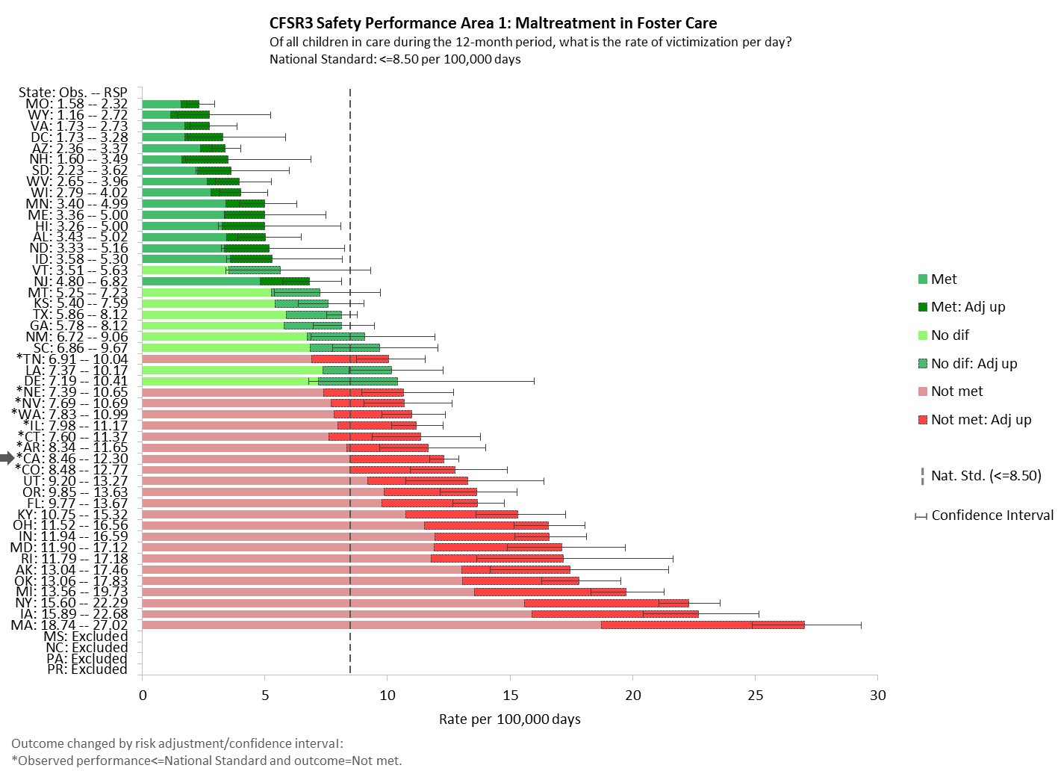

Slide 46
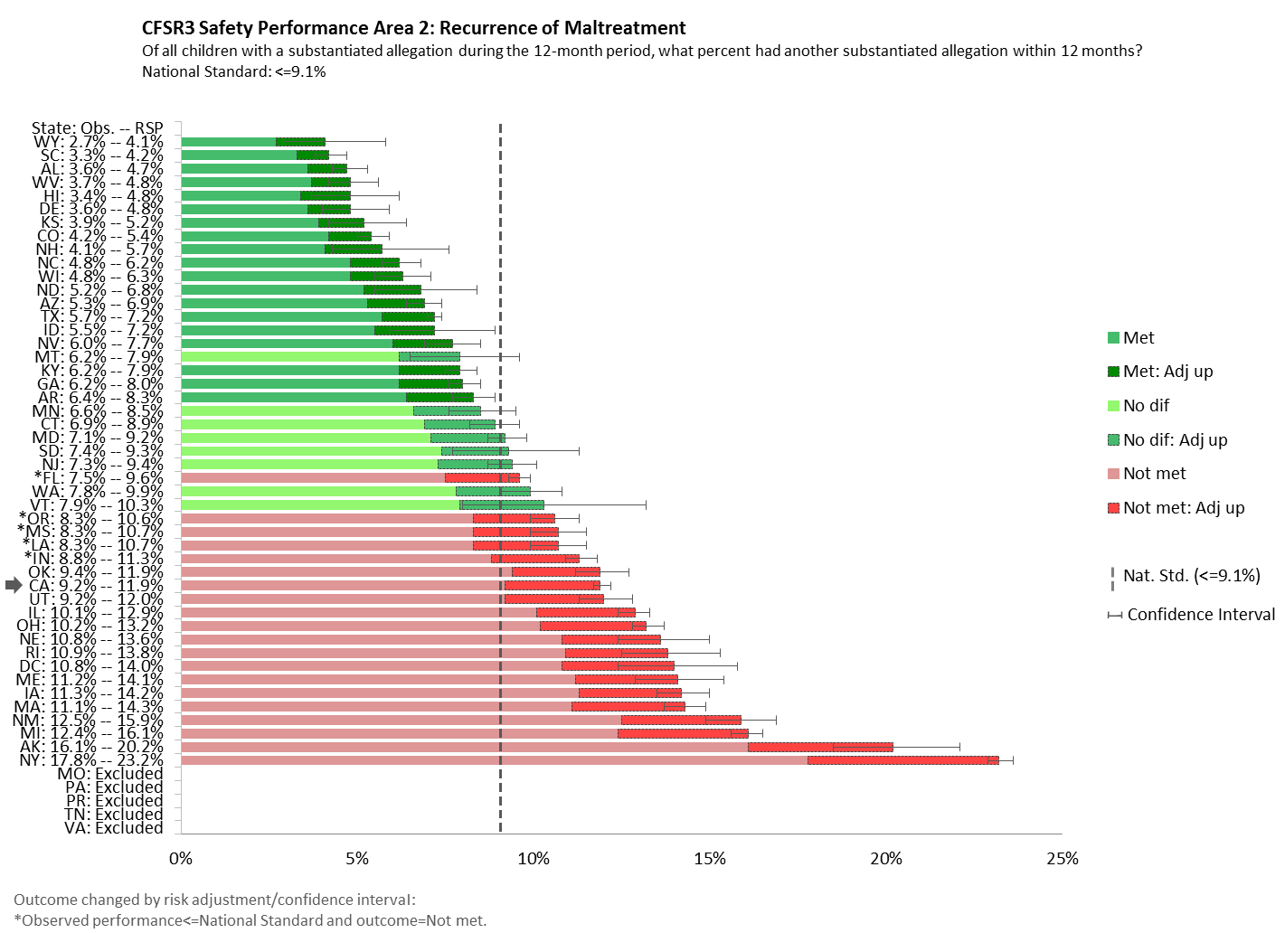

Slide 47
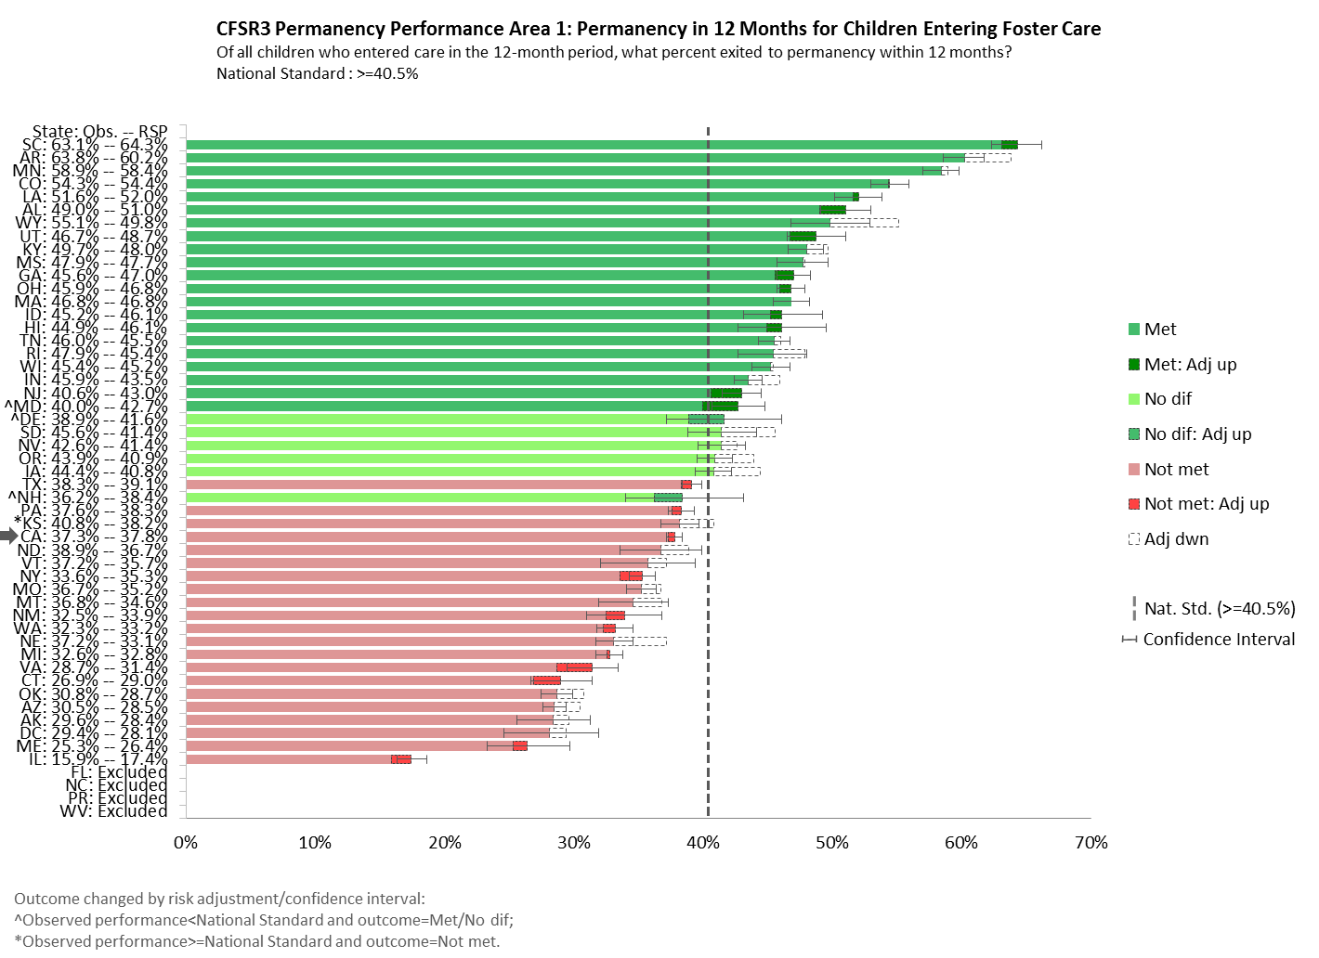

Slide 48
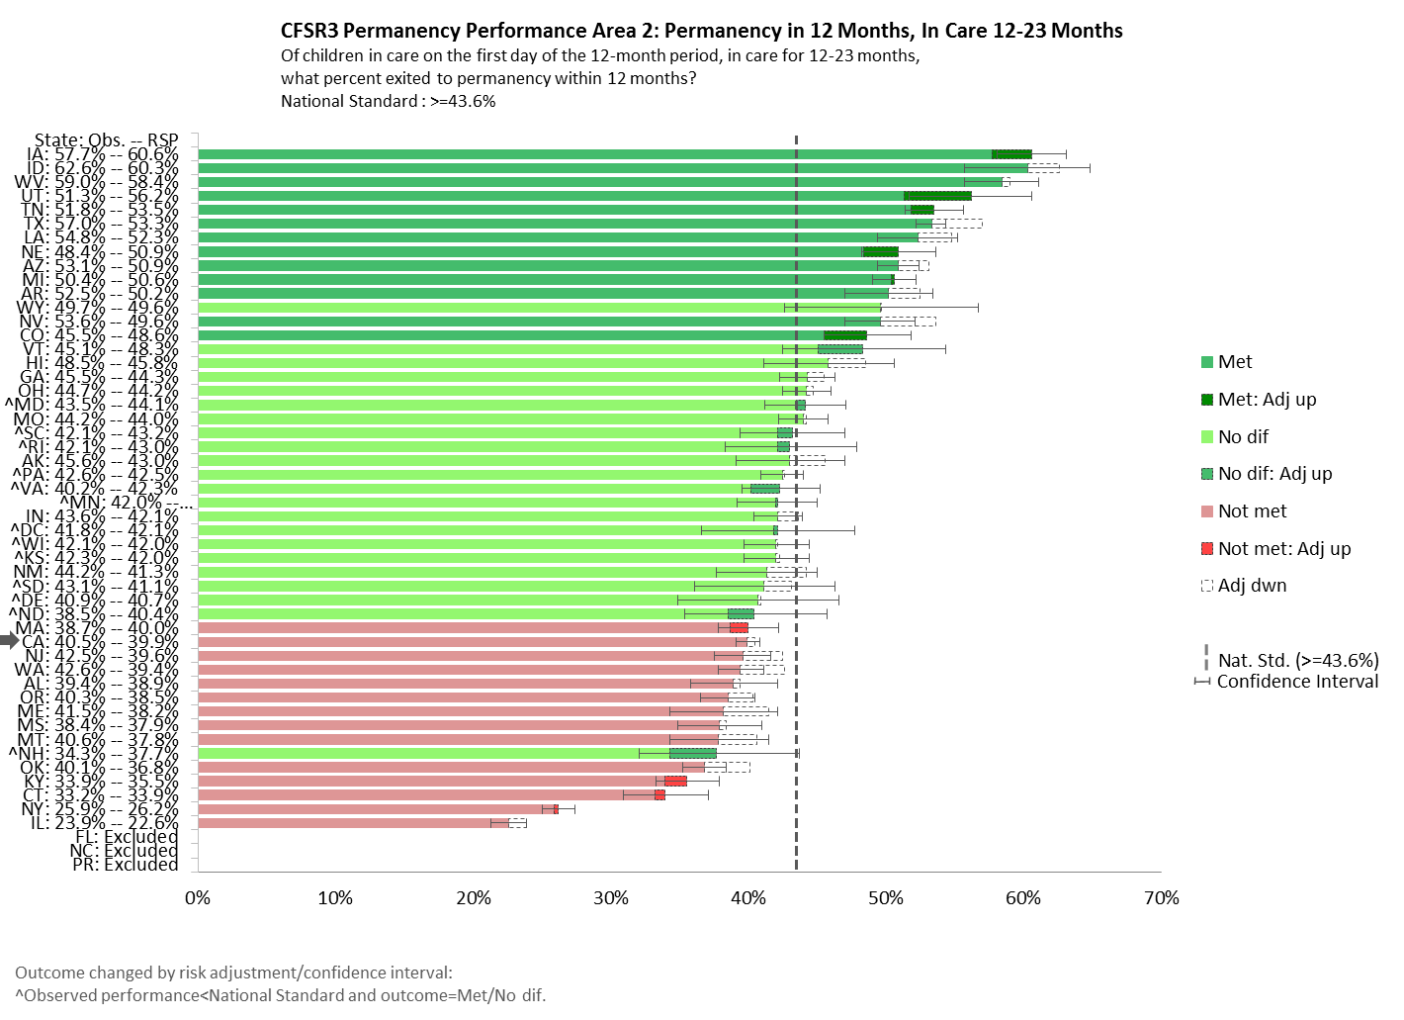

Slide 49
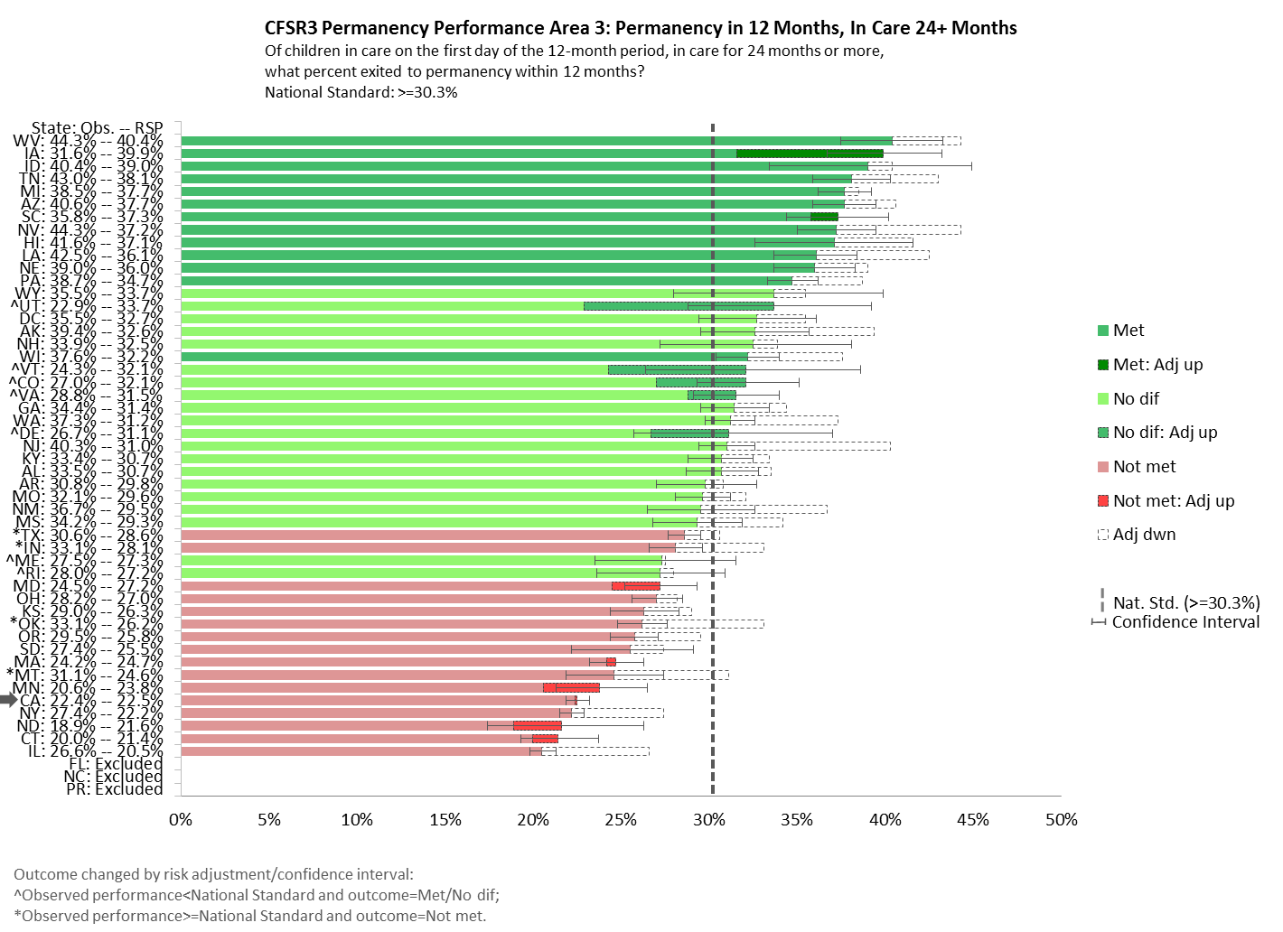

Slide 50
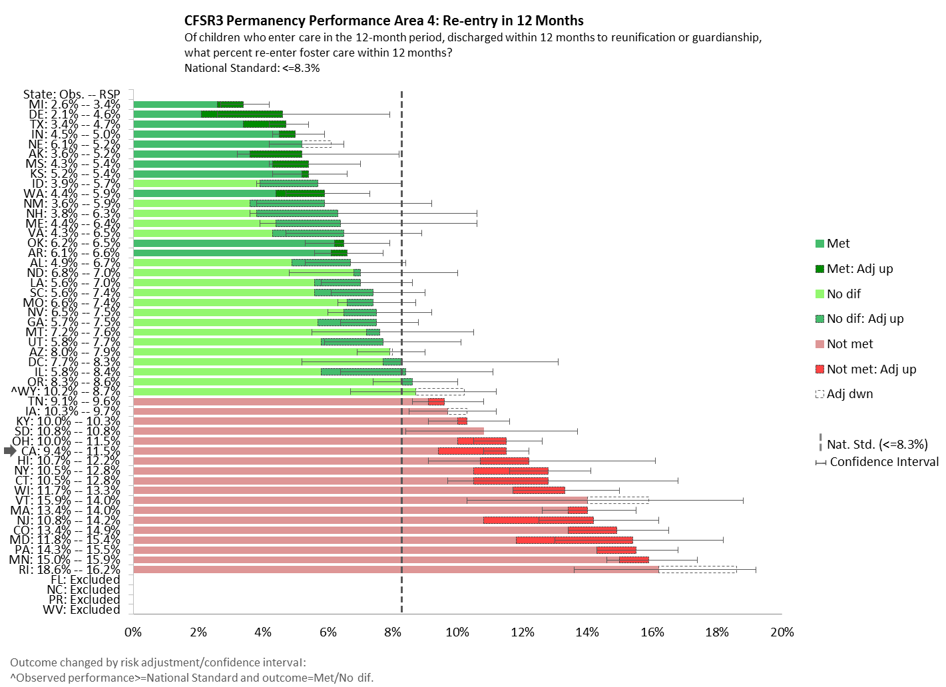

Slide 51
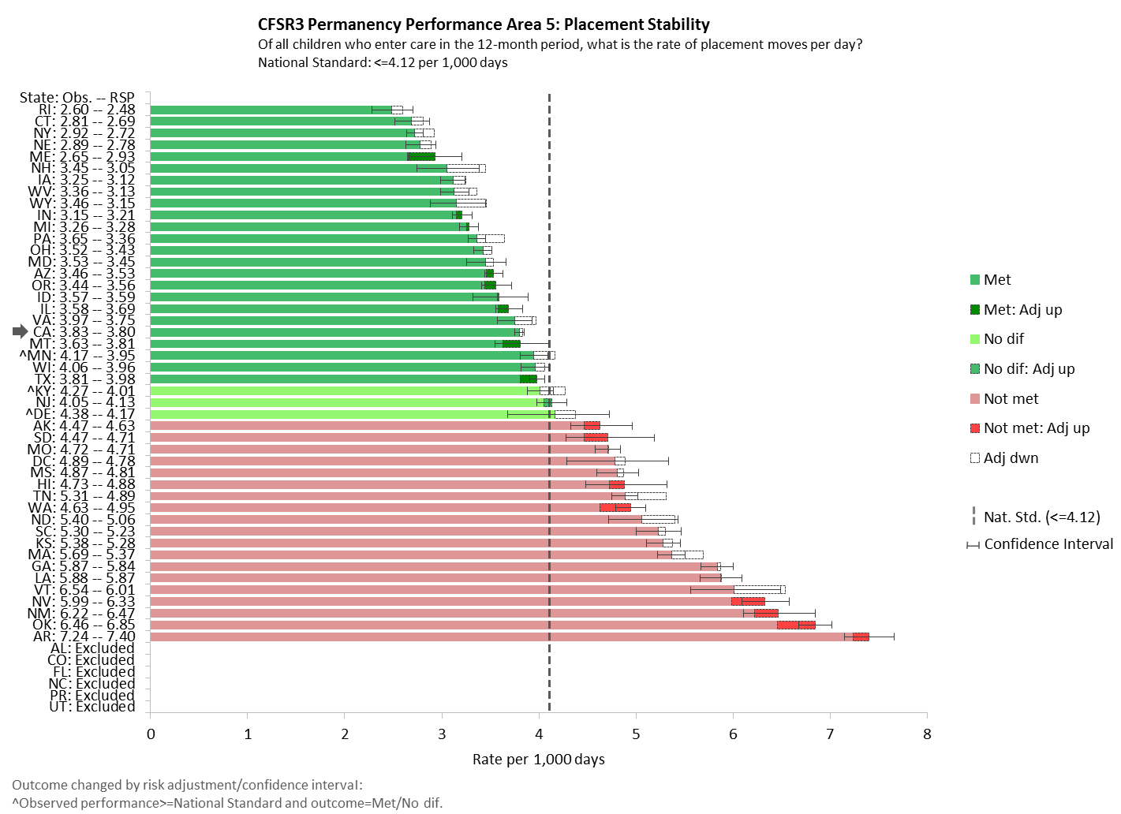

Slide 52
Setting Program Improvement Goals
Improvement goals for each of the data indicators are calculated from improvement factors, which are:
  Based on the state’s observed performance over the three most recent years of data
  Multiplied to the state’s baseline for each indicator needing improvement
Thresholds are calculated for companion measures (P1 and P4) and are the inverse of the improvement goals.

Slide 53
Calculating Improvement Factors/Goals
Example: Exits to Permanency in 12 Months (Entry Cohort)
Generate estimates of recent performance using 7 values:
California’s P1 Performance
1. | Year 1 (observed) | 39.8%
2. | Year 2 (observed) | 37.7%
3. | Year 3 (observed) | 37.3%
4. | Years 1-3 (average) | 38.3%
5. | Years 1 & 2 (average) | 38.8%
6. | Years 1 & 3 (average) | 38.6%
7. | Years 2 & 3 (average) | 37.5%

Slide 54
Calculating Improvement Factors/Goals
Example: Exits to Permanency in 12 Months (Entry Cohort)
Estimate variability in recent performance:
  Calculate a sample mean and standard deviation from the original seven values
  Resample (using bootstrapping) 1,000 times, generating 1,000 sample means and 1,000 standard deviations
Calculate a grand mean (average of all 1,000 sample means) and standard deviation (average of all 1,000 standard deviations)
California’s P1 Performance
 | Grand mean | 38.2%
 | Average standard deviation (Avg S) | 0.9%
Notes:
Bootstrapping is a commonly used statistical technique that estimates the distribution of a statistic (e.g. mean, variance) without making any assumptions about the shape of the distribution (e.g., normal). In this case, bootstrapping allows for a more accurate measure of the underlying variability in state performance. The process involves resampling with replacement from the 7 original estimates to form a “resample.” Each of those “resamples” have the potential to be unique: repeating some values and skipping others.
Standard deviation measures how much those estimates of past performance differ from the mean: a low SD = little variation/values are close to the mean, high SD = more variation/values are further away from the mean

Slide 55
Calculating Improvement Factors/Goals
Example: Exits to Permanency in 12 Months (Entry Cohort)
Calculate the improvement goal:
  Obtain the improvement factor by dividing the grand mean + 2 standard deviations (or -2 standard deviations depending on the indicator) by the grand mean
  Multiply the improvement factor by the baseline (year 3 performance)
Generate the threshold factor/threshold
  Threshold calculation is the inverse of the improvement goal (minus 2 standard deviations)
California’s P1 Performance
(38.2% + (2 * 0.9%)) / 38.2%
40.0% / 38.2% = 1.045
Improvement Factor = 1.045
1.045 * 37.3% = 39.0%
Improvement Goal = 39.0%
(38.2% - (2 * 0.9%)) / 38.2%
36.5% / 38.2% = 0.955
0.955 * 37.3% = 35.6%
Threshold = 35.6%
Notes:
Improvement factors are rounded to the third decimal point.
Note: repeating these calculations using rounded values (as shown) will produce slightly different values.

Slide 56
Companion Measures
Using California as an example, in order to meet the PIP goal for P1, the state must:
  Increase the percentage of children achieving permanency to 39.0%
  Not allow the percentage of children re-entering care to exceed 10.7% (the threshold for Re-entry to care – P4)
Conversely, to meet the PIP goal for P4, CA must reduce the percentage of children re-entering care to 8.1%, but cannot allow the percentage of children achieving permanency to decline further than 35.6%
Entry Cohort: Permanency in 12 months
Re-entries to Foster Care

Slide 57
Adjusted Goals/Thresholds
For improvement goals/thresholds that turn out to be too aggressive to be attainable or too modest to be meaningful, caps and floors are set on the improvement factors based on the distribution of all states’ improvement factors
  Cap (maximum) is set at the 50th percentile
  Floor (minimum) is set at either the 20th or the 80th percentile, depending on whether the desired outcome is a higher or lower value
  States whose improvement factors exceed the cap or fall short of the floor will have their improvement factors replaced by the maximum or minimum improvement factor for that indicator (these are “adjusted improvement goals”)

Slide 58
National Standards
INDICATOR | NATIONAL STANDARD |  | IMPROVEMENT FACTOR
 |  |  | FLOOR | CAP
S1: Maltreatment in Foster Care | 8.50* | â | 0.904 | 0.812
S2: Recurrence of Maltreatment | 9.1% | â | 0.951 | 0.902
P1: Permanency in 12 Months for Children Entering Foster Care | 40.5% | á | 1.031 | 1.063
P2: Permanency in 12 Months for Children in Foster Care 12-23 Months | 43.6% | á | 1.046 | 1.082
P3: Permanency in 12 Months for Children in Foster Care 24+ Months | 30.3% | á | 1.042 | 1.091
P4: Re-Entry to Foster Care in 12 Months | 8.3% | â | 0.891 | 0.834
P5: Placement Stability | 4.12** | â | 0.959 | 0.904
*Rate per 100,00 days in care **Rate per 1,000 days in care

Slide 59
California’s Performance
INDICATOR | OBSERVED PERFORMANCE |  |  | RSP* | IMPROVE-MENT FACTOR | GOAL
 | YR1 | YR2 | YR3 (baseline)
S1: Maltreatment in Foster Care | 8.60 | 8.42 | 8.46 | 12.30 | 0.904 | 7.65
S2: Recurrence of Maltreatment | 9.2% | 9.2% | 9.2% | 11.9% | 0.951 | 8.7%
P1: Permanency in 12 Months for Children Entering Foster Care | 39.8% | 37.7% | 37.3% | 37.8% | 1.045 | 39.0%
P2: Permanency in 12 Months for Children in Foster Care 12-23 Months | 42.0% | 43.1% | 40.5% | 39.9% | 1.046 | 42.4%
P3: Permanency in 12 Months for Children in Foster Care 24 Months+ | 22.8% | 22.9% | 22.4% | 22.5% | 1.042 | 23.3%
P4: Re-Entry to Foster Care in 12 Months | 7.7% | 8.6% | 9.4% | 11.5% | 0.867 | 8.1%
P5: Placement Stability | 4.34 | 4.05 | 3.83 | 3.80 | Standard Met – no PIP
*Risk Standardized Performance

Slide 60
Measuring Longitudinal Performance Using Multiple AFCARS Files
10/1/12
4/1/13
10/1/13
4/1/14
10/1/14
Source: Bryn King & Barbara Needell, adapted from Aron Shlonsky, The University of Melbourne (formerly at CCWIP)
Notes:
60
*REFLECTS SITUATIONS IN WHICH LONGITUDINAL AND AFCARS DATA MATCH (see following slides)
10 children---top to bottom
4 AFCARS submissions—child must be in care during that period to be in that AFCARS file
7 children in the most recent file (4/1/14-10/1/14) 2 of them are reentries, 4 entered earlier and still there, 1 entered first time this period
One child only in first 2 files (10/1/12-10/1/13)
One child only in 2nd and 3rd file (4/1/13-4/1/14)
One child only in 3rd file (10/1/13-4/1/14)

Slide 61
Limits of AFCARS
Method for constructing the AFCARS files has limitations that lead to differences between the federal assessment of California’s performance and performance measured using CCWIP’s longitudinal data
If a child experiences multiple placement episodes within a 6-month AFCARS file period, complete episode information is only retained for the most recent (or last) episode
  Select information about previous episodes within the 6-month period may be retained
  Has a marked effect on P1 and P4, but also impacts S2 and P5

Slide 62
LONGITUDINAL DATA VS. MULTIPLE AFCARS FILES
10/1/12 – 3/31/13
4/1/13 – 9/30/13
10/1/13 – 3/31/14
LONGITUDINAL DATA
EPISODE | START DATE | END DATE | EXIT REASON | LOS (DAYS) | S1 | P1 | P4 | P5
1 | 10/5/12 | 11/15/12 | Reunification | 41 | ✓ | ✓ |  | ✓
2 | 1/3/12 | 2/14/13 | Reunification | 42 | ✓ | ✓ | ✓ | ✓
3 | 2/20/13 | 3/28/14 | Guardianship | 401 | ✓ | ✓ | ✓ | ✓
AFCARS DATA
EPISODE | START DATE | END DATE | EXIT REASON | LOS (DAYS) | S1 | P1 | P4 | P5
 | 10/5/12
 |  | 2/14/13
1 | 2/20/13 | 3/28/14 | Guardianship | 401 | ✓ | ✓ |  | ✓
Notes:
Using the fully longitudinal file, the child’s 3 placement episodes are evident. The first appears to have ended in permanency after 41 days and in reentry 49 days after that exit, both within the 12-month time limit. Thus the first episode end would be counted in the P1 numerator and the reentry following that episode end would be counted in the P4 numerator.
Using the AFCRS file data the child appears to have one placement episode, beginning on 2/20/13 and lasting for more than 12 months before exit to permanency. The child appears to have had no reentries. Note: the 10/5/12 Episode Start data would be reported in the AFCARS file if it was the start of the child’s first ever episode, but not used for episode length or reentry calculations. The 2/14/13 Episode End would also be reported, but without any information as to the exit reason. The only data used for CFSR-3 calculations would be the 2/20/13 Episode Start date and the 3/28/14 Episode End date. Thus no events would be counted in the P1 and P4 numerators

Slide 63
Impact on Performance Calculations
(By Measure)
EPISODE | MEASURE | LONGITUDINAL | AFCARS
1 | S1 | Included in numerator/denominator | No data
 | P1 | Included in numerator/denominator (outcome = permanency) | No data
 | P4 | Basis for denominator in subsequent episode | No data
 | P5 | Included in numerator/denominator | No data
2 | S1 | Included in numerator/denominator | No data
 | P1 | Included in numerator/denominator (outcome = permanency) | No data
 | P4 | Included in numerator/denominator (outcome = reentry) Basis for denominator in subsequent episode | No data
 | P5 | Included in numerator/denominator | No data
3 | S1 | Included in numerator/denominator | Numerator/denominator
 | P1 | Included in numerator/denominator (outcome = no permanency) | Numerator/denominator (outcome = no permanency)
 | P4 | Included in numerator/denominator (outcome = reentry) Not included in denominator for subsequent episode (no permanency within 12 months) | Not included in numerator Not included in denominator for subsequent episode (no permanency within 12 months)
 | P5 | Included in numerator/denominator | Numerator/denominator

Slide 64
Changes to the Statewide assessment & Onsite Review

Slide 65
Statewide Assessment and Integration with the CFSP
Separate/Redundant Assessments
CFSP/ASPR
CFSR/PIP
Integrated Statewide Assessment
States can refer to CFSP/APSR and update info as needed
Notes:
The statewide assessment instrument will only focus on the specific questions needed for substantial conformity decisions and other regulatory requirements

Slide 66
Onsite Review: Stakeholder Interviews
Reserved for systemic factors where level of conformity is unclear from the statewide assessment (or CFSP/APSR)
The scope of stakeholder interviews conducted will vary based on demonstrated level of functioning on each of the systemic factors in the statewide assessment
Additional stakeholder interviews for a systemic factor may not be required (with the exception of service array)
Where statewide assessment data is insufficient to determine substantial conformity, the joint federal-state team will determine which stakeholder interviews are necessary to gather additional information during the onsite review

Slide 67
Onsite Review: Case Reviews
States meeting specific criteria are encouraged to conduct their own case reviews using the revised federal CFSR onsite review instrument
State policies, procedures, and other materials will be reviewed as needed to make a determination of whether a state's case review process can be used
If approved, state must provide information so CB can participate in state’s case review process
The alternative is a more traditional week-long case review conducted jointly by the state and CB

Slide 68
Criteria for Using State Case Review Process
The state must:
  Conduct annual (at least) internal case review process assessing statewide performance using a uniform sampling methodology
    Minimum of 65 cases served during the sample period (40 foster care cases and 25 in-home cases)
  Have a process in place for ensuring accurate and consistent case review ratings
  Use the federal instrument, rating guidance, and instructions

Slide 69
Conclusion
We finally may have a CFSR process that will be helpful to CDSS and the counties, and can be PART of an ongoing CQI system
Questions and Comments?
  Contact info

Slide 70
Sources
Executive Summary: Final Notice of Statewide Data Indicators and National Standards for Child and Family Services Reviews
Federal Register Notices: Statewide Data Indicators and National Standards for Child and Family Services Reviews
  May 2014
  October 2014
  April 2014
CFSR Technical Bulletins
  #8A
  #7
CFSR Round 3 Statewide Data Indicators (revised May 2015)
Sustaining the Momentum: The Next Round of Reviews
Children's Bureau Plan for CFSR Statewide Data Indicators and National Standards
For additional information: https://training.cfsrportal.org/resources/3105

