Slide 1
Bringing Continuous Quality Improvement to Operations
A Preview of Trainings
to Enhance Data Literacy Among
Child Welfare Staff
Daniel Webster & Wendy Wiegmann
Central Region CQI Convening
May 17, 2017

Slide 2
“It takes 31 days of conscious effort to make or break a habit. If someone practices something consistently for 31 days, on the 32nd day it becomes a habit. At that point, information has been internalized into behavioral change, which is called transformation.”
–Shiv Khera

Slide 3
Outline
The importance of data in child welfare
Sources of data and how they are used
Helping child welfare staff connect performance to vision and measurement.
Getting there using the CCWIP and SafeMeasures websites and worker/supervisor trainings

Slide 4
The Importance of Data
Allows child welfare agencies to:
Compare outcomes to agency mission & practice model
Strategize on what work needs to be done
Focus on what is being achieved
Identify what needs attention
Connect current practice to best practice and desired outcomes
Notes:
In our program statements, strategic plans, SIPs, and self-assessments, we are often able to accomplish 1-4. The hardest part always seems to be #5. The training that I have been using with certain counties attempts to get at this essential piece of using data to improve child welfare practice.

Slide 5
VISION
County SIPs
Strategic Plans
Community Partnerships
Divisions/Programs
Notes:
Using data collected in the community, from other departments, and from our own analysts, this is where managers and directors lay out their plans for improving child welfare performance in the county. This is often a comprehensive analysis of the strengths and weaknesses in the county, and how to utilize the programs, services, and partnerships available to improve.

Slide 6
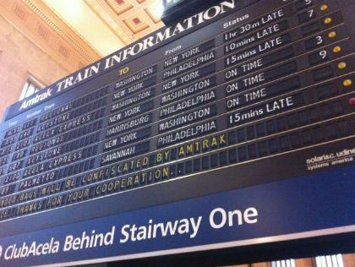
Measurement
CFSR Case Reviews
CFSR Self-Assessments
CCWIP Website
Notes:
This is where we get an understanding of how we are doing. Using guidance from ACS, we focus on certain specific measures, listen to the experiences of the children, families, and caregivers in our community, and track our progress using the UC Berkeley website and our internal staff of analysts.

Slide 7
Performance
Timely Visits
Accurate Assessments
Diligent Monitoring
Adequate Services
Concurrent Planning
Notes:
While absolutely related, the outcomes that we focus on are often distant from the more proximate process measures that dictate the daily practice of our workers and supervisors.
For many workers, this means that the conversations that we are having about outcomes feel far away and out of the control of them in their regular work.

Slide 8
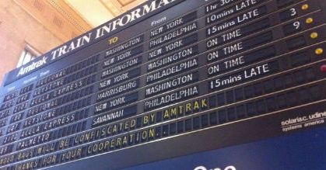
Making the Connections
Child welfare staff are aware of the outcomes under strategic focus and why.
They understand how county plans/programs are supposed to help them influence these outcomes.
Between
&
Child welfare staff know how outcomes are measured.
They know which groups are most impacted by outcomes.
They connect their daily activities to these outcomes.
Notes:
To help workers and supervisors understand how their daily activities are connected to the vision and performance measurement of our county, we need to build bridges.
Between performance and vision:
-- Workers need to understand where the county feels that it needs to reform. Does our SIP say that we have a problem with re-entries? Are workers aware that this is a focus of our agency?
-- Have we created special programs or services designed to influence these outcomes? Are workers aware of these connections or do the programs and services feel like arbitrary changes, or ancillary/unnecessary services? If workers understand that there was a purpose to the creation of these services/programs, they may feel compelled to modify their practice to incorporate them.
Between performance and measurement:
-- Workers and supervisors hear a lot about safety, permanency, and wellbeing. What they often don’t understand is how these things are measured. Do they know that measures P2 and P3 are specifically related to permanency for youth that have already been in care for a long time? These methodological understandings can help workers know that the details of their practice are as important as the overall goal.
-- An understanding of which subgroups are most impacted by outcomes can help workers focus their practice – they may slow down and pay additional attention when working with these groups or search out programs and services that specialize.

Slide 9
The Data Train
Bringing Child Welfare Staff On Board

Slide 10
Outline for Training 1
Review important concepts underlying child welfare data measurement (e.g., counterbalanced measures, entry cohorts).
Explore the methodologies for the seven Federal CFSR3 measures.
Introduce and examine features of the CCWIP website.
Building Connections Activity.

Slide 11
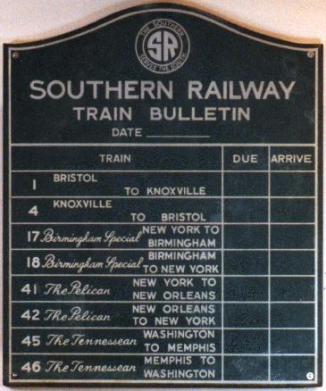
California Child Welfare Indicators Project
Aggregates California’s administrative child welfare data into customizable tables
Includes data measuring state (AB636) and federal (CFSR3) measures
Data can be stratified and filtered by year, county, age, ethnicity, gender, placement type, and other subcategories
Notes:
CCWIP can help!

Slide 12
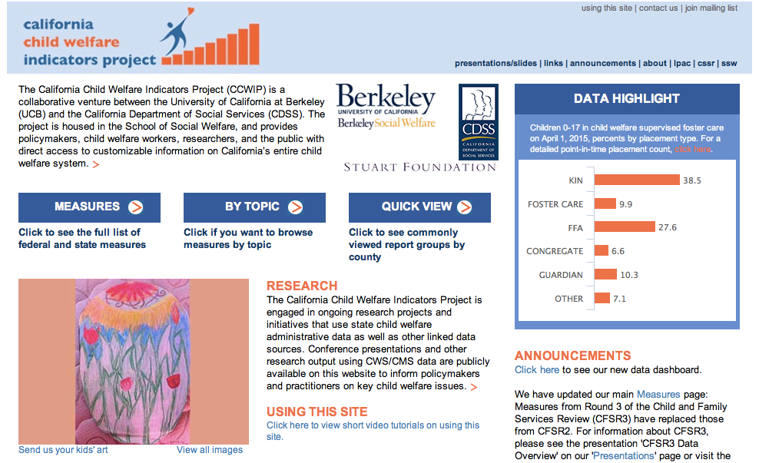
CCWIP Website

Slide 13
Building Connections Activity
Outcome
In groups of 3-4, child welfare staff are assigned an official outcome measuring child welfare performance.
Nuances
Groups examine the CCWIP website to understand how various groups are differentially affected. They examine other CCWIP reports that may be relevant to the outcome.
Resources & Barriers
Groups brainstorm county resources available to influence these outcomes or measure proximate outcomes. They discuss barriers they have encountered in practice to implementing these resources..
Notes:
Overview of activity

Slide 14
Demo: Ongoing Units
Outcome
CFSR3 Measure P4: Re-entry to foster care
Nuances
Re-entry rates are highest among children 0-3 and those placed in FFAs.
Resources & Barriers
Are there programs that focus on parenting classes and/or visitation with children 0-3?
Other relevant reports: Case Service Components, Placement Stability, Median LOS, Home/Placement Distances, Timely Caseworker Visits
Do children placed in FFAs have higher needs? How are families that are reunified with these children supported in providing for their needs?
Notes:
Demonstration of activity
Example of one way that the activity could be implemented when working specifically with workers in ongoing units.
Activity focuses on looking at the data for a measure where a county may not be performing as well = P4 – Re-entries to foster care

Slide 15
CCWIP Reports Relevant to Emergency Response Units
Child Maltreatment Allegation & Substantiation Rates
S2: Recurrence of Allegations
Referrals by Time to Investigation
Entry Rates
Home/Placement Distances
Least Restrictive Placement
ICWA Placement Preferences
Case Services Components

Slide 16
CCWIP Reports Relevant to Ongoing Units
S1: Maltreatment in Foster Care
S2: Recurrence of Maltreatment
P1-P3: Permanency in 12 Months
P4: Re-entry to Foster Care
P5: Placement Stability
Timely Monthly Caseworker Visits
Entry Rates
In Care Rates
Case Service Components
Home/Placement Distances
Least Restrictive Placement
Placement with Siblings
Median Length of Stay
Placement Days
Use of Psychotropic Medications
Timely Health/Dental Exams
Outcomes for Youth Exiting Foster Care at Age 18 or Older

Slide 17
CCWIP Reports Relevant to Teen Units
S1: Maltreatment in Foster Care
P1-P3: Permanency in 12 Months
P5: Placement Stability
Timely Monthly Caseworker Visits
Outcomes for Youth Exiting Foster Care at Age 18 or Older
In Care Rates
Case Service Components
Median Length of Stay
Placement Days
Home/Placement Distances
Least Restrictive Placement
Placement with Siblings
Use of Psychotropic Medications
Timely Health/Dental Exams
Exits from Foster Care

Slide 18
CCWIP Reports Relevant to Permanency Units
S1: Maltreatment in Foster Care
P1-P3: Permanency in 12 Months
P4: Re-entry to Foster Care
P5: Placement Stability
Timely Monthly Caseworker Visits
In Care Rates
Case Service Components
Home/Placement Distances
Placement with Siblings
Least Restrictive Placement
Median Length of Stay
Placement Days
Use of Psychotropic Medications
Timely Health/Dental Exams
Exits from Foster Care
Outcomes for Youth Exiting Foster Care at Age 18 or Older

Slide 19
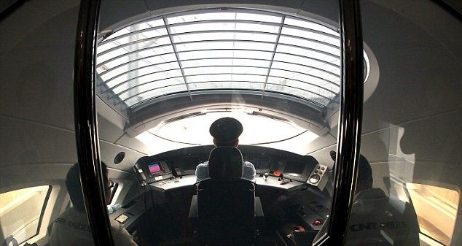
The Data Train Series 2
Understanding the Control Panel: How to Make the Most of the CCWIP and SafeMeasures Websites

Slide 20
Process vs. Outcome Measures
Outcome Measure: The desired safety, permanency, and well being results expected for children served by the child welfare system.
Process Measure: Indicate what providers do to maintain or improve child welfare outcomes.

Slide 21
Outline for Training 2
Review important county goals (possibly SIP goals)
Explore the CCWIP website to better understand current performance and the children affected by the goals
Identify the features and reports contained within SafeMeasures to aid workers/supervisors in achieving the goals
Modify SafeMeasures to keep on top of these features
Make a plan for regular use of CCWIP and SafeMeasures

Slide 22
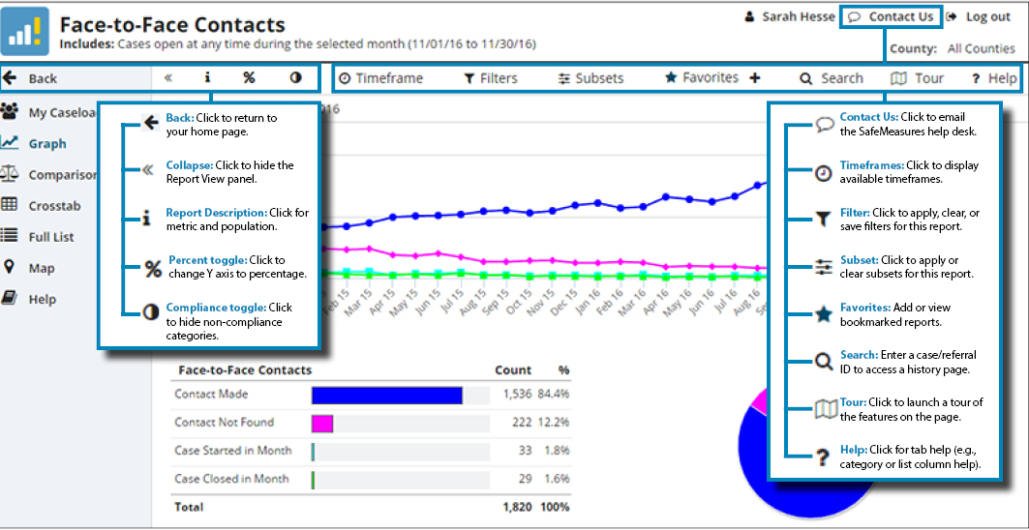
Safe Measures Navigation & Help
Source: https://app.safemeasures.org/Content/tutorials/common/SM51%20icons.png

Slide 23
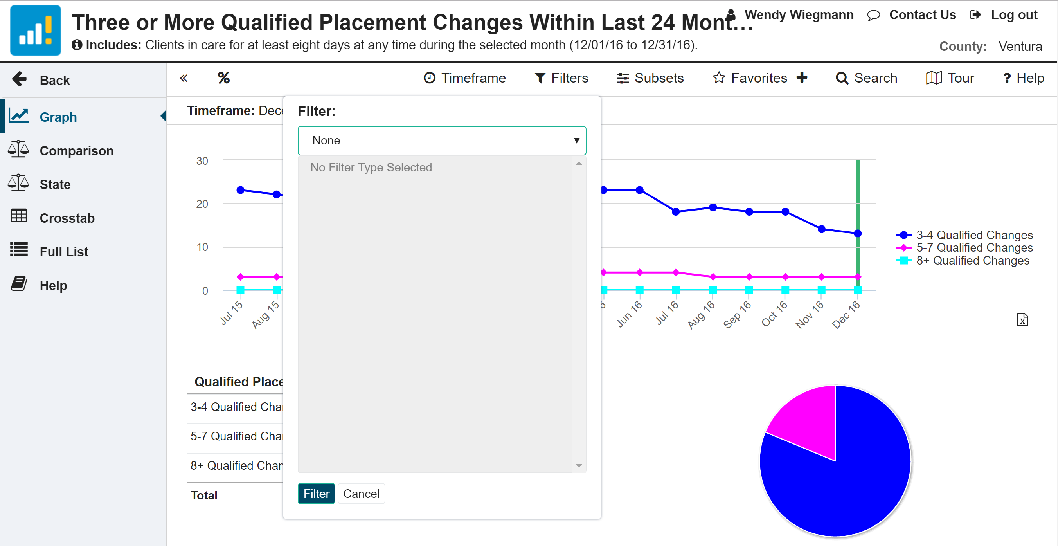
Filters
Notes:
Demo using actual page navigation on website
Includes Office, Unit, Caseload

Slide 24
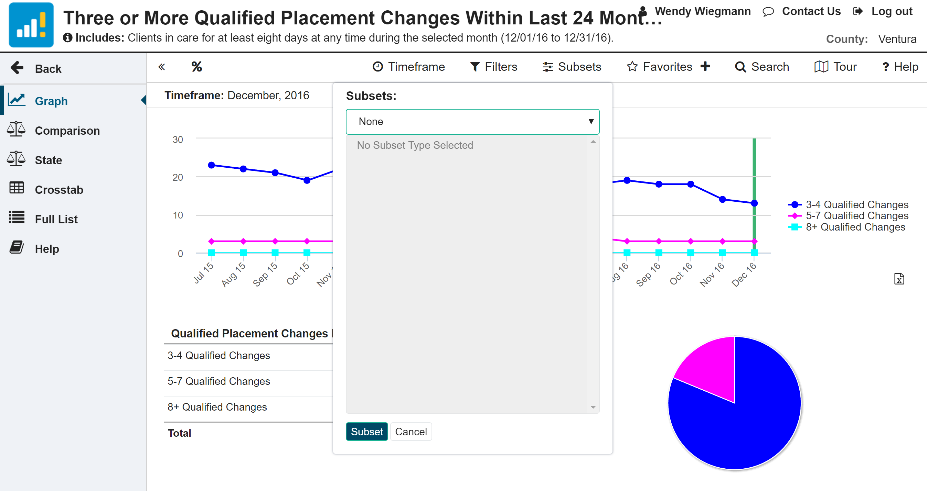
Subsets
Notes:
Demo using actual page navigation on website
Depending on the report, may include Service Component, Age, Ethnicity, Gender, Placement Type, Years in Placement, etc.

Slide 25
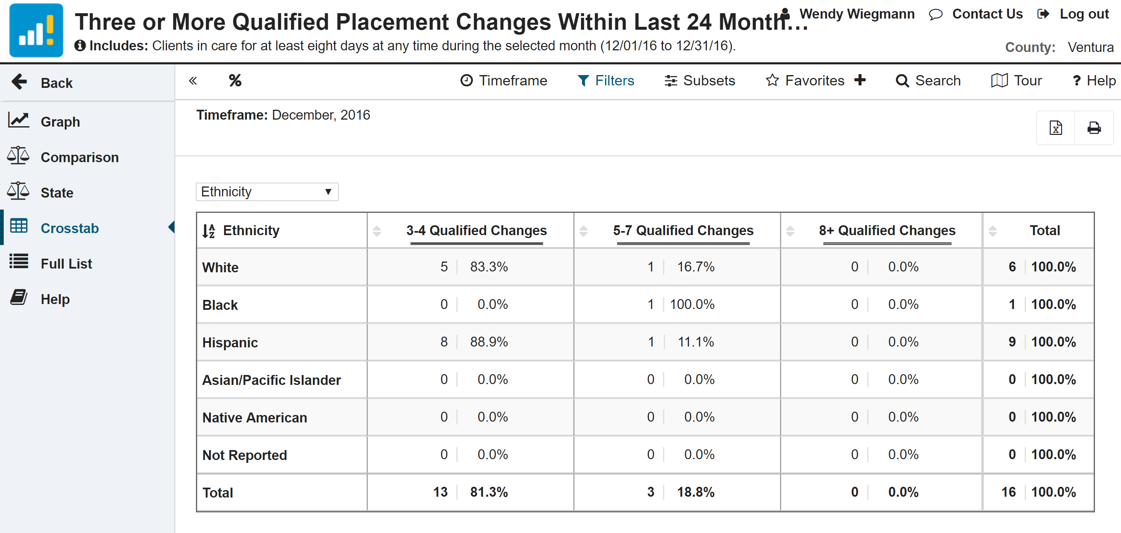
Crosstab & Full List
Notes:
Demo using actual page navigation on website

Slide 26
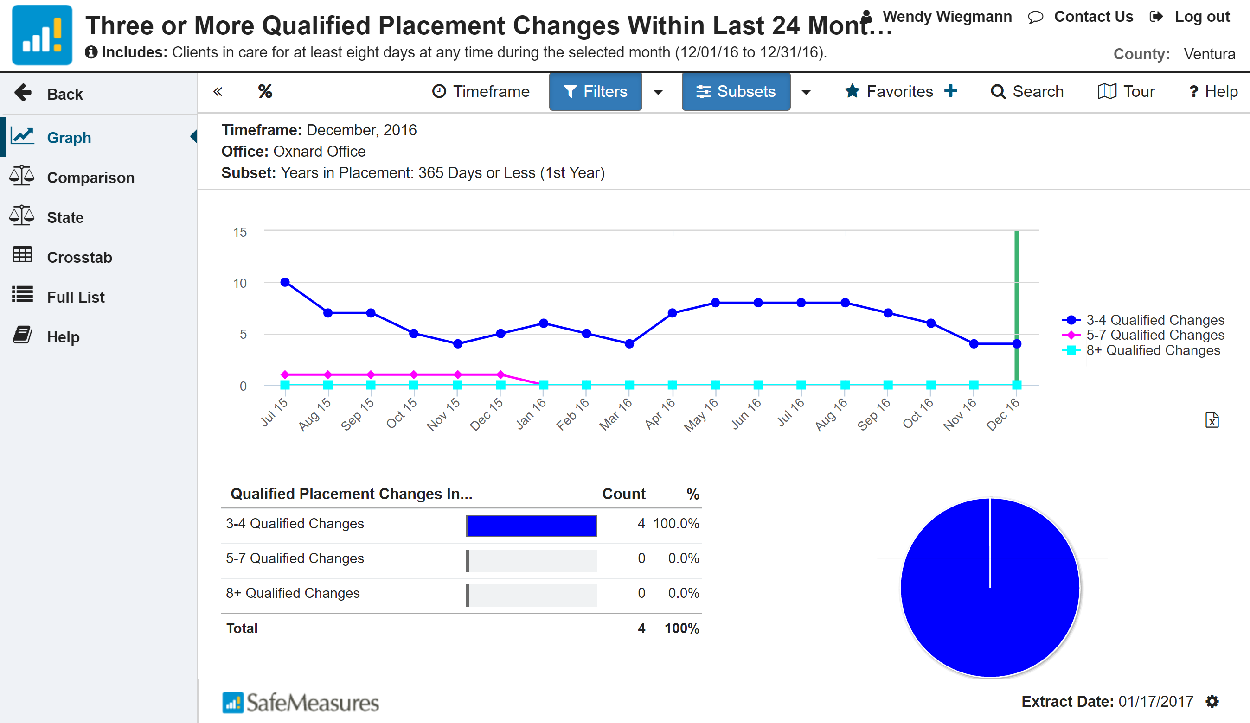
Creating a Favorite
Make sure you set your filters & subsets first!
Notes:
Demo using actual page navigation on website
Note: Make sure that you set your filters & subsets first!

Slide 27
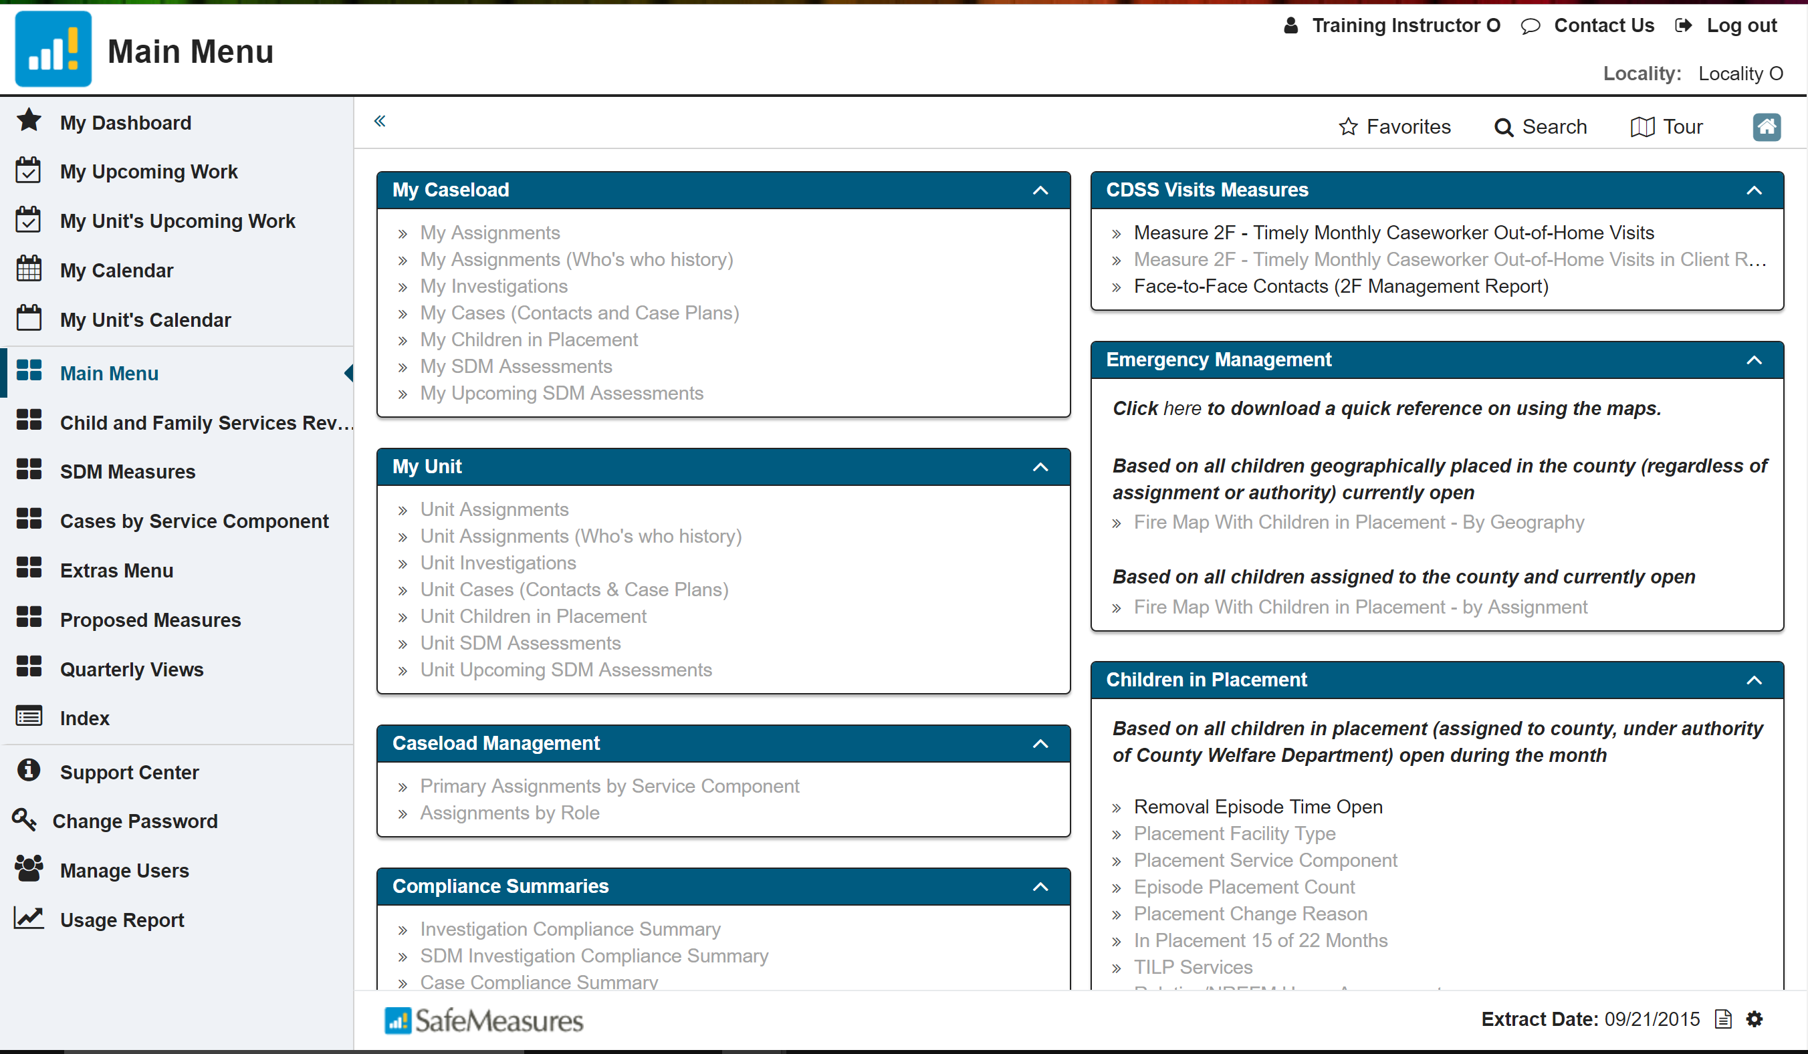
Key SafeMeasures Features
Notes:
Demo using actual page navigation on website

Slide 28
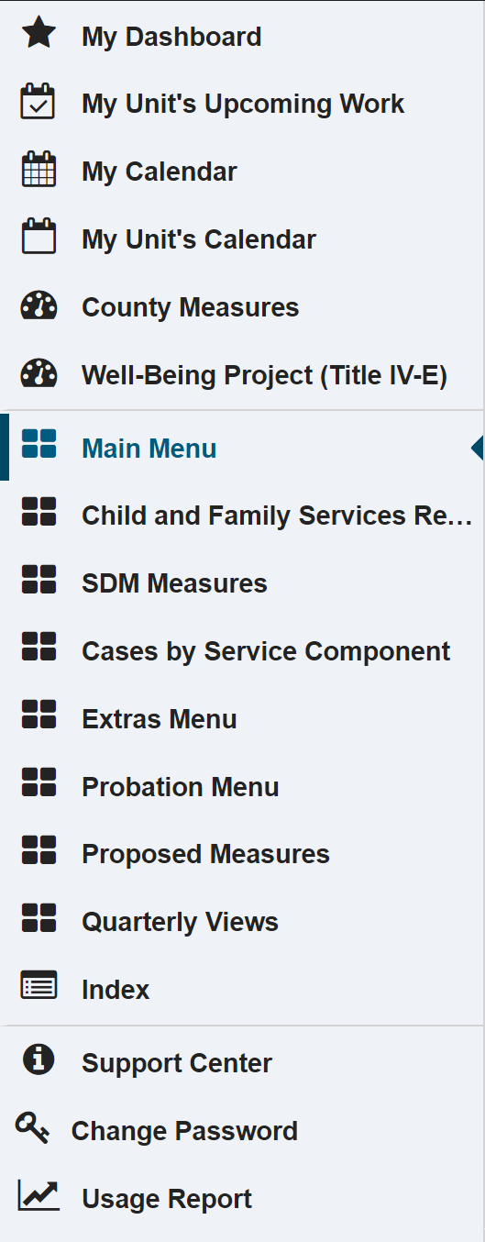
Additional SafeMeasures Lists
My Dashboard: Favorites, Alerts, Recommendations
My Upcoming Work: Stay On Top of Your Caseload
My Unit’s Upcoming Work: Be Aware of Problems
Calendars
County Measures: Outcomes & Process Measures Pre-Selected with NCCD
Well-Being Project: Dashboard and Trend Graphs
Features!
Major reports that have been used for 10 years and still receive a lot of use
Reports from CFSR 2 & CFSR 3 & Statewide Measures
Lists!!
Safety, Risk, and Strengths/Needs (Case Plan) Assessments
Outdated and rarely used - these features can be accessed via the reports
Ancillary reports that may be useful
Includes measures relevant to probation-supervised caseloads only
New measures that address new state initiatives (e.g., CCR and RFA)
Reports that are reported quarterly in addition to monthly
All measures, alphabetically
Notes:
Many of the reports included in these lists are already covered in your My Upcoming Work and County Measures reports. However, you may explore these lists for additional reports that you want to pay attention to.

Slide 29
Looking Ahead
Worker Action Planning
Written Report
Tie-in to Core Practice Model
CCR & RFA Implementation Tracking

Slide 30
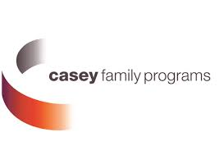
Thank You!
The California Child Welfare Indicators Project (CCWIP) is a collaboration of the California Department of Social Services and the School of Social Welfare, University of California at Berkeley, and is supported by the California Department of Social Services, Casey Family Programs, and the Conrad N. Hilton Foundation.

Slide 31
Daniel Webster
Wendy Wiegmann
CA Child Welfare Indicators Project
dwebster@berkeley.edu
wendy.wiegmann@berkeley.edu

