Slide 1
Data Driven Practice for Program Managers:
Riverside County
Melissa Correia
Adam Darnell
Casey Family Programs
Daniel Webster, MSW PhD
Center for Social Services Research
University of California, Berkeley
Riverside County DPSS
10281 Kidd Street, 2nd floor - Conference Room 2a & 2b
Riverside, CA
October 2012
The Performance Indicators Project at CSSR is supported by the
California Department of Social Services, and the Stuart Foundation

Slide 2


Slide 3
Riverside County
Using data to achieve outcomes and inform practice.

Slide 4
Managing with Data
Provides us the ability to:
Improve agency transparency and accountability (what did we do and how well did we do it?)
Connect processes to desired outcomes
Focus on key priorities
Identify what needs attention
Target resources and strategize on what work needs to be done
Tell the story
Engage stakeholders and staff, create urgency for action
Notes:
8:30 to 9:15

Slide 5
Barriers to Managing with Data
Data only framed as punitive “gotcha”
Data presented in silos / processes disconnected from outcomes
Lack of definitions / poorly labeled graphs and tables
Drowning in data – measure and report on what is useful, know your audience
Data Abuse
Notes:
8:30 to 9:15

Slide 6
Key Analytic Concepts:
Melissa Correia
Daniel Webster
The View Matters
Notes:
8:30 to 9:15

Slide 7
the current placement system*
(highly simplified)
the foster care system
a bunch of stuff happens
CHILD IN
CHILD OUT
*adapted from Lyle, G. L., & Barker, M.A. (1998) Patterns & Spells: New approaches to conceptualizing children’s out of home placement experiences. Chicago: American Evaluation Association Annual Conference
Notes:
7
8:30 to 9:15

Slide 8
Key Outcome Areas in Child Welfare
Rate of Referrals/
Substantiated Referrals
Home-Based
Services vs.
Out-of-Home
Care
Reentry to Care
Permanency
Through
Reunification,
Adoption, or
Guardianship
Counterbalanced
Indicators of
System
Performance
Use of Least
Restrictive
Form of Care
Shorter
Lengths
Of Stay
Well Being
Maintain Positive Attachments
Stability
Of Care
Notes:
This slide provides a framework for the kinds of things commonly measured in CW
Reinforces the idea that measuring one outcome can be misleading
Can’t just measure “reunification” without knowing what happened before and what happens after
Examples of interrelated measures: entry rate and timely reunification; placement stability and group care
8:30 to 9:15

Slide 9
Basic Terminology
Process Measures - familiar to staff, relevant at a caseworker level, current. Connected to outcomes!
Examples: Quality and quantity of activities such as: on time transportation; frequency of visits…
Outcome Measures - the “big picture” measure of system performance, especially when looked at longitudinally
Examples: entry rates, timely reunification, exits to permanency, re-entries…
Notes:
Stress the connection between caseworker visits and positive outcomes (will cover in the next section the connection between data and practice.
8:30 to 9:15

Slide 10
Measures of Central Tendency
Mean: the average value for a range of data
Median: the value of the middle item when the data are arranged from smallest to largest
Mode: the value that occurs most frequently within the data
12 4 15 63 7 9 4 17
4 4 7 9 12 15 17 63
= 9.7
7
= 9
Data 101
Notes:
8:30 to 9:15

Slide 11
Measures of Variability
Minimum: the smallest value within the data
Maximum: the largest value within the data
Range: the overall span of the data
4 4 7 9 12 15 17 63
Data 101
Notes:
8:30 to 9:15

Slide 12

Disaggregation
One of the most powerful ways to work with data…
Disaggregation involves dismantling or separating out groups within a population to better understand the dynamics and plan strategies for improvement
Useful for identifying critical issues that were previously undetected
Aggregate Permanency Outcomes
Race/Ethnicity
Service Bureau
Age
Placement Type
Data 101
Notes:
8:30 to 9:15

Slide 13
Connecting the Dots
Quality Service Review Measures: Engagement, support, involvement in case planning
Outcome Measures: Timely reunifications; placement stability; improved well-being
Mgmt/Dashboard Reports: Frequency and Quality of worker visits with birth parents, foster parents, children.
Quality Service Review: Individualized Services
Process Data: Accountability and case mgmt - Relevant to workers and supervisors
Intermediate Outcomes
Relevant to workers, supervisors, managers
Outcomes: “So What?”
Reflect Key Priorities of Leadership
Notes:
Helping to structure key data elements in this way helps avoid “data overload”
Why is it important to visit with both parents (a process measure) – because we think it improves engagement
(a shot term or intermediate outcome) which in turn leads to timely reunification without re-entry
Tells the story of system reform to key stakeholders
Helps the field understand their role in connection to the larger system’s goals
8:30 to 9:15

Slide 14
Factors Associated with Timely Reunification, Guardianship, and Permanent Relative Placement
Caseworker Visits with Parents
Child’s Visits with Parents and Siblings in Foster Care
Services to Children, Parents, & Foster Parents
Family/Child Involvement in Case Planning
ASFA Requirements Regarding Termination of Parental Rights
Placement Stability
The strongest associations with timely permanency included:
Administration for Children and Families, U.S Department of Health and Human Services, Findings From the Initial Child and Family Services Reviews, 2001–2004. Available at http://www.acf.hhs.gov/programs/cb/cwmonitoring/results/index.htm
Notes:
And we have some evidence that there is an association…
(Includes the 35 States reviewed in 2002-2004) This slide represents statistically significant associations between “strength” ratings on Item 8 (length of time to achieve reunification) in Permanency Outcome 1 with other performance indicators used to evaluate the outcomes and systemic factors in the CFSR.
8:30 to 9:15

Slide 15
the data landscape…
entry
cohorts
exit
cohorts
point
in time
Three key data samples
Notes:
Key concepts for performance measurement (Not just limited to permanency – other “endings”)
Three views of the data
For a long time, PIT was it – but we learned that neither PIT nor exit cohorts are appropriate for performance measurement
8:30 to 9:15

Slide 16
The view matters…
January 1, 2010
July 1, 2010
December 31, 2010
Source: Aron Shlonsky, University of Toronto (formerly at CSSR)
Notes:
16
This slide is used to demonstrate the inherent bias in point in time counts
Very important for performance measurement
PIT is useful for some things, but not for measuring outcomes – overestimates LOS
Exit cohorts are also imperfect – ignores those that don’t exit, so can underestimate LOS, can also punish you for good work

Slide 17
Overview of child welfare data
Riverside County in Context
Notes:
9:15 to 10

Slide 18
Nationwide, and in CA, the number of children in out of home care has been declining.
Throughout these slides, CA data are from the CWS/CMS Dynamic Report System at http://cssr.berkeley.edu/ucb_childwelfare/default.aspx National data are from NCANDS and AFCARS
Notes:
9:15 to 10
Explain the use of rates to control for population sizes.
Begin discussion of the caution around making comparisons.

Slide 19
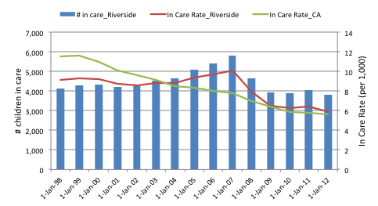
Riverside County has experienced a somewhat different trend. The number of children in out of home care declined substantially between 2007 and 2009 and has been relatively stable since
Throughout these slides, CA data are from the CWS/CMS Dynamic Report System at http://cssr.berkeley.edu/ucb_childwelfare/default.aspx National data are from NCANDS and AFCARS
Notes:
9:15 to 10

Slide 20
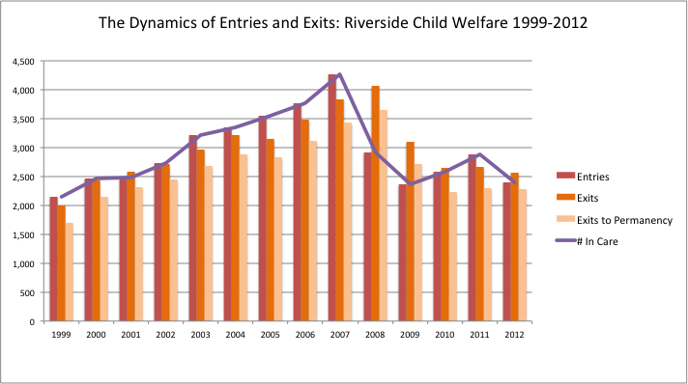
Notes:
A closer look at the dynamics – bathtub analogy refer to previous discussion of the view

Slide 21
Safety
National and State and County Level
Notes:
9:15 to 10

Slide 22
Key Questions: Prevention and In Home Services
For children that come to the attention of your agency – what proportion receive in-home and community-based services? (Compare to the proportion that enter care)
Describe trends in service provision – how long are cases open? What services are provided? At what cost?
Are there differences by region? Age? Race?
Do children enter care during or after services?
Do children experience repeat allegations or repeat maltreatment?
Notes:
It’s not “how much data do you have” but how well can you describe your agency?
I’m not going to cover all of this now, but answering these questions with available data could be part of a future work.
9:15 to 10

Slide 23
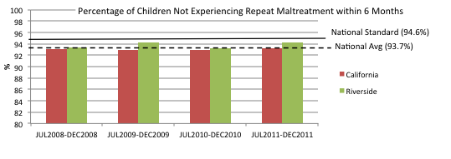
Between 2005 and 2010, the percent of children not experiencing repeat maltreatment increased and then declined in Riverside. It remains below the CA statewide average and the national standard.
Notes:
Discuss issues related to variation across jurisdictions in law, policy, practice: Substantiation rates. The standard of evidence for a finding of maltreatment varies greatly – as does time to investigation.
(Again, Those are just a few of the differences that would impact state and national comparisons. Overall, we suggest using such comparisons sparingly – to prompt discussion and generate dialogue about policy and practice. For performance improvement targets, our recommendation is always that jurisdictions use their own data as a baseline for improvement.)
9:15 to 10

Slide 24
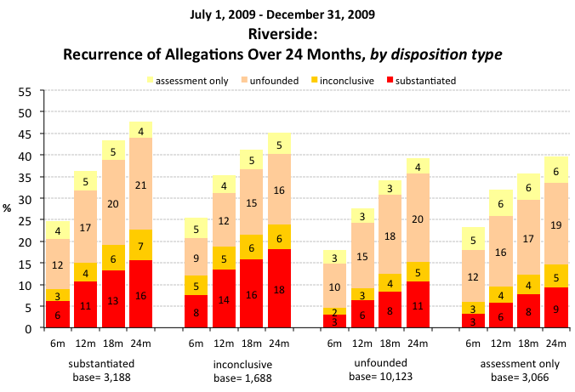
Placeholder for repeat allegations?
Notes:
Discuss limitations of federal safety measure what’s NOT counted
9:15 to 10

Slide 25
Children entering care
National and State and County Level
Notes:
9:15 to 10

Slide 26
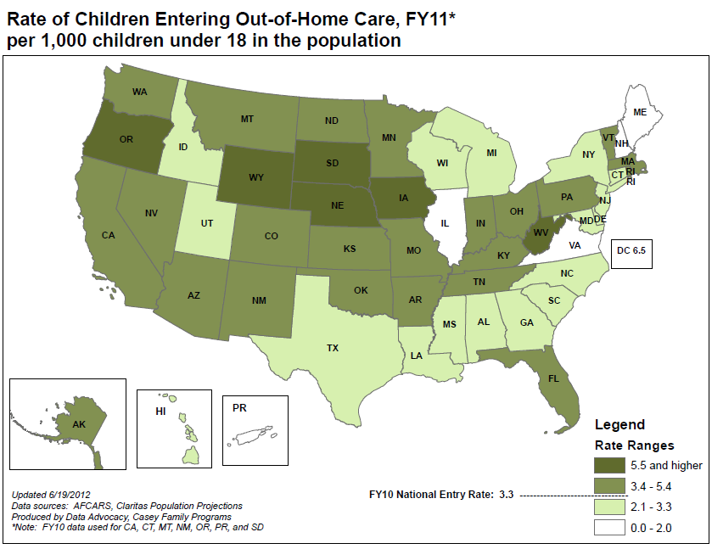
Notes:
CA Entry rate similar to National (3.2)
9:15 to 10

Slide 27
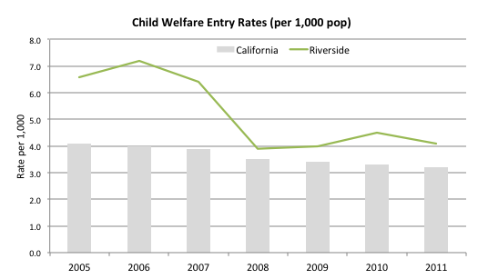
Trends in CW Entry Rates: CA and Riverside County
Notes:
Overall – the entry rate in Riverside is about 4 children per 1,000 – but this measure may mask differences – if you want to lower it, where should you focus?
9:15 to 10

Slide 28
Questions to Consider: Entries (removals)
Who are the children who are coming into care? (Demographic and case characteristics) Use rates per population, or per referrals received to make comparisons
Why are they entering care? (removal reasons, prior svc history)
What strategies might impact different populations?
Review trends and local geographic variation – would the program(s) have equal impact in all regions?
What jurisdictions have lower entry rates? How do the populations differ? Have similar states been successful in reducing entries?
Notes:
9:15 to 10

Slide 29
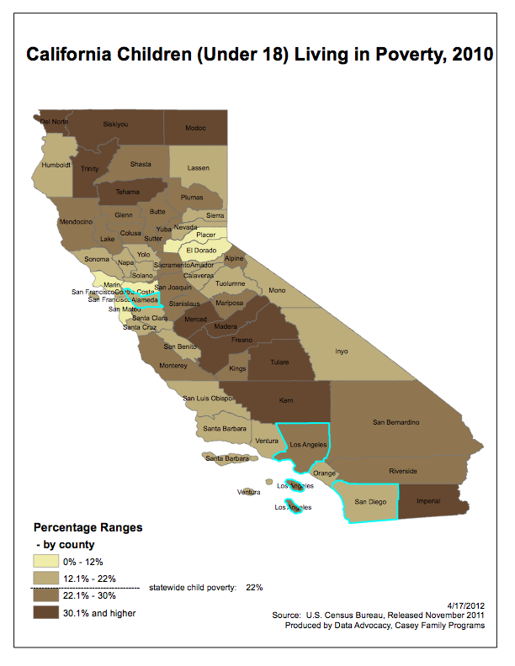
Comparing child welfare outcomes across jurisdictions can be useful to generate discussion about differences in demographics, policy, practice and service array
Notes:
9:15 to 10
(any slides from daniel?)

Slide 30
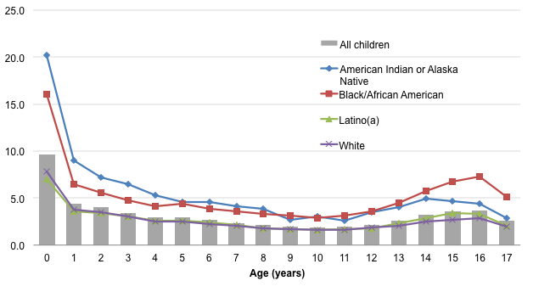
Nationwide Children Entering Care, Child Welfare: Babies of color have the highest rate of entry (FY10, per 1000)
Data source: AFCARS
Notes:
Some of the greatest disparity in terms of number of entries exists among babies of color
The rate is per 1000, which means that 2% of american indian babies are coming into foster care. And More than 1.5% of AA babies. MUCH higher in some states.
9:15 to 10

Slide 31
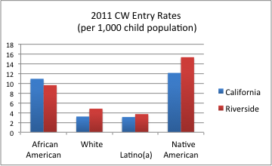
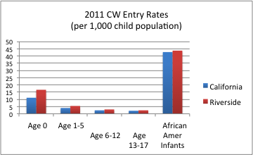
In CA and in Riverside County, entry rates are highest among African American and Native children. Entry rates are also highest for infants. This is consistent with national trends.
Notes:
9:15 to 10

Slide 32
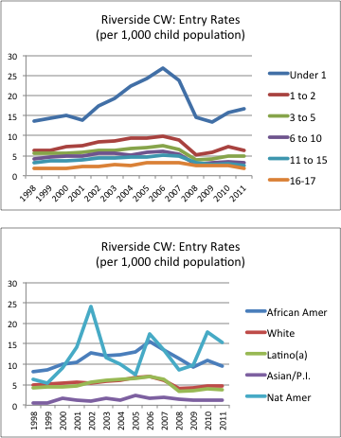
For most children, entry rates increased steadily from 1998 through 2006, declined through 2009, and have begun to increase.
Changes in entry rates are most dramatic for African American children and infants
Notes:
Reiterate the difference between rates and counts. Entries declined considerably for all but the oldest youth.

Slide 33
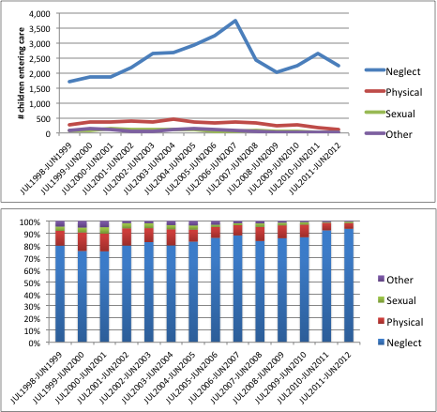
Entries by Removal Reason: Riverside County
Notes:
9:15 to 10

Slide 34
Practice Discussion
What specific policy, practice, or service changes have had the most impact on the number of children entering care?
Where has the impact been strongest? Where has this been less effective?
What challenges remain?
Notes:
9:15 to 10
BREAK 10 to 10:15

Slide 35
Children in care
Point in time
National and State and County Level
Notes:
Data useful for strategies like PRTs that reach children in care NOW
10:15 to 11

Slide 36
Key Questions: Children currently in care
What are the population demographics (age, race)
Has the number in care been changing or stable over time?
Is there a large group of older youth who have been in care a long period of time? What are the existing barriers to permanency for these youth?
What types of placements are children in?
What are children’s case plan goals? Are there differences by region, age, race?
Notes:
I’m not going to answer all of these , but answering these questions with available data could be part of a future CQI workshop
10:15 to 11

Slide 37
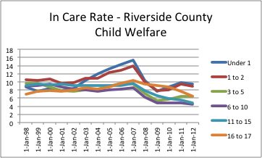
Children in care by age: Riverside County Child Welfare
In care rates have declined for all children in Alameda County, but there are differences by age. The youngest children still have the highest rate in care. (per 1,000 in the population)
Notes:
In some counties we see the older teens have really high in care rates, despite their relatively low entry rates, because of LOS. This doesn’t seem to be the case here.
10:15 to 11

Slide 38
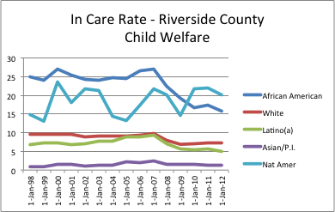
Children in care by Race/Ethnicity: Alameda County Child Welfare (rate per 1,000 child pop)
In care rates declined most dramatically among African American children and youth
Notes:
10:15 to 11

Slide 39
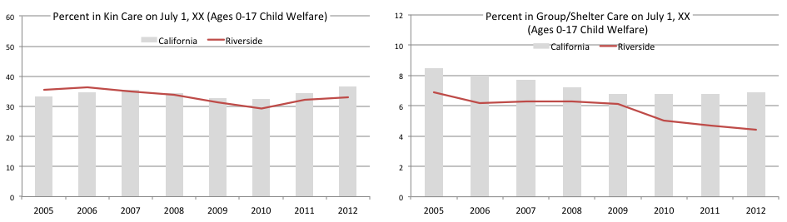
Placement Type – Point in Time: Compared to statewide data, Riverside county has a similar proportion of children placed in kinship care, and a smaller proportion of children and youth placed in group care.
Notes:
Discuss other ways to measure – first placement type, predominant placement type etc…
Likely variations by age/race
Also, about 10% in “guardian – other”
10:15 to 11

Slide 40
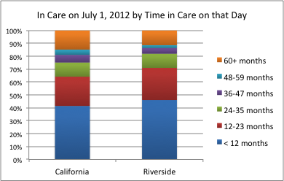
What else do we know about who’s in care?
Notes:
Can also break down by age and race and placement type (guardianship will be a factor, and also may effect the permanency outcomes we will discuss next.)
10:15 to 11

Slide 41
Outcomes: Exits and Length of stay
National State and County Level
Notes:
Strategies to affect LOS/exits/placement type
10:15 to 11

Slide 42
Key Questions: Permanency
How long do children stay in care after removal (longitudinal analysis)
What proportion of children entering care will eventually reunify?
What proportion of reunified children will re-enter care?
What about children/youth who have already been in care long periods of time?
How does this differ by age, race, risk factors, placement type, case type, geography?
Has this been changing or stable over time?
What interventions are currently in place to promote permanency? Are they achieving the desired results?
Notes:
Likelihood and timeliness
10:15 to 11

Slide 43
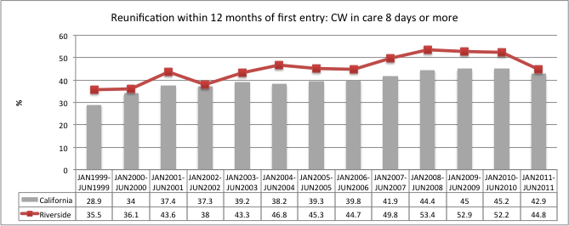
Compared to the state, children entering care in Riverside County are more likely to be reunified within 12 months Performance declined in 2011 after improving steadily.
Notes:
What’s interesting is that this measure improved steadily when entry rates were declining dramatically
10:15 to 11

Slide 44
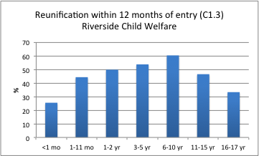
Timely Reunification 2011 First Entries: Child Welfare
Which groups of children are the most likely to return home within 12 months?
Notes:
Jan-Jun 11 first entries (8 days or longer)
10:15 to 11

Slide 45
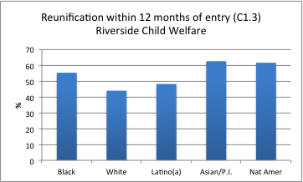
Timely Reunification 2011 First Entries: Child Welfare
Which groups of children are the most likely to return home within 12 months?
Notes:
Make the point about who is entering – (African American newborns!) and who is least likely to go home?
Jan-Jun 11 first entries
10:15 to 11

Slide 46
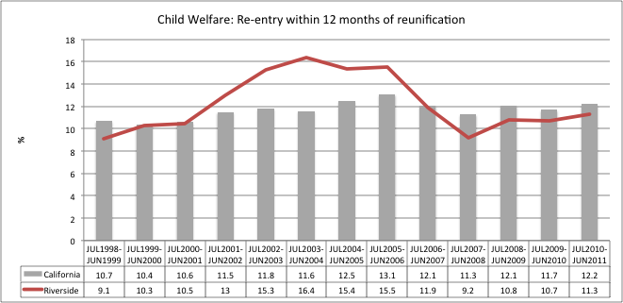
Balancing Act: Timely Reunification and Low Re-Entry
Notes:
10:15 to 11

Slide 47
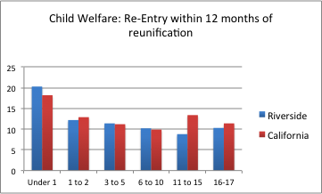
In Riverside, infants are the most likely to re-enter
Notes:
Exits to reunification during the year: Reentered in less than 12 months Agency Type=Child Welfare Jul 1, 2010 to Jun 30, 2011
10:15 to 11

Slide 48
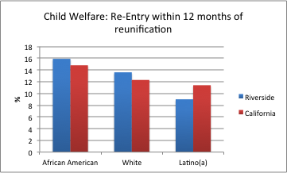
In Riverside, African American youth are the most likely to re-enter
Notes:
Exits to reunification during the year: Reentered in less than 12 months Agency Type=Child Welfare Jul 1, 2010 to Jun 30, 2011
Native and Asian N = 9 and 1
As with all of these, the next step would be to look at trends to see if these differences hold over time
10:15 to 11

Slide 49
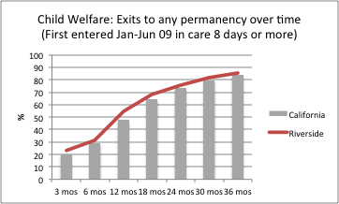
Exits to Permanency within 3 years of First Entry: CW
Notes:
Breakdown by exit type on next slide – data also available by age and race
10:15 to 11

Slide 50
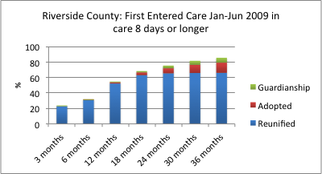
Permanency within 3 Years: Riverside Trends
Notes:
Note that reunification flattens out at 18 months – discuss the children still in care with guardian-other as their placement type
Should review how this plays out by age and race
10:15 to 11

Slide 51
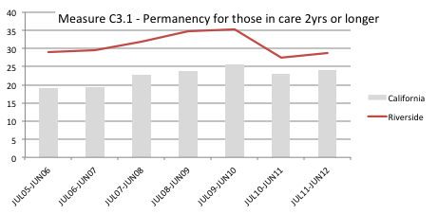
Children who have already been in care two years or more – What proportion will exit to permanency during the year that follows?
Notes:
This measures the “back end” efforts such as PRTs, family finding, any efforts aimed at the “long stayers”
Which would not get captured by first entry cohorts.
can also do by race – age differences are substantial (next slide)
10:15 to 11

Slide 52
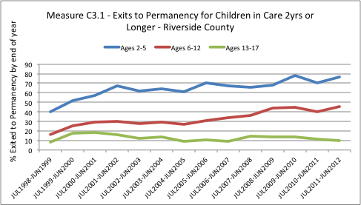
Children who have already been in care two years or more – What proportion will exit to permanency during the year that follows?
Notes:
General improvement for all – expected trends by age
10:15 to 11

Slide 53
Practice Discussion
What specific policy, practice, or service changes have had the most impact on the number of children in out of home care?
Where has the impact been strongest? (Front end, reducing entries; back end, increasing timely exits to permanency? Some combination? Something else?)
Who are the children still in care? What changes might be necessary to adjust to this different population?
Notes:
Before we look more closely at entries and exits – what are your thoughts?
10:15 to 11

Slide 54
Make the data work for you
Improving Outcomes
Notes:
Only if time allows

Slide 55
Observe
Explain
Strategy
Outcome
We’ve noted that:
And we believe it is because:
So we plan to:
Which will result in ENVISIONED OUTCOME:
Consider internal (practice/policy) and external (partners/services)
Review key outcome measures – look for variation in subgroups
Short term/intermediate AND long term outcomes
What can you do? How will you know you did it?
Use multiple sources of data
Developed by NYS OCFS
Notes:
Only if time allows – transition to Adam

