Slide 1



The data Train:
Bringing Child Welfare Staff on Board
Wendy Wiegmann, MSW, PhD
California Child Welfare Indicators Project
University of California, Berkeley
May 15, 2017

Slide 2
Outline
The importance of data in child welfare
Sources of data and how they are used
Helping child welfare staff connect performance to vision and measurement
Getting there using the CCWIP website & SafeMeasures

Slide 3
importance &
Uses of Data

Slide 4
The Importance of Data
Allows child welfare agencies to:
Compare outcomes to agency mission & practice model
Strategize on what work needs to be done
Focus on what is being achieved
Identify what needs attention
Connect current practice to best practice and desired outcomes
Notes:
In our program statements, strategic plans, SIPs, and self-assessments, county child welfare agencies are often able to accomplish 1-4. The hardest part always seems to be #5. This training attempts to get at this essential piece of using data to improve child welfare practice by training child welfare staff to find and understand their data measures.

Slide 5

VISION
Mariposa County SIPs
Strategic Plans
Community Partnerships
Divisions/Programs
Notes:
Using data collected in the community, from other departments, and from our own analysts, this is where managers and directors lay out their plans for improving child welfare performance in the county. This is often a comprehensive analysis of the strengths and weaknesses in the county, and how to utilize the programs, services, and partnerships available to improve.

Slide 6
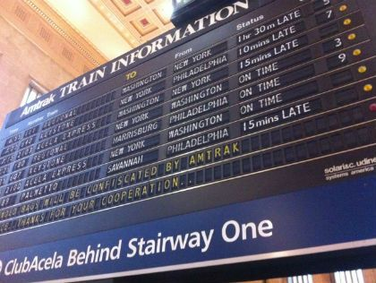
Measurement
CFSR Case Reviews
CFSR Self-Assessments
CCWIP Website
Notes:
This is where we get an understanding of how we are doing. Using guidance from ACS, we focus on certain specific measures, listen to the experiences of the children, families, and caregivers in our community, and track our progress using the UC Berkeley website and our internal staff of analysts.

Slide 7

Performance
Timely Visits
Accurate Assessments
Diligent Monitoring
Adequate Services
Concurrent Planning
Notes:
While absolutely related, the outcomes that managers often focus on are distant from the more proximate process measures that dictate the daily practice of workers and supervisors.
For many workers, this means that the conversations that we are having about outcomes feel far away and out of the control of them in their regular work.

Slide 8

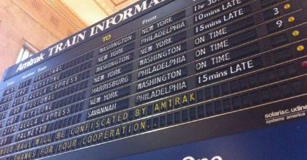
Making the Connections
Child welfare staff are aware of the outcomes under strategic focus and why.
They understand how county plans/programs are supposed to help them influence these outcomes.
Between
&
Child welfare staff know how outcomes are measured.
They know which groups are most impacted by outcomes.
They connect their daily activities to these outcomes.
Notes:
To help workers and supervisors understand how their daily activities are connected to the vision and performance measurement of our county, we need to build bridges.
Between performance and vision:
-- Workers need to understand where the county feels that it needs to reform. Does our SIP say that we have a problem with re-entries? Are workers aware that this is a focus of our agency?
-- Have we created special programs or services designed to influence these outcomes? Are workers aware of these connections or do the programs and services feel like arbitrary changes, or ancillary/unnecessary services? If workers understand that there was a purpose to the creation of these services/programs, they may feel compelled to modify their practice to incorporate them.
Between performance and measurement:
-- Workers and supervisors hear a lot about safety, permanency, and wellbeing. What they often don’t understand is how these things are measured. Do they know that measures P2 and P3 are specifically related to permanency for youth that have already been in care for a long time? These methodological understandings can help workers know that the details of their practice are as important as the overall goal.
-- An understanding of which subgroups are most impacted by outcomes can help workers focus their practice – they may slow down and pay additional attention when working with these groups or search out programs and services that specialize.

Slide 9
Mission
Connect current practice to best
practice and desired outcomes
This training attempts to get at this final, most difficult, but essential process by training child welfare staff to find and understand how their work is related to outcome measures.
To do so, we will focus specifically on how workers can use the CCWIP and SafeMeasures websites to stay on top of the processes that directly impact those measures.

Slide 10
California Child Welfare Indicators Project (CCWIP)

Slide 11

California Child Welfare
Indicators Project
Aggregates California’s administrative child welfare data into customizable tables
Includes data measuring state and federal (CFSR3) measures
Data can be stratified and filtered by year, county, age, ethnicity, gender, placement type, and other subcategories
Notes:
CCWIP can help!

Slide 12
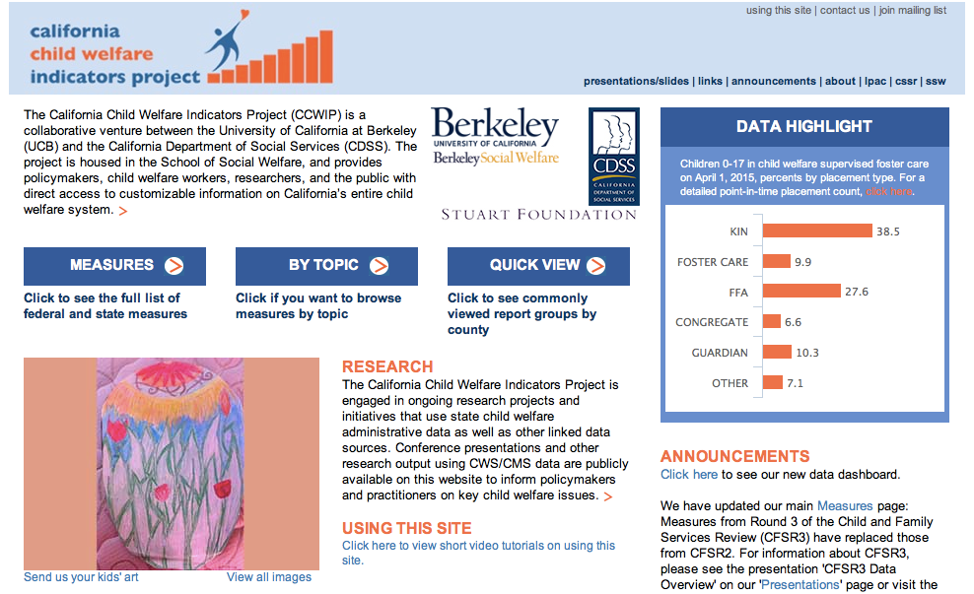
CCWIP Website

Slide 13
child welfare data measurement

Slide 14
3 Key Data Views in Child Welfare
Data
Entry
Cohorts
Exit
Cohorts
Point
in Time
Notes:
In addition to the issue of different (and sometimes competing) measures, it is also important to understand that the data can be examined multiple way, some of which give an accurate picture of what happened/happens to a child in the child welfare system, and others which may skew the picture.
The first question that has to be answered is, “Whose outcomes do I want to measure?”
There basic are 3 choices:
Children in foster care - the active caseload (other terms: point-in-time, cross-section, or census)
Children leaving foster care - children who left placement in the last year (other terms: an exit cohort)
Children entering foster care - children placed during some period of time, usually one year (other terms: an admission cohort)
Each of these approaches represents a different way to sample the children who have ever been in foster care

Slide 15
What are the implications?
It is much harder to measure outcomes over time using either a point-in-time or an exit cohort sample because the samples are missing some children:
  A point-in-time analysis is missing the kids who left placement
  An exit cohort only includes kids who leave
  You can’t assess change if you leave out either of these children because their experiences aren’t factored into the outcomes. All children have to be included in the system for monitoring outcomes.

Slide 16
PIT Snapshots vs Entry Cohorts
Jan. 1, 2016
Jan. 1, 2015
Jan. 1, 2017
Notes:
Another problem with point-in-time data: the over-capture of long-stayers.

Slide 17
Tracking an Entry Cohort for 1 Year
2015
2016
Dec. 31
Dec. 31
Jul. 7
Jul. 7
Mar. 1
Mar. 1
Jan. 1
Dec. 31
Jan. 1
Dec. 31
Notes:
How Entry Cohorts work

Slide 18
federal CFSR3 measures

Slide 19
CFSR: 2 Stage review process
Statewide Assessment
    The Children’s Bureau prepares a data profile that contains aggregate data on the state’s foster care and in-home services populations. In California, a similar process is conducted between the state and the counties.
    The data profiles allow each state (county) to compare certain safety and permanency data indicators with national standards determined by the Children’s Bureau.
Onsite Review
    Onsite Review includes (1) case reviews; (2) interviews with children and families engaged in services; and (3) interviews with community stakeholders, such as courts, community agencies, foster families, caseworkers, and service providers. In California, a random sample of cases is taken among the counties for this process.
    In Mariposa County, Teresa from PIU conducts the case reviews, with Baljit providing QA.

Slide 20
CFSR3 Outcomes: Safety
Children are, first and foremost, protected from abuse and neglect.
Children are safely maintained in their homes whenever possible and appropriate.

Slide 21
Data Indicators: Safety
  S1: Maltreatment in foster care
  “Of all children in care during the 12-month period, what is the rate of victimization per day?”
  S2: Recurrence of maltreatment
  “Of all children with a substantiated allegation during the 12-month period, what percent had another substantiated allegation within 12 months?”
Notes:
S1: Of all children in foster care during a 12-month period, what is the rate of victimization per day of foster care?
What’s changed from CFSR 2?
Rate of maltreatment per child days in foster care vs. percentage of children not maltreated in foster care
Includes all maltreatment types by any perpetrator vs. just maltreatment by foster parents/facility staff
Includes:
All days in foster care during the year (across episodes)
Multiple incidents of substantiated maltreatment for the same child are included in the numerator
Excludes:
Children in care for less than 8 days
Incidents occurring before or within 7 days of the date of removal
Children age 18+
Days in care after 18th birthday
S2: Of all children who were victims of a substantiated report of maltreatment during a 12-month reporting period, what percent were victims of another substantiated maltreatment allegation within 12 months of their initial report?
What’s changed from CFSR 2?
Window is 12 months vs. 6 months
Recurrence vs. no recurrence
Excludes:
Children age 18+ at initial report
Substantiated allegations occurring within 14 days of initial report

Slide 22
  S1: Maltreatment in foster care
Cohort: Children in Care Between Apr 2015 – Mar 2016
Child A
Days in care: 275
Instances of maltreatment: 0
1
Denominator: total days in care
275 + 45 + 310 + 95 + 188 = 913
2
Numerator: instances of maltreatment
0 + 1 + 2 + 0 + 0 = 3
Child B
Days in care: 45
Instances of maltreatment: 1
3
Calculate rate of maltreatment per day in care
3 / 913 = 0.003286
Child C
Days in care: 310
Instances of maltreatment: 2
4
Multiply by 100,000
0.003286 * 100,000 = 328.6 victimizations
per 100,000 days in foster care
Child D
Days in care (episode 1): 95
Instances of maltreatment: 0
Days in care (episode 2): 188
Instances of maltreatment: 0
National Standard:
<= 8.50 per 100,000
Notes:
S1: “Of all children in care during the 12-month period, what is the rate of victimization per day?”
Days in care – across episodes
Maltreatment – includes multiple instances/child

Slide 23
  S2: Recurrence of maltreatment
04/1/14
4/1/15
4/1/16
Children with a substantiated allegation during the 12-month period: 6
Children with another substantiated allegation within 12 months: 3
Performance (P1): 50%
National Standard: <=9.1%
Notes:
S2: “Of all children with a substantiated allegation during the 12-month period, what percent had another substantiated allegation within 12 months?”
Child 1: 7 months, first substantiated allegation prior to 12-month period
Child 2: 20 months, first substantiated allegation during 12-month period, second substantiated allegation after 12 months
Child 3: 17 months, first substantiated allegation prior to 12-month period
Child 4: 9 months, first substantiated allegation during 12-month period, second substantiated allegation within 12 months
Child 5: 4 months, first substantiated allegation prior to 12-month period
Child 6: 20 months, first substantiated allegation during 12-month period, no second allegation
Child 7: 5 months, first substantiated allegation during 12-month period, second substantiated allegation within 12 months
Child 8: 22 months, first substantiated allegation during 12-month period, second substantiated allegation after 12 months
Child 9: 2 months, first substantiated allegation prior to 12-month period
Child 10: 7 months, first substantiated allegation during 12-month period, second substantiated allegation within 12 months

Slide 24
Case Review Outcomes:
Safety
  Case Review Item 1: Timeliness of Initiating Investigations of Reports of Child Maltreatment
  Item 2: Services to Family to Protect Child(ren) in the Home and Prevent Removal or Re-Entry Into Foster Care
  Item 3: Risk and Safety Assessment and Management

Slide 25
CFSR3 Outcomes:
Permanency
Children have permanency and stability in their living arrangements.
The continuity of family relationships and connections is preserved for children.

Slide 26
Data Indicators:
Permanency
  P1: Permanency in 12 months for children entering foster care
  “Of all children who entered care in the 12-month period, what percent discharged to permanency within 12 months?”
  Trial Home Visit (THV) Adjustment: Children who have a discharge to reunification that was preceded by a trial home visit will have their length of stay adjusted to be at the time of the entry to the THV plus 30 days…and THV +30 will be considered the date they exited to permanency, even if the actual episode ends later.
Notes:
P1: Of all children who enter foster care in a 12-month period, what percent discharged to permanency within 12 months of entering foster care?
What’s changed from CFSR 2?
Expanded definition of permanence includes reunification, adoption, or guardianship vs. reunification only
Includes all children entering foster care during the year vs. just those who were removed for the first time
Entry cohort window is 12 months vs. 6 months
Excluded:
Children in care for less than 8 days
Children entering care at age 18+

Slide 27
  P1: Permanency in 12 months for children entering foster care
04/1/14
4/1/15
4/1/16
Children entering care during the year: 6
Children achieving permanency within 12 months: 4
Performance (P1): 67%
National Standard: >=40.5%
Notes:
P1: “Of all children who enter foster care in a 12-month period, what percent discharged to permanency within 12 months of entering foster care?”
Child 1: 7 months, entered care prior to 12-month period, exit to reunification
Child 2: 2 months, entered care during 12-month period, exit to reunification
Child 3: 17 months, entered care prior to 12-month period, exit to reunification, but not within 12 months
Child 4: 9 months, entered care during 12-month period, exit to guardianship
Child 5: 4 months, entered care prior to 12-month period, exit to reunification
Child 6: 20 months, entered care during 12-month period, no exit
Child 7: 5 months, entered care during 12-month period, exit to reunification
Child 8: 17 months, entered care during 12-month period, exit to reunification, but not within 12 months
Child 9: 2 months, entered care prior to 12-month period, exit to reunification
Child 10: 7 months, entered care during 12-month period, exit to reunification

Slide 28
Data Indicators:
Permanency (con’t)
  P2/P3: Permanency in 12 months for children in foster care for 12-23 months (P2) or for 24 months or more (P3)
  “Of all children in care on the first day of the 12-month period who had been in care between 12 and 23 months (P2) or for 24 months or more (P3), what percent discharged to permanency within 12 months?”
Notes:
P2/P3: Of all children in foster care on the first day of the 12-month period, who had been in foster care (in that episode) for 12-23 months (P2) or for 24 months or more (P3), what percent discharged to permanency within 12 months of the first day?
What’s changed from CFSR 2?
P2 is a new measure with an intermediate time period (between 12 and 23 months)
Excludes:
Children who were age 18+ on the first day of the year
No Trial Home Visit adjustment

Slide 29
  P2: Permanency in 12 months for children in care for 12-23 months
4/1/12
4/1/13
4/1/14
4/1/15
4/1/16
Children in care on the first day of the censor year who had been in care for 12-23 months: 6
Children achieving permanency within 12 months of censor date: 4
Performance (P2): 67%
National Standard: >=43.6%
Notes:
P2: “Of all children in care on the first day of the 12-month period who had been in care between 12 and 23 months, what percent discharged to permanency within 12 months?”
Child 1: No time prior to first day, exit to reunification (7 months total)
Child 2: 23 months prior to first day, no exit (more than 48 months total)
Child 3: 1 month prior to first day, exit to reunification (2 months total)
Child 4: 36 months prior to first day, exit to adoption (46 months total)
Child 5: 24 months prior to first day, exit to reunification (30 months total)
Child 6: 12 months prior to first day, exit to guardianship (14 months total)
Child 7: 10 months prior to first day, no exit (37 months total)
Child 8: 14 months prior to the first day, exit to reunification (22 months total)
Child 9: 22 months prior to the first day, exit to guardianship (46 months total)
Child 10: 18 months prior to the first day, exit to adoption (20 months total)
Child 11: 25 months prior to the first day, exit to adoption (38 months total)
Child 12: No time prior to first day, exit to reunification (6 months total)
Child 13: 27 months prior to the first day, exit to adoption (34 months total)
Child 14: 14 months prior to the first day, exit to reunification (18 months total)
Child 15: No time prior to the first day, exit to reunification (2 months total)
Child 16: 30 months prior to the first day, exit to guardianship (48 months total)
Child 17: 1 month prior to first day, exit to reunification (13 months total)
Child 18: 6 months prior to the first day, exit to adoption (11 months total)

Slide 30
  P3: Permanency in 12 months for children in care for 24+ months
4/1/12
4/1/13
4/1/14
4/1/15
4/1/16
Children in care on the first day of the censor year who had been in care for more than 24 months: 5
Children achieving permanency within 12 months of censor date: 3
Performance (P3): 60%
National Standard: >=30.3%
Notes:
P3: “Of all children in care on the first day of the 12-month period who had been in care for 24 months or more, what percent discharged to permanency within 12 months?”
Child 1: No time prior to first day, exit to reunification (7 months total)
Child 2: 23 months prior to first day, no exit (more than 48 months total)
Child 3: 1 month prior to first day, exit to reunification (2 months total)
Child 4: 36 months prior to first day, exit to adoption (46 months total)
Child 5: 24 months prior to first day, exit to reunification (30 months total)
Child 6: 12 months prior to first day, exit to guardianship (14 months total)
Child 7: 10 months prior to first day, no exit (37 months total)
Child 8: 14 months prior to the first day, exit to reunification (22 months total)
Child 9: 22 months prior to the first day, exit to guardianship (46 months total)
Child 10: 18 months prior to the first day, exit to adoption (20 months total)
Child 11: 25 months prior to the first day, exit to adoption (38 months total)
Child 12: No time prior to first day, exit to reunification (6 months total)
Child 13: 27 months prior to the first day, exit to adoption (34 months total)
Child 14: 14 months prior to the first day, exit to reunification (18 months total)
Child 15: No time prior to the first day, exit to reunification (2 months total)
Child 16: 30 months prior to the first day, exit to guardianship (48 months total)
Child 17: 1 month prior to first day, exit to reunification (13 months total)
Child 18: 6 months prior to the first day, exit to adoption (11 months total)

Slide 31
Data Indicators:
Permanency (con’t)
  P4: Re-entry to foster care
  “Of all children who enter care in the 12-month period who discharged within 12 months to reunification or guardianship, what percent re-enter foster care within 12 months.”
  P5: Placement stability
  “Of all children who enter care in the 12-month period, what is the rate of placement moves per day?”
Notes:
P4: Of all children who enter foster care in a 12- month period and are discharged within 12 months to reunification or guardianship, what percent re-entered foster care within 12 months of their date of discharge?
What’s changed from CFSR 2?
Entry cohort (denominator includes all children who enter care during the year and exit within 12 months) vs. all children who exit during the year
Includes exits to reunification and guardianship vs. reunification only
Excluded:
Children in care for less than 8 days
Children entering or exiting care at age 18+
Note:
If a child has multiple re-entries to foster care within 12 months of their discharge, only the first re-entry is selected.
P5: Of all children who enter foster care in a 12- month period, what is the rate of placement moves per day of foster care?
What’s changed?
Entry cohort vs. all children in care for less than 12 months
Controls for time in care by constructing a moves/placement day vs. the number of moves per child
Accurately accounts for actual number of moves vs. the prior “2 or more” indicator
Excluded:
Children in care for less than 8 days
Children entering or exiting care at age 18+
Note:
The initial removal from home (and into foster care) is not counted as a placement move.

Slide 32
  P4: Re-Entry to Foster Care
04/1/14
4/1/15
4/1/16
Children entering care during the year: 6
Children achieving permanency within 12 months: 4
Children reentering foster care within 12 months of date of discharge: 2
Performance (P4): 50%
National Standard: <=8.3%
8 months
4 months
Notes:
P4: “Of all children who enter foster care in a 12- month period and are discharged within 12 months to reunification or guardianship, what percent re-entered foster care within 12 months of their date of discharge?”
Child 1: 7 months, entered care prior to 12-month period, exit to reunification
Child 2: 2 months, entered care during 12-month period, exit to reunification
Child 3: 17 months, entered care prior to 12-month period, exit to reunification, but not within 12 months
Child 4: 9 months, entered care during 12-month period, exit to guardianship
Child 5: 4 months, entered care prior to 12-month period, exit to reunification
Child 6: 20 months, entered care during 12-month period, no exit
Child 7: 5 months, entered care during 12-month period, exit to reunification
Child 8: 17 months, entered care during 12-month period, exit to reunification, but not within 12 months
Child 9: 2 months, entered care prior to 12-month period, exit to reunification
Child 10: 7 months, entered care during 12-month period, exit to reunification

Slide 33
P5: Placement Stability
Cohort: Children Entering Care Between Apr 2013 – Mar 2014
Child A
Days in care: 342
Placement moves: 2
1
Denominator: total days in care
342 + 196 + 35 + 167 + 154 = 894
2
Numerator: placement moves
2 + 0 + 1 + 1 + 0 = 4
Child B
Days in care: 196
Placement moves: 0
3
Calculate rate of moves per day in care
4 / 894 = 0.00447
Child C
Days in care (episode 1): 35
Placement moves: 1
Days in care (episode 2): 167
Placement moves: 1
4
Multiply by 1,000
0.00447 * 1,000 = 4.5 placement moves per
1,000 days in foster care
Child D
Days in care: 154
Placement moves: 0
National Standard:
<= 4.12 per 1,000
Notes:
P5: “Of all children who enter care in the 12-month period, what is the rate of placement moves per day?”
Days in care/placement moves – across episodes

Slide 34
Case Review Outcomes: Permanency
  Case Review Item 4: Stability of Foster Care Placement
  Item 5: Permanency Goal for Child
  Item 6: Achieving Reunification, Guardianship, Adoption, or Other Planned Permanent Living Arrangement
  Case Review Item 7: Placement with Siblings

Slide 35
Case Review Outcomes: Permanency (con’t)
  Item 8: Visiting with Parents and Siblings in Foster Care
  Item 9: Preserving Connections
  Item 10: Relative Placement
  Item 11: Relationship of Child in Care with Parents

Slide 36
CFSR3 Outcomes:
Well-Being
Families have enhanced capacity to provide for their children's needs.
Children receive appropriate services to meet their educational needs.
Children receive adequate services to meet their physical and mental health needs.

Slide 37
Case Review Outcomes:
Well-Being
  Case Review Item 12: Needs and Services of Child (12A), Parents (12B), and Foster Parents (12C)
  CR Item 13: Child and Family Involvement in Case Planning
  CR Item 14: Caseworker Visits with Child
  CR Item 15: Caseworker Visits with Parents

Slide 38
Case Review Outcomes:
Well-Being (con’t)
  Case Review Item 16: Educational Needs of the Child
  CR Item 17: Physical Health of the Child
  CR Item 18: Mental/Behavioral Health of the Child

Slide 39
State Child Welfare Outcome Measurement

Slide 40
Child Welfare System Improvement and Accountability Act (AB 636)
Passed in 2001; went into effect January 1, 2004
Includes additional performance indicators, above those required by the CB
All 58 counties receive quarterly data reports (from CWS/CMS) on their outcomes
Data inform their System Improvement Plans (SIPs), which are sent to CDSS and become part of the state’s overall accountability process

Slide 41
Additional Statewide Indicators
Participation Rates
Timely Response (Investigation & Visitation)
Sibling Placement
Least Restrictive Placement
ICWA/Native American Placement Status
Timely Health/Dental Exams
Authorizations for Psychotropic Medications
Individualized Education Plans
Exit Outcomes for Youth Aging out of Foster Care

Slide 42
… Break …

Slide 43
examining child welfare data using the ccwip website

Slide 44
Website

Slide 45
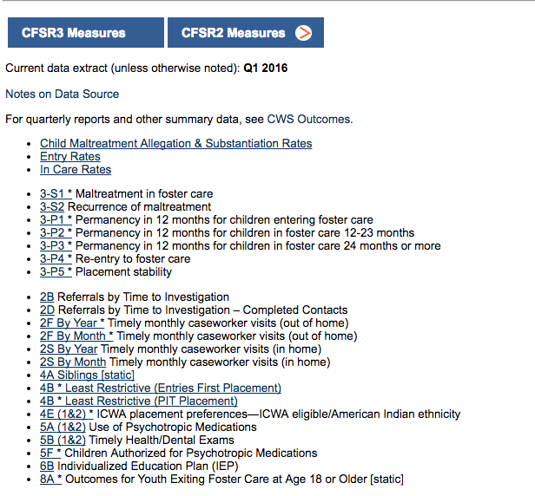
Report Index:
Federal (CFSR) Measures
Notes:
Demo using actual page navigation on website

Slide 46
Report Index:
AB636 Measures
Notes:
Demo using actual page navigation on website

Slide 47
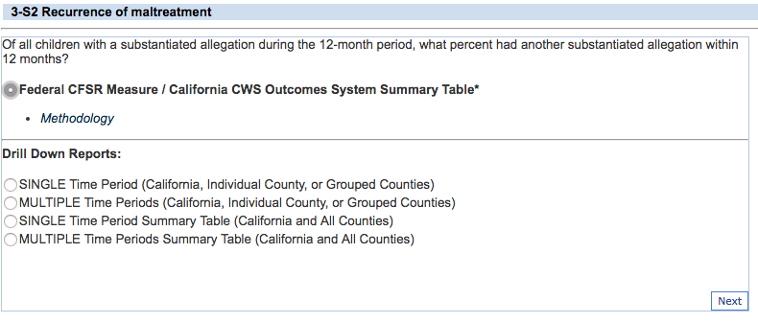
Federal CFSR Summaries
Notes:
Demo using actual page navigation on website

Slide 48
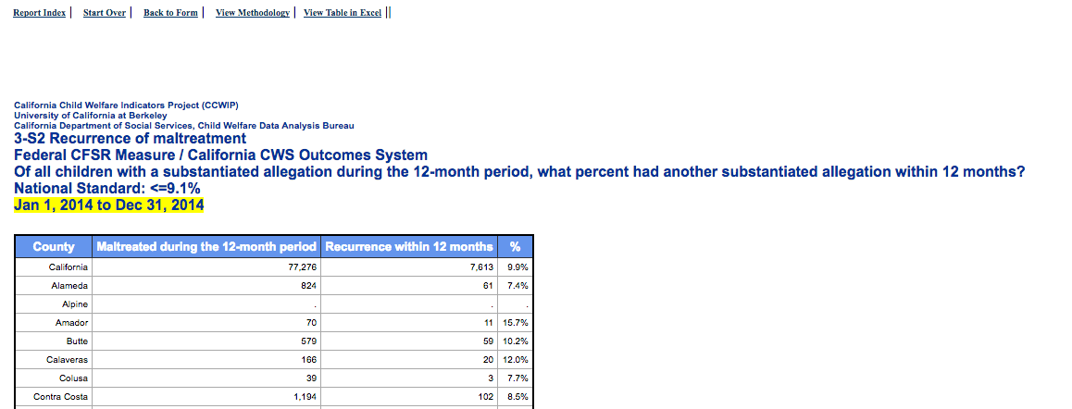
Methodology Links
Notes:
Demo using actual page navigation on website

Slide 49
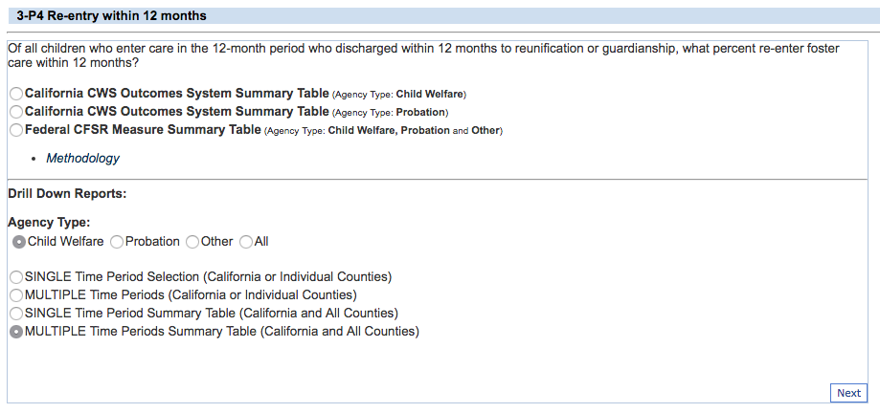
Multiple Time Periods

Slide 50
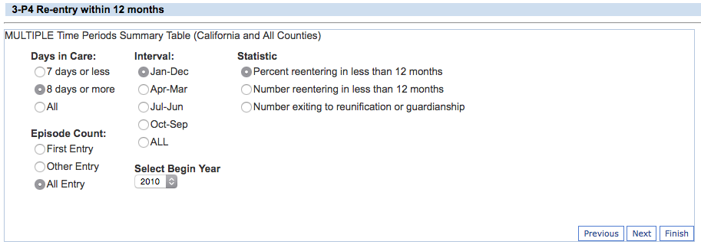
Additional Subgroup Filters

Slide 51
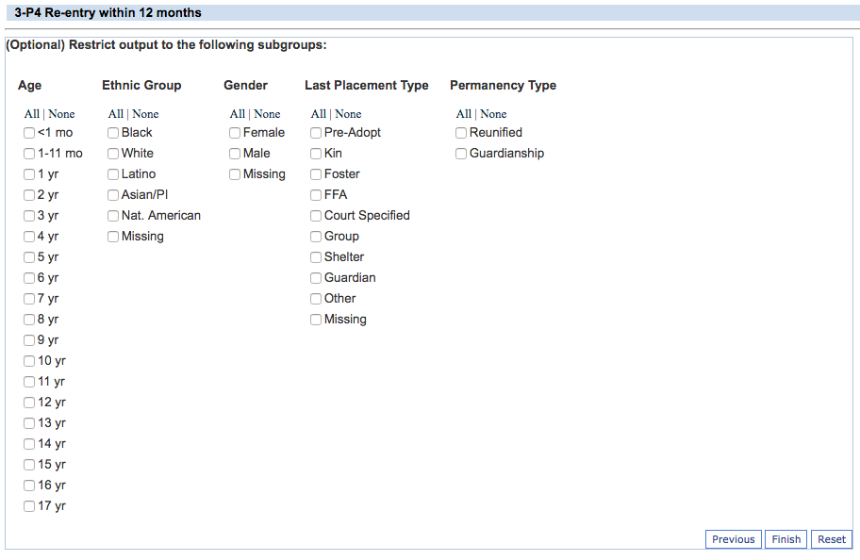
Additional Subgroup Filters

Slide 52
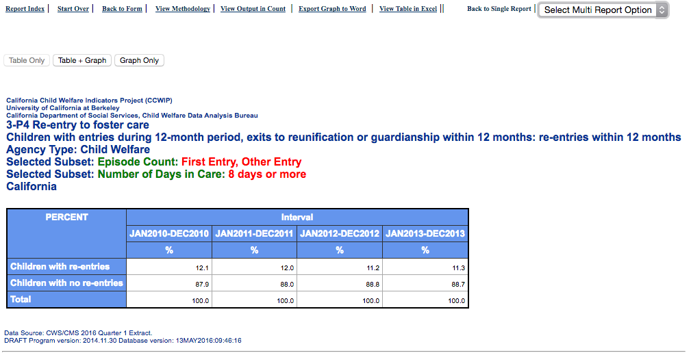
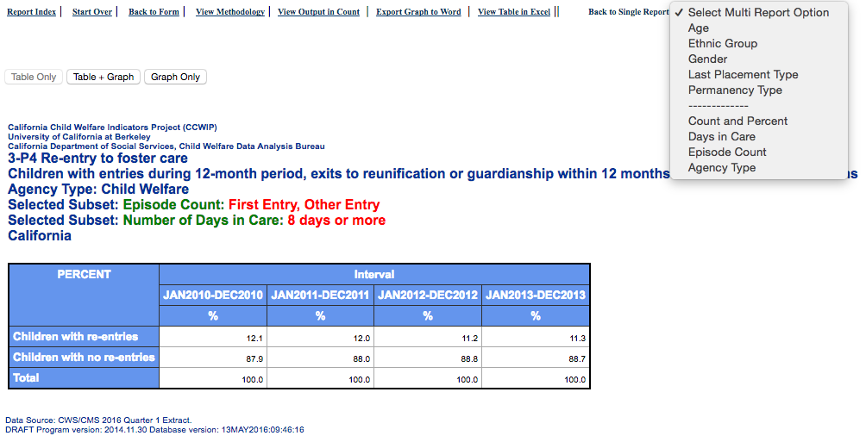
Multi-Report Option

Slide 53
Maximizing the usefulness of SafeMeasures

Slide 54
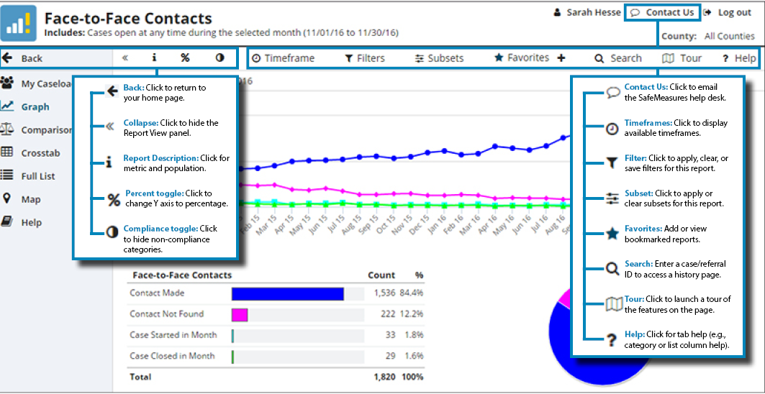
Safe Measures Navigation & Help
Source: https://app.safemeasures.org/Content/tutorials/common/SM51%20icons.png

Slide 55
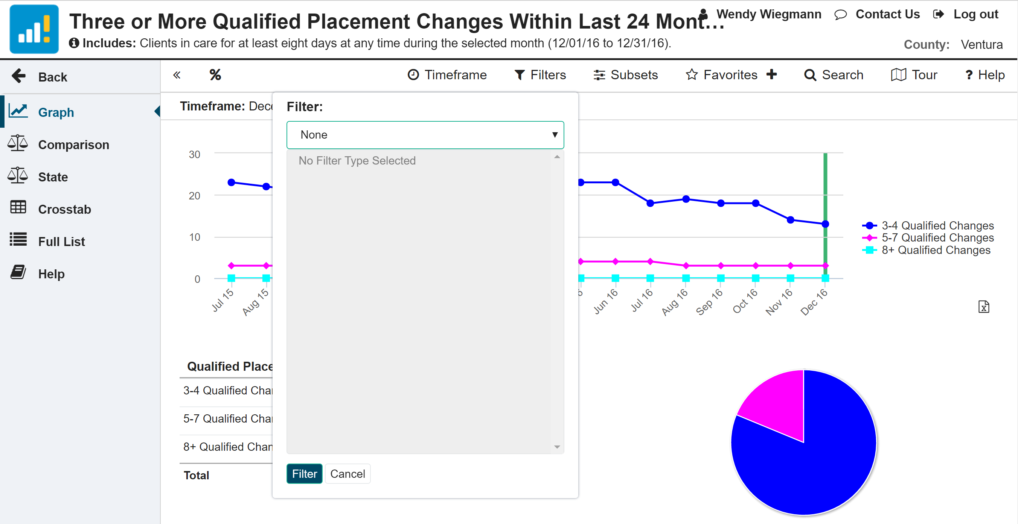
Filters
Notes:
Demo using actual page navigation on website
Includes Office, Unit, Caseload

Slide 56
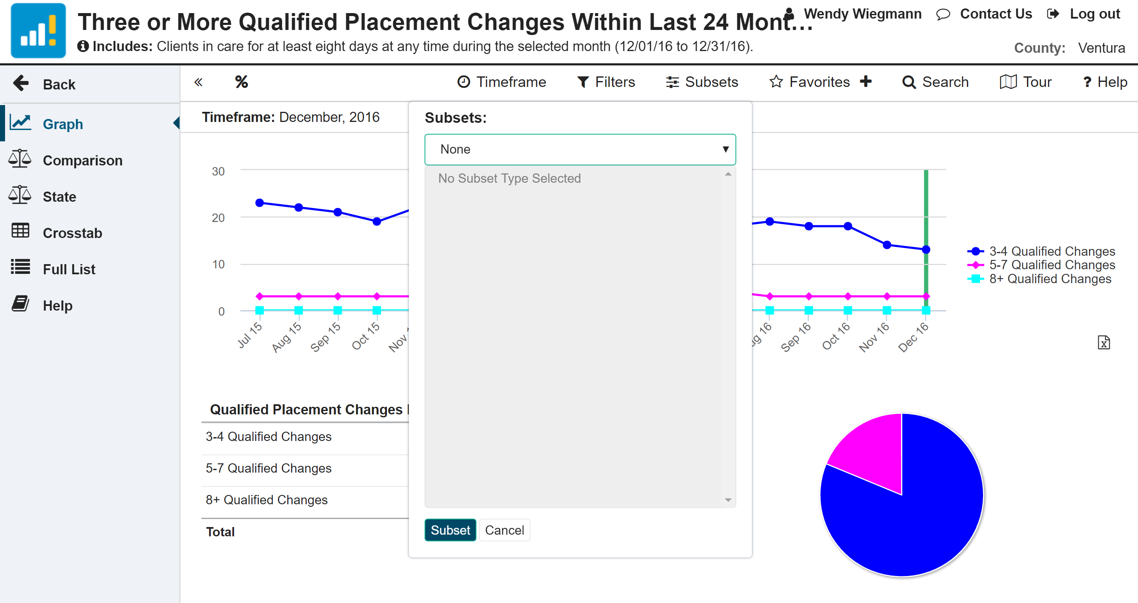
Subsets
Notes:
Demo using actual page navigation on website
Depending on the report, may include Service Component, Age, Ethnicity, Gender, Placement Type, Years in Placement, etc.

Slide 57
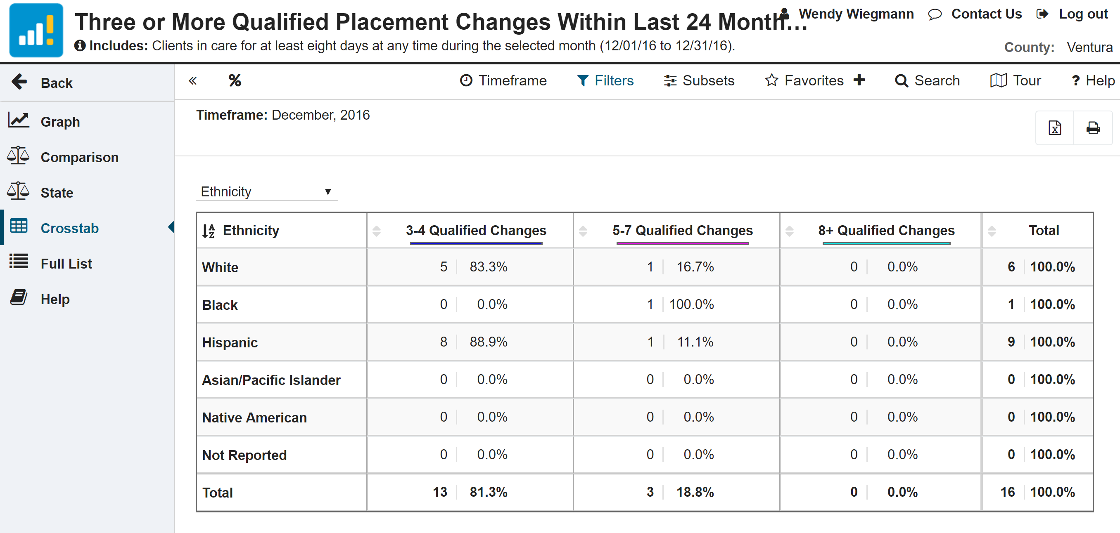
Crosstab & Full List
Notes:
Demo using actual page navigation on website

Slide 58
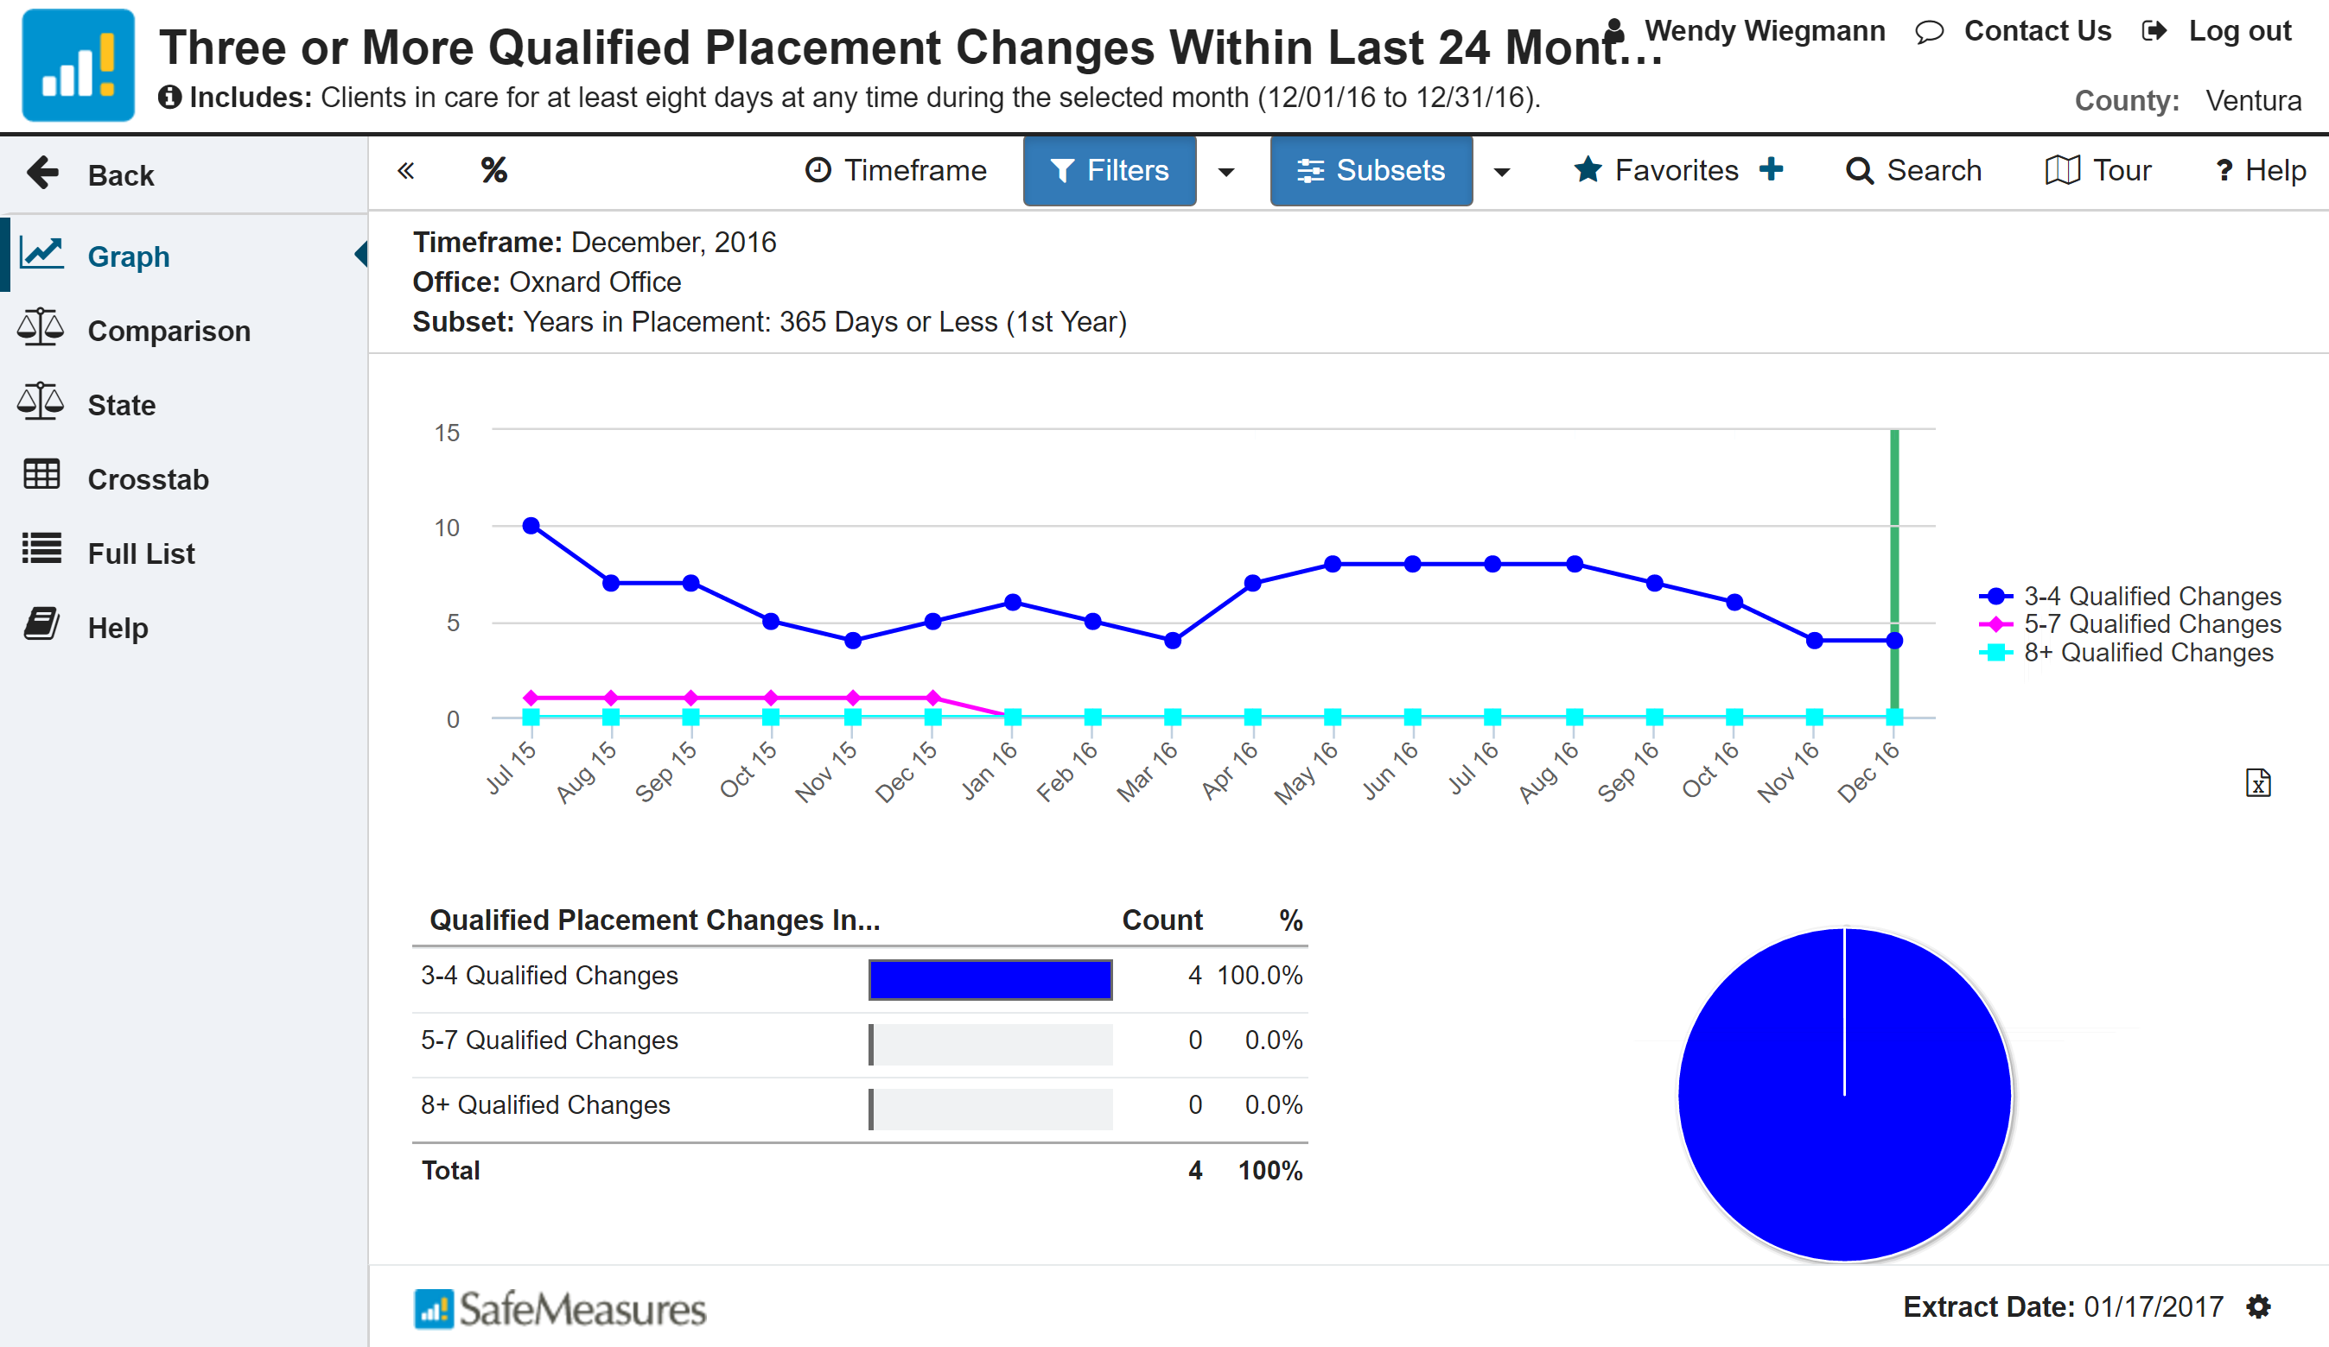
Creating a Favorite
Make sure you set your filters & subsets first!
Notes:
Demo using actual page navigation on website
Note: Make sure that you set your filters & subsets first!

Slide 59
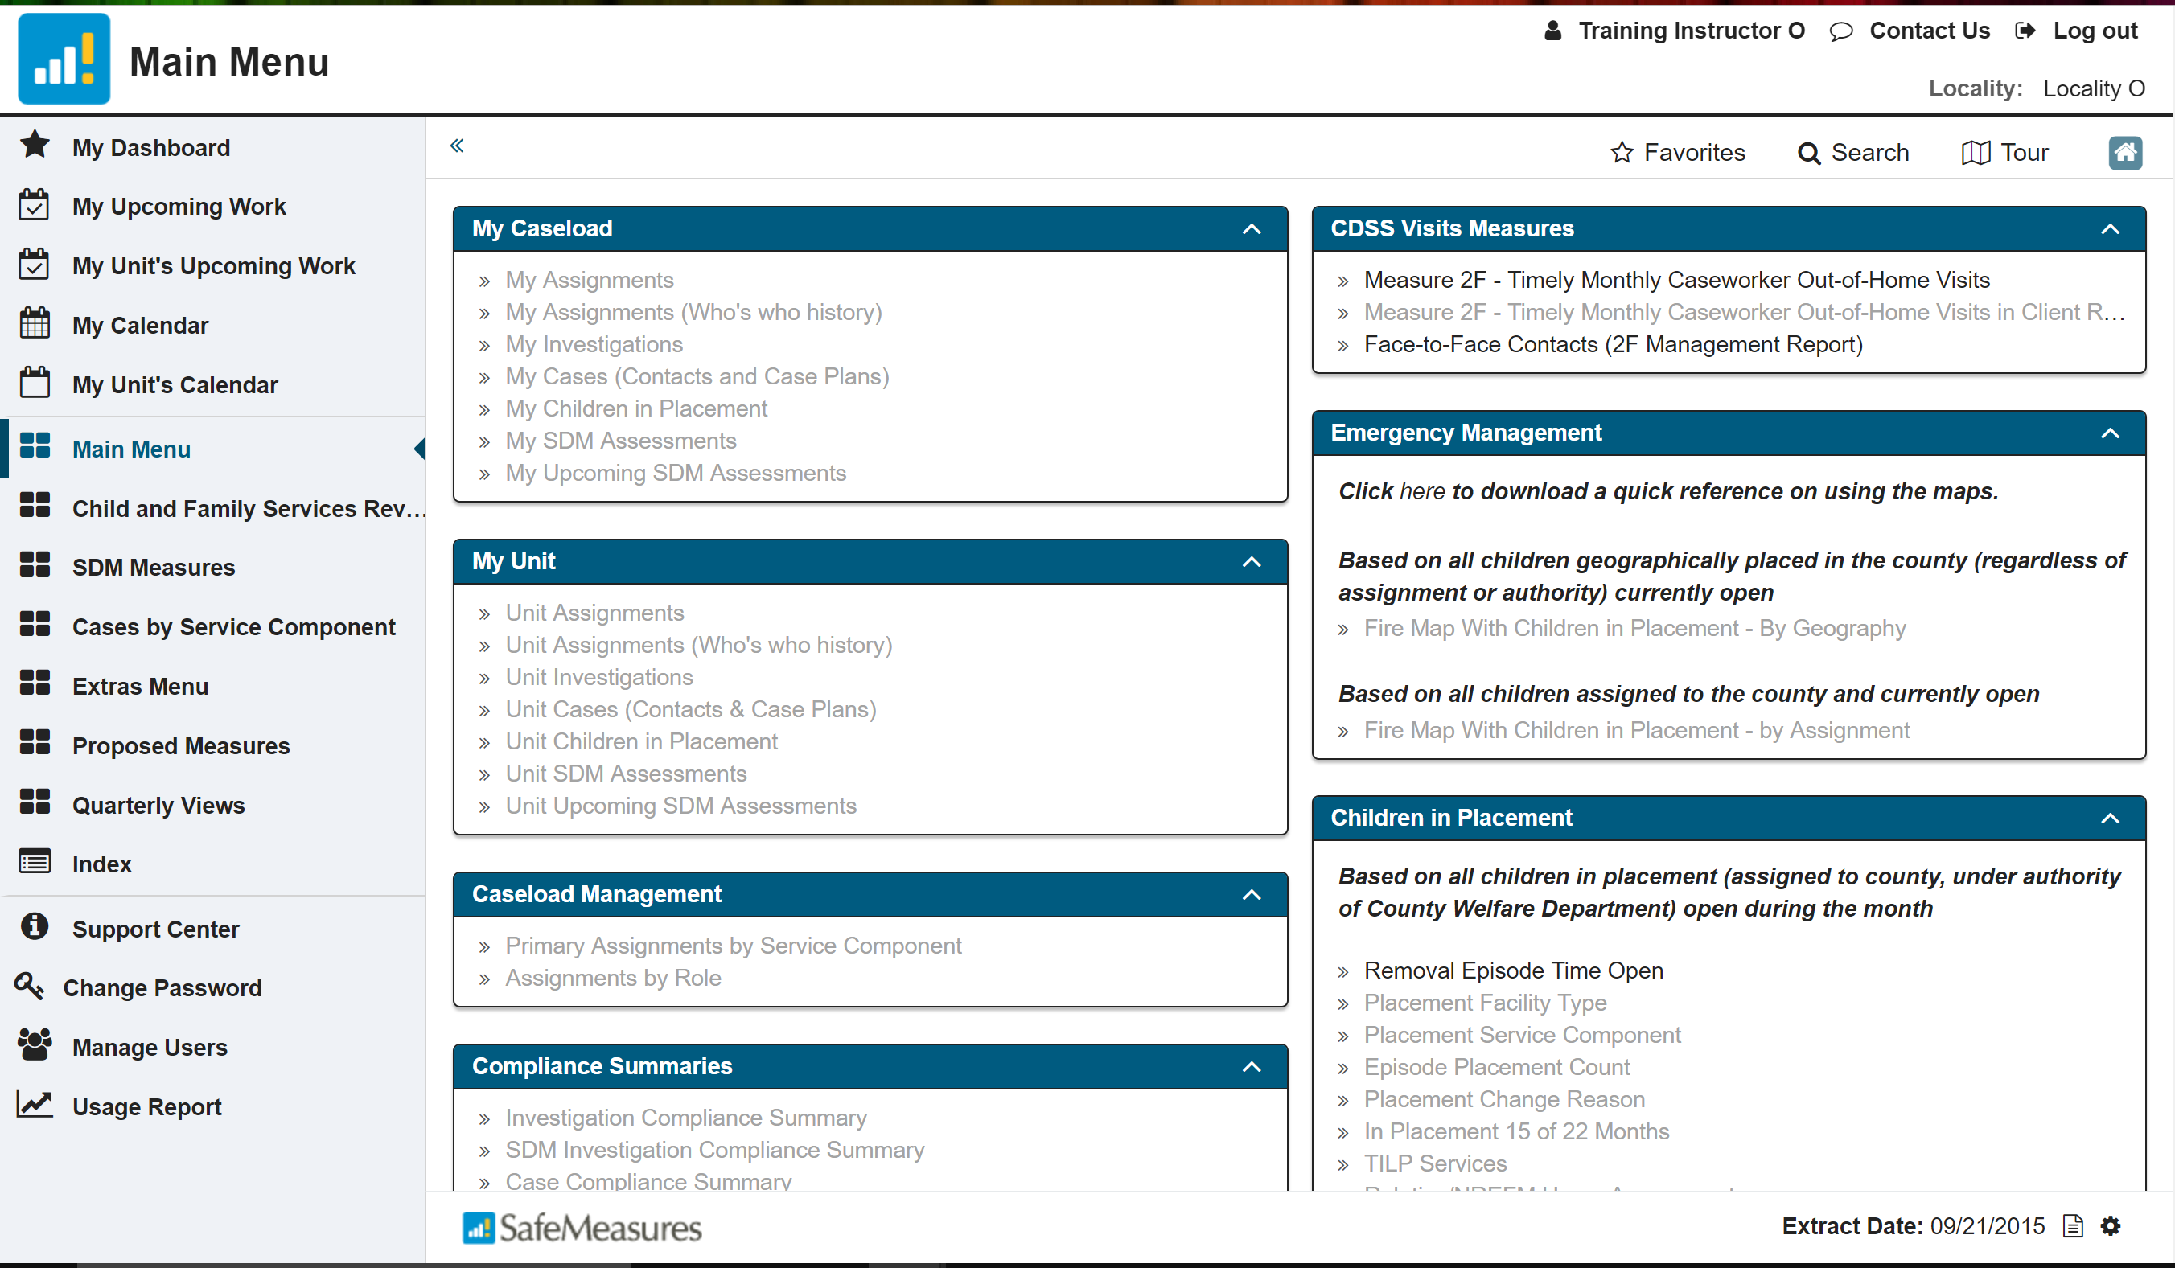
Key SafeMeasures Features
Notes:
Demo using actual page navigation on website

Slide 60
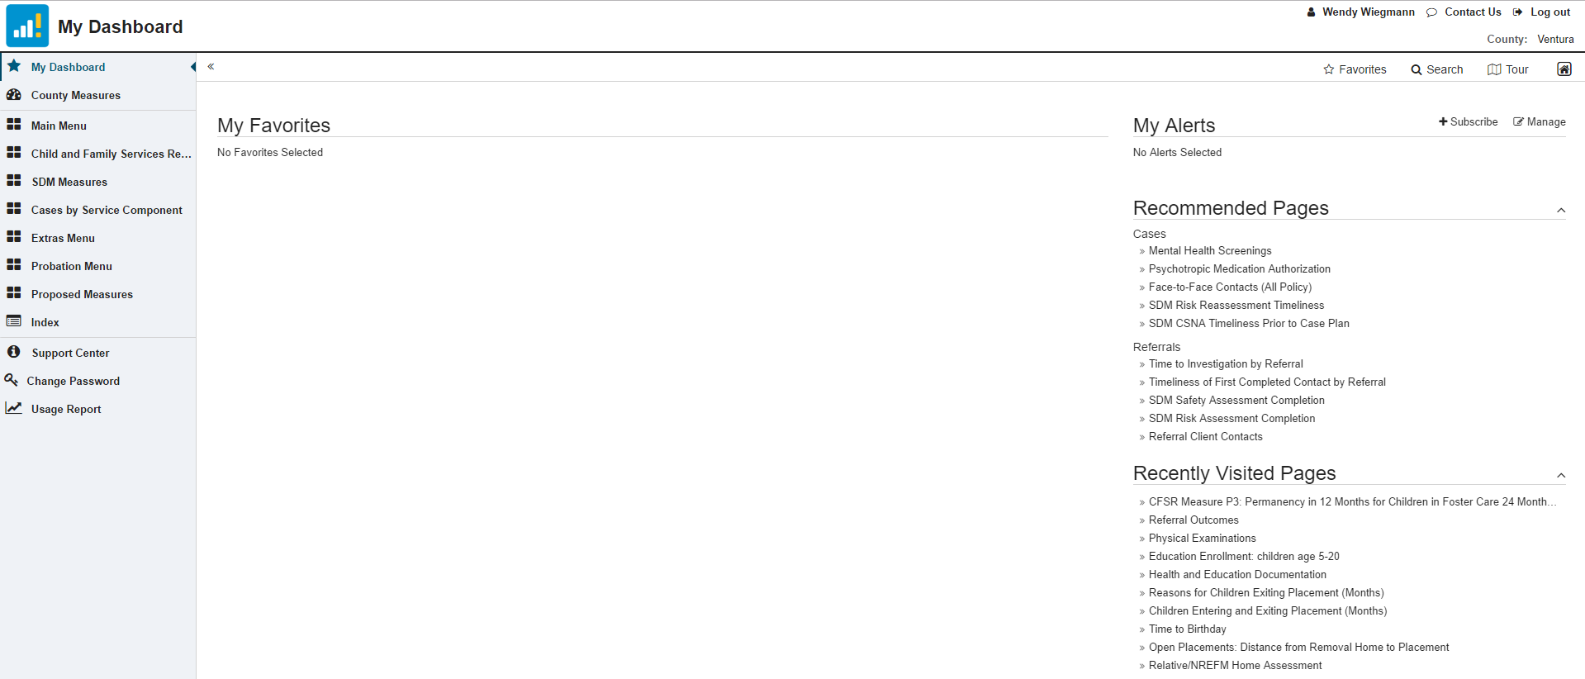
My Dashboard
Notes:
My Favorites: Reports selected by you for revisiting – These reports can be filtered, or subsets selected to help you focus specifically on the children you are interested in.
My Alerts: Specifically tailored reports for your county created by NCCD
Recommended Pages: Pages recommended to you based on previous activity and County Measures
Recently Visited Pages

Slide 61
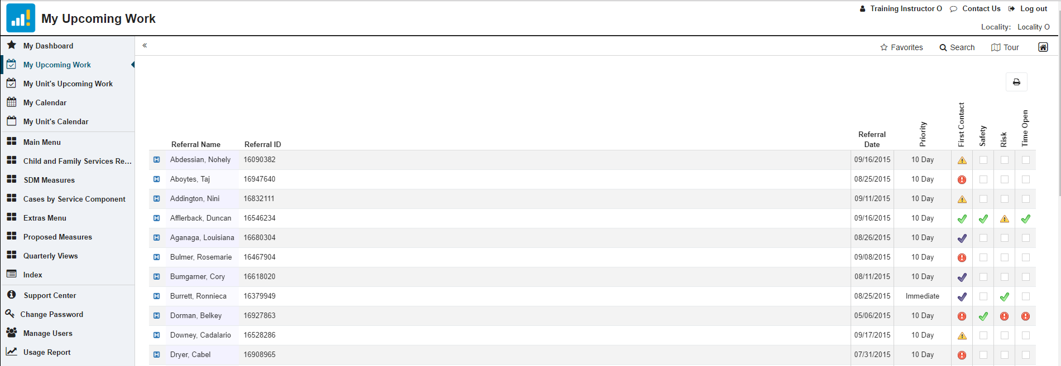
My Upcoming Work - Referral
Note: This display comes from a training system. No actual client names or IDs are displayed
Notes:
First Contact: Yes/No. Have you made (green) or attempted (purple) the first contact with the client?
Safety: Yes/No. Did you complete the SDM Safety Assessment on time? By policy, all safety assessments must be completed within two working days of the first contact. Please note that the completion date for safety compliance is the date the assessment is entered, not the assessment date indicated on the form.
Risk: Yes/No. Did you complete the SDM Risk Assessment on time? By policy, all risk assessments must be completed within 30 days of the first contact.
Time Open: If there is a green check, the referral has been open for less than 30 days from the referral start date. Yellow hazard sign indicates 30-60 days and the red icon indicates that the referral has been open for more than 60 days.

Slide 62
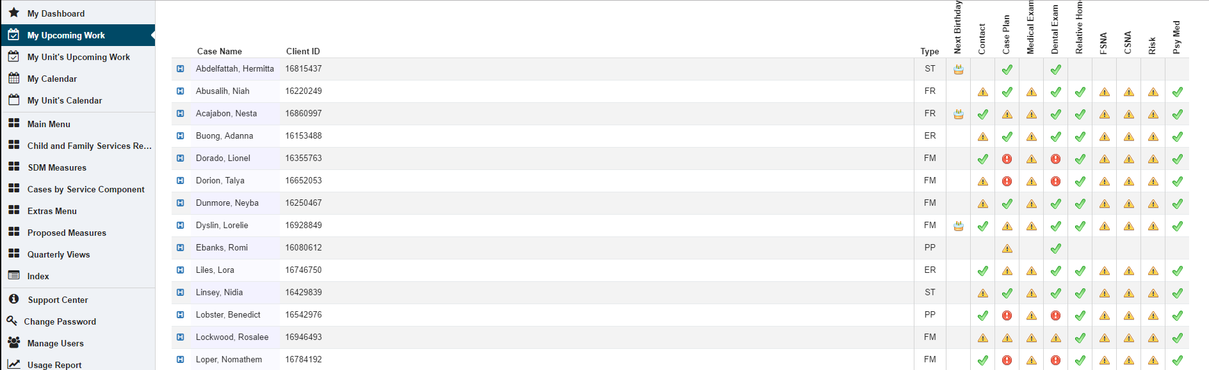
My Upcoming Work - Case
Note: This display comes from a training system. No actual client names or IDs are displayed
Notes:
Next Birthday: Birthday cake indicates a birthday coming up in the next 30 days.
Contact: This summary shows if a face-to-face client contact was made within the required timeframe. Only actual face-to-face contacts completed with the child/victim during the required timeframe are counted. A qualified contact is required monthly for all open cases. If a contact frequency waiver is in place, the time between contacts can be extended to two, three, or six months. This report currently allows for Contact Frequency Waivers which are no longer allowed under 2F. Non-dependent legal guardianship cases default to a six-month contact schedule.
Case Plan: Yes/No. Has the parent signature status been documented ("signed" or "refused to sign") for the active case plan?
Medical Exam: This display shows whether the client has been kept up to date with Child Health and Disability Prevention (CHDP) medical exams. When a child is removed from a home, he/she should receive an initial CHDP medical exam within 30 days of the removal date. After the initial examination date, workers are expected to ensure the child is seen for a qualifying medical exam in accordance with the published exam periodicity schedule.
Dental Exam: This display shows whether the child has been kept up-to-date with Child Health and Disability Prevention (CHDP) dental exams. When a child (3 years or older) is removed from a home, he/she should receive an initial CHDP dental exam within 30 days of his/her removal date. After the initial examination date, workers are expected to ensure that the child is seen for a qualifying dental exam in accordance with the published exam periodicity schedule. If the child being removed is under 3 years old, he/she will not be required (by AB636 standards) to have a CHDP dental exam until 30 days after his/her third birthday. If the client has had an exam after age 20, he/she does not need future CHDP exams and will be considered in compliance until he/she is out of the system.
Relative Home: Has a relative home assessment been completed for a child placed in a relative/NREFM home placement?
FSNA: Was a family strengths and needs assessment (FSNA) completed within 30 days prior to effective case plan (65 for court-dependent cases)? Excludes initial case plans and initial FSNAs.
CSNA: Was a child strengths and needs assessment (CSNA) completed within 30 days prior to effective case plan (65 for court-dependent cases)? Excludes initial case plans and initial CSNAs.
Risk: Was a risk reassessment or reunification assessment completed within 30 days prior to effective case plan (65 for court-dependent cases)? Excludes initial case plans and initial risk assessments.
Psy Med: Does the child have a current psychotropic medication authorization?

Slide 63
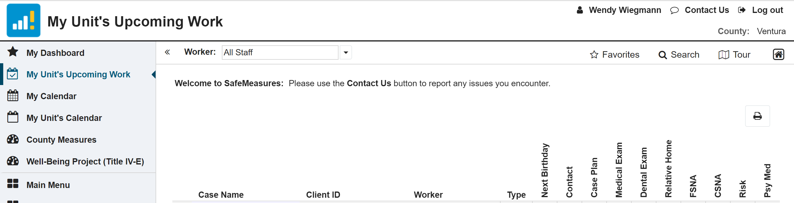
My Unit’s Upcoming Work
Notes:
Can filter by worker and sort by Case Name, ClientID, Worker (if you haven’t already preselected a worker), or any of the categories (these will list by most concerning).
Next Birthday: Birthday cake indicates a birthday coming up in the next 30 days.
Contact: This summary shows if a face-to-face client contact was made within the required timeframe. Only actual face-to-face contacts completed with the child/victim during the required timeframe are counted. A qualified contact is required monthly for all open cases. If a contact frequency waiver is in place, the time between contacts can be extended to two, three, or six months. This report currently allows for Contact Frequency Waivers which are no longer allowed under 2F. Non-dependent legal guardianship cases default to a six-month contact schedule.
Case Plan: Yes/No. Has the parent signature status been documented ("signed" or "refused to sign") for the active case plan?
Medical Exam: This display shows whether the client has been kept up to date with Child Health and Disability Prevention (CHDP) medical exams. When a child is removed from a home, he/she should receive an initial CHDP medical exam within 30 days of the removal date. After the initial examination date, workers are expected to ensure the child is seen for a qualifying medical exam in accordance with the published exam periodicity schedule.
Dental Exam: This display shows whether the child has been kept up-to-date with Child Health and Disability Prevention (CHDP) dental exams. When a child (3 years or older) is removed from a home, he/she should receive an initial CHDP dental exam within 30 days of his/her removal date. After the initial examination date, workers are expected to ensure that the child is seen for a qualifying dental exam in accordance with the published exam periodicity schedule. If the child being removed is under 3 years old, he/she will not be required (by AB636 standards) to have a CHDP dental exam until 30 days after his/her third birthday. If the client has had an exam after age 20, he/she does not need future CHDP exams and will be considered in compliance until he/she is out of the system.
Relative Home: Has a relative home assessment been completed for a child placed in a relative/NREFM home placement?
FSNA: Was a family strengths and needs assessment (FSNA) completed within 30 days prior to effective case plan (65 for court-dependent cases)? Excludes initial case plans and initial FSNAs.
CSNA: Was a child strengths and needs assessment (CSNA) completed within 30 days prior to effective case plan (65 for court-dependent cases)? Excludes initial case plans and initial CSNAs.
Risk: Was a risk reassessment or reunification assessment completed within 30 days prior to effective case plan (65 for court-dependent cases)? Excludes initial case plans and initial risk assessments.
Psy Med: Does the child have a current psychotropic medication authorization?

Slide 64
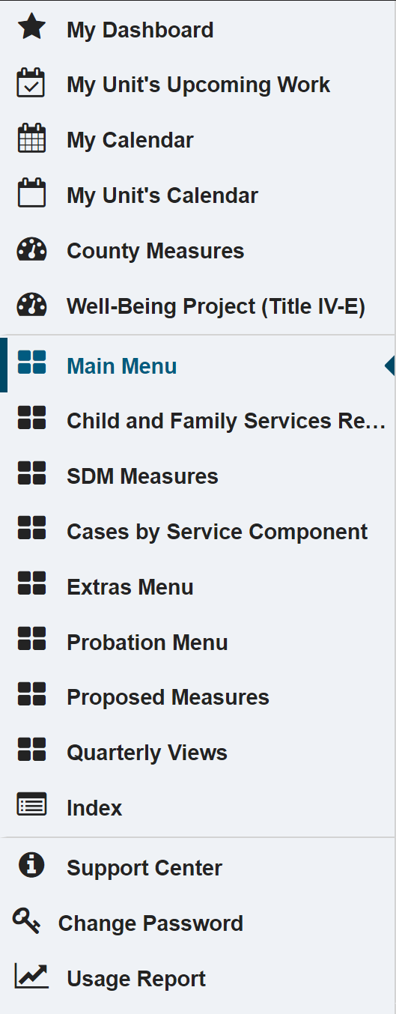
Additional SafeMeasures Lists
My Dashboard: Favorites, Alerts, Recommendations
My Upcoming Work: Stay On Top of Your Caseload
My Unit’s Upcoming Work: Be Aware of Problems
Calendars
Etcetera
Features!
Major reports that have been used for 10 years and still receive a lot of use
Reports from CFSR 2 & CFSR 3 & Statewide Measures
Lists!!
Safety, Risk, and Strengths/Needs (Case Plan) Assessments
Outdated and rarely used - these features can be accessed via the reports
Ancillary reports that may be useful
Includes measures relevant to probation-supervised caseloads only
New measures that address new state initiatives (e.g., CCR and RFA)
Reports that are reported quarterly in addition to monthly
All measures, alphabetically
Notes:
Many of the reports included in these lists are already covered in your My Upcoming Work and County Measures reports. However, you may explore these lists for additional reports that you want to pay attention to.

Slide 65
Main Menu
Notable Reports for Workers, Supervisors, or Both
Workers | Supervisors | Both
My Caseload | My Unit | Compliance Summaries
Investigation Time Open | Time to Referral Assignment | Time to First Contact
Face-to-Face Contacts | Data Issues | Case Plan Status
Face-to-Face Contacts in Preferred Location |  | Parent Signature
Education Enrollment |  | TILP Services
Current Physical & Dental Examinations |  | Relative/NREFM Home Assessments
Children Authorized for Psychotropic Mediation |  | Health & Education Documentation
Notes:
Many of these reports are included in the My Upcoming Work and County Reports. Full Main Menu list was too long to include. Instead, I included a list of reports most relevant to workers, supervisors, or both.
**Make a note of:
-- Children Authorized for Psychotropic Medication
-- Data Issues section

Slide 66
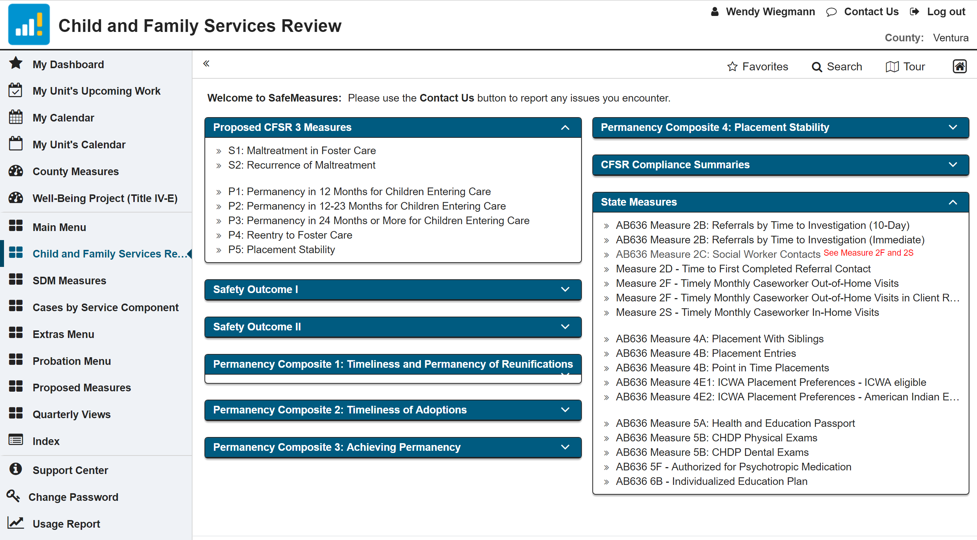
Children and Family Services Review
Notes:
No need to look at anything on this list except for the CFSR 3 and state measures

Slide 67
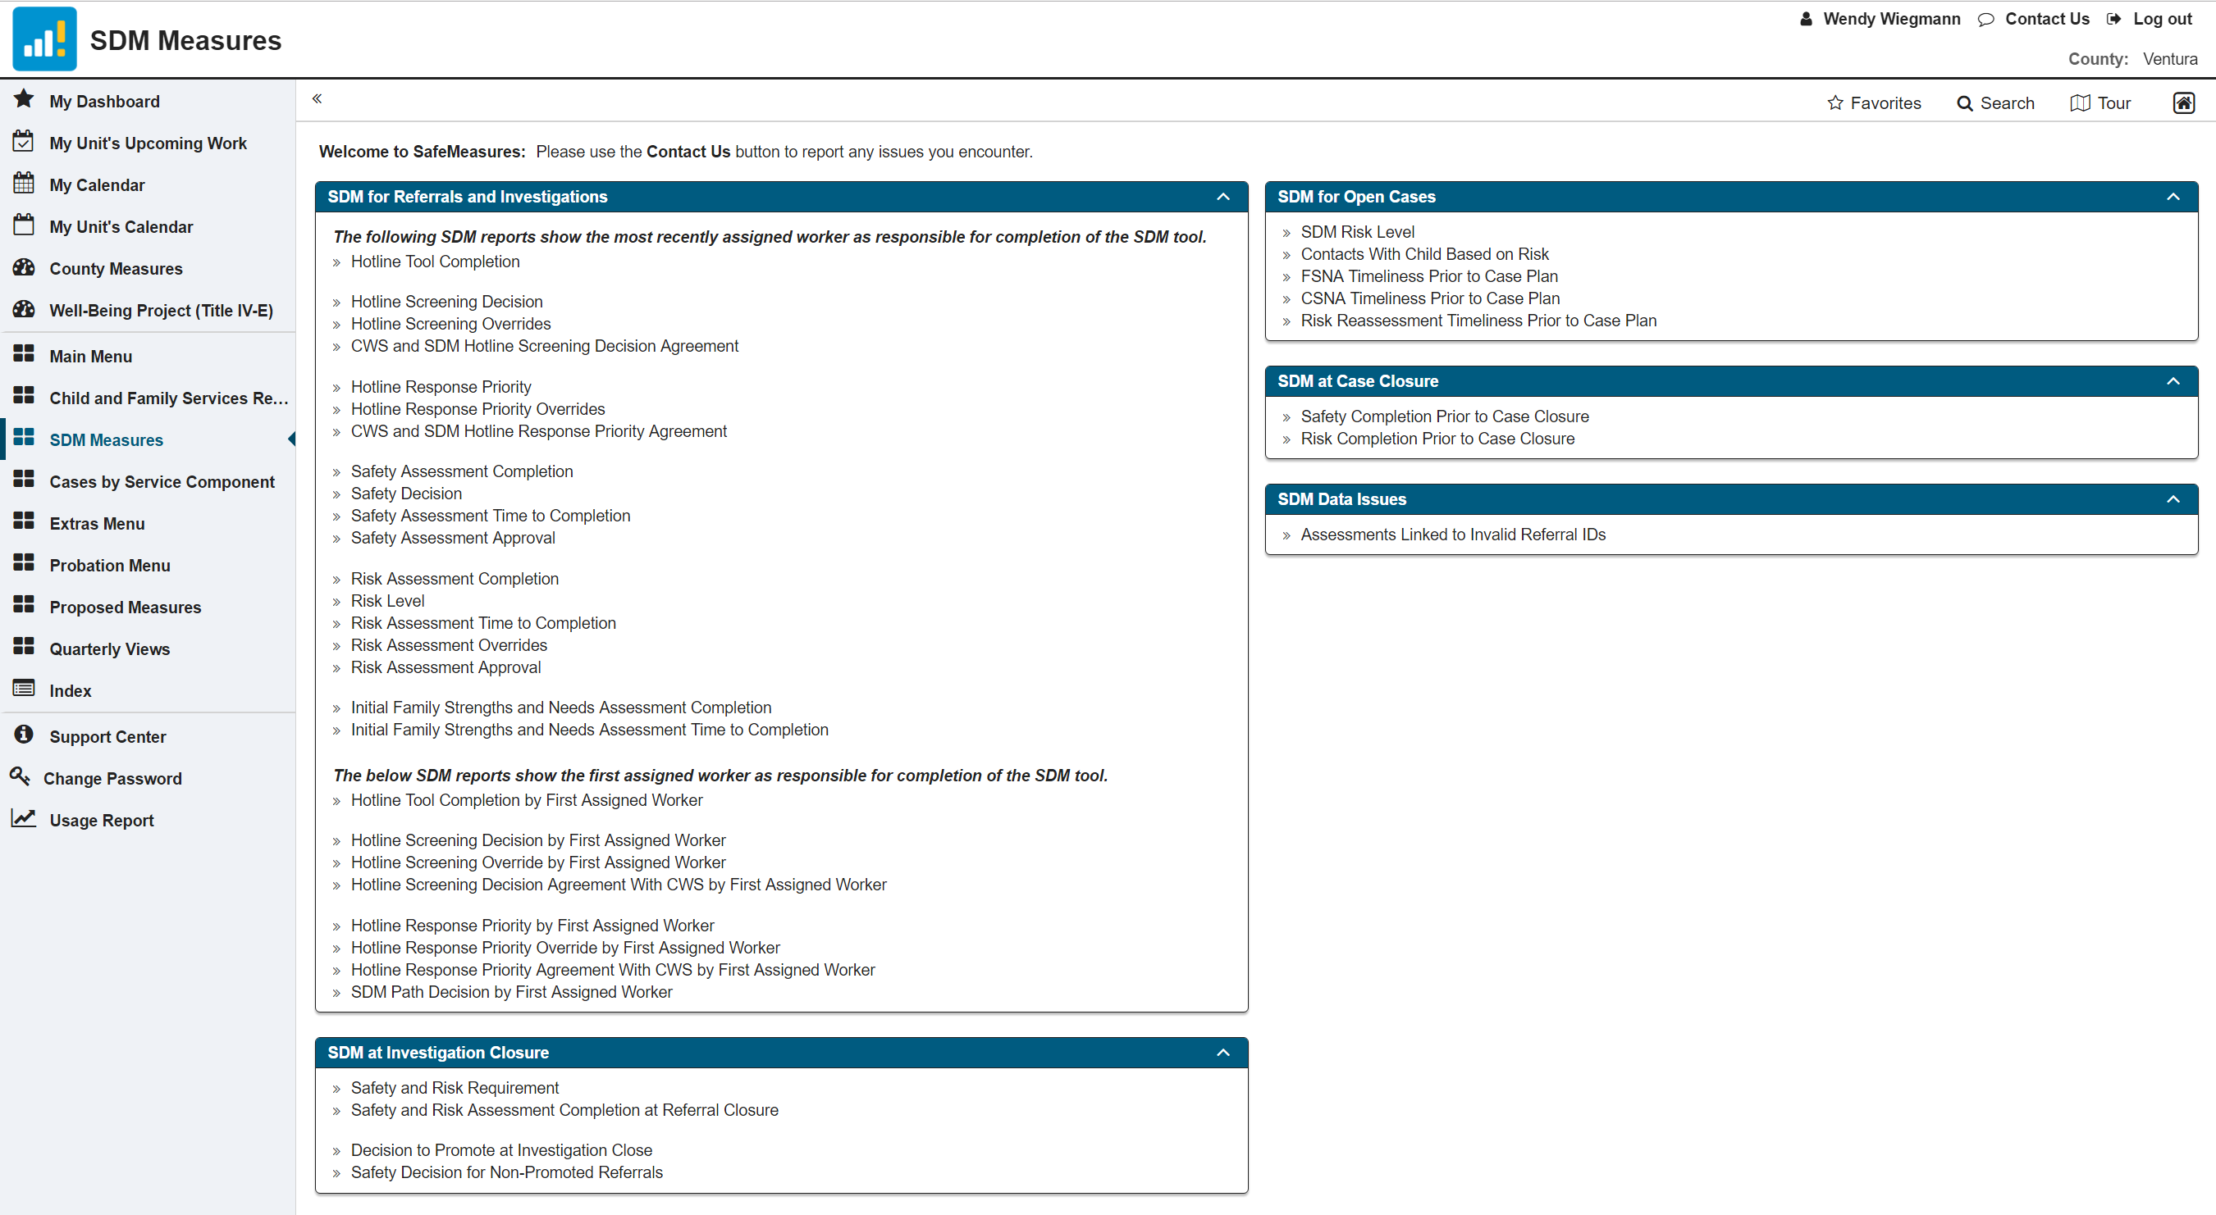
SDM Measures
Notes:
**Make a note of:
-- SDM at Investigation Closure
-- SDM at Case Closure
-- Referral and Case FSNA and CSNA reports.
-- SDM Data issues (for supervisors).

Slide 68
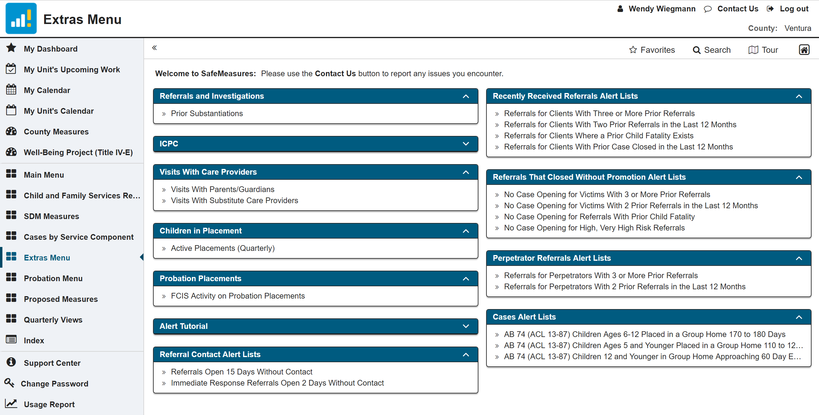
Extras Menu
Notes:
**Make a note of:
-- Referral Contact Alert Lists – too long to make contact
-- Referral, Promotion, and Perpetrator Alert Lists – cases that may need another look (for supervisors)
-- Case Alert Lists – Relevant to placements in group homes

Slide 69
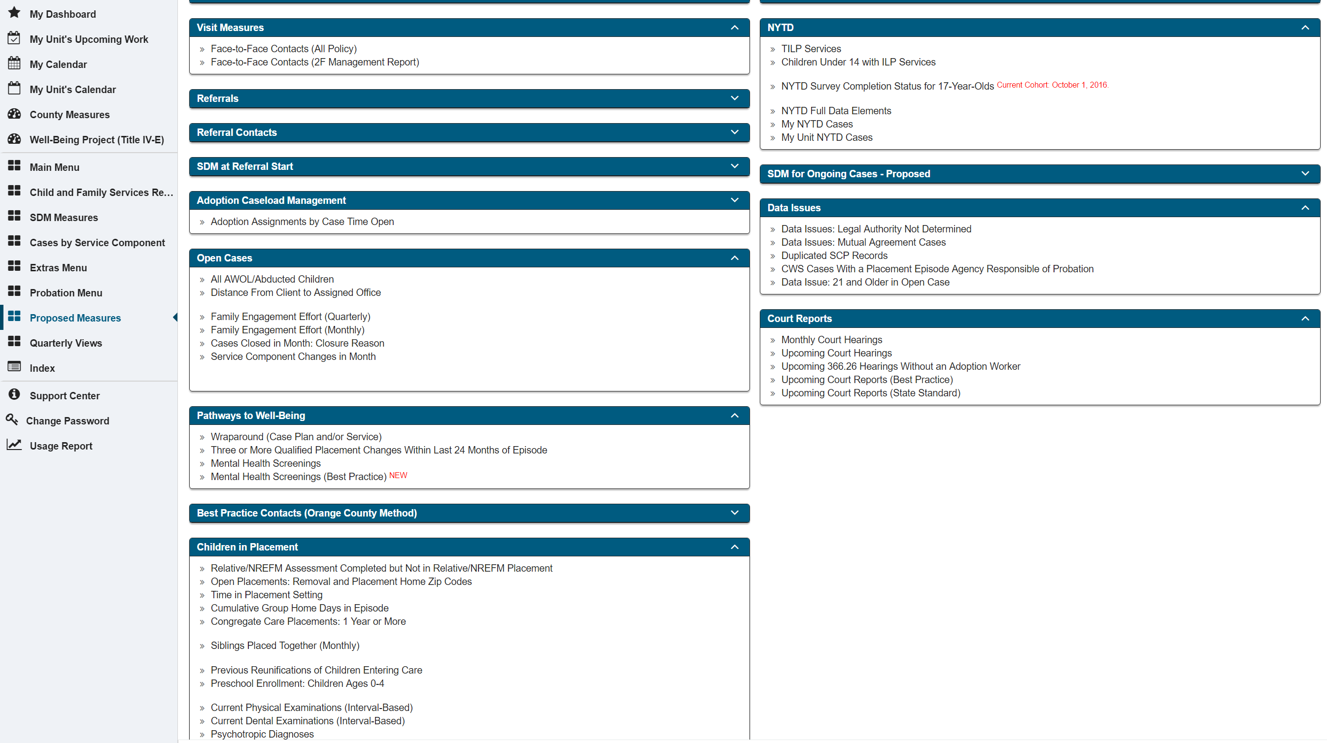
Proposed Measures
Notes:
This is a treasure trove, especially for the WIG and P4
**Make a note of:
-- Family Engagement Effort (Under Open Cases)
-- Mental Health Screenings (Under Pathways to Well-Being)
-- Psychotropic Diagnoses (Under Children in Placement)

Slide 70



Thank You!
  The California Child Welfare Indicators Project (CCWIP) is a collaboration of the California Department of Social Services and the School of Social Welfare, University of California at Berkeley, and is supported by the California Department of Social Services, the Stuart Foundation, and the Conrad N. Hilton Foundation.
Notes:
CCWIP is a collaboration of the California Department of Social Services and the School of Social Welfare, University of California at Berkeley, and is supported by the California Department of Social Services and the Stuart Foundation.

Slide 71
Questions? wendy.wiegmann@berkeley.edu

