Slide 1



CCWIP Data Analysis Training
Using the CCWIP Website to Answer Questions about Key Child Welfare Outcomes
Wendy Wiegmann
CCWIP
August 19, 2016

Slide 2
The Current Placement System*
(highly simplified)
the foster care system
CHILD IN
a bunch of stuff happens
CHILD OUT
*Adapted from Lyle, G. L., & Barker, M.A. (1998). Patterns & Spells: New Approaches to Conceptualizing Children’s Out of Home Placement Experiences. Chicago, IL: American Evaluation Association Annual Conference.
Notes:
2

Slide 3
Counterbalanced Indicators of
System Performance
rate of referrals/
substantiated referrals
home-based services vs.
out of home care
reentry to care
permanency
through reunification,
adoption, or
guardianship
use of least
restrictive
form of care
length
of stay
positive attachments to family, friends, and neighbors
stability of care
Source: Usher, C.L., Wildfire, J.B., Gogan, H.C. & Brown, E.L. (2002). Measuring Outcomes in Child Welfare. Chapel Hill, NC: Jordan Institute for Families,

Slide 4
Outline
Compare the three most common ways of looking at child welfare data.
Introduce the California Child Welfare Indicators Project (CCWIP).
Examine features of the CCWIP website and key data indicators for California’s children.

Slide 5
Time Dynamics in data analysis

Slide 6
3 Key Data Views in Child Welfare
Data
Entry
Cohorts
Exit
Cohorts
Point
in Time
Notes:
The first question that has to be answered is, “Whose outcomes do I want to measure?”
There basic are 3 choices:
Children in foster care - the active caseload (other terms: point-in-time, cross-section, or census)
Children leaving foster care - children who left placement in the last year (other terms: an exit cohort)
Children entering foster care - children placed during some period of time, usually one year (other terms: an admission cohort)
Each of these approaches represents a different way to sample the children who have ever been in foster care

Slide 7
Time Dynamics
Cross-Sectional Studies
  Examines a phenomenon by collecting/examining a “cross-section” of data (one observation at any point in time)
Exit Cohort
  Based on one observation at the last point in time
Longitudinal Studies
  Based on repeated observations over multiple points in time
Notes:
Cross-Sectional Studies
Examines a phenomenon by collecting/examining a “cross-section” of data at one time (one observation at a point in time)
BIG problem: Many questions we seek to answer aim to understand causal processes that occur over time (e.g., outcomes for children in foster care)
Exit Cohort Studies
Based on one observation at the last point in time
Longitudinal Studies
Based on repeated observations of a given unit over multiple points in time
Trend Studies
Cohort /Panel Studies

Slide 8
What is the difference?
Cross-Sectional/Point-in-time - Only children in care
Exit cohort - Only children who left care
Entry cohort - All children who entered

Slide 9
What are the implications?
It is much harder to measure outcomes over time using either a point-in-time or an exit cohort sample because the samples are missing some children:
  A point-in-time analysis is missing the kids who left placement
  An exit cohort only includes kids who leave
  You can’t assess change if you leave out either of these children because their experiences aren’t factored into the outcomes. All children have to be included in the system for monitoring outcomes.

Slide 10
PIT Snapshots vs Entry Cohorts
Jan. 1, 2015
Jan. 1, 2014
Jan. 1, 2016
Notes:
Another problem with point-in-time data: the overcapture of long-stayers.

Slide 11
Tracking an Entry Cohort for 1 Year
2014
2015
Dec. 31
Dec. 31
Jul. 7
Jul. 7
Mar. 1
Mar. 1
Jan. 1
Dec. 31
Jan. 1
Dec. 31
Notes:
How Entry Cohorts work

Slide 12
The California Child Welfare Indicators Project (CCWIP)

Slide 13
CCWIP Overview
Aggregates California’s administrative child welfare data into customizable tables that are refreshed quarterly and made available on a public website
Provides stakeholders with direct access to information on California’s entire child welfare system to examine performance measures over time
Data can be stratified and filtered by year, county, age, ethnicity, gender, placement type, and other subcategories

Slide 14
Where do the data come from?
Data entered by county social workers
Compiled by IBM
“Data dump” received by CCWIP
Longitudinally configured
Used for quarterly reports
Data used to track outcomes
Published on public website

Slide 15
Activity: “Exploring CCWIP Data”
first allegation of maltreatment
allegation evaluated out
second allegation of maltreatment
allegation substantiated
pre-placement family maintenance services provided
child placed in out-of-home foster care
child reunified
third allegation of maltreatment
child re-enters foster care
Notes:
This is an example of what kind of system level information about children’s pathways through the system – there is more information available on the site such as disparities, placement with siblings, and placement distances.

Slide 16
website
http://cssr.berkeley.edu/ucb_childwelfare/

Slide 17
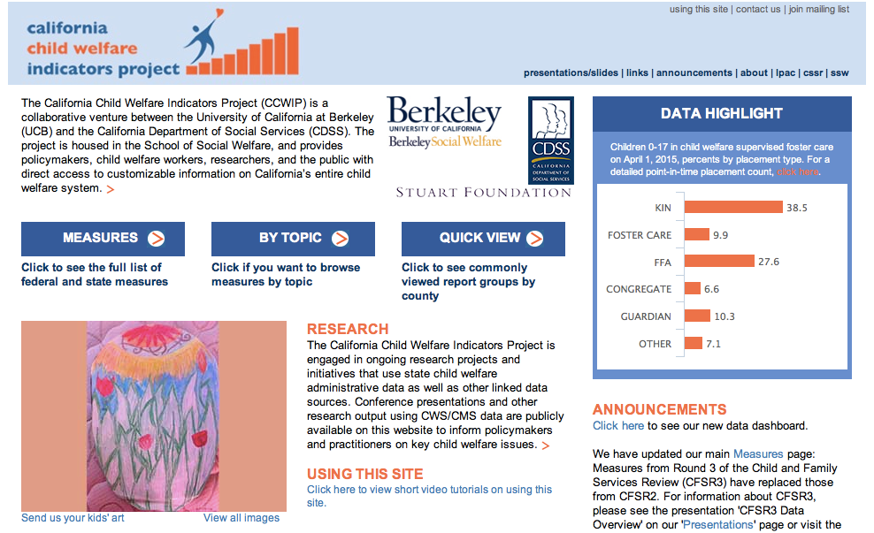
Website

Slide 18
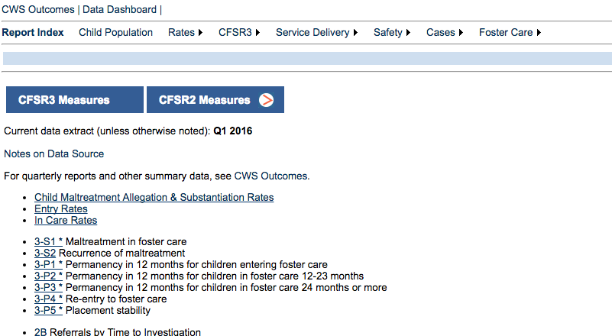
Report Index

Slide 19
Computing a Percent
PERCENT: A proportion in relation to a whole expressed as a fraction of 100.
% percent (per 100) = x 100
part
___
total

Slide 20
Computing a Percent
Among children who were the subject of a child maltreatment allegation in 2015, what percentage were substantiated?
# substantiated
_________________
# allegations
x 100
Raw Numbers (counts)
# Substantiated = 76,909
# Allegations = 501,411
76,909
= ________ X 100
501,411
= 0.153 x 100
= 15.3%
Notes:
Data is from the Child Maltreatment Allegation and Substantiation Rates (California): http://cssr.berkeley.edu/ucb_childwelfare/RefRates.aspx
This calculation translates our raw number into a standard scale that we can interpret and use to compare across counties or states.

Slide 21
Computing a Rate per 1,000
RATE: A proportion in relation to a whole, can be expressed as a fraction of 100, 1000, 100,000, etc.
rate per 1000 = x 1000
part
____
total
Notes:
Why do we use rate per 1,000 vs per 100 or per 10,000?

Slide 22
Computing a Rate per 1,000
What was the child maltreatment allegation rate for children in California in 2015? (i.e., how many children were the subject of a child maltreatment allegation out of all possible children in the population?)
# allegations
______________
# child population
x 1000
Raw Numbers (counts)
# Allegations = 501,411
# Child population = 9,102,486
501,411
= _________ X 1000
9,102,486
= 0.055 x 1000
Scales for a meaningful interpretation and comparison.
= 55.1
Notes:
Data is from the Child Maltreatment Allegation and Substantiation Rates (California): http://cssr.berkeley.edu/ucb_childwelfare/RefRates.aspx
By multiplying by 1000, we translate the raw number (501,411) into a rate that we can interpret (55.1). This also allows us to compare across counties and across states as the numbers we are comparing are now on the same scale (i.e. per 1000).

Slide 23
Please complete exercises
1a through 1c
Worksheet:

Slide 24
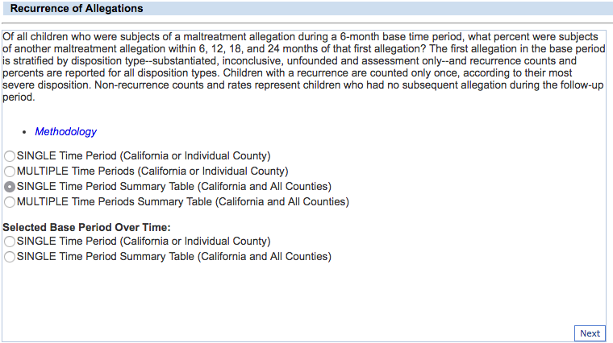
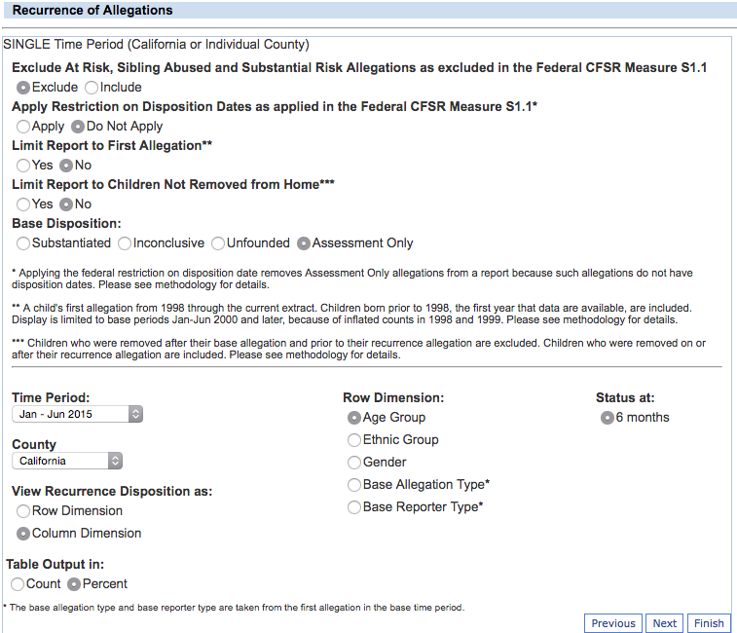
Filters

Slide 25
Please complete exercises
2a & 2b
Worksheet:
Notes:
Importance of the comparison to their percentage of the population not just most frequent.

Slide 26
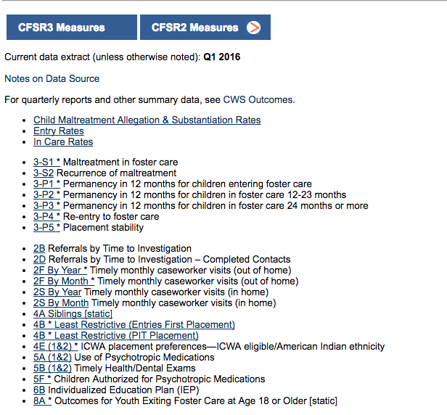
Federal (CFSR) Measures

Slide 27
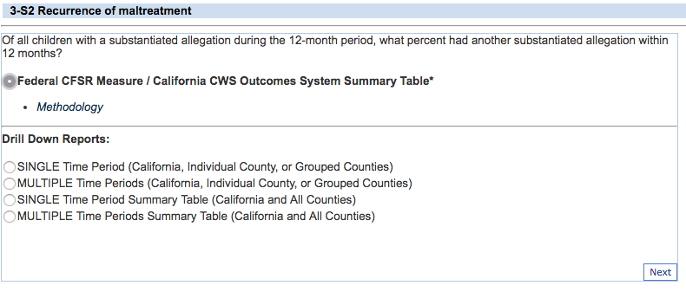
Federal CFSR Summaries

Slide 28
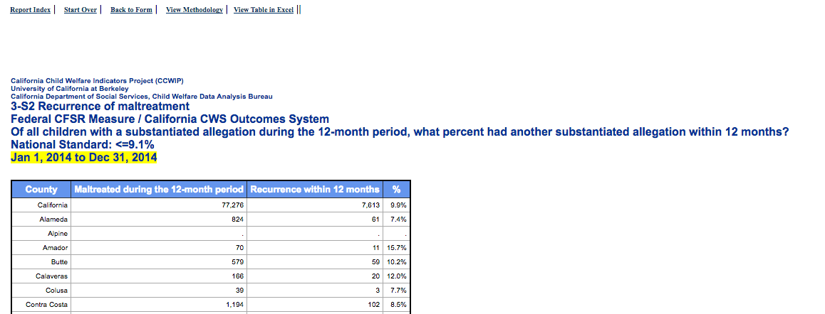
Methodology Links

Slide 29
Please complete exercises
3a through 3D
Worksheet:

Slide 30
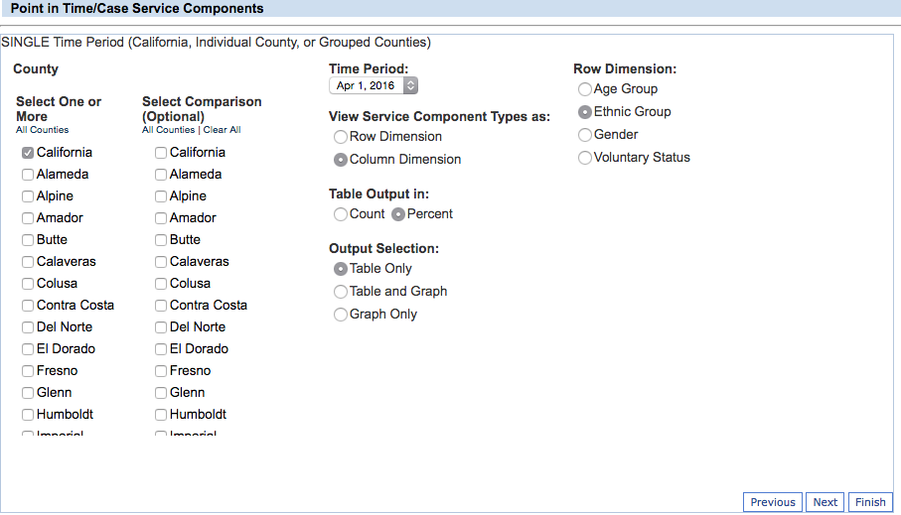
Row & Column Dimensions

Slide 31
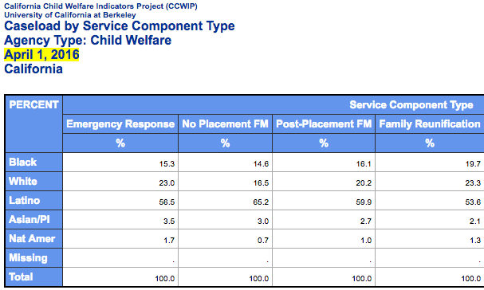
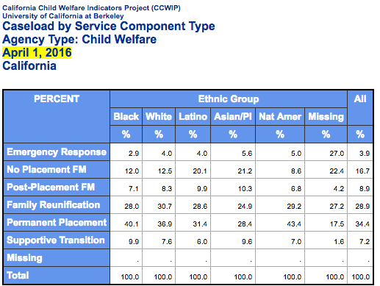
Service Component as
Row & Column Dimensions
Row
Column

Slide 32
Please complete exercises
4a & 4b
Worksheet:

Slide 33
Disproportionality vs. Disparity
Disproportionality: When a group makes up a proportion of those experiencing some event that is higher or lower than that group’s proportion of the population
Disparity: A comparison of one group (e.g., regarding disproportionality, services, outcomes) to another group

Slide 34
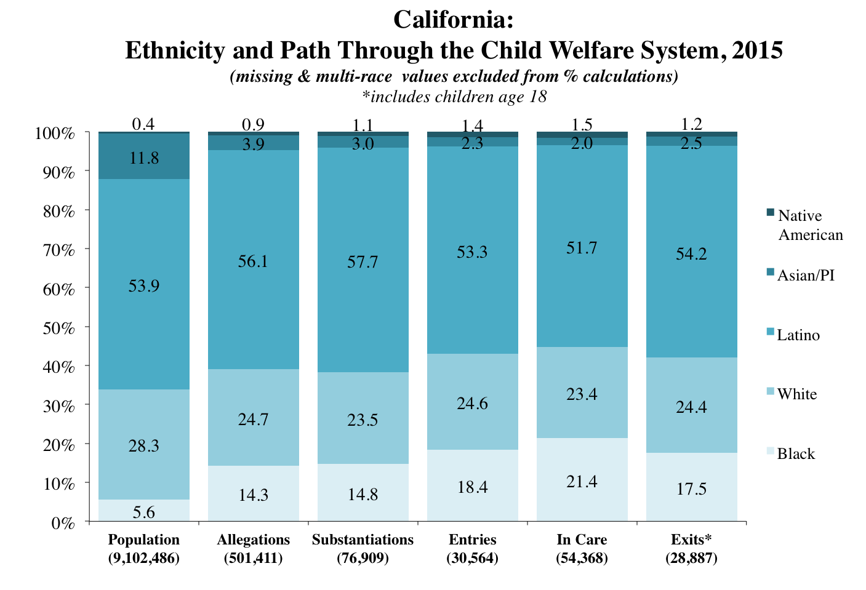

Slide 35
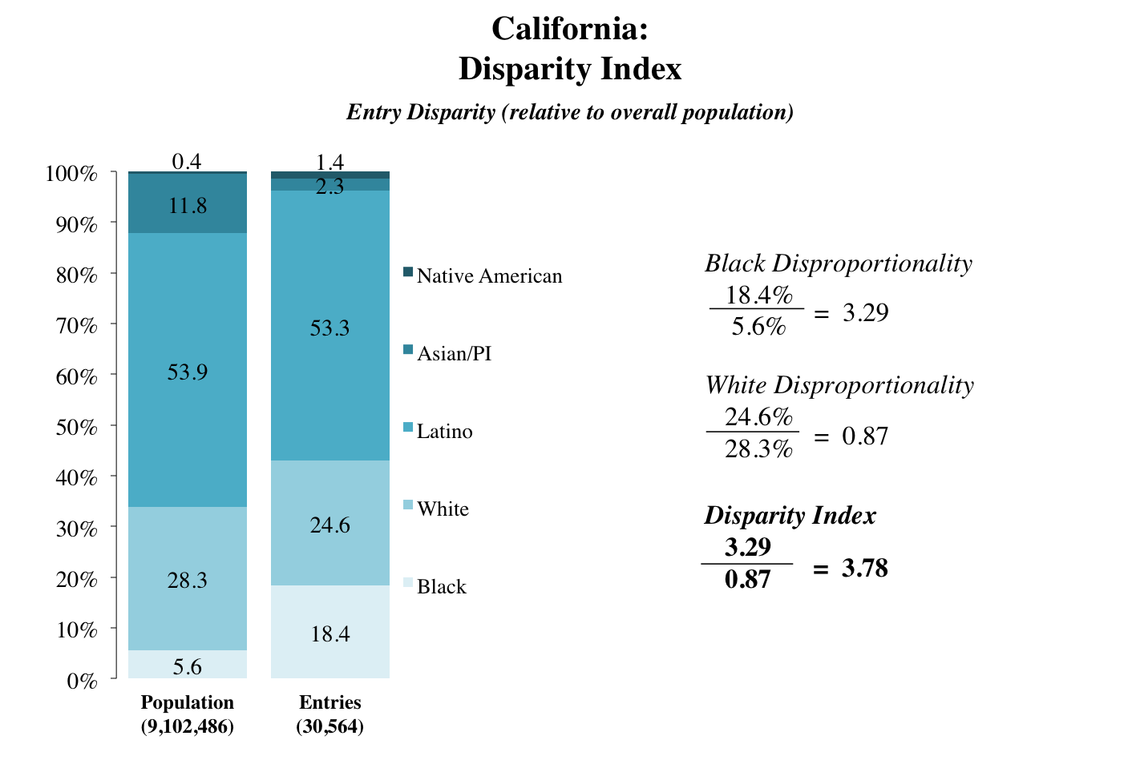
“Black children are 3.78 times more likely to enter care than white children.”

Slide 36
Please complete exercises
5a through 5c
Worksheet:

Slide 37
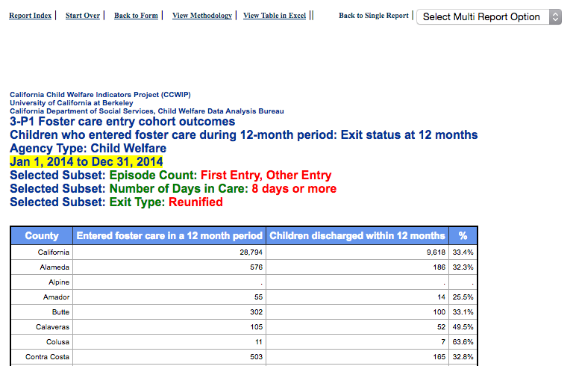
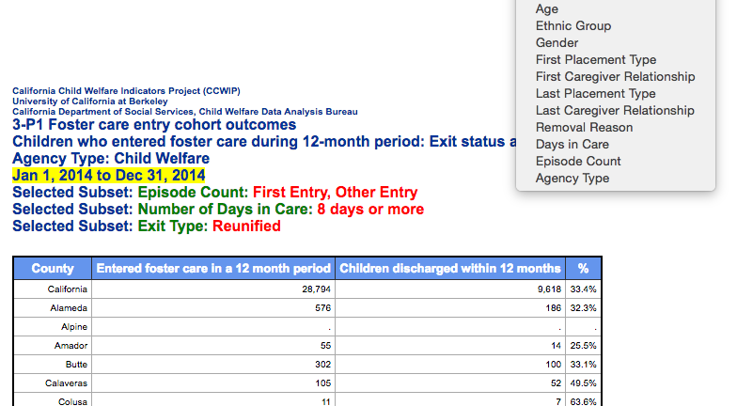
Multi-Report Option

Slide 38
Please complete exercises
6a & 6b
Worksheet:

Slide 39
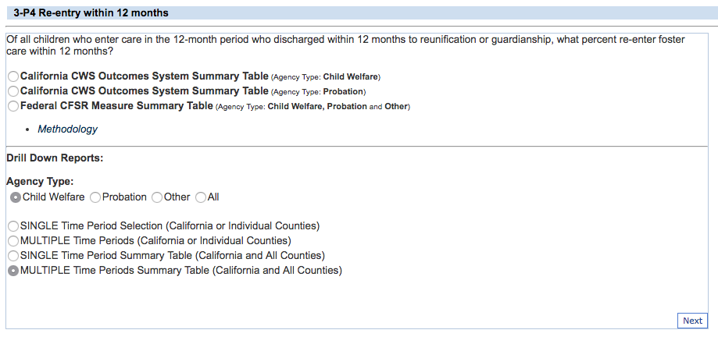
Multiple Time Periods

Slide 40
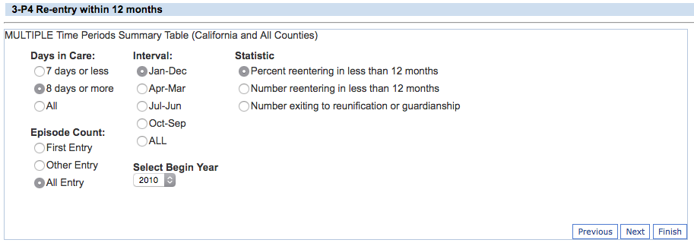
Additional Subgroup Filters

Slide 41
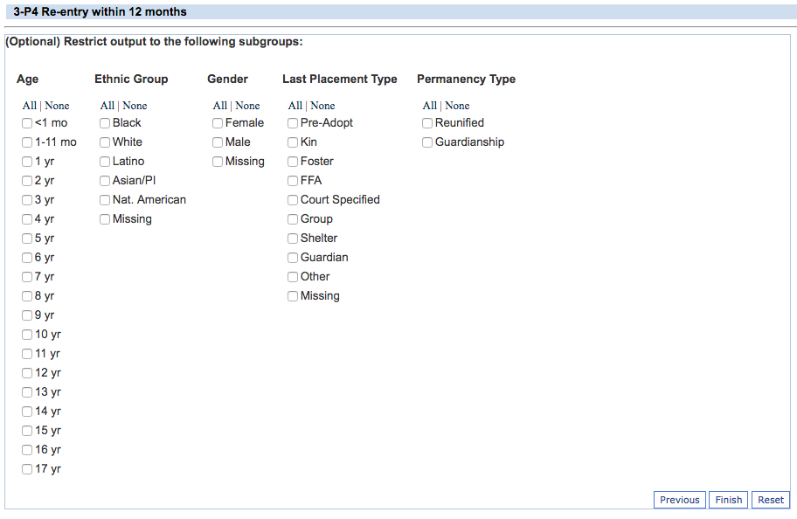
Additional Subgroup Filters

Slide 42
Please complete exercises
7a through 7c
Worksheet:

Slide 43



Thank You!
  The California Child Welfare Indicators Project (CCWIP) is a collaboration of the California Department of Social Services and the School of Social Welfare, University of California at Berkeley, and is supported by the California Department of Social Services, the Stuart Foundation, and the Conrad N. Hilton Foundation.
Notes:
CCWIP is a collaboration of the California Department of Social Services and the School of Social Welfare, University of California at Berkeley, and is supported by the California Department of Social Services and the Stuart Foundation.

