Slide 1
California CW Performance Indicators Project: Hopes for Big Changes in the CFSR What’s New on the Website
Barbara Needell, MSW, PhD
Center for Social Services Research
University of California at Berkeley
The Performance Indicators Project is a collaboration of the
California Department of Social Services and
the University of California at Berkeley,
and is supported by the
California Department of Social Services and the Stuart Foundation

Slide 2
assumptions
familiarity with CFSR process
prior visit to UCB/CDSS website
appetite for alphabet soup
IC
IV-E
CFSP
AFCARS
ACF
SACWIS
CQI
PIP
CWDA
NRC
NAPCWA
QA
APSR
CFSR
NYTD

Slide 3
the current placement system* (highly simplified)
the foster care system
a bunch of stuff happens
CHILD IN
CHILD OUT
*adapted from Lyle, G. L., & Barker, M.A. (1998) Patterns & Spells: New approaches to conceptualizing children’s out of home placement experiences. Chicago: American Evaluation Association Annual Conference
Notes:
3

Slide 4
recommendations for CFSR redesign
NAPCWA
Casey Family Programs
CWDA
Notes:
Recommendations and Responses to ACF Requests for Comments about CFSR Redesign:
NAPCWA
input from CA & 48 other states
expert panel
Casey Family Programs
Several Conferences with many states/counties attending (including CA counties)
CWDA

Slide 5
outcome measures…
what we have
what we need
Composite 1
C1.1
Composite 2
C2.1
Composite 3
C3.1
Composite 4
C1.2
C1.4
C4.1
C4.2
C4.3
C3.2
C3.3
C2.2
C2.3
C2.4
C1.3
C2.5
valid.
reliable.
comprehensible.
= a good measure.
Notes:
Outcome data measures should be valid, reliable and comprehensible.
Use of principal components analysis should be abandoned.

Slide 6
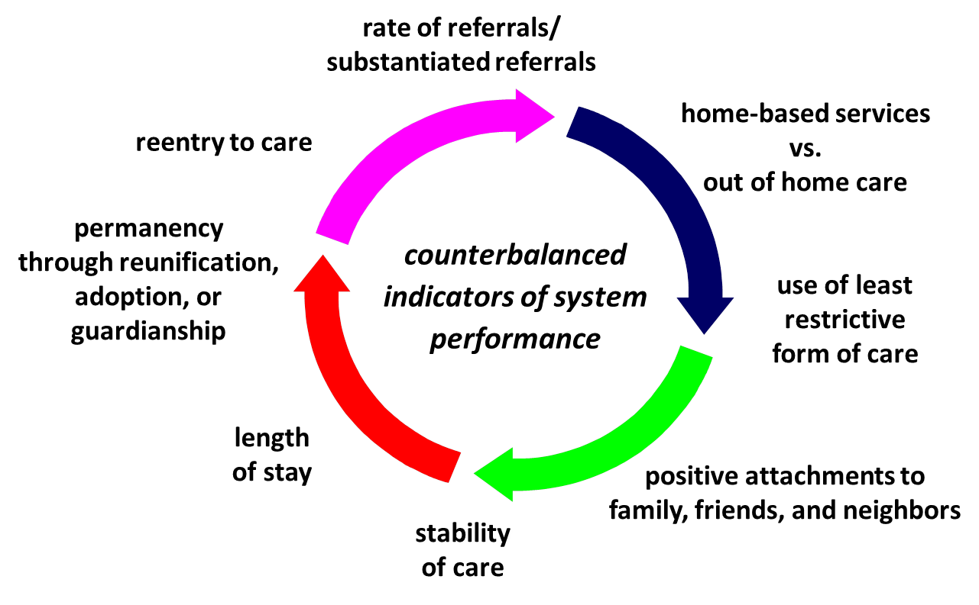
outcome measures…
Data should be gathered and analyzed in a manner that facilitates understanding of how one area of practice affects another
Notes:
Data should be gathered and analyzed in a manner that facilitates understanding of how one area of practice affects another.

Slide 7
outcome measures…
baseline Z
period 5
period 6
period 1
period 2
period 3
period 4
target
national standards
STATE C
baseline Y
period 5
period 6
period 1
period 2
period 3
period 4
target
STATE B
baseline X
period 5
period 6
period 1
period 2
period 3
period 4
target
STATE A
Notes:
Assessment of state improvement should be examined over time and against states’ own baselines.
States should set their own targets for improvement.
No national standards.

Slide 8
proposed measures
Maltreatment Recurrence
Entry to Care
Abuse in Care
Placement Stability
Length of Stay
Exits to Permanency
Maintenance of Permanence
outcome measures (required)
adoption disruption
re-reports post in-home services
exits from in-home services
in-home services
re-reporting rate
victimization rate
case opening rate
investigation rate
response rate
reporting rate
IGNORE THIS LEVEL
additional measures (optional)
Notes:
Proposed Outcome Measures (required):
Maltreatment Recurrence
# re-victimized within 6, 12, 18, 24 months/#child victims in a 12-month period
Entry Rate
# children into foster care <18/child population <18)
Abuse in Foster Care
# children maltreated by their provider during the year/child care-years during the year
Placement Stability
# of moves per child/care year in the most recent year
Median Length of Stay
Months after entry it takes for ¼, ½ and ¾ of children to exit care.
Exit to Permanency
# children achieving permanence (reunification, guardianship, relative placement, adoption) in 6, 12, 24, 36 months/#children entering foster care (12-month entry cohort).
# children exiting to permanency during the year/children in care on first day of year
Maintenance of Permanency
# of children re-entering care within 6, 12, 18, 24 months of exit/# children exiting care to reunification, guardian, placement with relatives
Capacity Measures (optional):
Reporting Rate
# unique children reported/# child population <18
Response Rate
# unique children receiving response/# child population <18
Investigation Rate
# unique children receiving investigation/# child population <18
Case Opening Rate
# unique children with case opened/# child population <18
Victimization Rate
# unique children founded or indicated for child maltreatment/# child population <18
Re-reports
# children with a new screened-in report/# children with screened-in report in a 12- month period
Children Beginning In-Home Services
# children beginning in homes services in a 12-month period/# case openings
Children Exiting In-Home Services to Case Closure or Foster Care
# children exiting in home services to case closure and # children exiting in-home services to foster care in a 12-month period/# children exiting in-home services
Re-report Following Closure of In-Home Services
# of children with a subsequent screened in report within 6 months following closure from in-home services
Adoption Disruption
# of children re-entering care within 6, 12, 18 and 24 months of exit/# children exiting care to a finalized adoption.

Slide 9
proposed measures
worker – child visits
timeliness of investigations
process measures (required)
school enrollment
mental health screening
dental evaluation
medical evaluation
IGNORE THIS LEVEL
status at/after emancipation
well-being measures (optional)
Notes:
Process Measures (required):
Worker-Child Visits
# children visited face-to-face during month/# children in foster care for full month
Timeliness of Investigations
# of initial face-to-face contacts between worker and alleged victim seen within state response time/# alleged victims
Well-Being Measures (optional):
Connections to services (medical and dental evaluations, mental health screening, school enrollment). Children in foster care for at least 60 days:
# children receiving medical evaluation within 60 days/# entries
# children receiving dental evaluation within 60 days/# entries
# children receiving MH screening within 60 days/# entries
# children enrolling in school within 7 days within entry/# entries
Status of children at and after emancipation

Slide 10
state CQI/QA systems
CQI / QA Systems
DATA
FUNDING
QA costs should be 75% reimbursable (IV-E training expenses)
states with inadequate capacity should receive federal assistance
MONITORING
“levels of adequacy” for state systems set by DHHS
states meeting adequate standard of self-monitoring and performance use internal review processes
qualitative data
TARGETS
quantitative data
other states rely on federally guided review process
no more than three targeted areas at a time
Notes:
Monitoring
DHHS should establish levels of adequacy for state CQI and QA systems.
States meeting the highest standard of self-monitoring and performance should be allowed to use their own internal CQI processes instead of federal review.
Data
CQI/QA systems should rely on both qualitative and quantitative data.
Targets
No more than three targeted areas at a given time.
Funding
Costs for QA activities should be 75% reimbursable, as a part of IV-E training expenses.
States with inadequate CQI/QA capacity should receive federal assistance

Slide 11
eliminate redundancies
current
CFSR/ PIP
proposed
integrated process & reports
CFSP/ APSR
IV-Review
current
AFCARS
proposed
combined compliance review
SACWIS
Notes:
The CFSR and PIP should be folded into the CFSP and AFSR with one overarching plan for a five-year continuous CQI cycle.
The SACWIS and AFCARS compliance reviews can also be combined into one process.
The IV-E review may need to stand alone as a compliance review that relates to the whole system, although it could be an added component to a selected number of case reviews.

Slide 12
federal role?
NRCs & ICs
relevant and timely technical assistance
coordination of information-sharing between organizations
IV-E Funding
SACWIS funding flexibility to keep pace with technology development
comprehensive finance reform
data
option 1:
fiscal support to states for longitudinal databases
option 2: construction and management of federal longitudinal database
Notes:
National Resource Center (NRCs) and Implementation Centers (ICs) should offer relevant, useful and timely technical assistance. NRCs can also coordinate efforts and improve information-sharing between organizations and foundations.
Federal IV-E funding for SACWIS should be used more flexibly to keep pace with technological developments and agency needs. Waivers are a stop-gap measure that demonstrates the need for comprehensive child welfare financial reform.
The federal government should provide fiscal support to states for a multi-year longitudinal database OR construct and manage its own longitudinal federal database

Slide 13
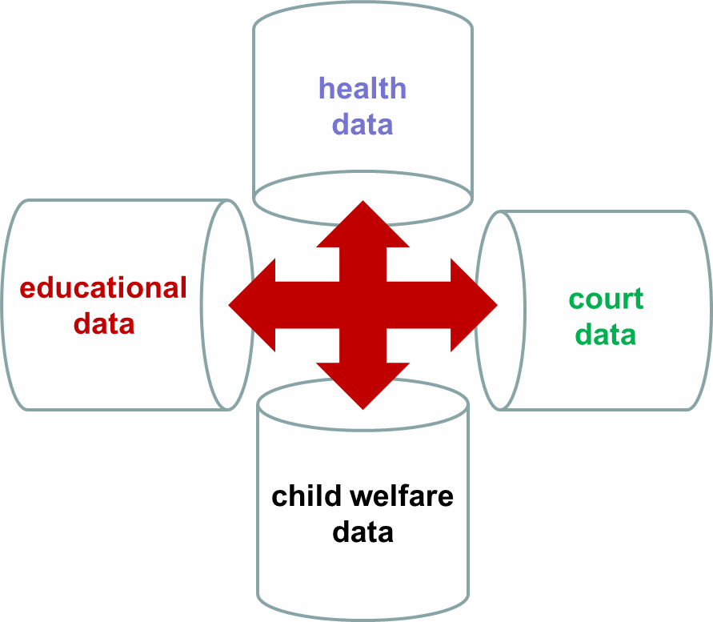
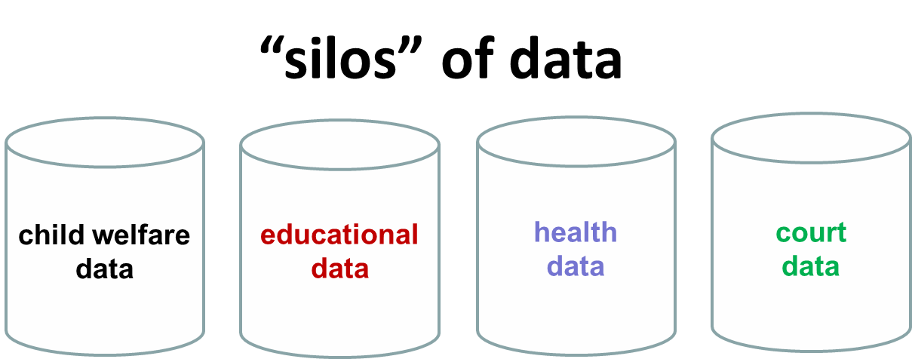
data-sharing / interoperability (near-term goal)
Notes:
Technological innovations should be pursued to improve data sharing across health, education, court and social services systems.

Slide 14
outcome measures…
birth
home visiting
family supports
referral
entry
family preservation
measures of primary and secondary prevention services?
Notes:
Measures of prevention services should be developed.

Slide 15
data-sharing / interoperability (longer-term vision)
social services data concerning vulnerable children and families
current.
fully linked and integrated (real-time) administrative data systems for the coordinated delivery and evaluation of services
future.
Notes:
Technological innovations should be pursued to improve data sharing across health, education, court and social services systems.

Slide 16
evaluating performance
improved performance
targeted investments
evaluation
outcome measures should not be pass/fail, objective is continuous improvement
an incentive-based system promotes the growth of programs and practices that have proven effective
good performance does not require the same level of federal oversight, continuum of oversight can be used to reward performance while focusing federal resources on states requiring more assistance
poor performance indicates an area where investments are needed, penalties divert scarce resources
penalties should be used only when there is a lack of good faith effort or willful disregard on the part of the state, penalty options should be negotiated with jurisdictions in an effort to target investments
Notes:
Outcome measures should not be pass/fail.
Can be used to recognize and encourage building on programs and practices that have proven effective.
Can also promote improvement by recognizing good performance. (Example: a continuum of federal oversight, with less oversight being a reward for positive performance.)
Poor performance should be tied with increased investment into areas requiring improvement.
Penalties divert scarce resources from child welfare systems.
If used at all, only when there is “a lack of good faith effort or willful disregard on the part of the state of any plan for improvement
DHHS should have discretion to negotiate penalty options with jurisdictions.
Can be tied to outcome measures

Slide 17
website changes & new functionality

Slide 18
multi-reports
multiple tables on a single page
change between different breakouts using the dropdown menu
demo: measure C1.3 (Reunification within 12 Months)
http://cssr.berkeley.edu/ucb_childwelfare/c1M3.aspx
Notes:
Although the website has always offered users the ability to examine outcomes across demographic categories, it now allows users to create multiple tables on a single page using a dropdown menu called multi-reports.
Users can utilize this feature without leaving the report they have already created and can change between different breakouts using the dropdown menu.
Demo: Measure C1.3 (Reunification within 12 Months) can be stratified by Age AND Ethnic Group, Gender, Placement Type, Removal Reason, and Caregiver Relationship.

Slide 19
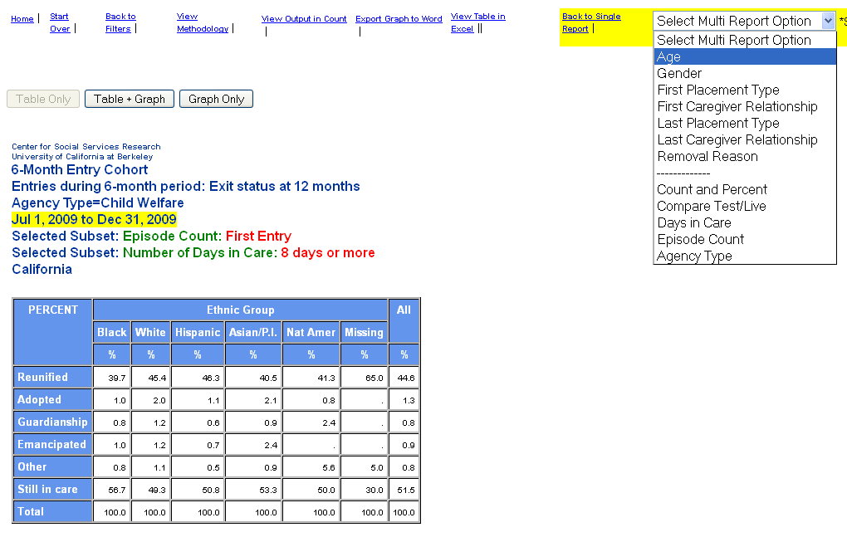
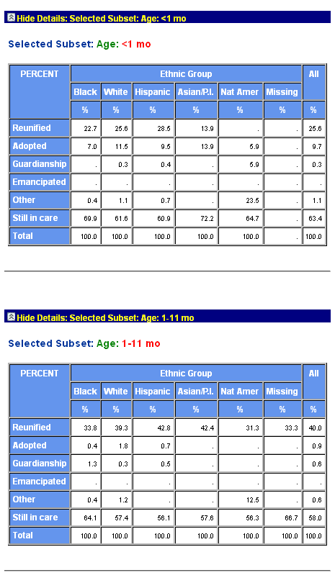
multi-reports (demo)

Slide 20
graphing
Table + Graph and Graph only
can be used in combination with the multi-reports function
can also be saved in a MS Word document and copied into MS Excel
demo: Measure C1.3 (Reunification within 12 months)
http://cssr.berkeley.edu/ucb_childwelfare/c1M3.aspx
Notes:
For the majority of the reports, the website now offers users the ability to generate a graph of a report they have created on the same page as the report using one of two buttons: Table + Graph and Graph only.
The graphing function can be used in combination with the multi-reports function to create multiple tables and graphs on the same page.
Graphs can also be saved in a MS Word document and copied into MS Excel.

Slide 21
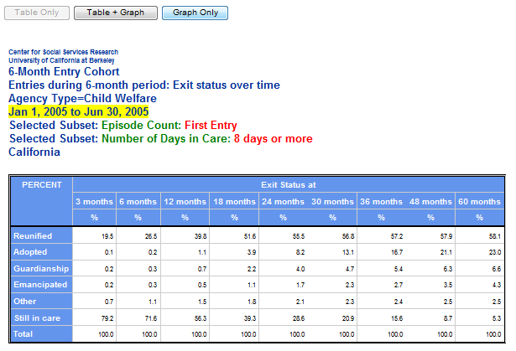
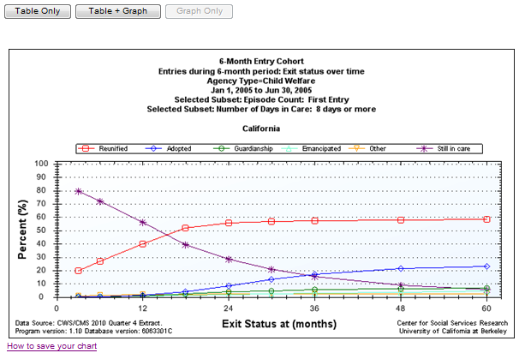
graphing (demo)

Slide 22
clustering
Entries and Point-in-Time (more to come)
Compare individual counties to each other or to California as a whole
Compare clusters of counties (e.g. urban vs. rural)
can be viewed in tables and graphs (no multi-report function)
demo: Bay Area Counties and Los Angeles
http://cssr.berkeley.edu/ucb_childwelfare/Entries.aspx
Notes:
For two reports, Entries and Point-in-Time, a new grouping feature allows users to quickly group and compare counties
Compare individual counties to each other or to California as a whole
Compare clusters of counties (e.g. urban vs. rural)
Data can be viewed in both tables and graphs and can be narrowed using filters (no multi-report function when using the county comparison function).
Demo: examine the placement differences for first entries by ethnicity in two major metropolitan areas, the San Francisco Bay Area (Alameda, Contra Costa, Marin, Napa, San Benito, San Francisco, San Mateo, Santa Clara, Solano, and Sonoma) and the Greater Los Angeles Area (Los Angeles, Orange, Riverside, San Bernardino, Ventura)
http://cssr.berkeley.edu/ucb_childwelfare/Entries.aspx

Slide 23
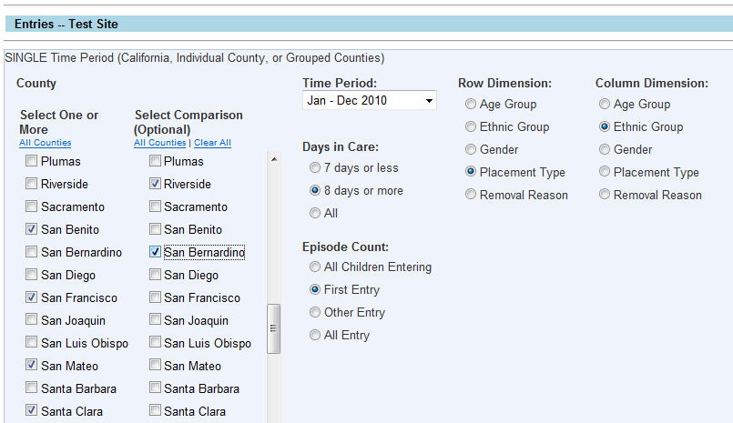
clustering (demo): selecting groups for comparisons (entries)

Slide 24
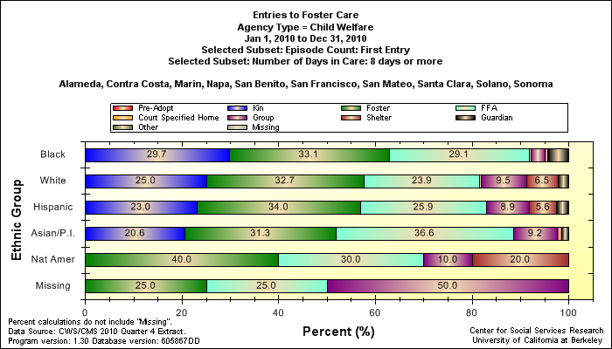
clustering (output): first entries by ethnicity and placement type in the San Francisco Bay Area, 2010

Slide 25
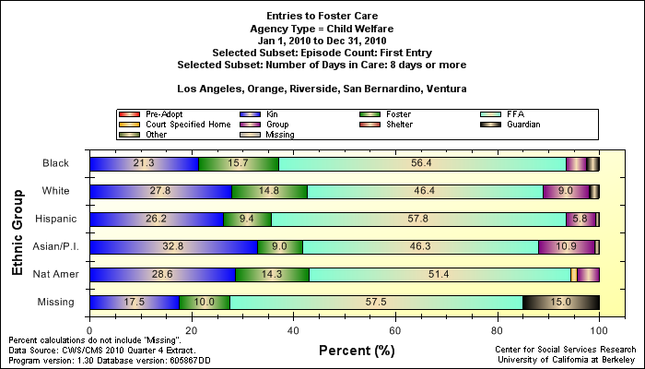
clustering (output): first entries by ethnicity and placement type in the Greater Los Angeles Area, 2010

Slide 26
key outcomes presentation tool
selected reports
display and compare California and/or individual counties
percent change calculations
from our main page:
click 'see CWS Outcomes' or 'CWS Outcomes' on the navigation bar to go to: http://cssr.berkeley.edu/ucb_childwelfare/Ccfsr.aspx

Slide 27
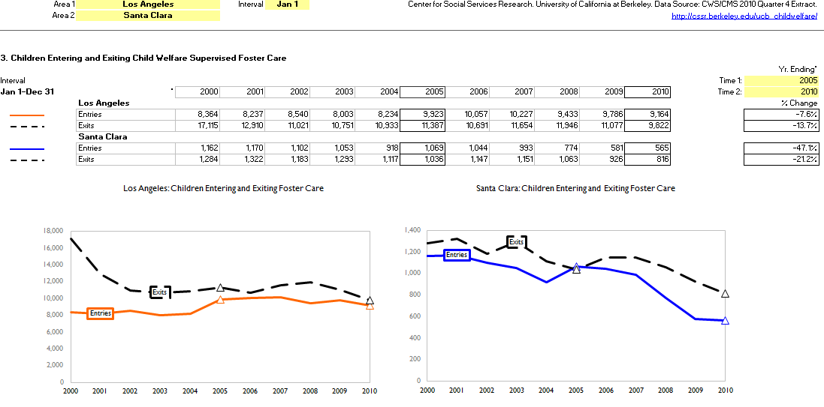
key outcomes presentation tool

Slide 28
placement stability
enhancement of current federal measure
likelihood of moves in most recent year
http://cssr.berkeley.edu/ucb_childwelfare/C4M123.aspx

Slide 29
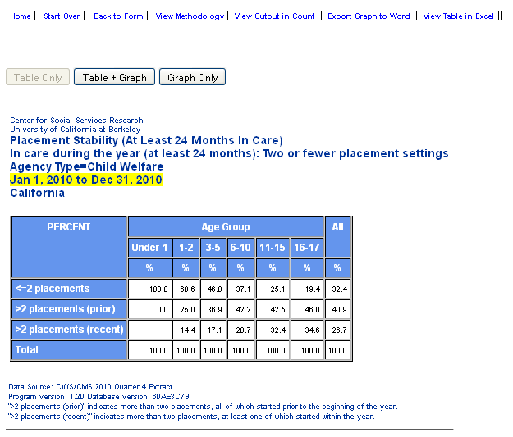
placement stability (demo)

Slide 30
poverty data
2005-2010 estimates of the population of children (ages 0-17) living in poverty by race/ethnicity
using the U.S. Census Bureau's 2005-2009 American Community Survey (ACS) 5-Year Estimates, poverty multipliers were calculated by race/ethnicity for California and each of its 58 counties
multiplier applied to the California Department of Finance Population Estimates for the years 2005-2010
http://cssr.berkeley.edu/ucb_childwelfare/population.aspx

Slide 31
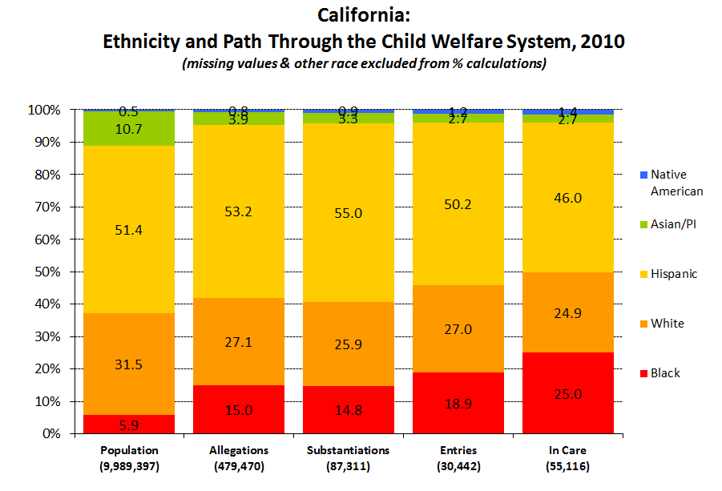
Notes:
Q4_10

Slide 32
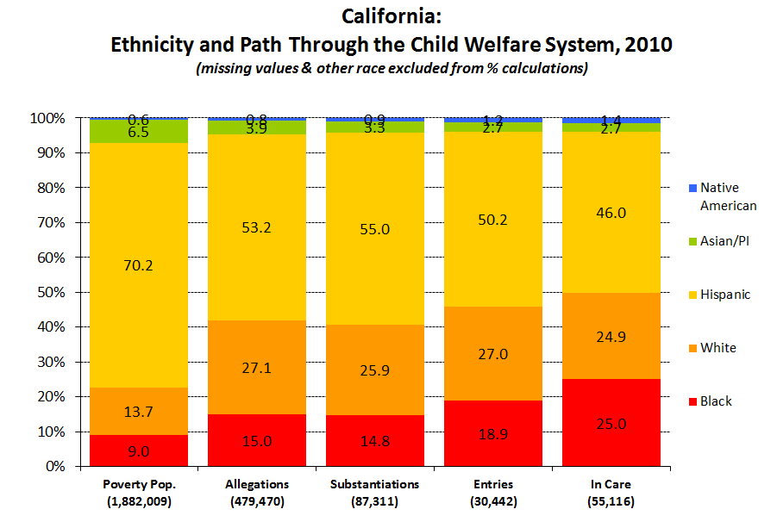

Slide 33
definitions
disproportionality: when a group makes up a proportion of those experiencing some event that is higher or lower than that group’s proportion of the population
disparity: a comparison of one group (e.g, regarding disproportionality, services, outcomes) to another group
population in poverty: disproportionality calculated using the population of children in poverty rather than the general population (census)

Slide 34
Black Disproportionality
18.9%
5.9%
= 3.21
White Disproportionality
27.0%
31.5%
= 0.86
Hispanic Disproportionality
50.2%
51.4%
= 0.98
Black vs. White Disparity Index
3.21
0.86
= 3.74
Black vs. Hispanic Disparity Index
3.21
0.98
= 3.29

Slide 35
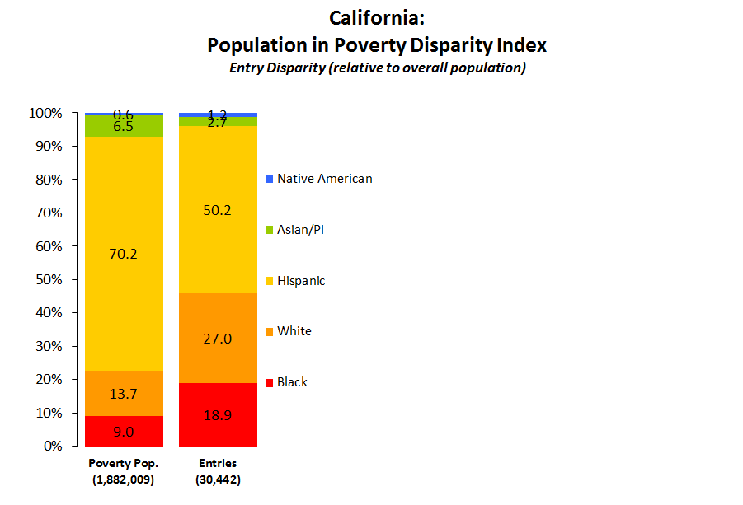
Black Disproportionality
18.9%
9.0%
= 2.11
White Disproportionality
27.0%
13.7%
= 1.97
Hispanic Disproportionality
50.2%
70.2%
= 0.72
Black vs. White Disparity Index
2.11
1.97
= 1.07
Black vs. Hispanic Disparity Index
2.11
0.72
= 2.95

Slide 36
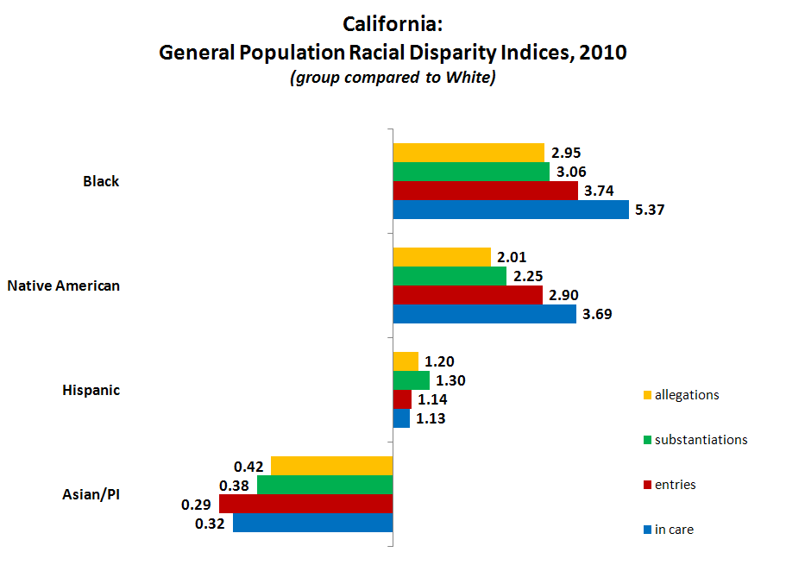

Slide 37
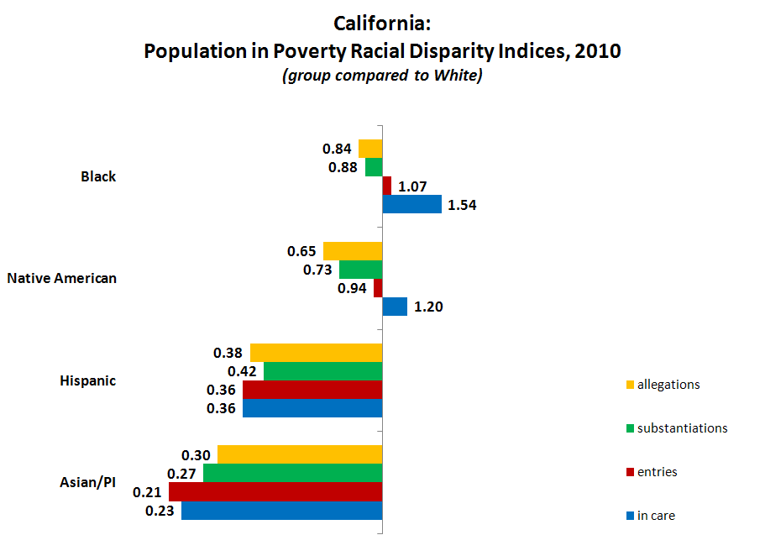

Slide 38
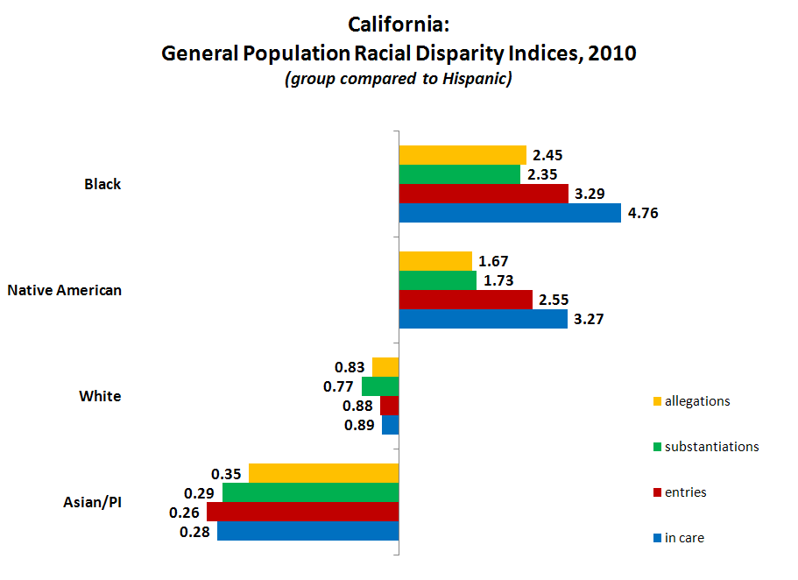

Slide 39
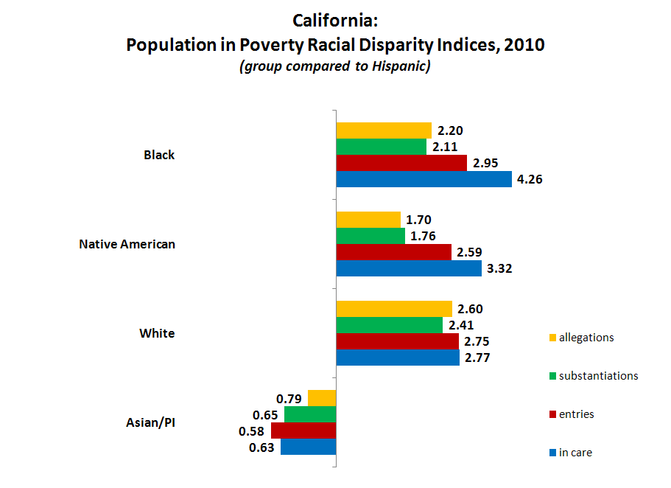

Slide 40
coming next quarter…
county groupings extended to additional reports
alternative race/ethnicity breakouts for Entries report (census based)
additional reports with graph and multi-report functionality
shift toward reduced lag in data (from 6 months to 3 months by January 2012)

Slide 41
Questions? Comments?

Slide 42
http://cssr.berkeley.edu/ucb_childwelfare
Needell, B., Webster, D., Armijo, M., Lee, S., Dawson, W., Magruder, J., Exel, M., Cuccaro-Alamin, S., Putnam-Hornstein, E., Williams, D., Simon, V., Hamilton, D., Lou, C., Peng, C., Moore, M., Jacobs, L., & King, B. (2011). Child Welfare Services Reports for California. Retrieved 6/6/2011, from University of California at Berkeley Center for Social Services Research website. URL: <http://cssr.berkeley.edu/ucb_childwelfare>
Notes:
42

