Slide 1
Disproportionality and Disparity in California Child Welfare Systems What the Data Tell Us
CA Child Welfare Indicators Project
School of Social Welfare
University of California, Berkeley
Notes:
Q4 2023 Data
Updated 03/06/2024

Slide 2
Disproportionality vs. Disparity
Disproportionality: When a group makes up a proportion of those experiencing some event that is higher or lower than that group’s proportion of the population
Disparity: A comparison of one group (e.g., regarding disproportionality, services, outcomes) to another group

Slide 3
Ethnicity and Path Through the Child Welfare System California: 2023 (missing & multi-race values excluded from % calculations)

Slide 4
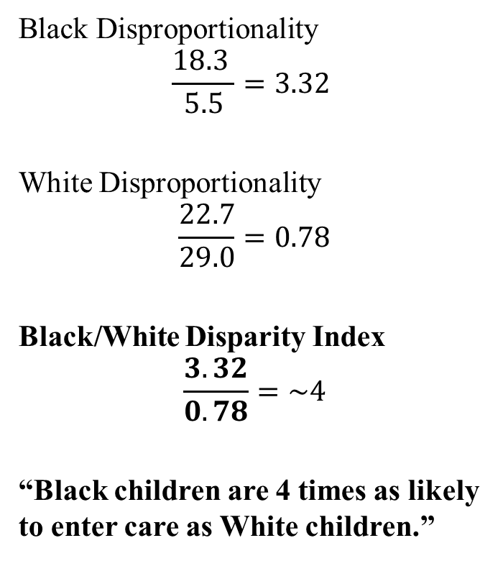
Entries to Foster Care Compared to General Population California: 2023 (missing & multi-race values excluded from % calculations)
Black Disproportionality
$$\frac{18.3 }{5.5}=3.32$$
White Disproportionality
$$\frac{22.7}{29.0}=0.78$$
Black/White Disparity Index
$$\frac{3.32}{0.78}=\sim 4$$
“Black children are 4 times as likely to enter care as White children.”

Slide 5
General Population Racial Disparity Indices California: 2023 (group compared to White)
Notes:
Graph showing the greater (bars spanning to the right) or lesser (bars spanning to the left) likelihood that Black, Native American, Latino, and Asian/PI children in poverty will have child welfare experiences compared to White children in poverty.
Black disparity indices range from 3 times as likely (allegations) to nearly 5 times as likely (in care)
NA disparity indices range from approximately 2.77 times as likely (allegations) to 4.6 times as likely (in care)
Latino disparity ranges 30% (allegations) to 53% (in care) more likely

Slide 6
Population in Poverty Estimates
Combination of data from the U.S. Census Bureau's American Community Survey (ACS), and population data from The California Department of Finance.
Separate multipliers were created for each Race/Ethnicity at the state level and for each of the 58 counties.
Poverty Multiplier = $\frac{Number of Children in Poverty}{Total Number of Children}$
The multiplier was then applied to the California Department of Finance Population Estimates

Slide 7
Population in Poverty Racial Disparity Indices California: 2023 (group compared to White)
Notes:
Graph showing the greater (bars spanning to the right) or lesser (bars spanning to the left) likelihood that Black, Native American, Latino, and Asian/PI children in poverty will have child welfare experiences compared to White children in poverty.
Disparity rates are reduced when poverty/geographic factors are taken into consideration, particularly for Allegations and Substantiated Allegations. Disparities persist for Black and Native American children, particularly for entries and in care rates. For Latino/a children, disparity is reversed.

Slide 8
Thank You!
The California Child Welfare Indicators Project (CCWIP) is a collaboration of the California Department of Social Services and the School of Social Welfare, University of California at Berkeley, and is supported by the California Department of Social Services, Casey Family Programs, and the Conrad N. Hilton Foundation.

Slide 9
Questions?
Wendy Wiegmann
wendy.wiegmann@berkeley.edu

