Slide 1




A population-based analysis of race/Ethnicity, Maternal Nativity, and Socioeconomic Status as risk factors for maltreatment
October 3, 2012
CWDA
Barbara Needell, PhD
Emily Putnam-Hornstein, PhD
Notes:
Barbara start

Slide 2
Acknowledgements
Thank you to our colleagues at the Center for Social Services Research and the California Department of Social Services
Funding for this and other research arising from the California Performance Indicators Project generously provided by the California Department of Social Services, the Stuart Foundation, & Casey Family Programs

Slide 3
Disparity discussions
What?
Who?
Where?
When?
How?
Why?
What? (what defines disproportionality and disparity?)
Who? (who is disproportionately represented?)
Where? (where is disproportionality observed?)
When? (when do disparities arise?)
How? (how is disparity being addressed?)
Why? (why do disparities exist?)

Slide 4
Why do Racial Disparities exist?
race/ethnicity
bias
DISPARITIES
risk
human resources
social
resources
material
resources

Slide 5
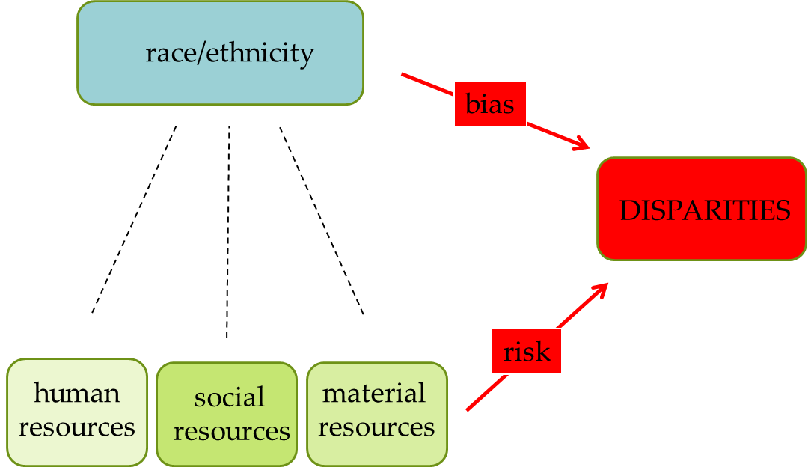
why does it matter?
The relative contributions of bias versus differences in risk hold important implications for how and where we intervene to reduce/eliminate disparities…as well as what our expectations should be for identifiable improvements
“Major factors affecting children’s entry into foster care included African American families’ higher rates of poverty, families’ difficulties in accessing support services so that they can provide a safe home for vulnerable children and prevent their removal, and racial bias and cultural misunderstanding among child welfare decision makers.” (GAO, 2007)

Slide 6
Background
Historically, racial disparities have been measured using aggregated data, capturing crude (or unadjusted) differences between racial groups
Recent studies, however, highlight the importance of adjusting for individual and community-level factors correlated with both race and maltreatment risk and suggest that both reasons for poverty, and the impact of poverty, may vary across groups
Notes:
Wulczyn and Lery, Drake

Slide 7
the typical Aggregate racial disparity analysis
California, 2011

Slide 8
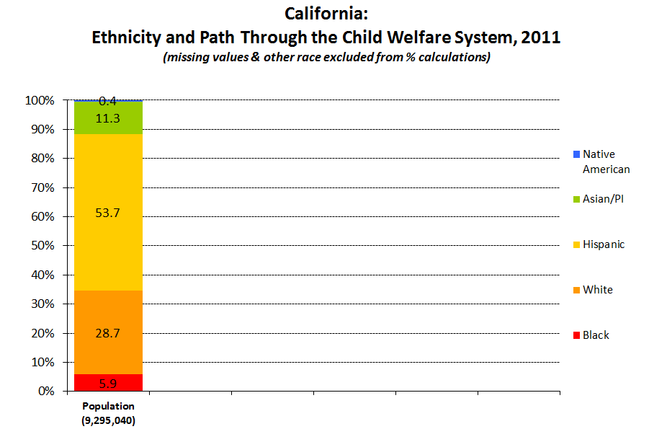
Notes:
Q4_11

Slide 9
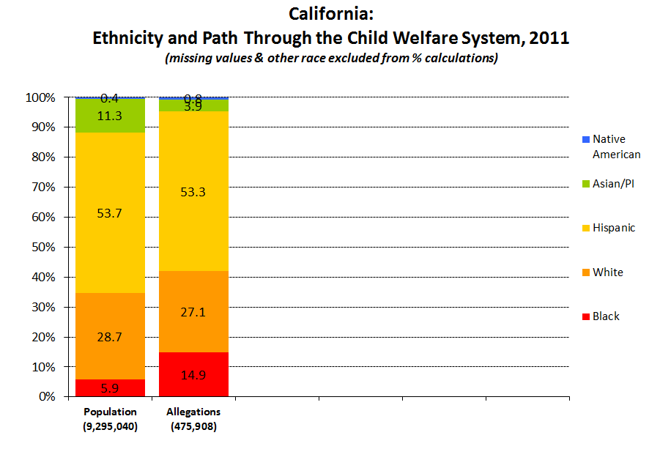
Notes:
Q4_11

Slide 10
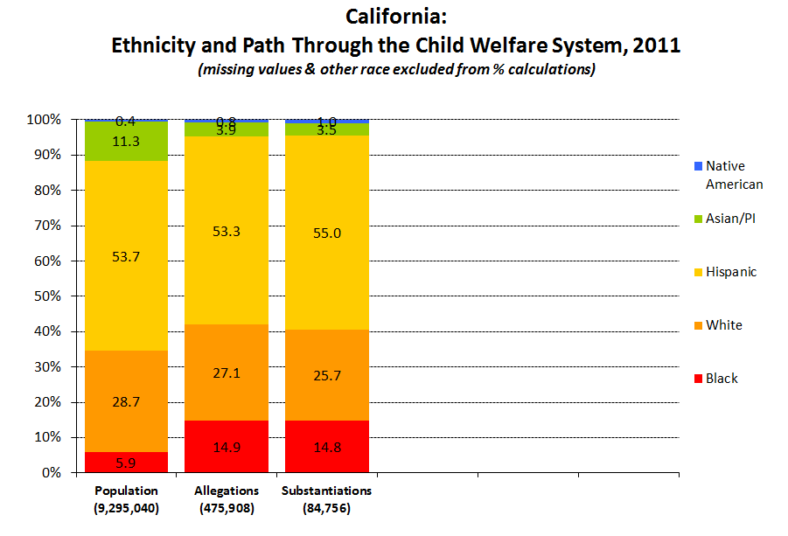
Notes:
Q4_11

Slide 11
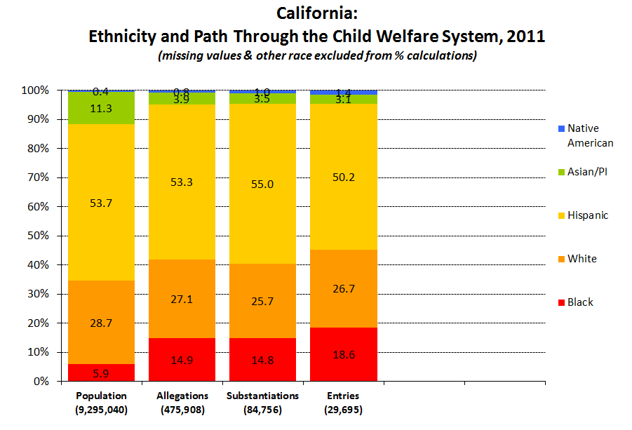
Notes:
Q4_11

Slide 12
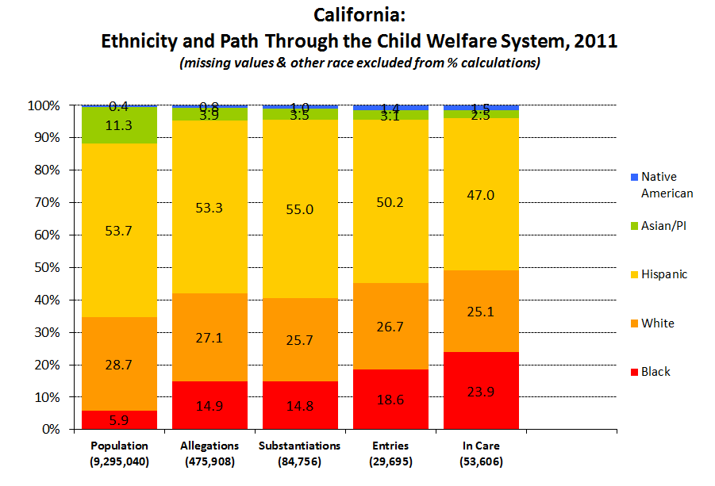
Notes:
Q4_11

Slide 13
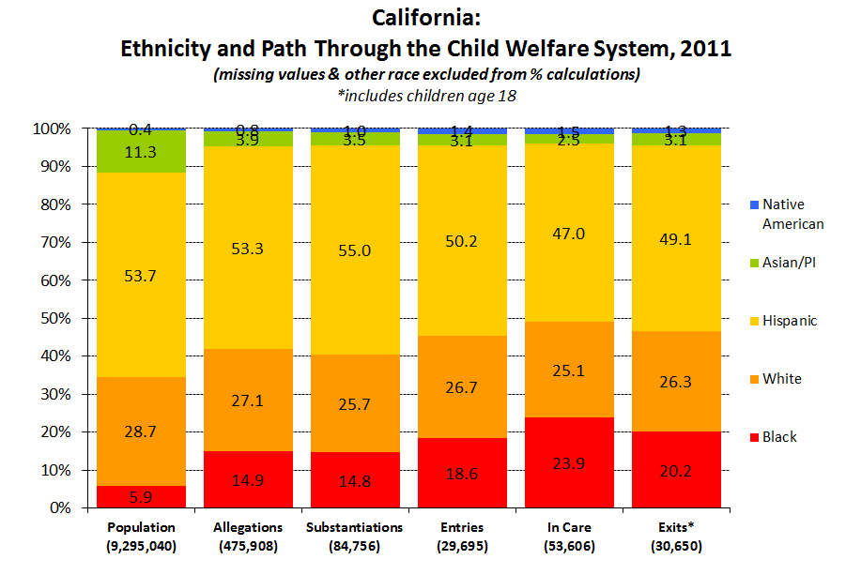
Notes:
Q4_11

Slide 14
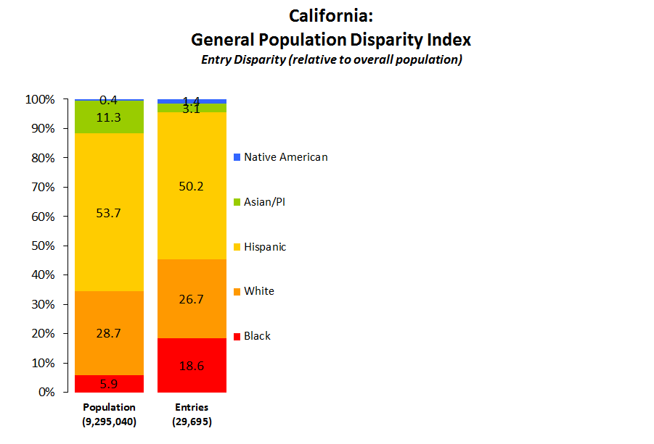
Black Disproportionality
18.6%
5.9%
= 3.15
White Disproportionality
26.7%
28.7%
= 0.93
Hispanic Disproportionality
50.2%
53.7%
= 0.94
Black vs. White Disparity Index
3.15
0.93
= 3.39
Black vs. Hispanic Disparity Index
3.15
0.94
= 3.36

Slide 15
Problems with this approach
Aggregated data such as this do not tell us if there are individual differences in the likelihood of referral, substantiation, or entry to foster care among children of different races/ethnicities who have the same risk factors/risk profile
Why have we relied on aggregated data in our discussions of racial disparities?
  GOOD REASON: aggregate data summarize group over/under-representation (very real)
  BAD REASON: we have not had better data to work with
    Administrative CPS data do not allow for individual-level risk differences to be calculated because we do not have individual-level information for children in the population who DID not have contact with CPS
    Also missing in the CPS data is information concerning well-established correlates of child maltreatment

Slide 16
New Research from CalIFORNIA
Putnam-Hornstein, E., Needell, B., King, B. & Johnson-Motoyama, M. (in press). Racial and Ethnic Disparities: A Population-Based Examination of Risk Factors for Involvement with Child Protective Services. Child Abuse and Neglect

Slide 17
a “snapshot” of CPS-involved children
before
CPS Data
after
Children not Reported for Maltreatment
Notes:
Emily takes over

Slide 18
Expanding CPS data with population-based data linkages
child protective service records
birth data
death data
before
CPS Data
after
Children not Reported for Maltreatment
population-based information

Slide 19
birth record variables
sex
female
birth weight
2500g+
prenatal care
1st trimester
<2500g
birth abnormality
3rd trimester
no care
present
none
maternal birth place
US born
non-US born
race
native american
black
Hispanic
white
asian/pacific islander
2nd trimester
male
maternal age
<=19
maternal education
<high school
pregnancy termination hx
prior termination
20-24
high school
named father
none reported
missing
named father
# of children in the family
one
two
birth payment method
public/med-cal
other
25-29
30+
some college
college+
three+

Slide 20
Methods / Approach
Prospective analysis of full 2002 California birth cohort (N=531,035) from birth through the age of five
  Allows us to examine differences in risk of CPS contact by race/ethnicity, maternal nativity, and socioeconomic and health indicators
  Allows us to examine risk factors associated with CPS contact
Modeled crude (unadjusted) rates of system contact by race/ethnicity
Modeled adjusted rates of system contact to examine the independent effect of race/ethnicity when looking at children who have the same “profile” in terms of sex, birth-weight, health, maternal age, paternity, birth order, maternal education, prenatal care

Slide 21
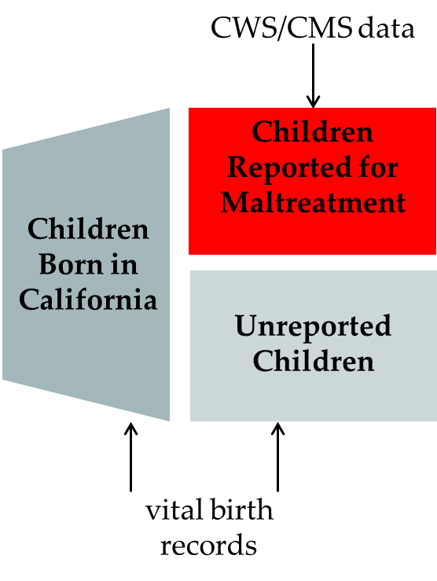
A few interesting findings to emerge…starting with risk factors for maltreatment
14% of children in cohort were reported to CPS by age 5
  lower bound estimate…could not match 16% of CPS records
  children may have moved out of state and had contact
Significant variations in rates of CPS referrals by sociodemographic characteristics
Notes:
Notes about paternity:
Establishing paternity is the process of determining the legal father of a child. When parents are married, paternity is automatically established in most cases. If parents are unmarried, paternity establishment is not automatic and the process should be started by both parents as soon as possible for the benefit of the child. Unmarried parents can establish paternity (legal fatherhood) by signing the voluntary Declaration of Paternity. This can be done in the hospital after the child is born. A Declaration of Paternity may also be signed by parents after they leave the hospital.
Unmarried parents who sign the Declaration of Paternity form help their child(ren) gain the same rights and privileges of a child born within a marriage. Some of those rights include: financial support from both parents, access to important family medical records, access to the non-custodial parent's medical benefits, and the emotional benefit of knowing who both parents are.
In an effort to create a legal link between unmarried fathers and their children, the California Department of Child Support Services joined other states in a partnership with licensed hospitals and clinics with birthing facilities to establish the Paternity Opportunity Program (POP). This voluntary in-hospital paternity acknowledgment program, implemented in January 1995, involves about 330 of California's licensed hospitals and clinics with birthing facilities. The program has since been expanded to prenatal clinics, county welfare offices, local vital records offices, and courts.

Slide 25
Thinking about these risk factors…before getting to Race

Slide 26
an epidemiologic risk assessment tool?
we classified as “high risk” any child with three or more of the following (theoretically modifiable) risk factors at birth:
    late prenatal care (after the first trimester)
    missing paternity
    <=high school degree
    3+ children in the family
    maternal age <=24 years
    Medi-Cal birth for a US-born mother

Slide 27
administered at birth?
Full Birth Cohort
Children Reported to CPS

Slide 28
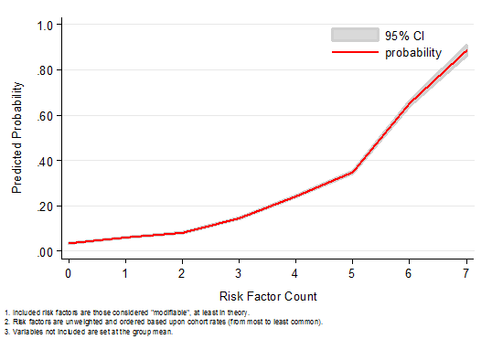
recognizing the risk associated with the presence of multiple risk factors…
High Risk on Every Modifiable Risk Factor: 89% probability of CPS report
Low Risk on Every Modifiable Risk Factor: 3% probability of CPS report

Slide 29
Returning to race…

Slide 31
Racial Disparities and CPS
Notable variations were observed in the distribution of cohort characteristics by racial/ethnic group, as well as maternal nativity
  e.g. black vs. white: <HS degree (16% vs. 7%)
  Pronounced racial/ethnic heterogeneity in parenting risk burdens in the overall cohort (population), yet a much more consistent picture emerged among the publicly insured
    black vs. white: <HS degree (25% vs. 25%)

Slide 32
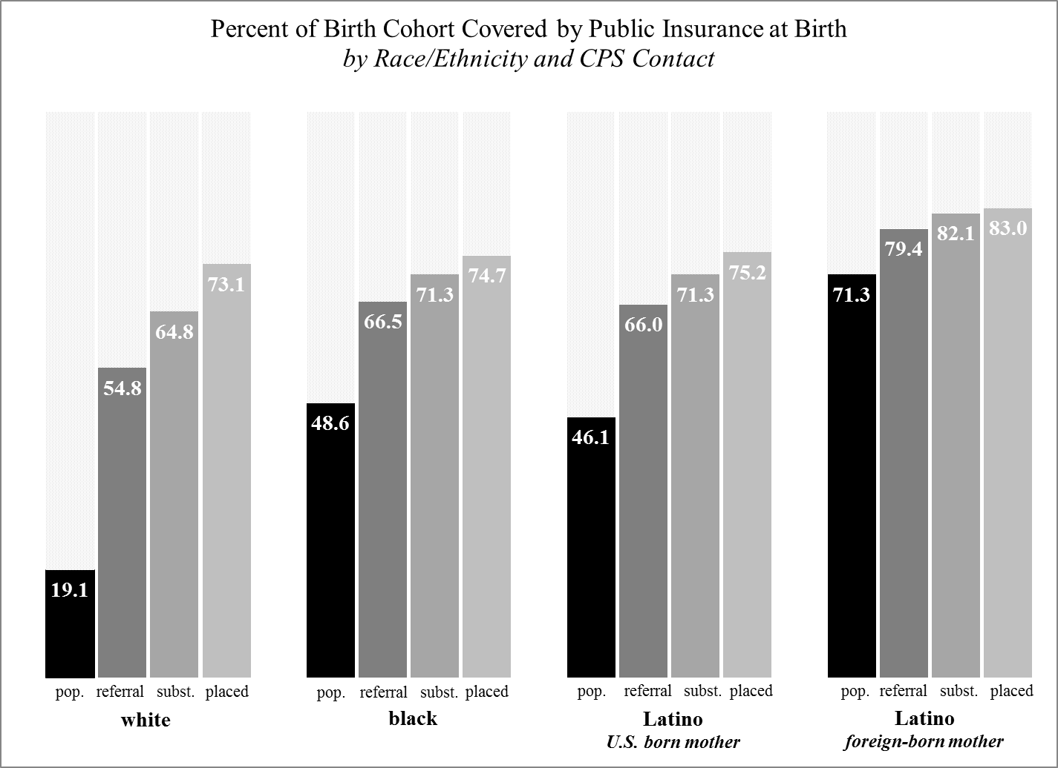
Why focus on children covered by Medi-cal?
Notes:
While we cannot say why people are poor, we can say with certainty that most children who come to the attention of the child welfare system are poor. And we also know that the poverty rate vary dramatically across racial groups.
Therefore, in order to come as close as possible to an apples to apples (or similarly situated) scenario, we have limited the findings we are presenting today to those children who were poor (as indicated by medi-cal coverage at birth)

Slide 33
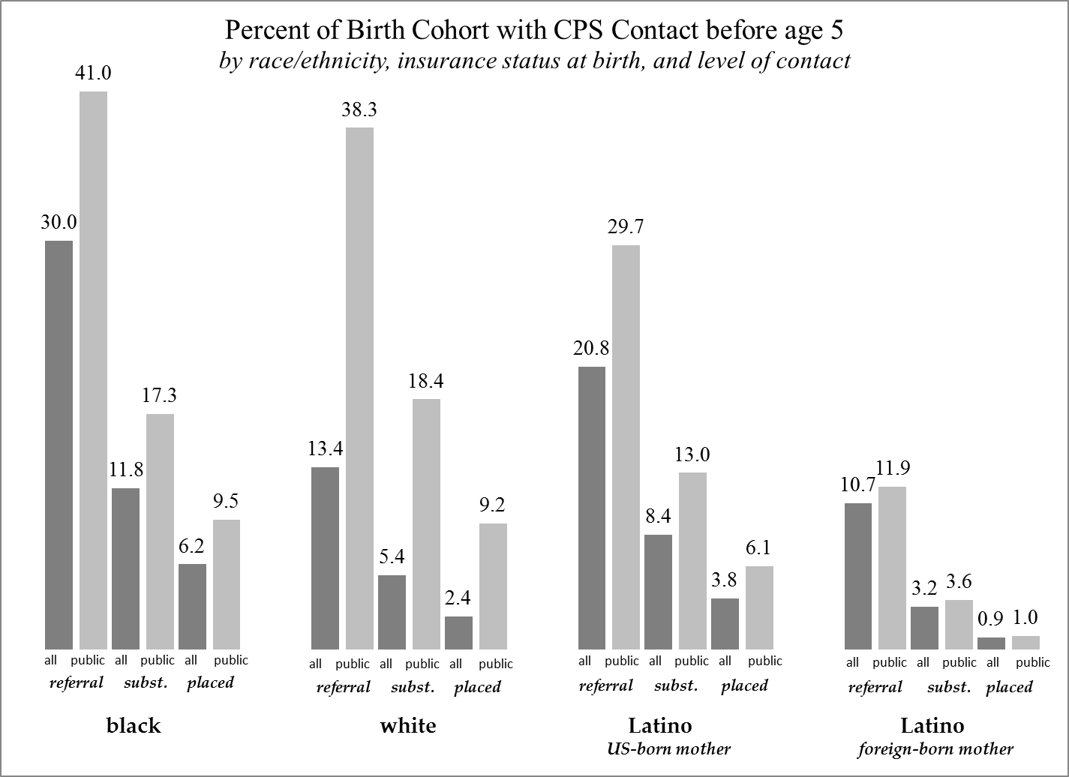

Slide 34
Approach
Examined aggregate (crude) racial disparities in the overall birth cohort
Examined racial disparities among children covered by public health insurance at birth
  large and fairly racially invariant share of children covered by public insurance across CPS contact points
  implications of this coverage for surveillance and contact with mandated reporters
Examined racial disparities among children covered by public health insurance at birth, with adjustments for other risk factors earlier shown to be predictive of CPS involvement

Slide 35
Black Latino, US-born mother Latino, foreign-born mother
Notes:
1.18 full adj

Slide 36
Black Latino, US-born mother Latino, foreign-born mother
Notes:
.97 full adj

Slide 37
Black Latino, US-born mother Latino, foreign-born mother
Notes:
1.01 fu adj

Slide 38
Black Latino, US-born mother Latino, foreign-born mother

Slide 39
Summary of Findings
Cumulative rates of child welfare contact by age 5 vary dramatically across racial/ethnic groups, as does the prevalence of other risk factors
Summary statistics indicating large black/white racial disparities mask significant covariate effects
The Latino population of children in California consists of at least two distinct subsets, differentially impacted by poverty and with different risks of child welfare contact

Slide 40
Implications?
This (and other) recent studies suggest that once we are able to adjust for socioeconomic differences and the cumulative impact of other risk factors, racial disparities continue to emerge, but often not in the manner once thought!
  low SES white children MORE likely than low SES black children to be referred, substantiated, and enter foster care
  differential sorting by poverty (as suggested by Drake)?
Aggregate racial disparities are very real and must be addressed. These disparities almost certainly arise from some combination of risk factors, bias, and access issues.
Notes:
Back to Barbara

Slide 41
Implications (part 2)
The CPS system has focused heavily on reducing individual-level bias/increasing cultural understanding – both of which are very important.
BUT the population-based data used in this study suggest that the risk of referral, substantiation, and entry to foster care for individual children varies much more so based on the presence of multiple risk factors at birth and the socioeconomic conditions in which they are born rather than race/ethnicity.
To really “move the needle” to reduce racial/ethnic disparities, we need to not only continue to address individual-level bias, but we must also engage other systems to address entrenched differences in parenting burdens that place certain groups of children at disproportionate risk of CPS involvement.

Slide 42
Limitations
These data do not
  Examine racial disparities for CPS involvement among older children
  Explore racial disparities in services and outcomes once children are in the system
  Examine possible variations by county in these dynamics
  Indicate that there is no racial bias
  Indicate that there is racial bias
  Speak to the iceberg question…

Slide 43

the iceberg
Maltreated children known to child protective services
Maltreated children not known to child protective services

Slide 44
poverty data
2010 estimates of the population of children (ages 0-17) living in poverty by race/ethnicity
Using the U.S. Census Bureau's American Community Survey (ACS) 2006-2010 five-year Estimates, poverty multipliers were calculated by race/ethnicity for California and each of its 58 counties
These multipliers were then applied to California population data from the 2010 U.S. Census
http://cssr.berkeley.edu/ucb_childwelfare/population.aspx

Slide 45
why are people poor? *
2006-2010 Estimates of CA Children in Poverty
Black 29%
White 9%
Hispanic 26%
Asian/PI 12%
Native American 27%
* http://www.pisab.org/
Notes:
Q3_11

Slide 46
Black Disproportionality
18.6%
5.9%
= 3.15
White Disproportionality
26.7%
28.7%
= 0.93
Hispanic Disproportionality
50.2%
53.7%
= 0.94
Black vs. White Disparity Index
3.15
0.93
= 3.39
Black vs. Hispanic Disparity Index
3.15
0.94
= 3.36
Notes:
Repeating this slide intentionally

Slide 47
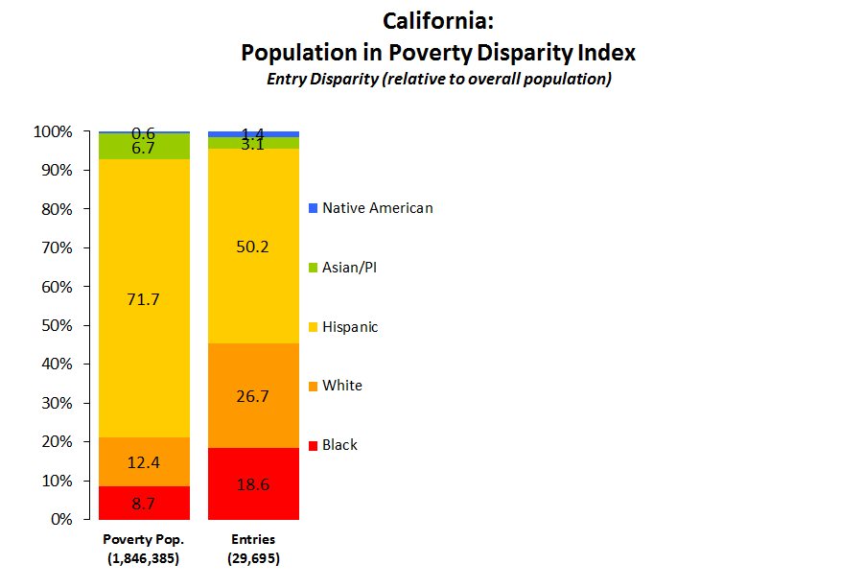
Black Disproportionality
18.6%
8.7%
= 2.15
White Disproportionality
26.7%
12.4%
= 2.16
Hispanic Disproportionality
50.2%
71.7%
= 0.70
Black vs. White Disparity Index
2.15
2.16
= 1.00
Black vs. Hispanic Disparity Index
2.15
0.70
= 3.06

Slide 48
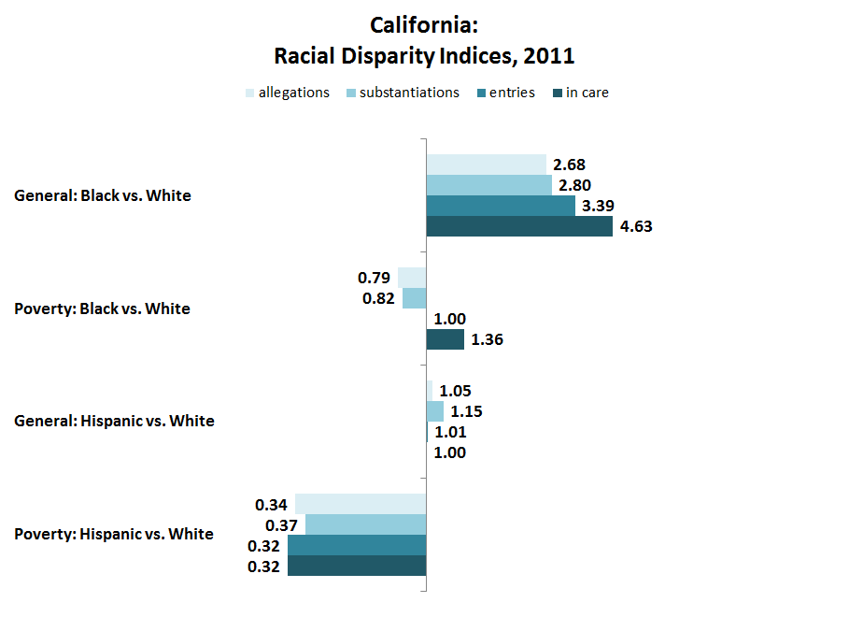

Slide 49
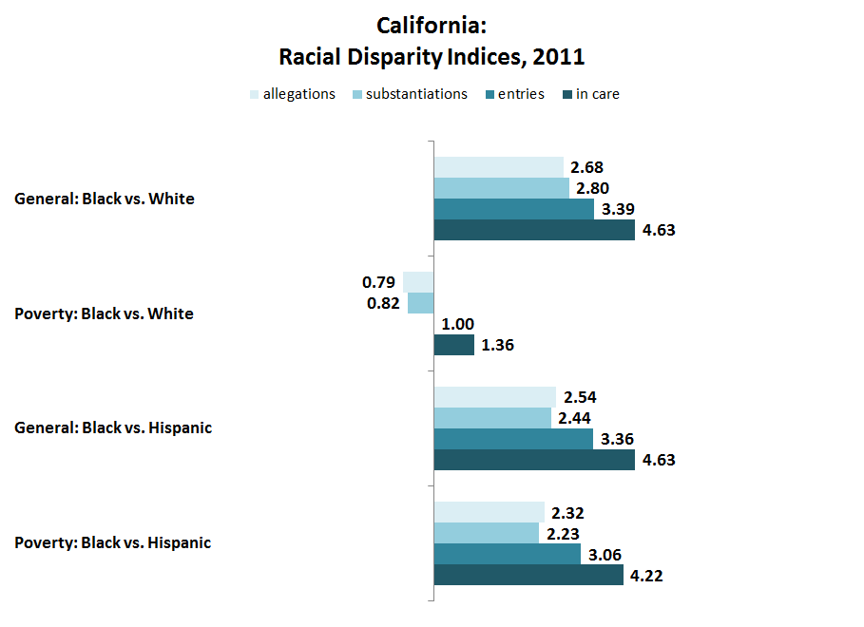

Slide 50


Questions?
Comments? bneedell@berkeley.edu ehornste@usc.edu

Slide 51
(IF TIME ALLOWS)
What is institutional/Structural Racism?
Stolen shamelessly from:
Annie E. Casey Foundation---RACE MATTERS TOOLKIT
http://www.aecf.org/KnowledgeCenter/PublicationsSeries/RaceMatters.aspx

Slide 52
What Single Policy from Decades Ago Contributed to These Present-Day Outcomes?
Homeownership disparities
Neighborhood disparities
Surveillance & assessment disparities
Health disparities
Wealth disparities
Notes:
(relates to neighborhood stability) 75% Whites; 56% Asian Americans; 48% Blacks; 47% Latinos
(relates to available resources)African Americans and Latinos have 30% fewer supermarkets, up to 76% higher prices, more toxic environments
Differences in hospital usage of baby toxicology tests, differences in mandated reporting, “benefit of the doubt” by officials, zip code discrimination
Differences in prenatal care; inadequately stocked pharmacies; exposure to lead poisoning
disparities (safety net for tough times) Family Median Net Worth by Raced $20,600B $18,600H $140,700 W (own –owe)
2004 Survey of Consumer Finances FRB 2006

Slide 53
What Single Policy from Decades Ago Contributed to These Present-Day Outcomes (continued)
  In short, what policy strongly contributed to opportunity-rich or opportunity-poor settings/circumstances for raising kids & the judgments accompanying each?

Slide 54
The GI Bill: A Story of Embedded Racial Inequity
Notes:
Information about the GI Bill:
Also known as the Servicemen’s Readjustment Act, following WWII
Purported to be the greatest piece of social legislation ever
U.S. spent $95 billion on this social program (Put this number in today’s perspective – e.g., double the estimate to rebuild the Gulf Coast after Hurricane Katrina)
Assisted 16 million returning soldiers to be reintegrated into US society
Provided veterans with access to job training, college tuition, home loans and small business support
Created the modern day middle-class and fueled development of the suburbs
For more information on the GI Bill and its effects, see When Affirmative Action was White by Ira Katznelson, Columbia University Press, 2005.
Background for the next slides:
The story to be told is about three young boys whose fathers served in WWII and how this social legislation from 60 years ago continues to impact their families.
It is a story about how advantage and disadvantage accumulate because of the unequal opportunities embedded in the GI Bill.

Slide 55
Philip’s Story
Child Born Father’s GI Bill: FHA Consequences Consequences
Right After Status & VA loans for Child’s for Child’s
WWII Education Well-being in
Adulthood
Low-income, White Able to use Family borrowed Philip gets
White veteran, high low-interest from home equity professional
school mortgage to support child’s job, buys own
diploma, from provisions to college education house, Philadelphia move family (first in family to inherits from public go to college) appreciated
housing to house
segregated when
suburban father
home ownership dies
Notes:
Observation:
For this and the next two slides, each column highlights a feature of the child’s profile as it is played out around one aspect of the GI Bill, the unequal availability of FHA and VA loans to purchase a home.

Slide 56
Thomas’s Story
Child Born Father’s GI Bill: FHA Consequences Consequences
Right After Status & VA loans for Child’s for Child’s
WWII Education Well-being in
Adulthood
Low-income, Black Could not access Family could not Thomas works
Black veteran, high home loan b/c of afford to send in minimum
school racially-restrictive child to college; wage jobs,
diploma, from underwriting high school continues to
Philadelphia criteria; family diploma is from live in family remained in rental under-resourced home,
housing in the city segregated school considers joining the Army, has to
borrow $
when father
dies to give
him decent
funeral
Notes:
Suggested talking point:
The GI Bill was open to all veterans; however, its implementation proved to be discriminatory. Congress had agreed that GI Bill supports could be administered locally. Local implementers maintained the racially discriminatory actions that characterized local public and private sector behaviors prior to the war.

Slide 57
Juan’s Story
Child Born Father’s GI Bill: FHA Consequences Consequences
Right After Status & VA loans for Child’s for Child’s
WWII Education Well-being in
Adulthood
Low-income, Latino Could not access Family could not Juan works
Latino veteran, high home loan b/c of afford to send in minimum
school racially-restrictive child to college; wage jobs,
diploma, from underwriting high school continues to
Texas criteria; family diploma is from live in family remained in rural under-resourced home,
rental housing language marries segregated and newcomer racially Latina, sends segregated part of
school family’s limited
income to her
extended family
in Mexico

Slide 58
Fast Forward to Today . . .
Philip’s Children: Thomas’ and Juan’s Children:
Philip gives children his father’s They have no houses to
appreciated house inherit
They live in thriving communities They live in disinvested communities
Their college education’s paid At work, they complete college on work study and by home equity student loans, with subsequent starting debts to pay back
Philip establishes trust fund Thomas and Juan have few personal assets to leave
for grandchildren grandchildren
Notes:
Suggested talking points:
Reinforce for the audience that social policy created 60 years ago continues to have disparate impact. These stories challenge the assumption that discrimination is a thing of the past by demonstrating that even past discrimination has ongoing consequences for today’s population. Benefits and disadvantages accumulate over time.
Note that these stories followed only one aspect of the GI Bill: home loans. If job training, educational support, and small business loans were also tracked, additional layers of unequal opportunity would be revealed to add to the home ownership inequities.

Slide 59
Fast Forward to Today . . .
Neighborhood-Based Opportunities include good schools, accessible jobs, affordable quality services,
fair financial & retail outlets,
safe recreational space, etc.
How Do “Opportunity-Rich” and “Opportunity-Poor” Neighborhoods Affect the Kids/Families You Serve Today?
Notes:
Suggested talking points:
Reinforce for the audience that social policy created 60 years ago continues to have disparate impact. These stories challenge the assumption that discrimination is a thing of the past by demonstrating that even past discrimination has ongoing consequences for today’s population. Benefits and disadvantages accumulate over time.
Note that these stories followed only one aspect of the GI Bill: home loans. If job training, educational support, and small business loans were also tracked, additional layers of unequal opportunity would be revealed to add to the home ownership inequities.

Slide 60
POSSIBLE PATHWAY FROM THE GI BILL TO CURRENT CHILD WELFARE/JJ/EDUCATION DISPARITIES
GI Bill
Racial Segregation, City & Suburbs
Desegregation Produces Class Separation w/in Communities of Color
Out-migration of Jobs from Inner City, Resource Disinvestment from Schools, Infrastructure
Opportunity-Poor Neighborhoods for Lower-Income Families of Color
Heightened Surveillance & Stigma from Authorities: Hospitals, Child Welfare, Juvenile Justice, Police, School Administrators, Etc.
Disproportionate Expulsion from Mainstream Institutions
(Schools, Homes) & Intake into Deep End Systems
Drugs
& Drug Law Disparities
Disparities in Family Supports & Individual Treatment, Which Lengthen Stay in Deep End Systems

Slide 61
Era of Equal Opportunity Policies (50s, 60s, and 70s)
Opportunity Victories . . . But Inequitable Outcomes
Mendez vs. Westminister Schools today
Brown vs. Board of Education remain racially segregated and still unequal in terms of access to resources.
Fair Housing Act of 1968 Discrimination persists
in zoning, real estate practices, and lending.
Affirmative Action Largest beneficiaries have
been White women.
Voting Rights Act of 1965 More elected officials of color but w/o adequate resources in urban areas to govern effectively; redistricting to erode political power;
ballot box inequities.
Notes:
Suggested talking points:
The politics of this era produced significant victories regarding opportunity for all, as noted in the first column.
But these legal and legislative victories haven’t produced the outcomes they intended, as the second column describes. See the Race Matters Fact Sheets on education, neighborhood vitality, family economic success, and civic participation for specific data about inequities in education, housing, jobs, and voting, respectively.
Invite the audience to add other opportunity victories here along with their inequitable outcomes.
In preparation for the next slide:
Despite ongoing inequality, the opportunity victories are being challenged.

Slide 62
Era of Retrenchment (80s, 90s, 00s)
Challenge to Opportunity Victories Inequitable Outcomes
English Only Laws as state referenda Deprives civil
rights (e.g. vote, legal proceed- ings, and education) for those with limited English proficiency
“Racial Privacy” Act as state referenda If it had passed, no data for accountability to promote equity in education, public contracting, or employment
Anti-affirmative action legal challenges Erode the small employment and education gains that have been made and increase the likelihood of return to previous practices
Notes:
Suggested talking point:
Invite the audience to add other challenges to opportunity victories and describe their likely outcomes.

Slide 63
How do Child Welfare Policies Map in Terms of Victories & Retrenchment for Racial Equity?
Adoption & Safe Families Act 1997– quicker permanency but quicker termination of parental rights (impact on incarcerated mothers, who are disproportionately women of color)
Family Preservation & Support 1994/Promoting Safe & Stable Families 1997 – Do disparities exist in terms of who gets services?
Multi-Ethnic Placement Act 1994/Interethnic Adoption Provisions 1996 (MEPA-IEPA) – “Diligent recruitment largely ignored” (Race Matters Consortium: MEPA-IEPA)
Fostering Connections to Success and Increasing Adoptions Act of 2008- Kinship guardianship? Other provisions?

Slide 64
Bottom Line
Being classified as Black, Asian, Native American or Latino has never carried, and still doesn’t carry, the same advantages as being classified as White.
Notes:
Suggested talking points:
The previous stories have been about how racial inequities are deeply embedded in social policies and practices. This is the case whether the policies and practices use the word “race” or not.
The quick march through 60 years of U.S. history points out that opportunity for all is a goal that has sometimes been closer to realization, other times less so. The history of race in the U.S. is one of steps forward and steps backward (retrenchment) – in contrast to the popularly held belief that this history is one of continual progress.

