Slide 1
Pandemic Effects on Children’s Experiences: Baseline & Emerging System Data Trends Child Welfare Council Meeting 7/21/2020
Greg Rose
Deputy Director
California Dept. of Social Services
Dana Blackwell
Senior Director
Casey Family Programs
Daniel Webster
Principal Investigator
California Child Welfare Indicators Project
University of California, Berkeley
Notes:
Many thanks to Brian Clapier, Niki LeProhn, Chris Cleary, Joe Magruder, Wendy Wiegmann, and Ivy Hammond for their input in creating this presentation.
Data for graphs in slides 3-9 drawn from the CWS/CMS 2020 Quarter 1 Extract.
Data for graphs in slides 10-12 are drawn from the CDSS dashboard.

Slide 2
Outline
Presentation Background
Baseline California Data pre-COVID
Emerging System Data Trends being Tracked
Issues to Consider Moving Forward

Slide 3
Baseline California Data Trends…
Allegation Rate Number of children for whom there is an allegation of child maltreatment during the year per 1,000 in the population
Black
Native Amer.
Latino
White
Asian/PI
Notes:
**National Trend: (no national trend for “children with allegations rate”—though the national trend for “investigation rate” has been rising over the past decade
Approximately 475K total children with an allegation in 2019, and frequencies have declined about 4% in the last 5 years.
2019 Frequencies:
Black ~57k
Native Am ~4k
Latino ~219k
White ~108k
Asian ~19k
Missing ethnicity (not graphed) ~69k, frequencies have almost doubled in past 5-6 years
Anecdotal reports from county staff suggests this at least partly driven by increased missing data on the ‘Hispanic origin’ variable. Some staff slow to adhere to the CWS/CMS updates requiring Federal ethnicity categories. Other considerations: Latinos more likely to report as White than in the past, seems to be linked with a decreasing proportion of Latinos with missing race. Is race becoming more fluid and less clear (in the 23 and me era)? It might be easier for some, especially in the stress of a CPS encounter, to answer the ethnicity query with "I don't know."

Slide 4
Baseline California Data Trends…
Substantiation Rate Number of children with a substantiated report of child maltreatment per 1,000 in the population
Black
Native Amer.
Latino
White
Asian/PI
Notes:
**National Trend: national “substantiation rate” has been relatively steady ~9/1k for the past 5 years or so.
Approximately 67K total children with a substantiation in 2019, and frequencies have declined about 18% in the last 5 years.
2019 Frequencies:
Black ~9k
Native Am ~less than 1k
Latino ~35k
White ~16k
Asian ~2k
Missing ethnicity (not graphed) ~4600, frequencies have almost doubled in past 5 years

Slide 5
Baseline California Data Trends…
Entry Rate Number of children entering foster care per 1,000 in the population
Black
Native Amer.
Latino
White
Asian/PI
Notes:
**National Trend: national “entry rate” decreased slightly over the past several years from 3.6/1k in 2015 to 3.3/1k in 2019
Approximately 28K total children entering foster care in 2019, and frequencies have declined 11% over the past 5 years.
2019 Frequencies:
Black ~5k
Native Am less than 500
Latino ~15k
White ~7k
Asian less than 1k
Missing ethnicity (not graphed) ~800, frequencies have approximately doubled in past 5 years

Slide 6
Baseline California Data Trends…
In Care Rate Number of children who are in foster care mid-year per 1,000 in the population
Black
Native Amer.
Latino
White
Asian/PI
Notes:
**National Trend: national “in care rate” has been relatively steady ~6/1k for the past several years.
Approximately 51K total children in CW-supervised foster care on 7/1/2019, and frequencies have declined about 6% over the past 5 years.
2019 Frequencies:
Black ~11k
Native Am less than 1k
Latino ~27k
White ~11k
Asian ~1k
Missing ethnicity (not graphed) ~900, frequencies have almost doubled in past 5 years

Slide 7
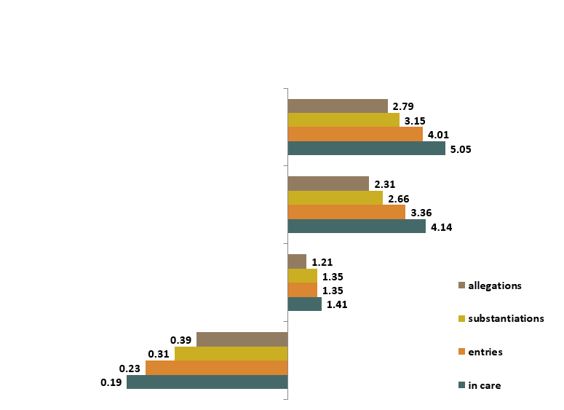
Baseline California Data Trends…
Racial Disparity Indices (General Population) Ethnic Group Disparity Compared with White Children along CW Continuum
Black
Native American
Latino
Asian/PI
White

Slide 8
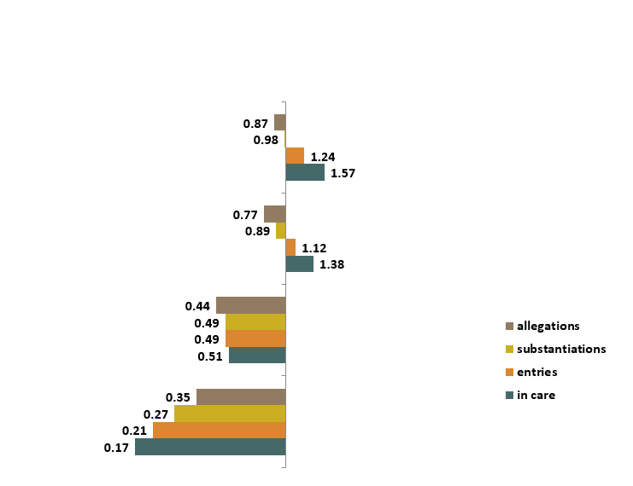
Baseline California Data Trends…
Racial Disparity Indices (Poverty Population) Ethnic Group Disparity Compared with White Children along CW Continuum
Black
Native American
Latino
Asian/PI
White
Notes:
Population in Poverty Estimates methodology:
A Combination of data from the U.S. Census Bureau's American Community Survey (ACS), and population data from The California Department of Finance.
Separate multipliers were created for each Race/Ethnicity at the state level and for each of the 58 counties.
Poverty Multiplier = (𝑁𝑢𝑚𝑏𝑒𝑟 𝑜𝑓 𝐶ℎ𝑖𝑙𝑑𝑟𝑒𝑛 𝑖𝑛 𝑃𝑜𝑣𝑒𝑟𝑡𝑦)/(𝑇𝑜𝑡𝑎𝑙 𝑁𝑢𝑚𝑏𝑒𝑟 𝑜𝑓 𝐶ℎ𝑖𝑙𝑑𝑟𝑒𝑛)
The multiplier was then applied to the California Department of Finance Population Estimates

Slide 9
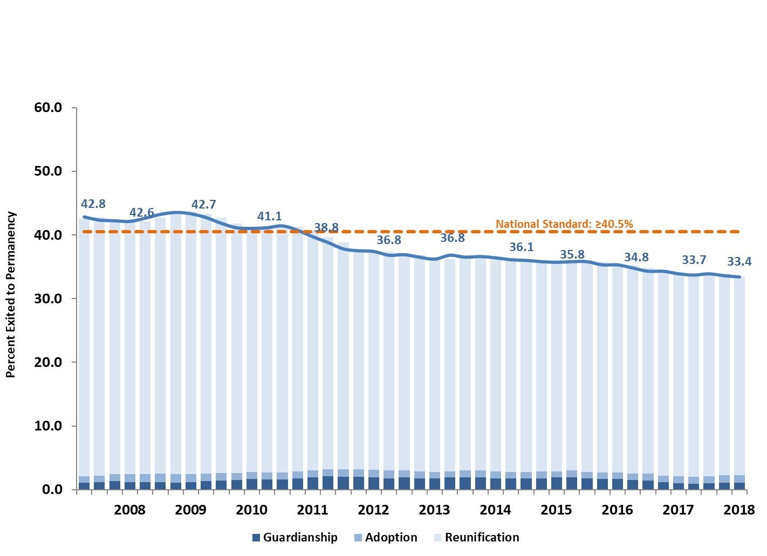
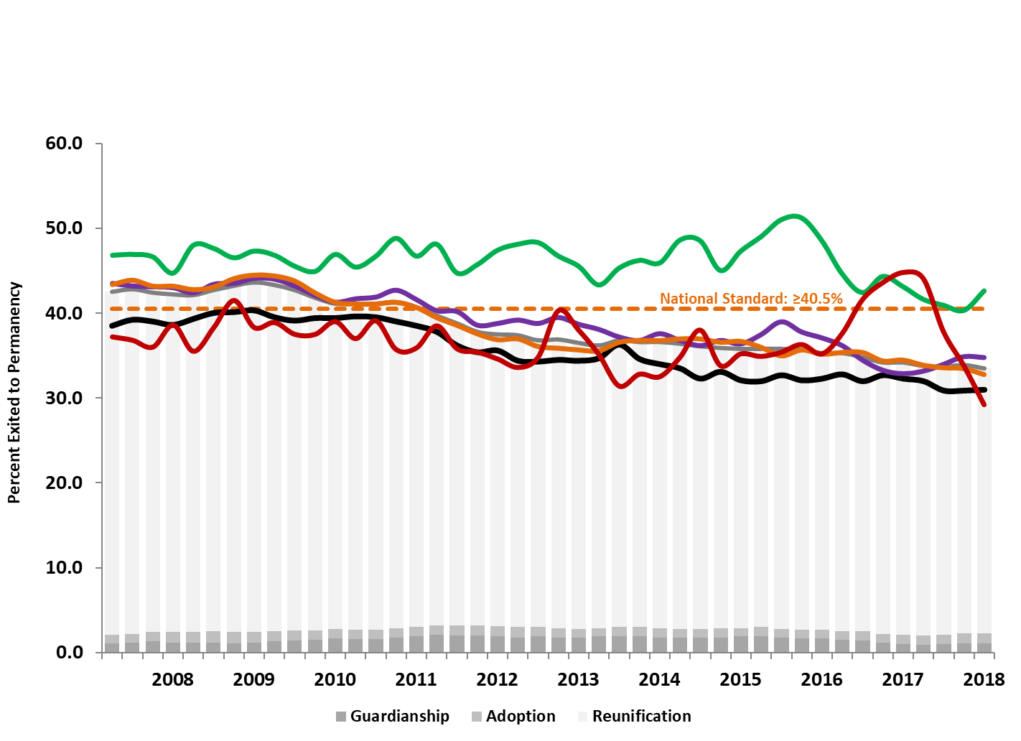
Baseline California Data Trends…
Timely Permanency Percent of children who exit to permanency within 12 months
of entry to care
Asian/PI
White
Latino
Black
Native Amer.

Slide 10
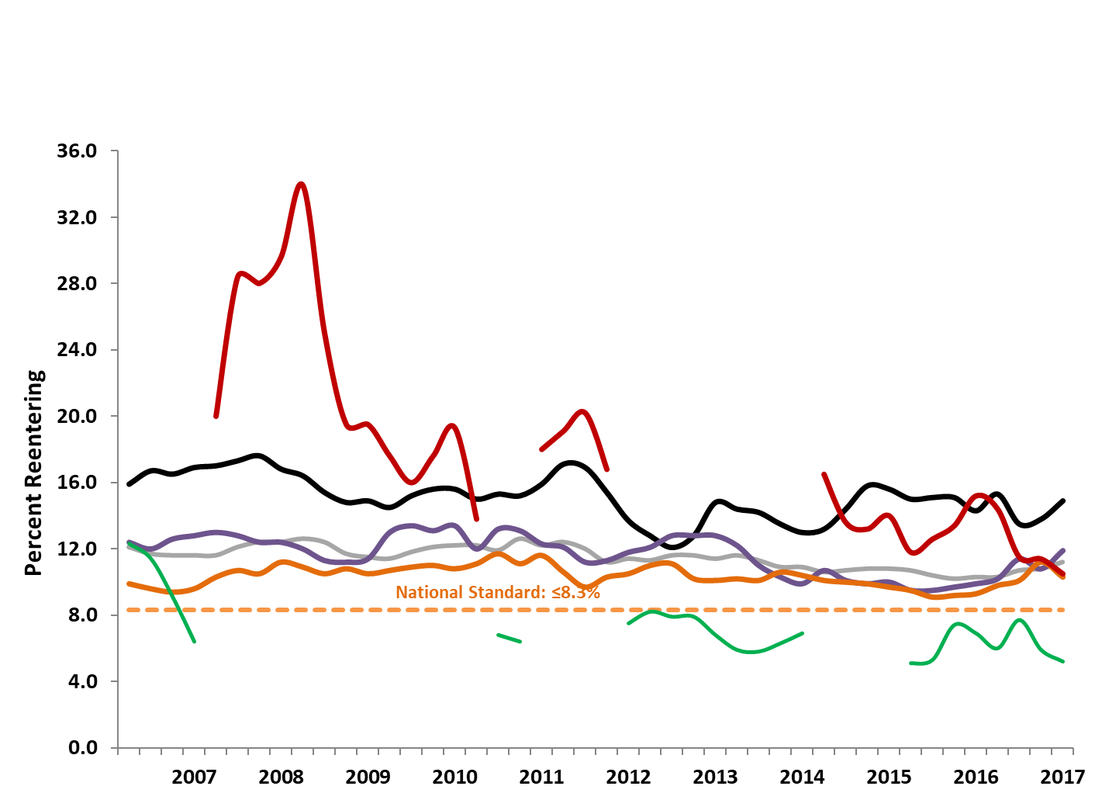
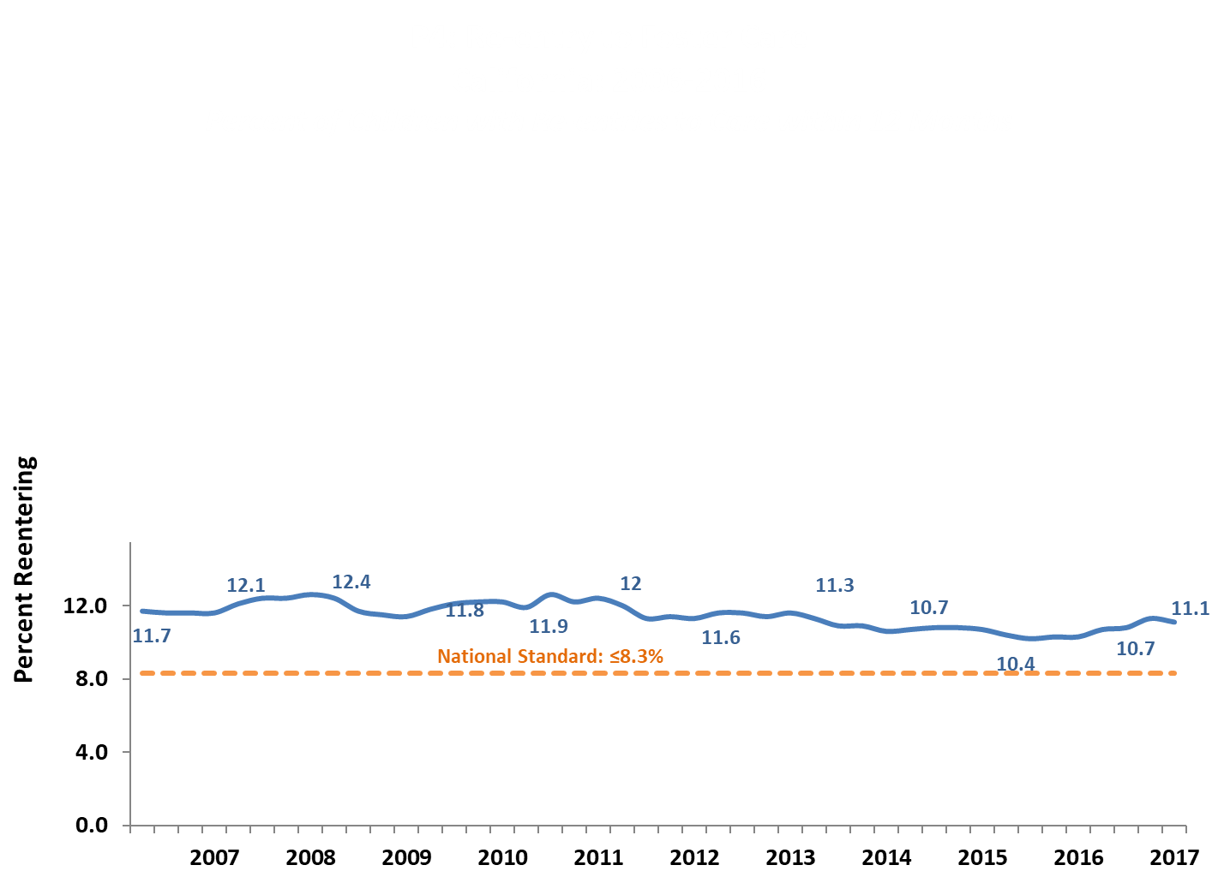
Baseline California Data Trends…
Reentry to Care Percent of children who exited to reunification or guardianship within 12 months of Entry
and returned to care within 12 months
Black
White
Native Amer.
Latino
Asian/PI

Slide 11
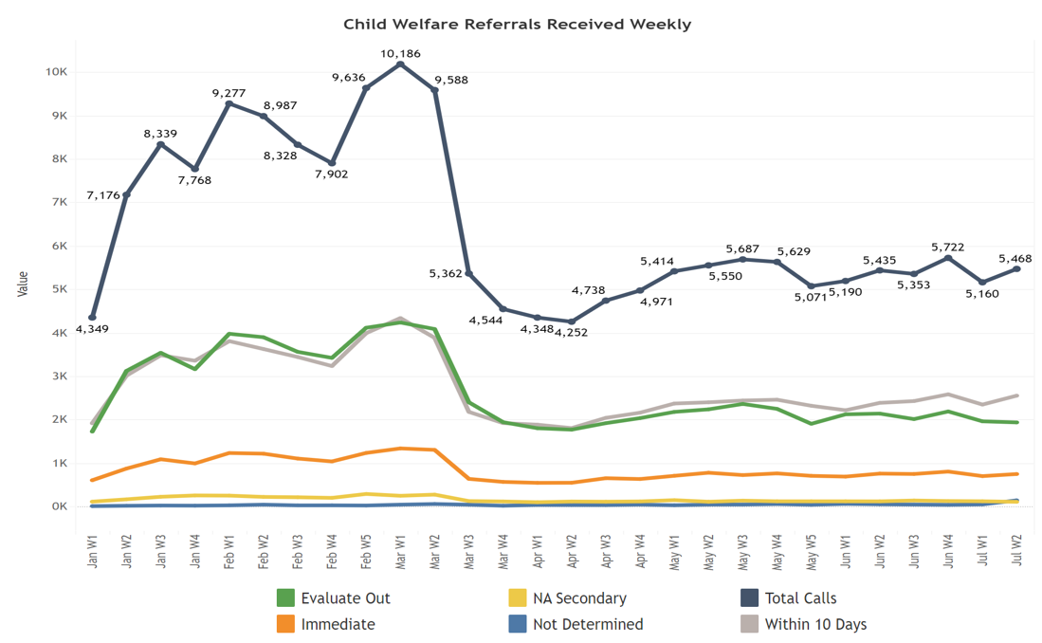
Emerging System Data Trends …
CDSS Data Dashboard

Slide 12
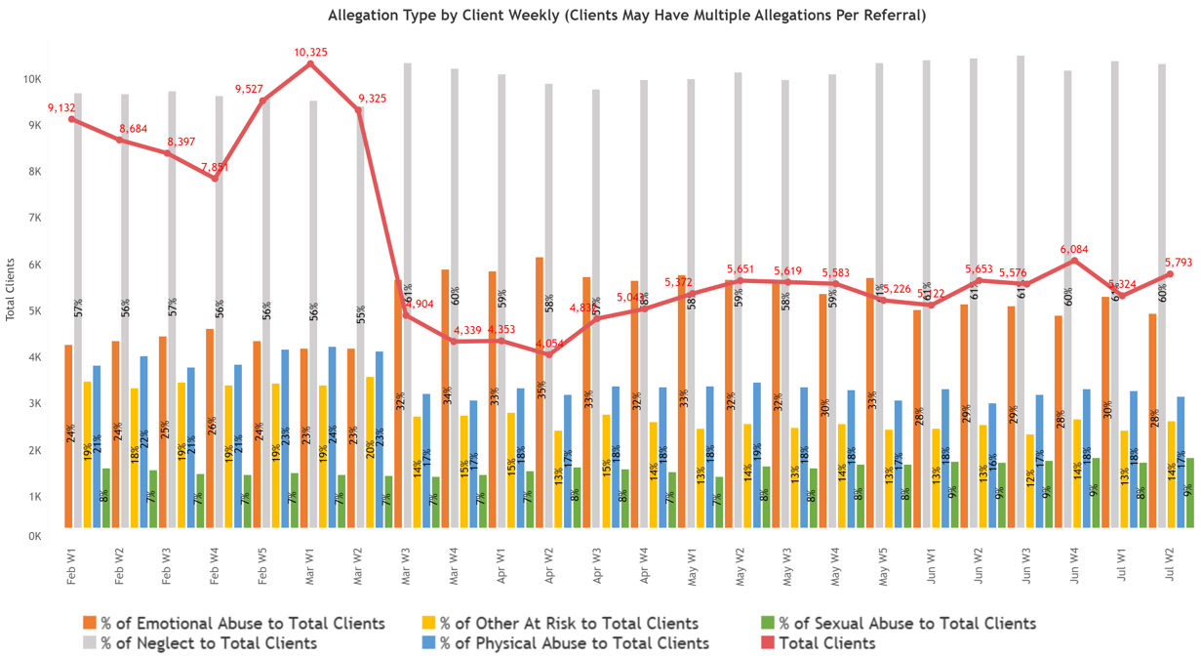
Emerging System Data Trends …
CDSS Data Dashboard

Slide 13
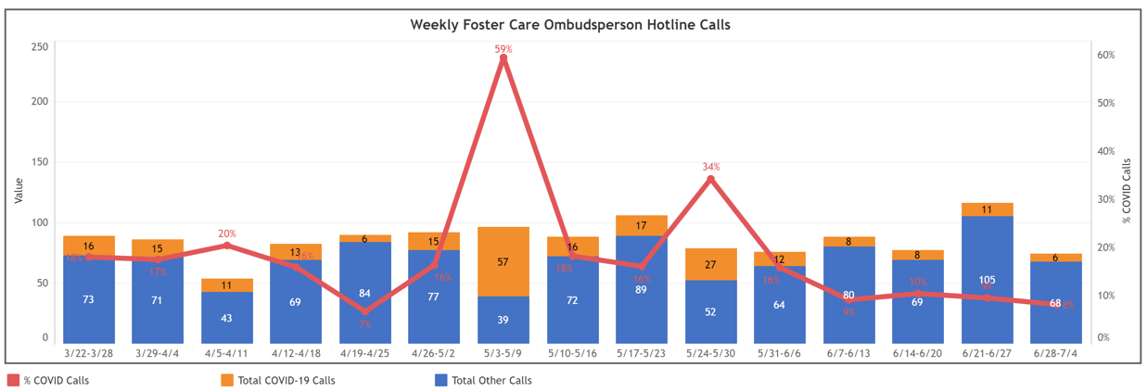
Emerging System Data Trends …
CDSS Data Dashboard

Slide 14
Ongoing Considerations
Will existing racial disparities across CWS outcomes worsen?
How can the Child Welfare Council include race & race equity in our work in an ongoing systematic way?
Overrepresentation in “essential” frontline jobs, urban areas, crowded housing
Larger gaps in CWS continuum rates, permanency
Before the state fully re-opens: increased risk?
More serious allegation types, and/or proportion of reports substantiated
Disposition shift—fewer inconclusive or unfounded, and more evaluate out?
Increases in Fatality/Near Fatalities?
Declines—timely response, first contacts, in-home contacts
Congregate care settings health risks

Slide 15
Ongoing Considerations continued…
When the state fully re-opens: a surge in CWS involvement?
Allegation rates increase? (post-holiday trends perhaps to anticipate)
Allegations shift—fewer DV and more sexual abuse referrals?
Increase in referrals where children are homeless, and/or in removals?
How to monitor Covid impact on children across CW and other systems?
Routine and reliable cross-system data record linkages (e.g., Health, Employment)
Population overlap between service systems and by geo-area
Metrics to track outcomes trends
Notes:
Other thoughts:
--CA currently observing larger proportion of referrals with both emotional abuse and neglect (often a sign of DV)
--Initial placements with relatives may decrease (as it takes more time to approve homes)
--Perhaps will see a paradoxical decline in placement disruptions (as it becomes difficult to find another home)
--Perhaps a natural experiment for Extended Foster Care beyond 21? For example one year post-discharge status for NMDs Pre/Post-Covid to examine potential benefit of additional time in care beyond age 21 (but need to control/account for post-Covid environmental factors (e.g., depressed economy, greater health risks, etc.)

Slide 16
Questions?
Daniel Webster, PhD
dwebster@berkeley.edu
https://ccwip.berkeley.edu
The California Child Welfare Indicators Project (CCWIP) is a collaboration of the California Department of Social Services and the School of Social Welfare, University of California at Berkeley, and is supported by the California Department of Social Services, Casey Family Programs, and the Conrad N. Hilton Foundation.

