Slide 1
Ongoing CWS Racial Disparities and Outcomes Tracking in the FFPSA Era Prevention & Early Intervention Committee Kathryn Icenhower, David Swanson Hollinger, Co-Chairs Child Welfare Council Meeting 3/3/2021
Daniel Webster, PhD
Principal Investigator
California Child Welfare Indicators Project
University of California, Berkeley
Notes:
Special thanks to Kathryn Icenhower, David Swanson Hollinger, and Dana Blackwell (Casey Family Programs) for important input on the development of this presentation.

Slide 2
Outline
Child welfare system trends and ethnic disparities over time
Important issues for outcomes tracking under FFPSA
Ongoing considerations and discussion

Slide 3
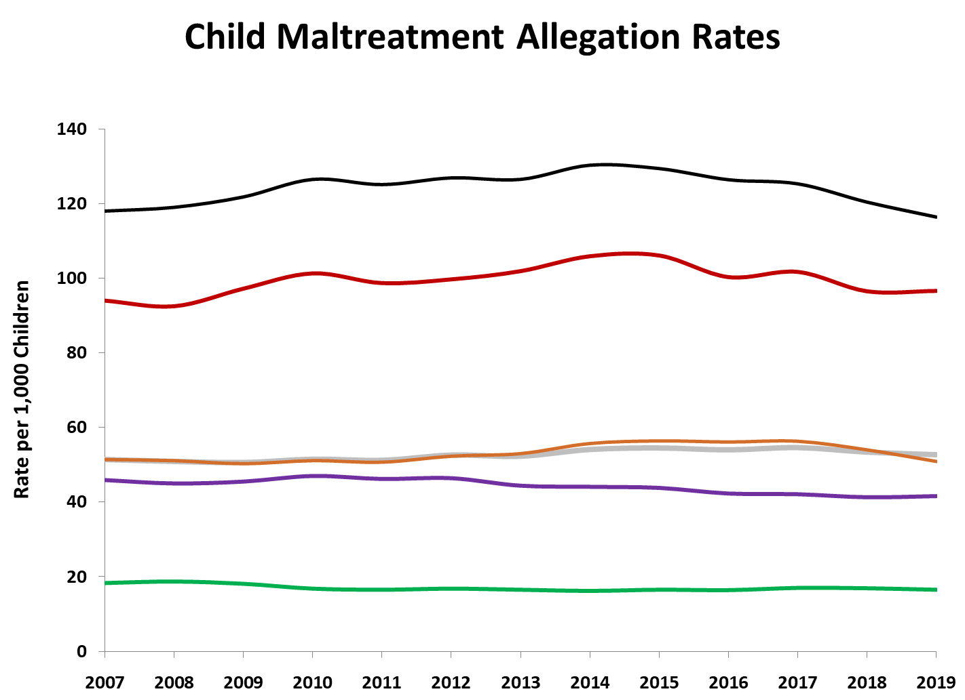
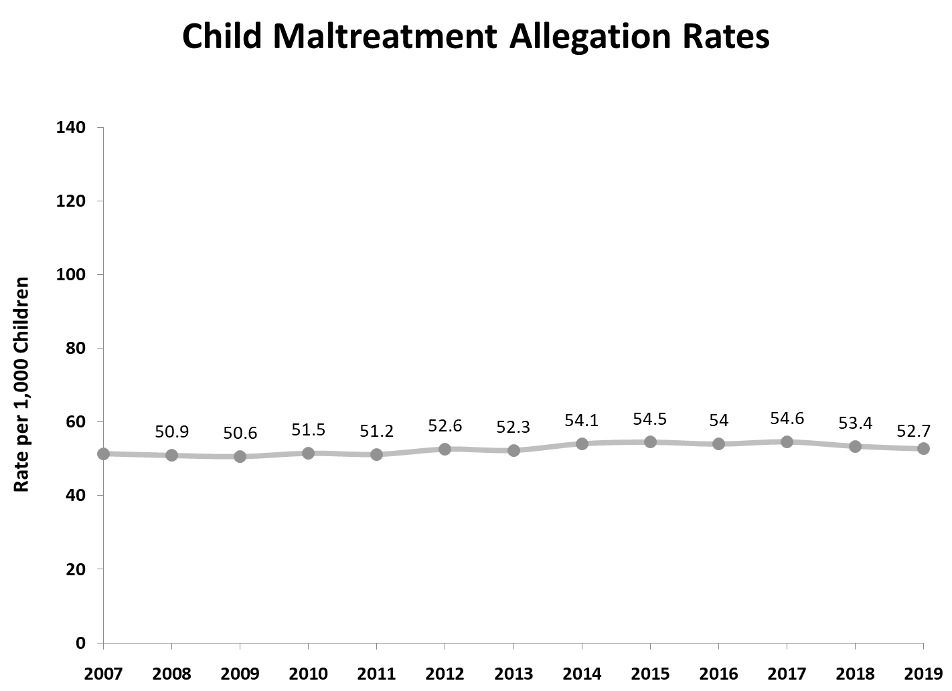
Child Maltreatment Allegation Rates
Black
Native Amer.
California
Latino
White
Asian/PI

Slide 4
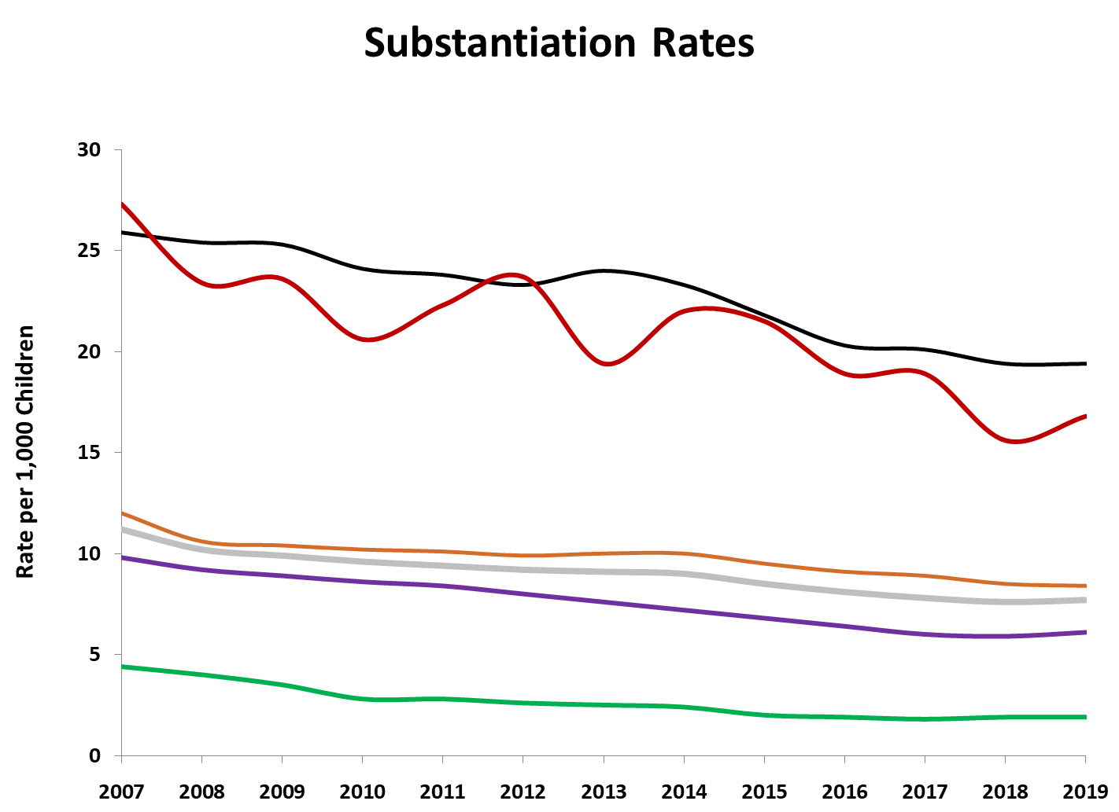
Substantiation Rates
Black
Native Amer.
Latino
California
White
Asian/PI

Slide 5
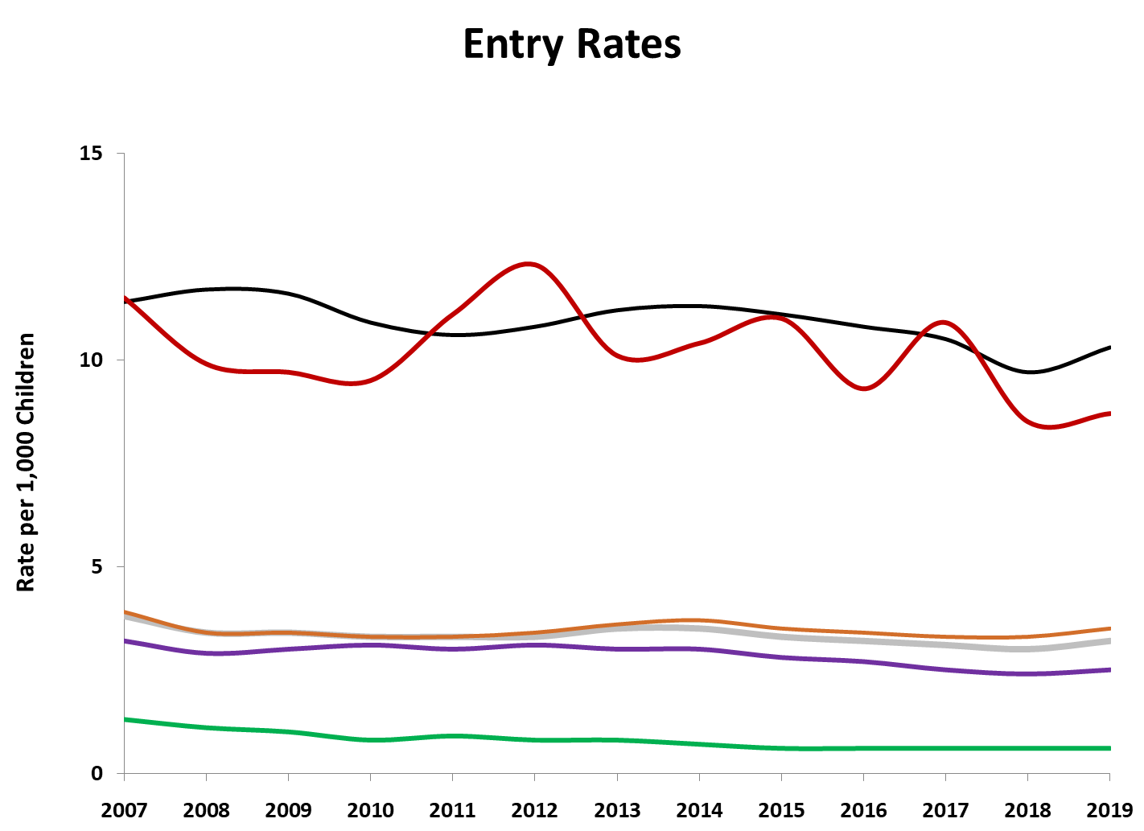
Entry Rates
Black
Native Amer.
Latino
California
White
Asian/PI

Slide 6
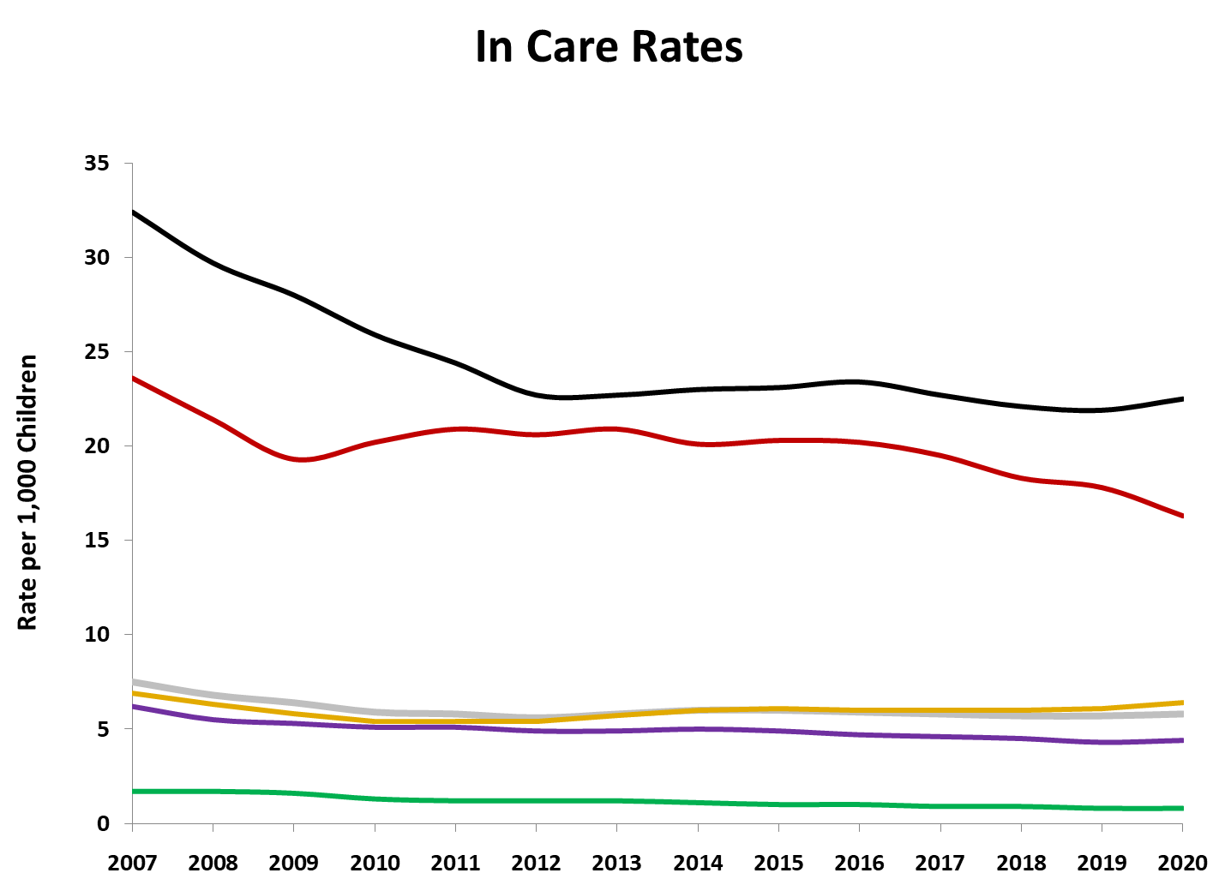
In Care Rates
Black
Native Amer.
Latino
California
White
Asian/PI

Slide 7
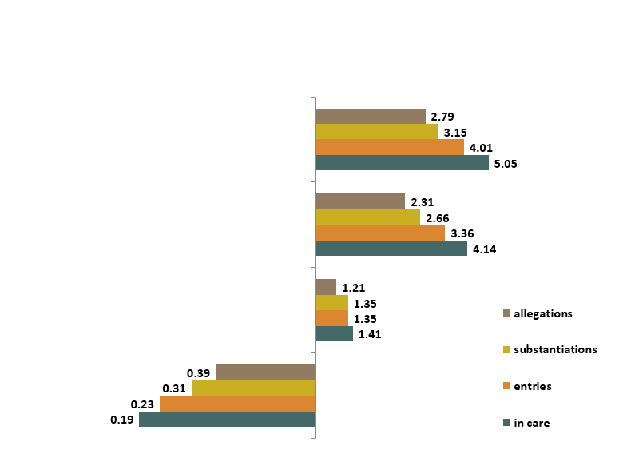
Racial Disparity Indices (General Population) Ethnic Group Disparity Compared with White Children along CW Continuum
Black
Native American
Latino
Asian/PI
White

Slide 8
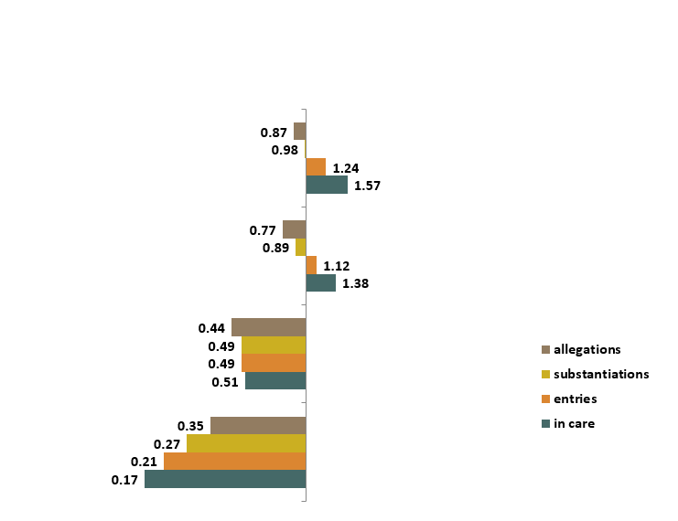
Racial Disparity Indices (Poverty Population) Ethnic Group Disparity Compared with White Children along CW Continuum
Black
Native American
Latino
Asian/PI
White
Notes:
Population in Poverty Estimates methodology:
A Combination of data from the U.S. Census Bureau's American Community Survey (ACS), and population data from The California Department of Finance.
Separate multipliers were created for each Race/Ethnicity at the state level and for each of the 58 counties.
Poverty Multiplier = (𝑁𝑢𝑚𝑏𝑒𝑟 𝑜𝑓 𝐶ℎ𝑖𝑙𝑑𝑟𝑒𝑛 𝑖𝑛 𝑃𝑜𝑣𝑒𝑟𝑡𝑦)/(𝑇𝑜𝑡𝑎𝑙 𝑁𝑢𝑚𝑏𝑒𝑟 𝑜𝑓 𝐶ℎ𝑖𝑙𝑑𝑟𝑒𝑛)
The multiplier was then applied to the California Department of Finance Population Estimates

Slide 9
Entries to Foster Care by Placement Type and Ethnicity

Slide 10
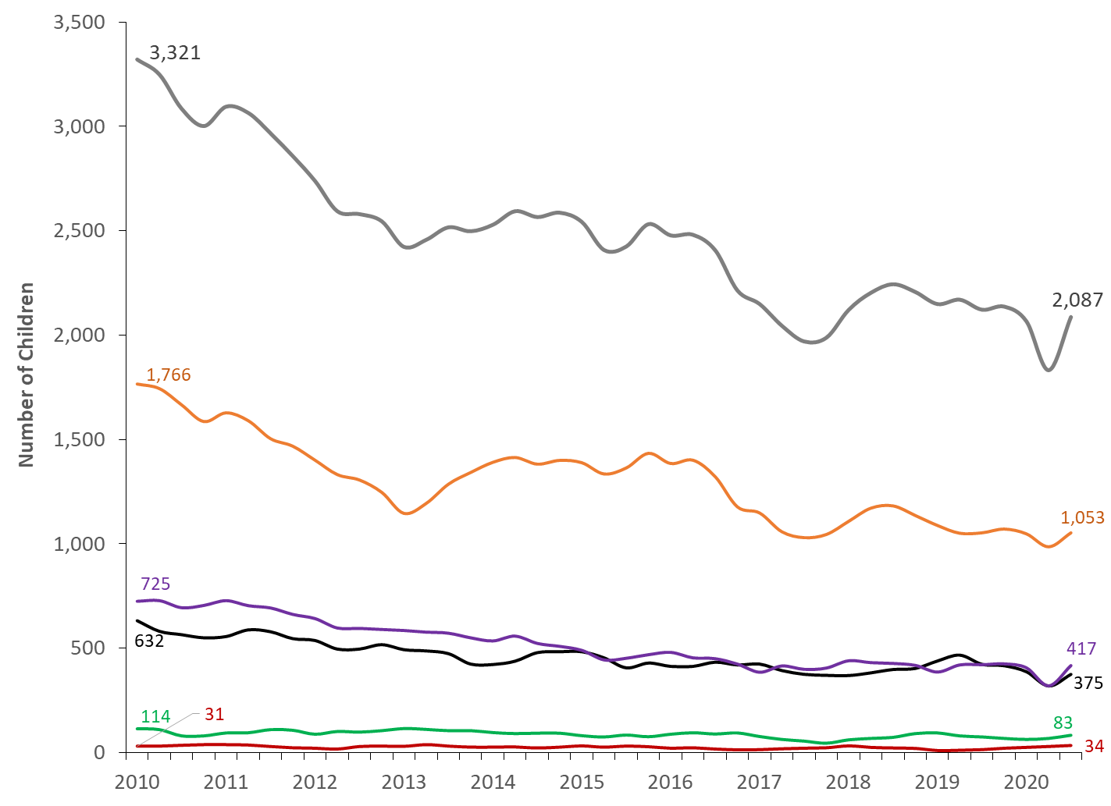
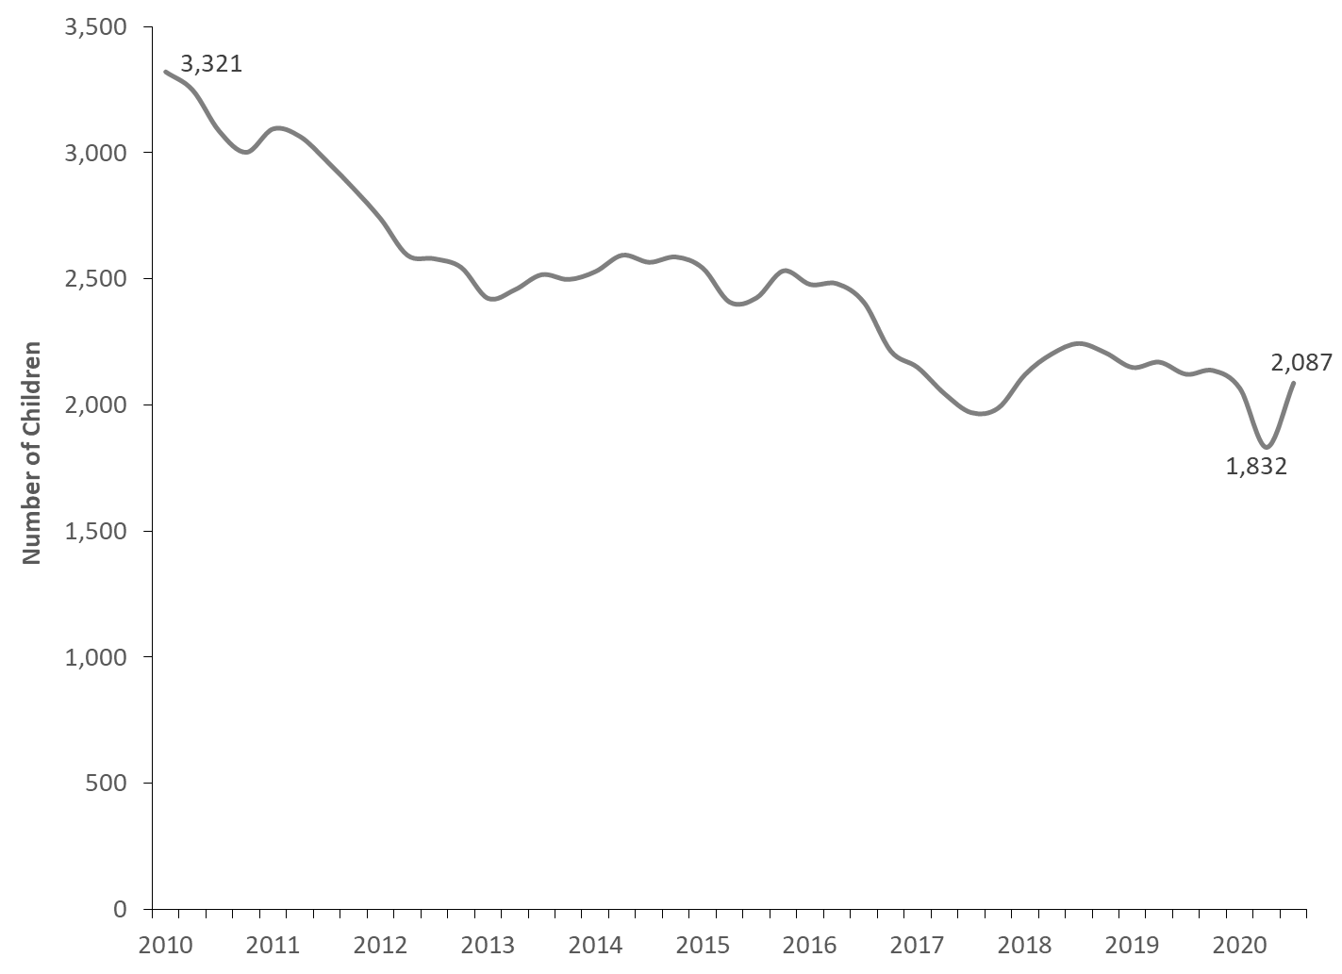
Entries to Foster Care:
Short Stayers (less than 7 days) in Care by Ethnicity
California
Latino
White
Black
Asian/PI
Native American

Slide 11
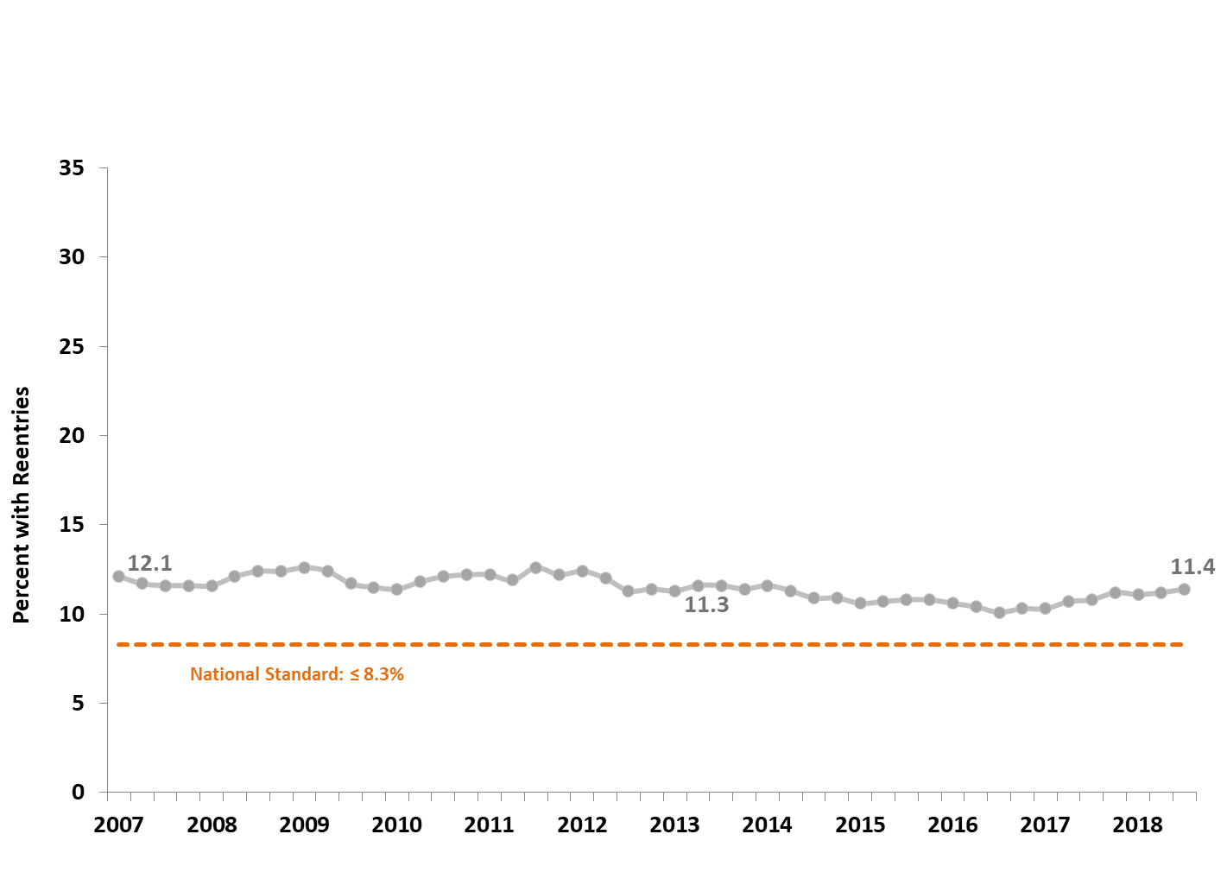
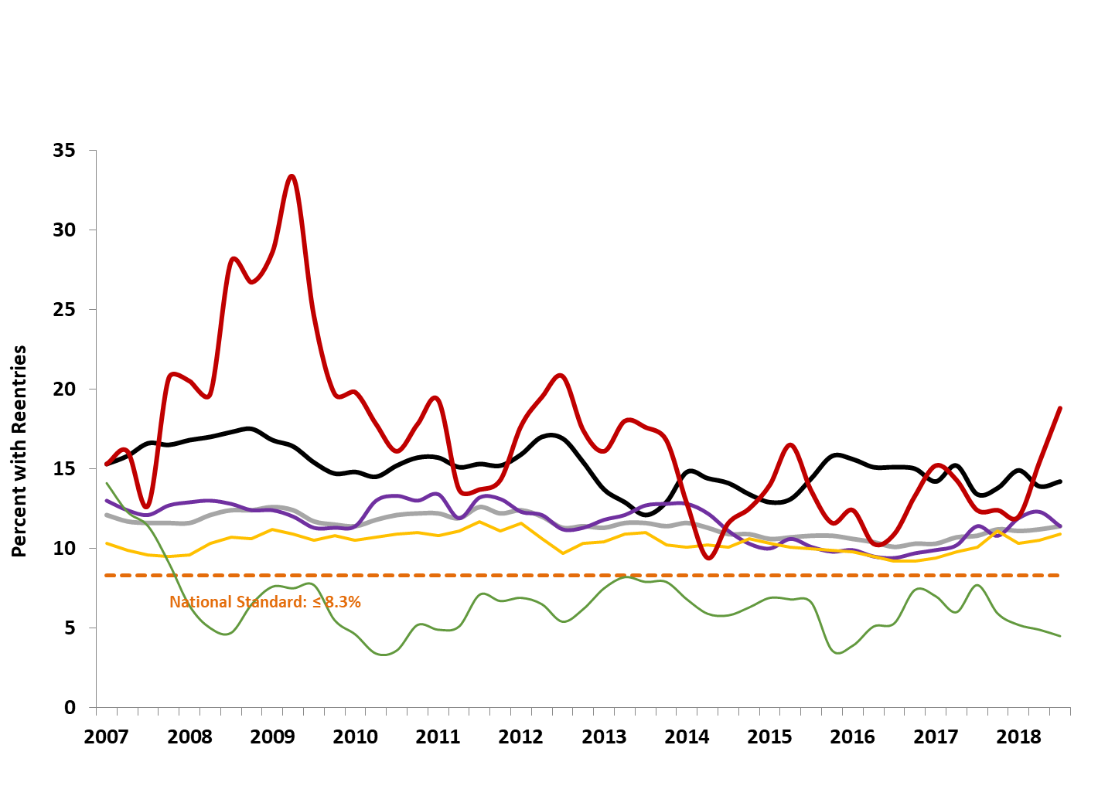
Reentry to Care
Native American
Black
White
Latino
California
Asian/PI

Slide 12
Tracking Outcomes Under FFPSA
Agreeing on a Target Population
Broad versus narrow approach to “candidates”
Possible candidate pools
Will candidate pools increase disparities?
Complexity of Tracking Candidates
Data sources
More versus Less difficult specifications
Example of complexities for one candidate pool

Slide 13
California Candidacy Considerations
Narrow/Medium Narrow* | Medium Broad | Broad
Investigations unfounded but high/very high risk or one safety threat | Hotline – no safety concerns but FF needs identified by State approved assessment; linked with contractual prevention services provider | Community pathway (future FF implementation)
Child at home with sibling(s) in FC
Adoption/guardianship at risk
Family Maintenance or Voluntary FM | Children and youth who have exited foster care and are at risk of re-entry
Indian child at risk
602 youth
* This table created by colleagues at Chapin Hall at the University of Chicago

Slide 14
Specifying Candidate Pools – Complexity
Less Difficult | More Difficult
Substantiated or Inconclusive Allegations (with or w/out priors) | Tribal families
At least one safety threat on SDM | Families in communities with a prevalence of Adverse Childhood Experiences and Adverse Community Environments
Evaluated Out after a Hotline Referral | Families at risk of disruption post adoption and guardianship
Participating in voluntary or court-ordered FM | Adolescents Struggling with Substance Use Issues
Children in a Kinship Placement | Active CSEC Youth
Families Post-Reunification | Runaway and Homeless youth
Less Difficult | More Difficult

Slide 15
Ongoing Considerations
Existing racial disparities across CWS outcomes:
Larger gaps in CWS continuum rates and permanency in the short term?
How can the Child Welfare Council include race & race equity in our work in an ongoing systematic way?
FFPSA is hopefully just the start:
Services for ‘candidates’ will help move support upstream, but…
We should collectively aim for an holistic “Child Well Being System”

Slide 16
Questions?
Daniel Webster, PhD
dwebster@berkeley.edu
https://ccwip.berkeley.edu
The California Child Welfare Indicators Project (CCWIP) is a collaboration of the California Department of Social Services and the School of Social Welfare, University of California at Berkeley, and is supported by the California Department of Social Services, Casey Family Programs, and the Conrad N. Hilton Foundation.

