Slide 1
CCWIP New Website Demo
Wendy Wiegmann
CA Child Welfare Indicators Project
3/5/2020

Slide 2
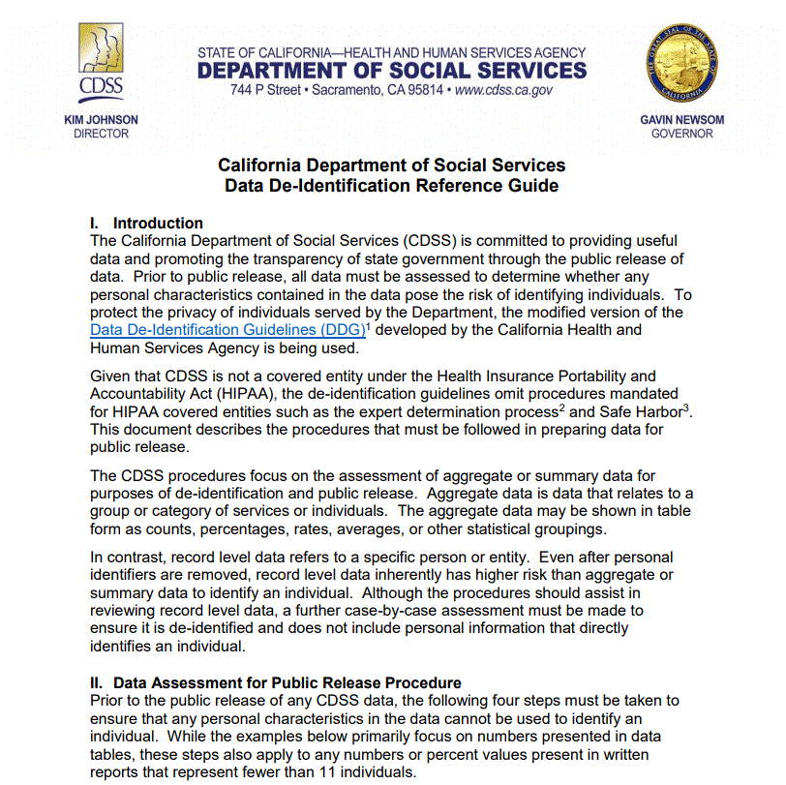
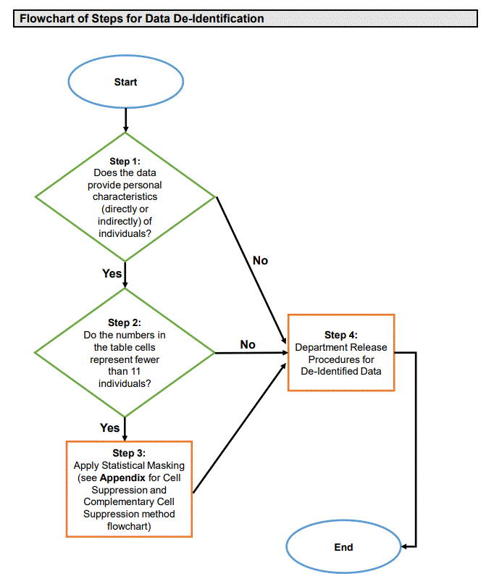
CDSS Data De-Identification Reference Guide
Notes:
https://www.cdss.ca.gov/portals/9/Data%20De-Identification%20Guidelines%20DSS%20Reference%20Guide_FINAL.pdf

Slide 3
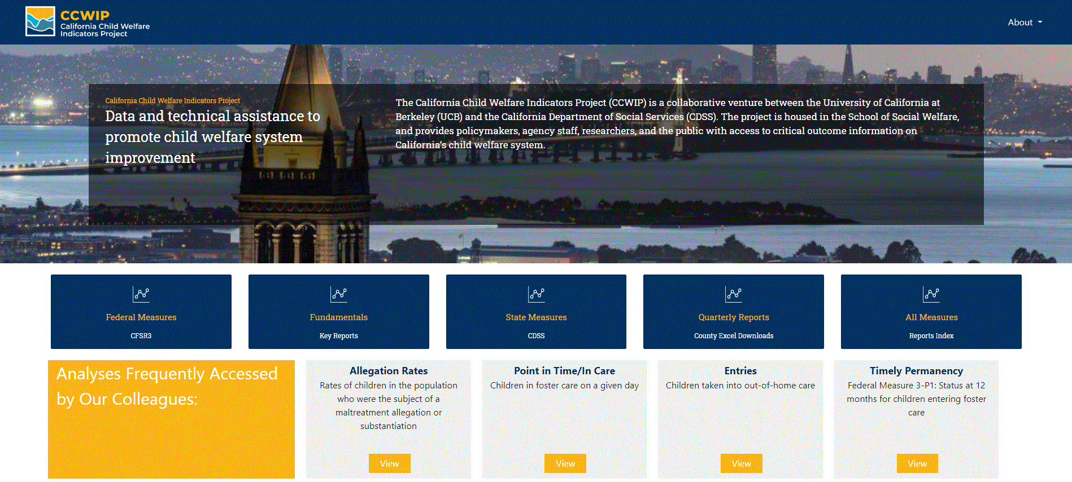
Homepage: https://ccwip.berkeley.edu/

Slide 4
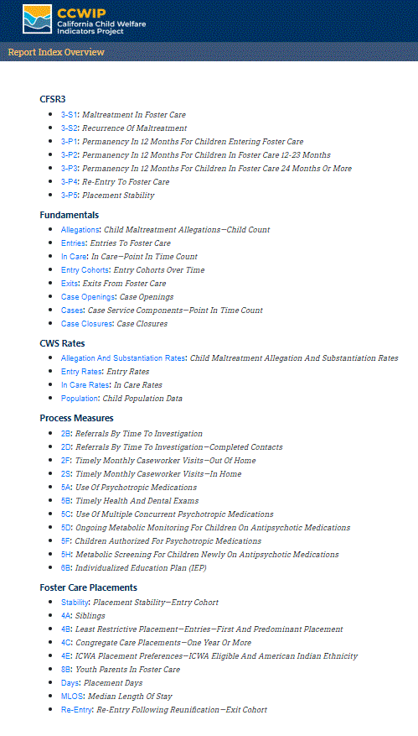
Buckets/Categories
CFSR3
Federal Child & Family Service Review outcome indicators
Fundamentals
Indicators useful to a basic understanding of the child welfare system
CWS Rates
Comparisons of child welfare rates to population data
Process Measures
Child welfare worker activities
Foster Care Placements
Indicators focused on out-of-home placements
Index

Slide 5
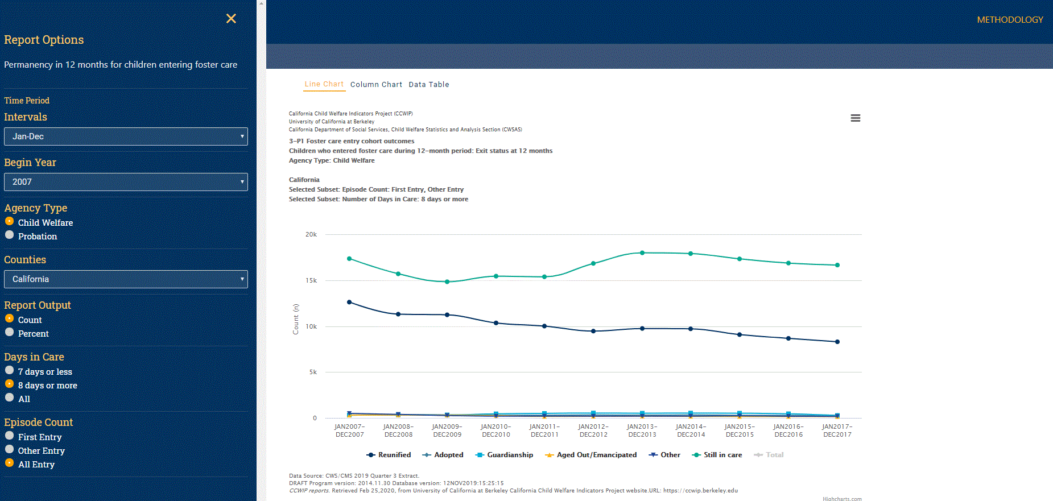
Report Output

Slide 6
AB636 Quarterly Outcomes Workbooks (masked)
Unmasked versions transmitted directly to counties from CDSS
Notes:
Dates
March 1, 2020
Implementation of Data De-identification guidelines (masking)
Launch of the new CCWIP public-facing website
Ongoing
Masked versions of AB636 Quarterly Outcomes Workbooks available on new site
Unmasked versions of AB636 Quarterly Outcomes Workbooks transmitted to counties from CDSS
April 1, 2020
Launch of private version of the CCWIP website, accessible via CWS/CMS login
Unmasked versions of AB636 Quarterly Outcomes Workbooks available via private website

Slide 7
 | March 1, 2020 Launch (Q3 19 Extract) | April 1, 2020 Refresh (Q4 19 Extract) | July 1, 2020 Refresh (Q1 20 Extract) | Future Quarters
Presentation & Slides | Upon Request (Email) | Public Site
Disparity Indices | Upon Request (Email) | Private Site |  | Public Site
County Comparisons | Public Site via Multiple Browsers
Multiple County Aggregation & Comparisons | Selected Tables Upon Request (Email) | Private Site
P1–P4 Stratification by Age, Ethnicity, or Gender | Upon Request (Email) | Private Site | Public Site
Compare Row & Column Dimensions on All Outcomes | Selected Tables Upon Request (Email) | Private Site
Masked PIT Out of County Placements | Upon Request (Email) | Public Site
Unmasked PIT Out of County Placements | Upon Request (Email) | Private Site
CCWIP Website Features & Estimated Timeline

Slide 8
Thank You!
The California Child Welfare Indicators Project (CCWIP) is a collaboration of the California Department of Social Services and the School of Social Welfare, University of California at Berkeley, and is supported by the California Department of Social Services, Casey Family Programs, and the Conrad N. Hilton Foundation.

Slide 9
Questions?
Wendy Wiegmann
wendy.wiegmann@berkeley.edu
510-643-0839

